Slide 1
Vietnam: Involvement and Escalation

Slide 2
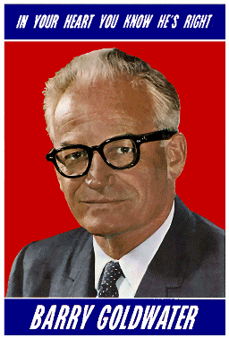
Johnson Increases US Involvement
-LBJ wins election of 1964
-people scared of Goldwater’s approach to Cold War

Slide 3
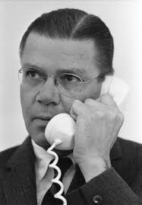
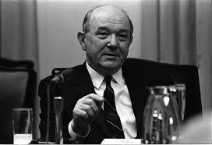
Who is crafting policy?
Sec of Defense - Robert McNamara
Sec of State - Dean Rusk
1965 - most Americans favor policy

Slide 4
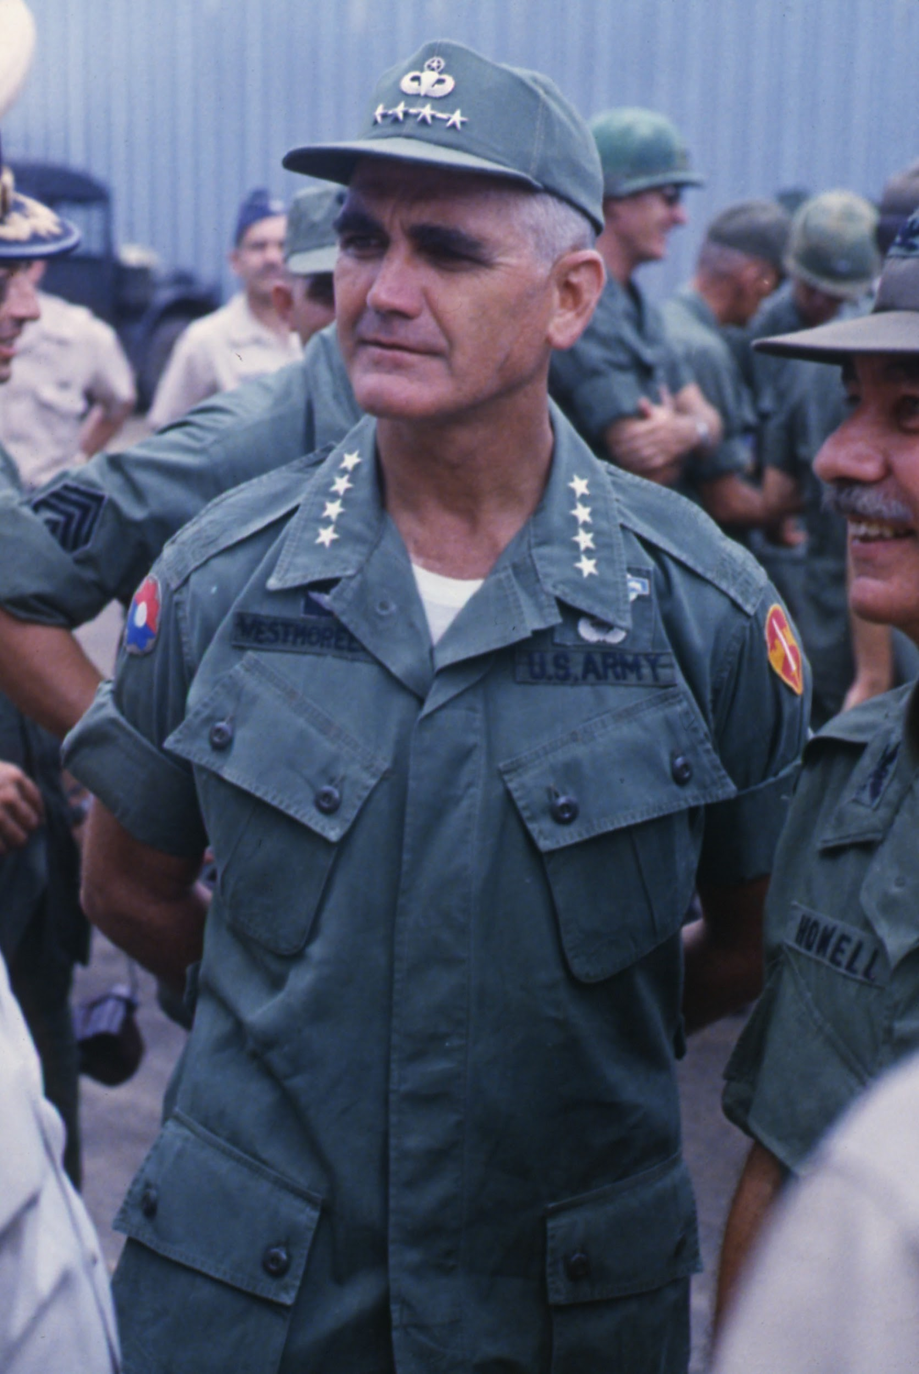
More Troops
-by end of 1965 - 180,000 in Vietnam
-Gen William Westmoreland requests more
-500,000 troops by end of 1967

Slide 5
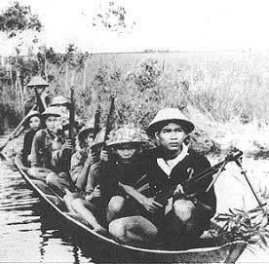
Fighting in the Jungle
facing a hidden enemy
-Vietcong used guerilla warfare
-hit-and-run, ambushes, tunnels
-booby traps and land mines

Slide 6
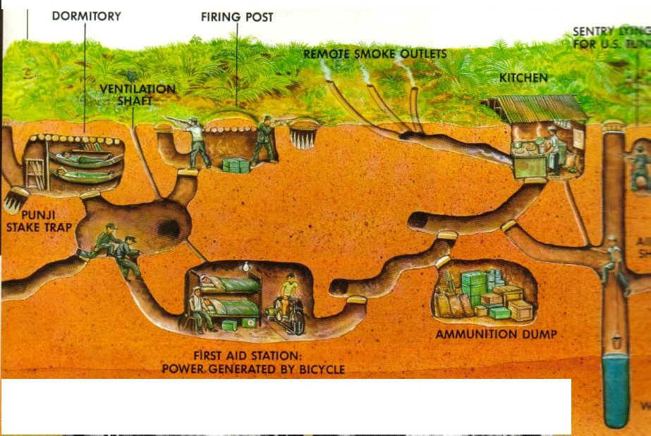

Slide 7
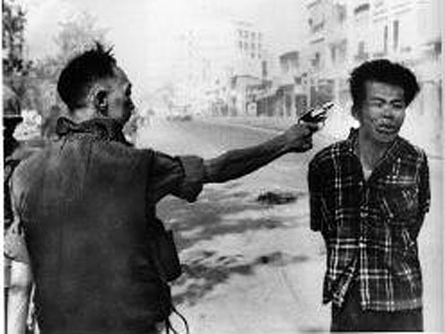

Slide 8
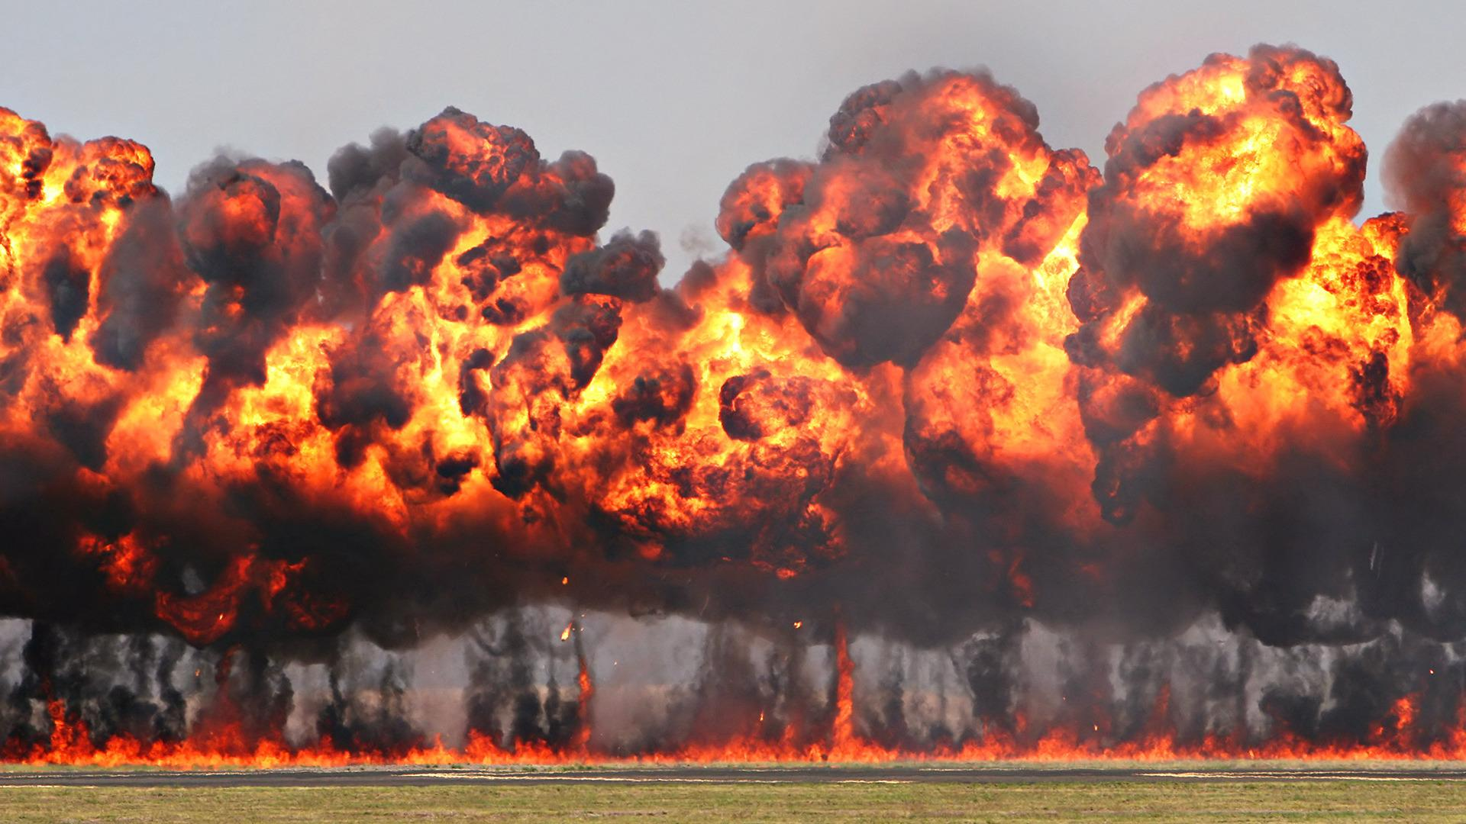
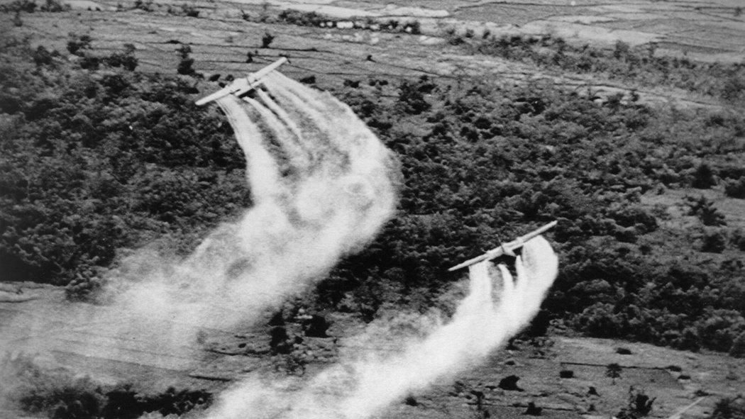
US had to earn S. Vietnamese Support
Napalm
Agent Orange
Search and Destroy

Slide 9
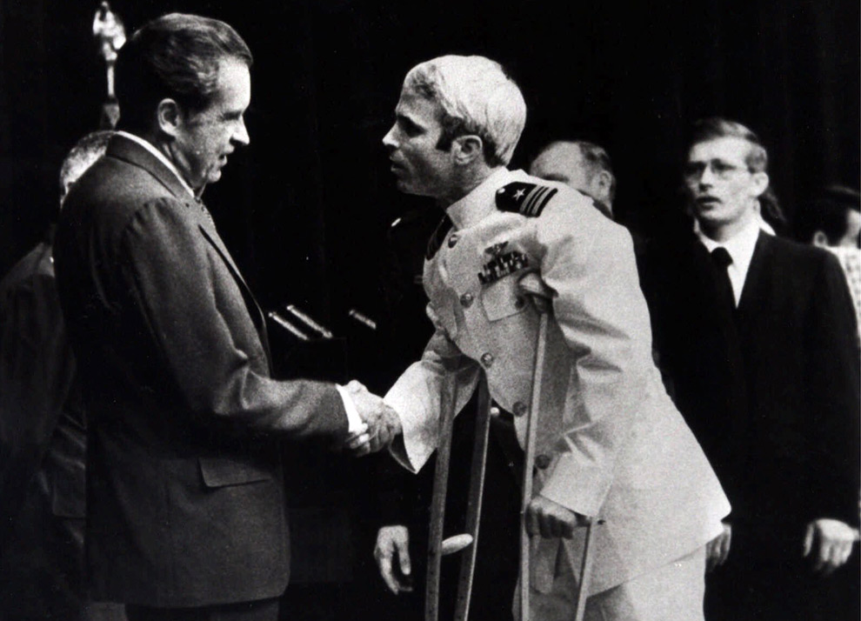
US Troop Morale
Starts to decline
Prisoners of War faced a difficult struggle

Slide 10
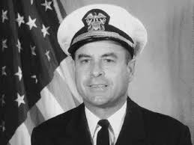
Jeremiah Denton
https://www.youtube.com/watch?v=BgelmcOdS38

Slide 11
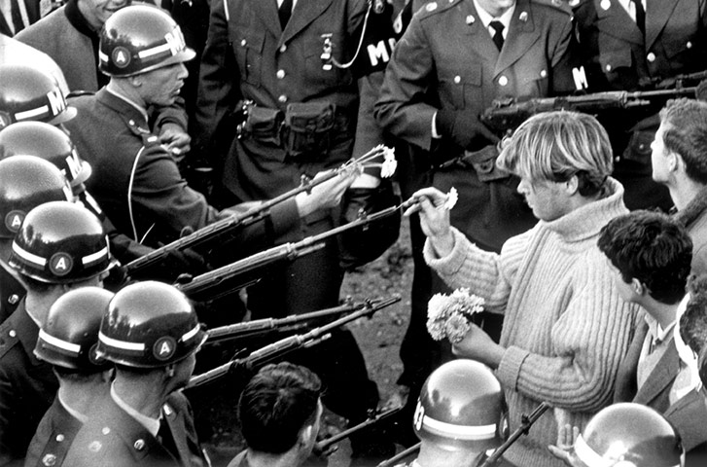
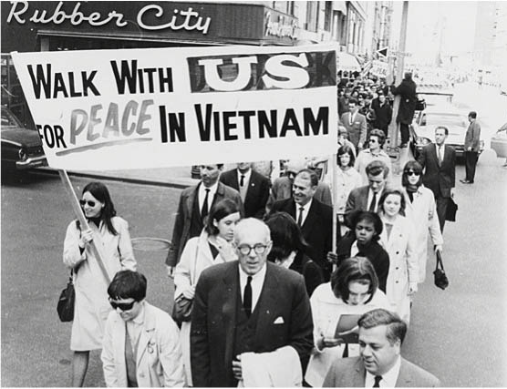
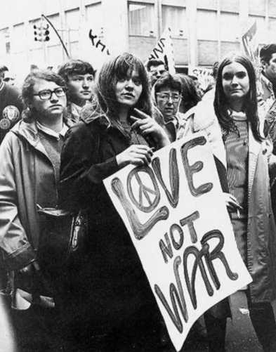
Domestic Support Wavers
Great Society put on hold
“Hey Hey LBJ How Many Kids Have You Killed Today?”

Slide 12
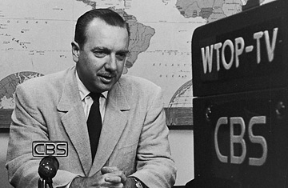
The “Living Room War”
-Combat Footage nightly on TV
-Westmoreland assured an “imminent surrender”
-Credibility Gap?

