Slide 1
Homefront in World War II
A.P. U.S. History

Slide 2
B. The Shock of War
oEthnic loyalties not questioned in WWII- immigration had slowed
nException- Japanese Americans to internment camps (Exec. Order 9066)
oNew Deal officially came to an end- Congress refused to fund & FDR focused on war
oCitizens focused on winning the war

Slide 3
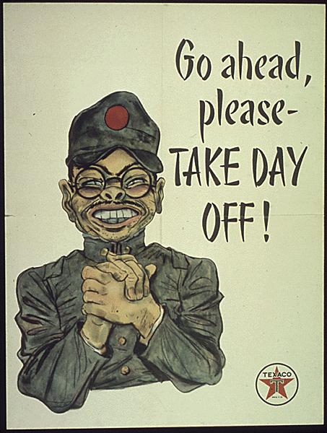
Japanese-Americans
►After Pearl Harbor, Americans panic that Japanese will once again attack United States.
►Caused a wave of prejudice against Japanese Americans.

Slide 4
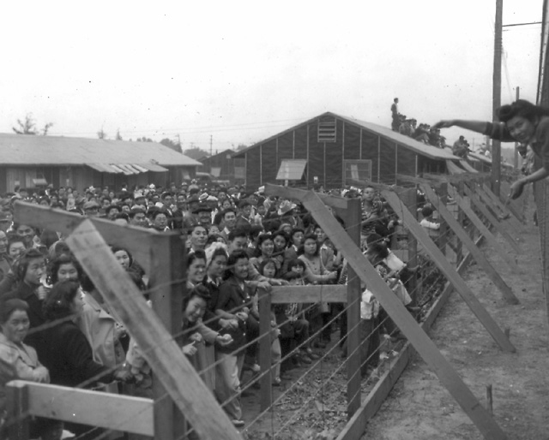
Internment
►Feb. 19, 1942 – FDR signs an order requiring removal of people of Japanese ancestry from Cali, Wash, Oregon, and Arizona for “national security” – Executive Order 9066
►110,000 Japanese Americans shipped to “relocation centers” (prison camps)

Slide 5
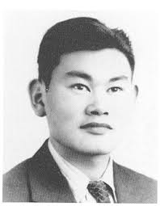
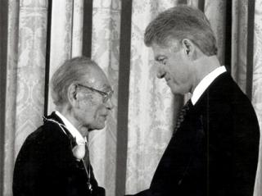
Korematsu vs US
►1944 – Supreme Court decided that gov’t policy of relocating Japanese-Americans was justified on basis of “military necessity”

Slide 6
FDR’s Four Freedoms
►Freedom from fear, freedom from want, freedom of religion, freedom of speech – listed by FDR in January 1941 as guiding principles of US domestic and foreign policy.

Slide 7
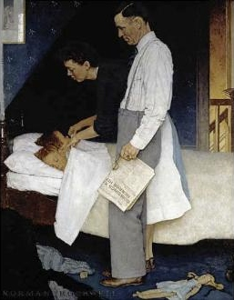
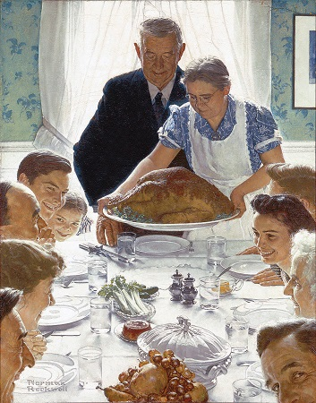
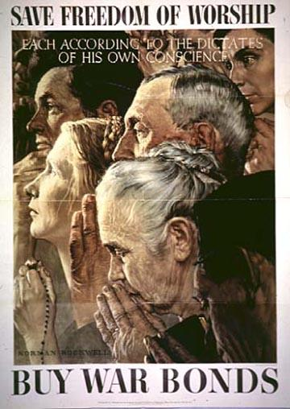
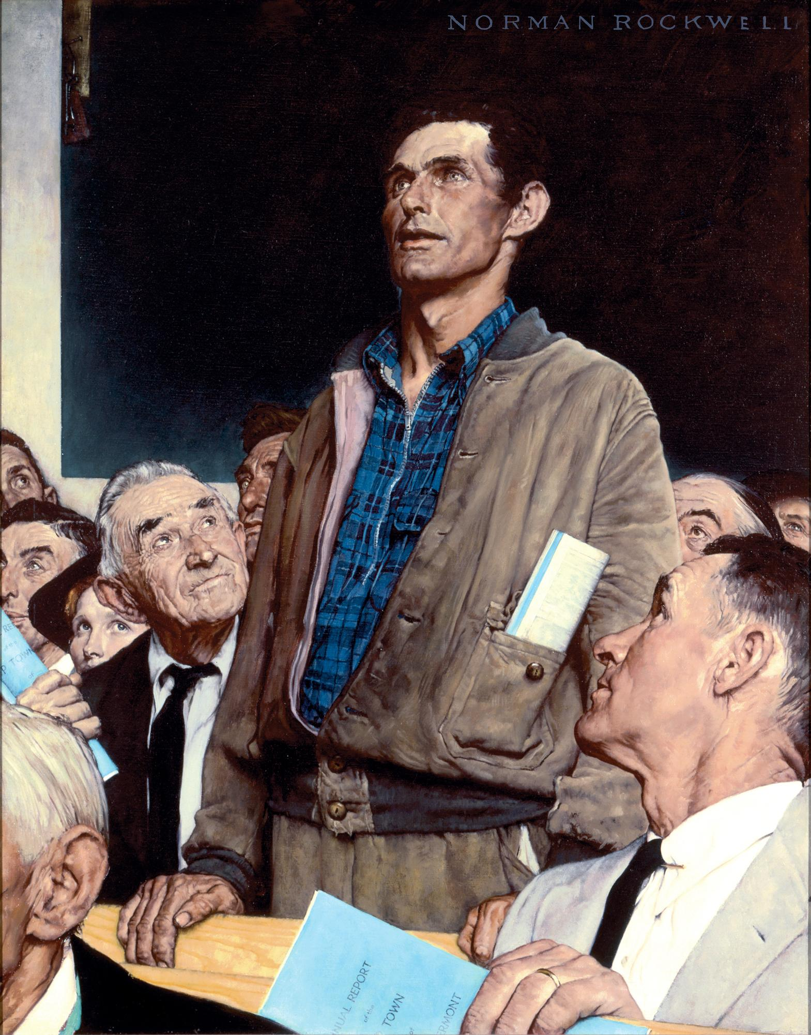

Slide 8
C. Building the War Machine
oWar Production Board- oversaw wartime industry
nMilitary orders ended depression
nNonessential production stopped
oOffice of Price Administration- held inflation to acceptable levels
oWar Labor Board- oversaw labor issues (ceilings on wage increases)
nStrikes- Smith Connally Anti-Strike Act (June 1943)- fed. govt. could take over halted industries, stopping work was a federal violation

Slide 9
D. Manpower and Womanpower
o15 million men (GIs)- some exemptions from draft
o216,000 women
nWAACs, WAVEs, SPARs
oMexican labor agreement- 1942- braceros
oWomen workers (6 million)- Rosie the Riveter
nMost women didn’t work & 2/3 of those that did, left jobs at war’s end
nGovt. day care centers

Slide 10
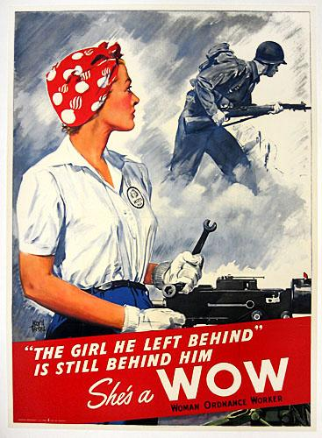
►Women become 35% of total workforce.
§Forced/encouraged to give up jobs after war.

Slide 11
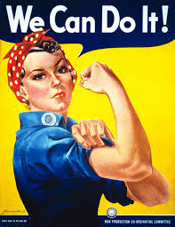
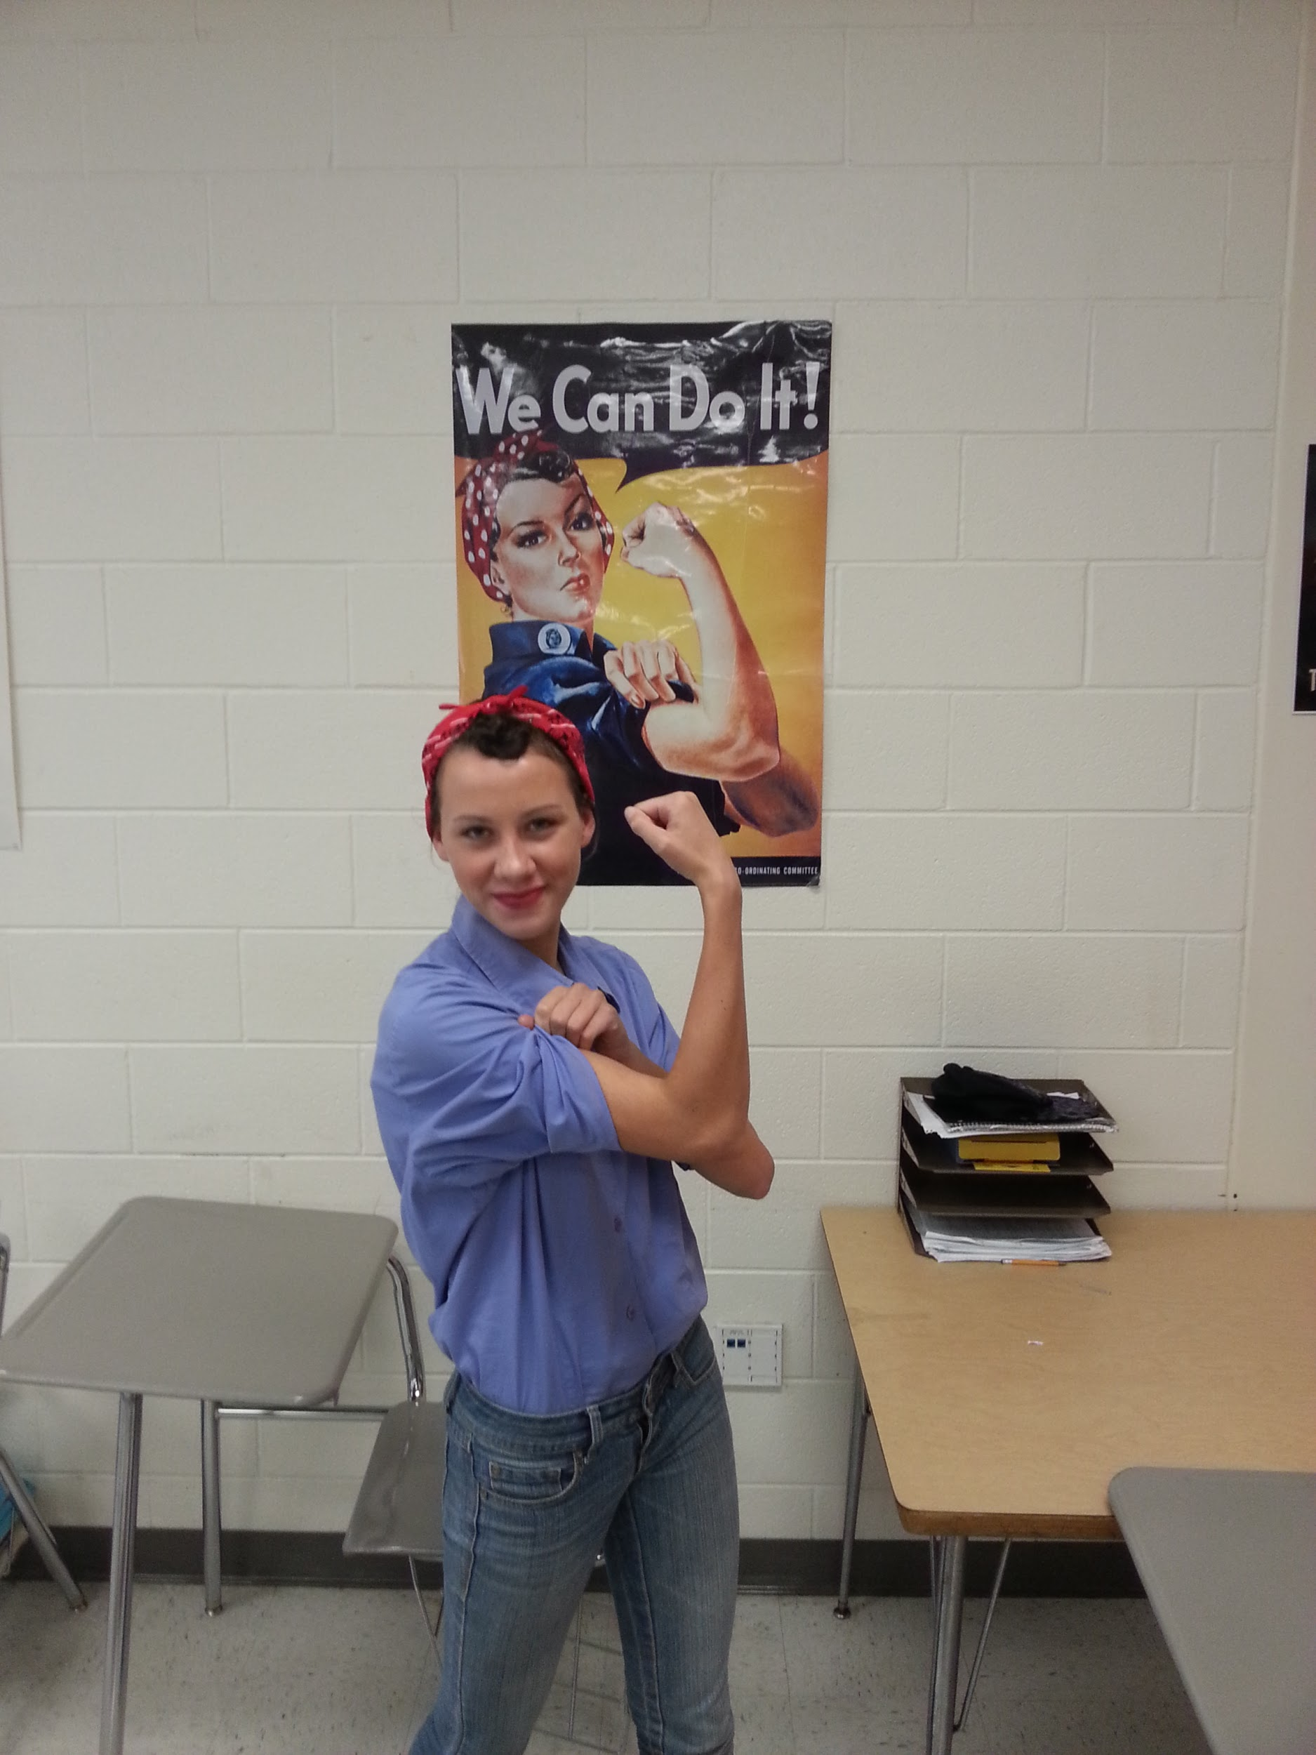

Slide 12
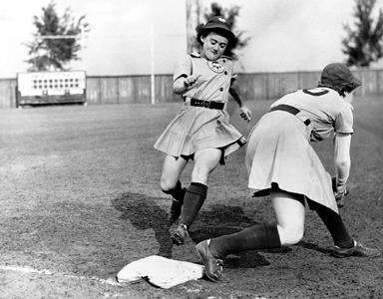

Slide 13
Population Shifts
►Towns with defense industries see a sharp increase in population.
►One of greatest mass migrations in U.S. history.

Slide 14
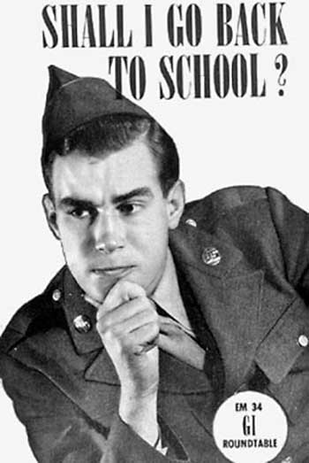
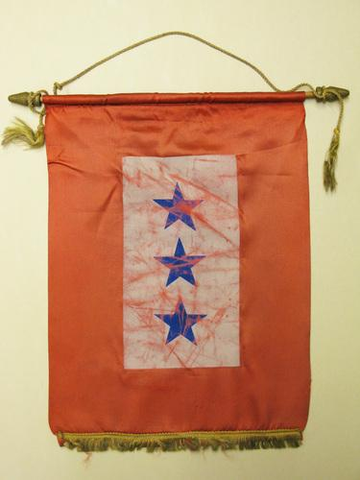
Social Adjustments
►Society adjusts to having fewer young men around.
►# of marriages increases
►Congress helps servicemen coming home with Servicemen’s Readjustment Act (GI Bill of Rights) – provided education and training for veterans.

Slide 15
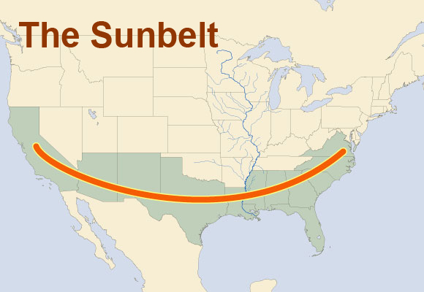
E. Wartime Migration
oPeople moved due to industry- South (Sunbelt)
oAfrican Americans left south in dramatic numbers

Slide 16
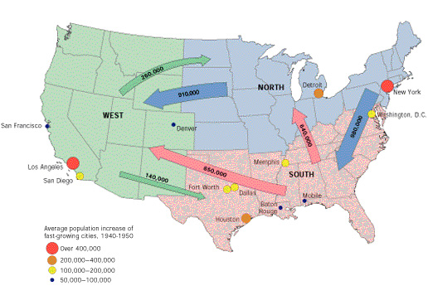

Slide 17
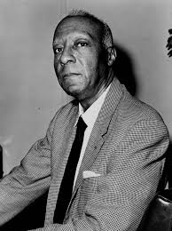
oA. Philip Randolph- Porter’s Union
nMarch on Washington- 1941

Slide 18
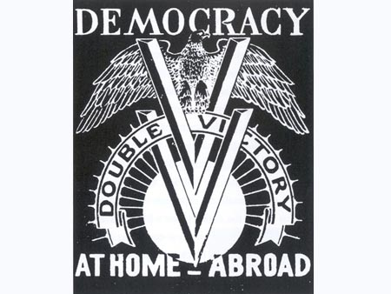
oAfrican American service- noncombat, segregated
nDouble V- victory over dictators & discrimination
nNAACP & CORE (Congress of Racial Equality)

Slide 19
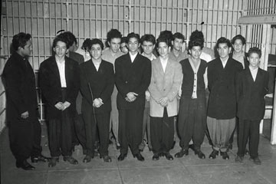
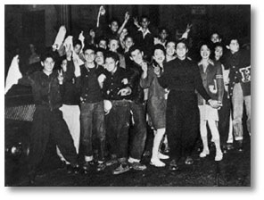
oNative Americans
oMexican Americans- zoot-suit riots- LA 1943;
-Detroit Race Riots

Slide 20
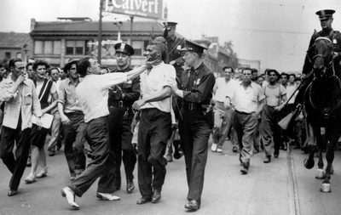

Slide 21
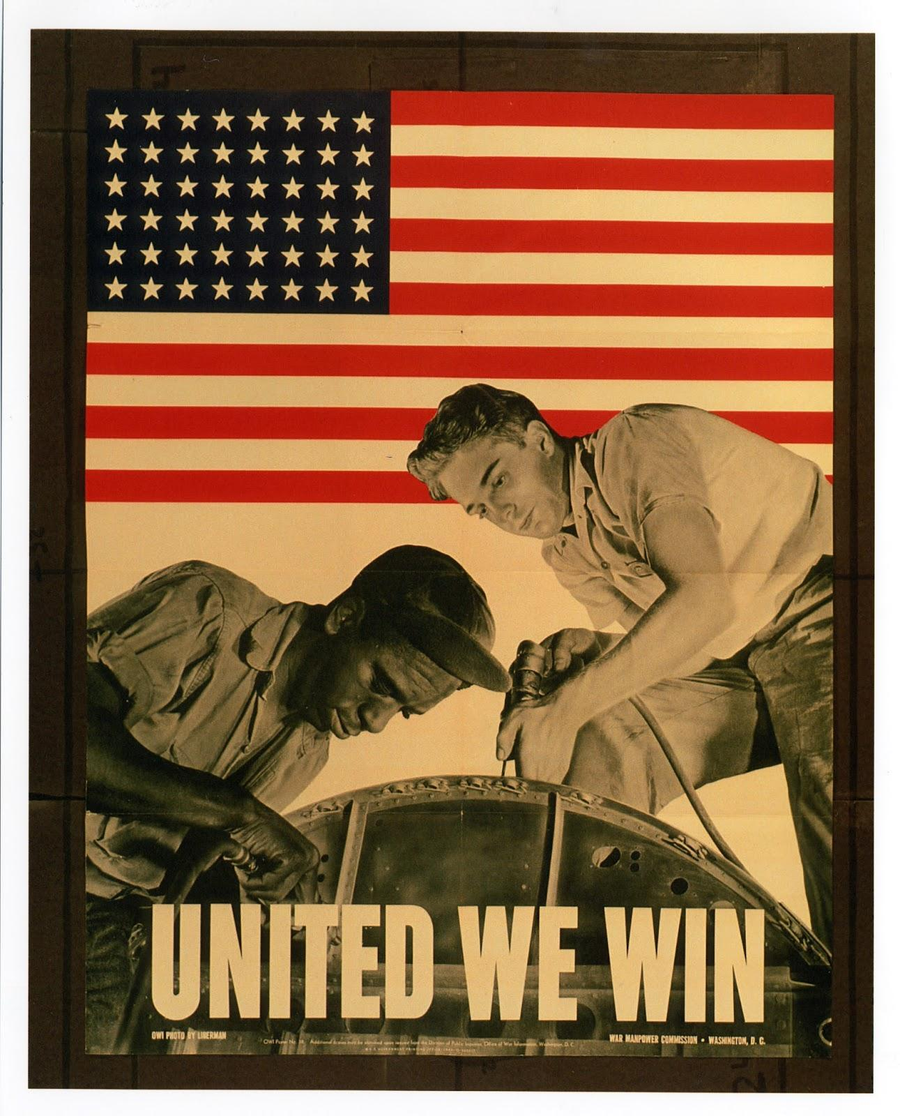
Executive Order 8802
nFDR issued order forbidding discrimination in defense industry & est. Fair Employment Practices Commission

Slide 22
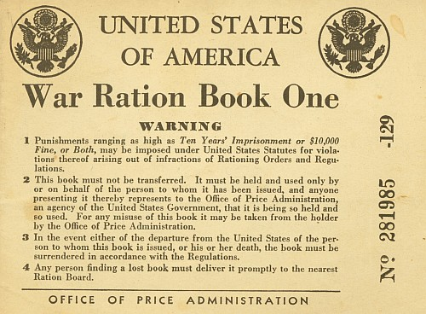
F. Holding the Home Front
oNot just out of depression- business grew more than ever
oThe Hand of Govt.
nRationing - Office of Price
Administation
nWLB, FEPC

Slide 23
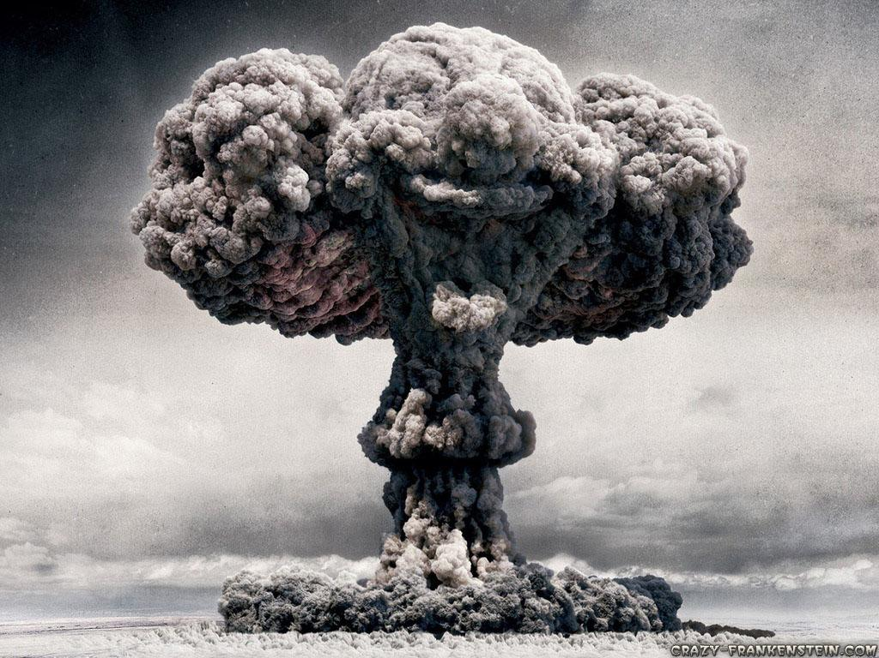
nOffice of Scientific Research & Development
oCost- $330 billion (10X WWI & 2x ALL federal spending since 1776)
nDebt soared from $49 bil. In 1940 to $259 bil. In 1945
n$10 mil./ hour

Slide 24
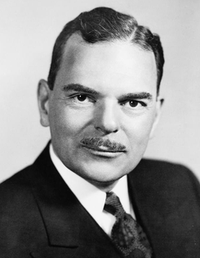
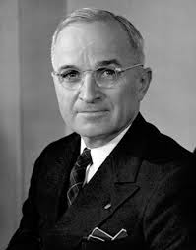
M. FDR: The Fourth-Termite of 1944
oRepublicans- Thomas Dewey- governor and government reformer of New York- young & inexperienced
nJohn Bricker as VP candidate
oDems- FDR
nHarry S. Truman as VP candidate- important choice

Slide 25
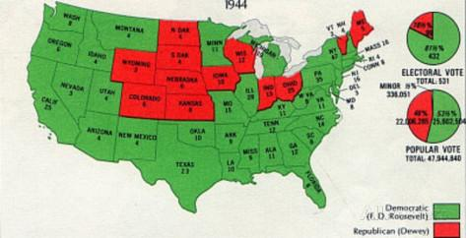

Slide 26
R. The Allies Triumphant
oUS human costs- over 1 million cas.
nNew technology made survival easier
oSoviets lost 20 million
oUS didn’t fight on its own land- industry boosted
oOrganization showed US potential
nLeadership
nIngenuity
nProduction

