Slide 1
American History 2
The West

Slide 3
Government Policy
Mid 1800s policy changed from relocating tribes farther west to seizing land and sending them to reservations

Slide 4
Disappearance of the Buffalo
1800 - ~60 million buffalo on the Plains
1894 – as few as 25 remained
Why?

Slide 5
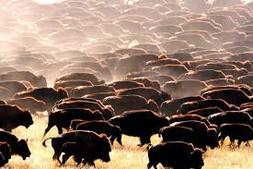

Slide 6
Destruction of Herds
-White settlement reduced grazing lands and cut migration routes

-Settler’s livestock carried diseases that destroyed herds


Slide 7
More Destruction of Herds
-US Army encouraged destruction of herds to wipe out Plains Indians’ food supply

-Demand for hides in east

-Sport hunting – railroad “hunting specials”

Slide 8
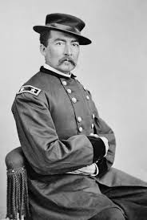
"Let them kill, skin, and sell until the buffalo is exterminated, as it is the only way to bring lasting peace and allow civilization to advance."
- General Philip Sheridan

Slide 9
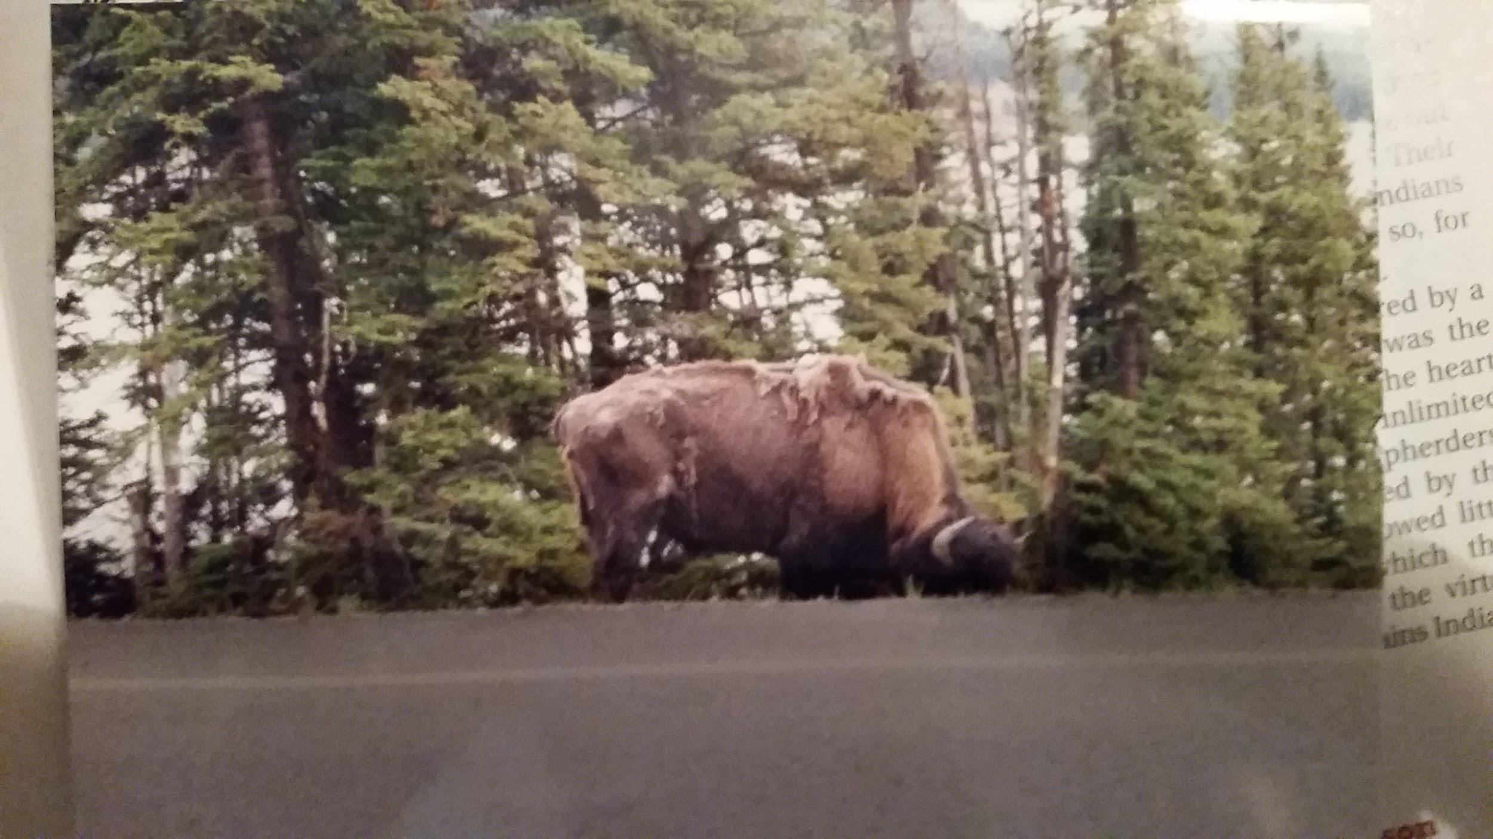

Slide 10
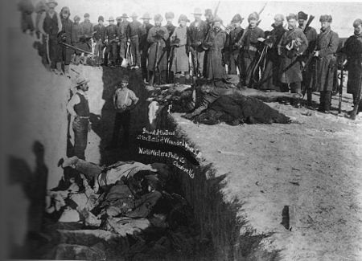
Sand Creek Massacre – November 1864
Battle of Little Big Horn (“Custer’s Last Stand” – June 25, 1876
Retreat of the Nez Perce (Chief Joseph)
Wounded Knee Massacre – December 1890

Slide 11
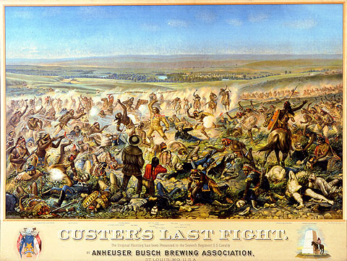

Slide 13
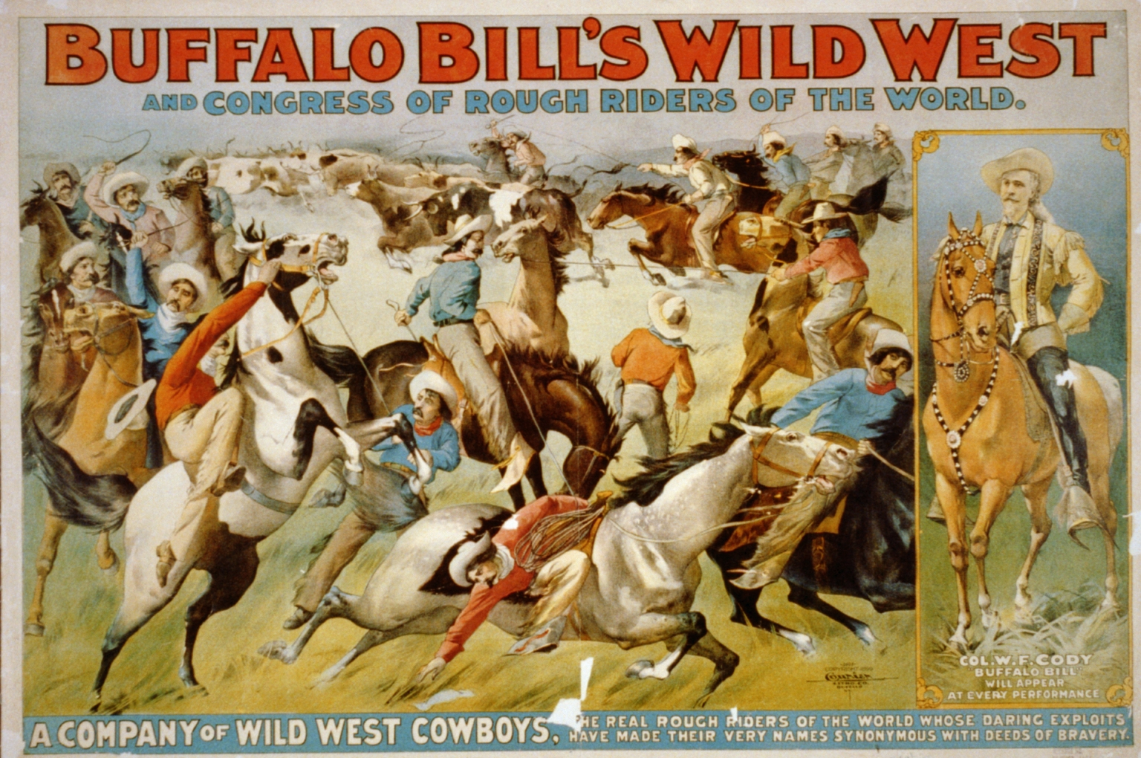
Buffalo Bill’s Wild West Show

Slide 14
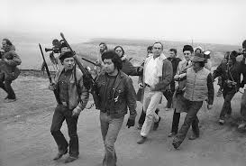
Wounded Knee Massacre marked the end of the “Indian Wars” – bloody conflict between US Army and Plains Indians
(until 1973)

Slide 15
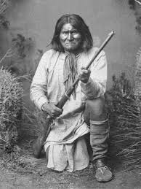
Geronimo
Surrendered 1896

Slide 18
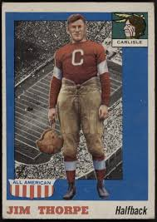
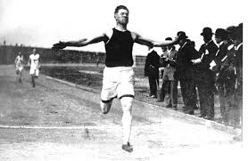

Slide 19
Dawes Severalty Act (Dawes Act)
-1887
-Significant step from Congress towards assimilation
-Broke up Native American reservation lands and turned them over to individual Native Americans
• Could be bought by settlers
• Forced a white method of land ownership

Slide 20
Dawes Act (continued)
no tribal land
Male head of household given 160 acres of land
Federal govt. schools, starting w/ Carlisle School in 1879
People who administered the act were dishonest

Slide 21
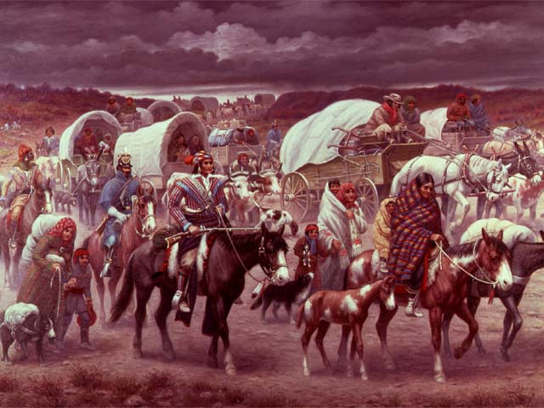
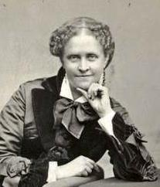
Helen Hunt Jackson - A Century of Dishonor
•1881 work outlining the unfair treatment of American Indians by the US government.

Slide 22
Buffalo Soldiers
•First black professional soldiers in a peacetime army became known as “buffalo soldiers.”
•9th and 10th cavalry units used to fight hostile Native Americans in the west.
–Cheyenne called them “buffalo soldiers” after their hair.

Slide 23
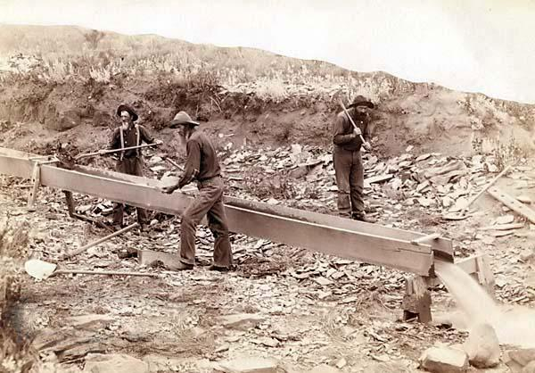
Mining
-originally “placer” mining or “panning” in CA gold rush
-placer deposits exhausted
-companies - hydraulic mining, dredging, deep-shaft “hard-rock” mining

Slide 24
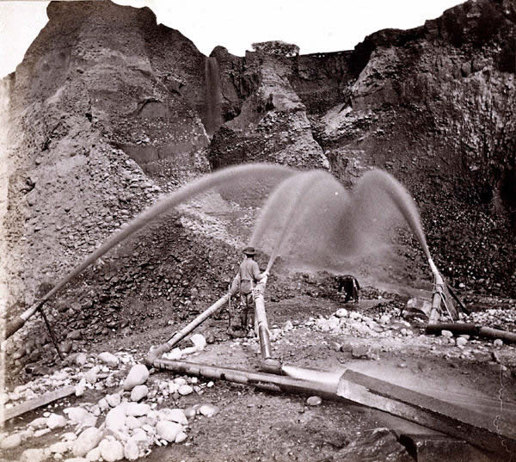
Hyrdralicking, Dredging, shaft mining
-high pressure water – strip topsoil and gravel
-barren canyons w/o vegetation
-debris covered farmland, clogged rivers, killed fish

Slide 25
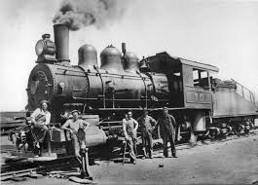
Railroads Open The West
•Federal Government gave large land grants to railroads (to assist in the settlement of the west).
•Railroads received 10 square miles of public land for every mile of track in a state and 20 square miles for every mile of track laid in a territory.

Slide 26
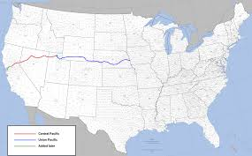
Union Pacific and Central Pacific create a transcontinental railroad
•Central Pacific moved east from Sacramento and Union Pacific moved west from Omaha.
•Many workers were immigrants (Irish and Chinese).

Slide 27
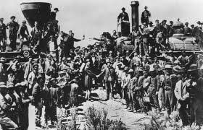
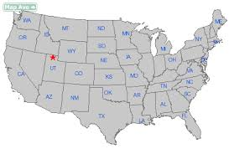
Promontory, Utah
•Central Pacific and Union Pacific met on May 10, 1869 at Promontory, Utah.

Slide 28
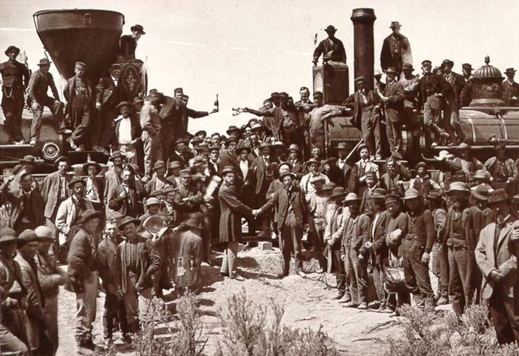

Slide 29
Gov’t Support of Western Settlement
•Homestead Act of 1862 – offered 160 acres of land in the West to any head of a household (citizen or intended citizen) if he would cultivate land for five years. ($30 fee)
-Republican platform on 1860 - fewer Dems. in Congress

Slide 30
Homestead Act (continued)
5 x as many families purchased land

Slide 31
Problems w/ Homestead Act
Not great land, Fraud- corporations & dummy homesteaders
Hardships on plains
Little water- 100th meridian
Dry farming & the Dust Bowl, Hard soil, No trees
Adaptations- sod houses, new grains, barbed wire, federally funded irrigation & dam projects

Slide 32
Problems w/ Homestead Act
Not great land, Fraud- corporations & dummy homesteaders
Hardships on plains
Little water- 100th meridian
Dry farming & the Dust Bowl, Hard soil, No trees
Adaptations- sod houses, new grains, barbed wire, federally funded irrigation & dam projects

Slide 33
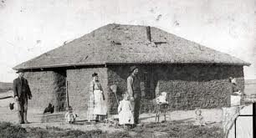

Slide 34
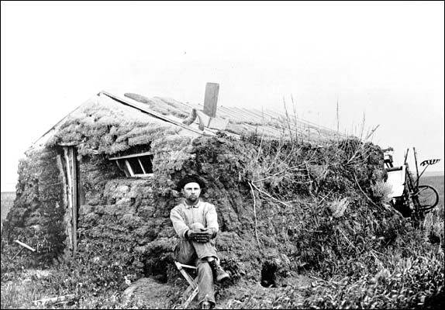

Slide 35
Morill Land Grant Act (1862)
•Gave federal land to the states to establish agricultural colleges.

Slide 36
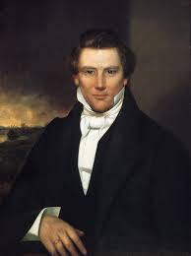
Mormons

Slide 37
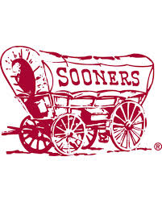
Oklahoma - former Indian Territory
Plan to open OK for settlement in 1889
Squatters or “Sooners”- had to be evicted
Formally opened on April 22, 1889
“89ers” poured in at noon
Became “Sooner State” in 1907

Slide 38
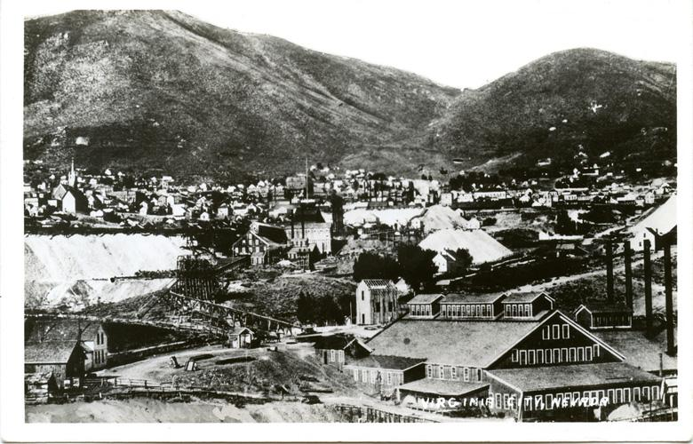
Small strikes led to boom towns turned bust towns all over the west
Lawless & raucous

Slide 39
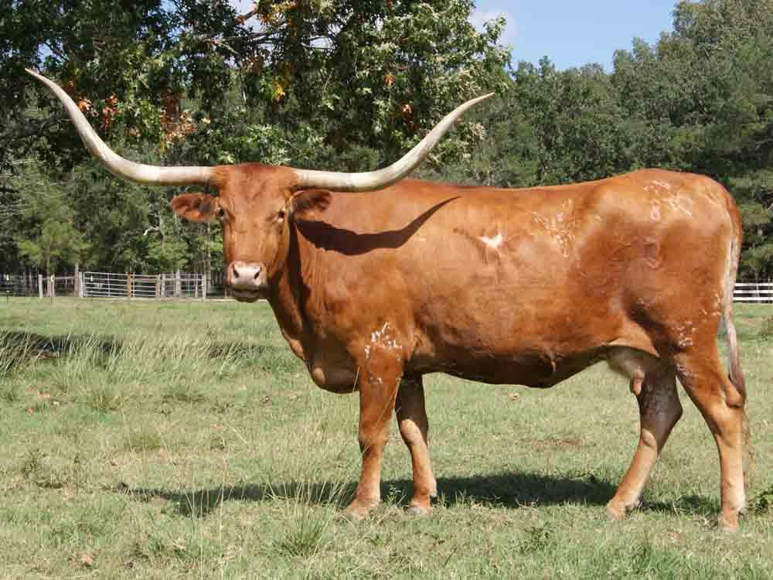
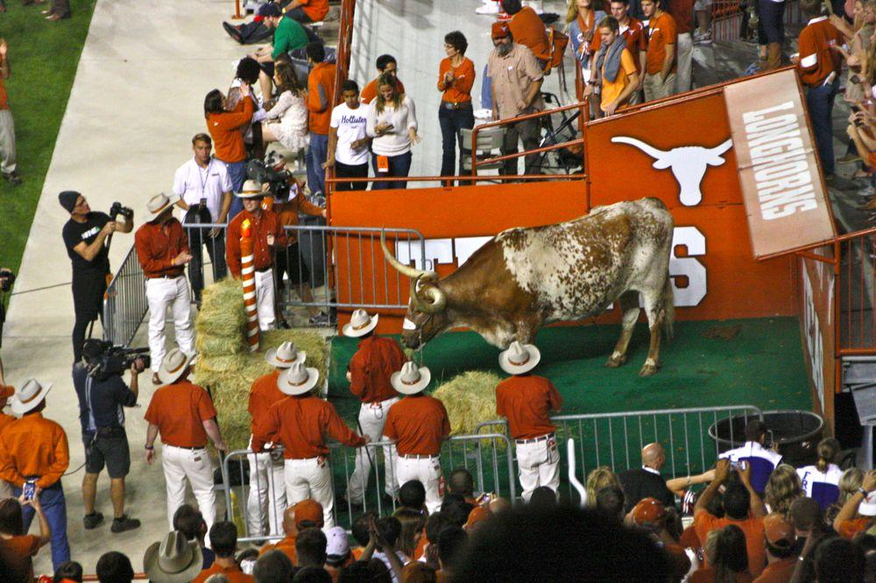
Long horns in TX- hides vs meat after Civil War
Transcontinental RR & cow towns
Refrigerated RR cars- meatpacking

Slide 40
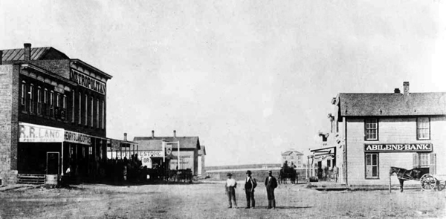
Abilene, Kansas
Joseph McCoy – 1867
Illinois livestock dealer
-200,000/10 > 2 mil/4
“The Real McCoy”

Slide 41
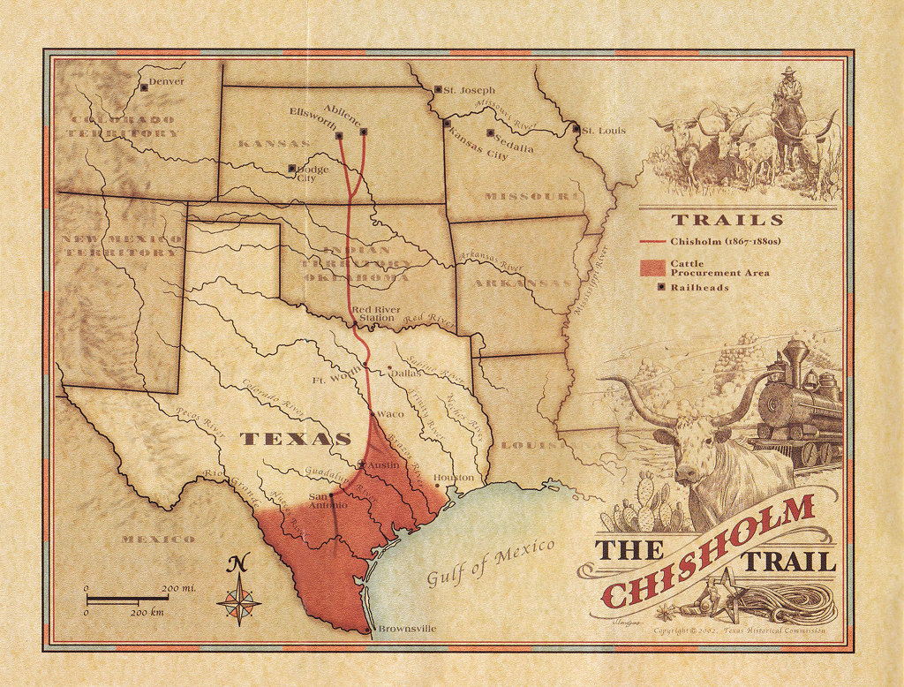

Slide 42
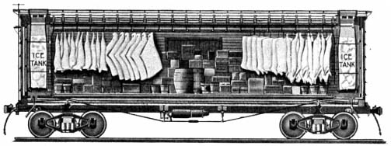
Refrigerated RR Car
-1877 - Gustavus Swift – efficient mechanical refrigeration

Slide 43
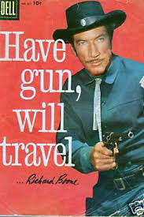
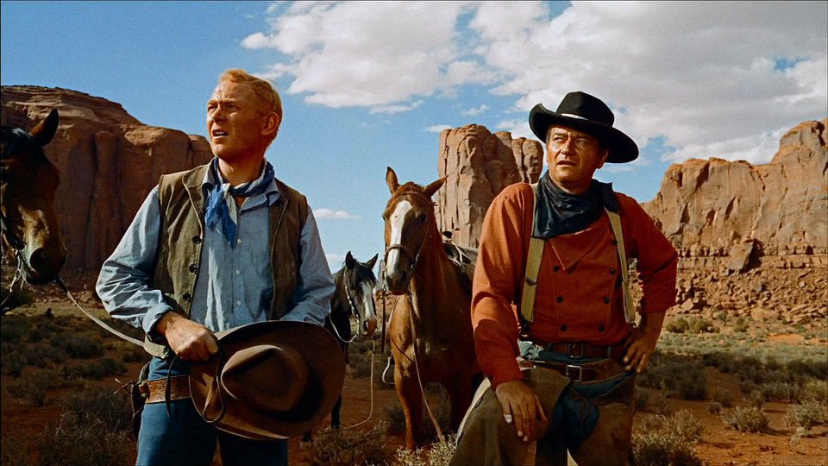
Cowboys – Myth and Reality

Slide 44
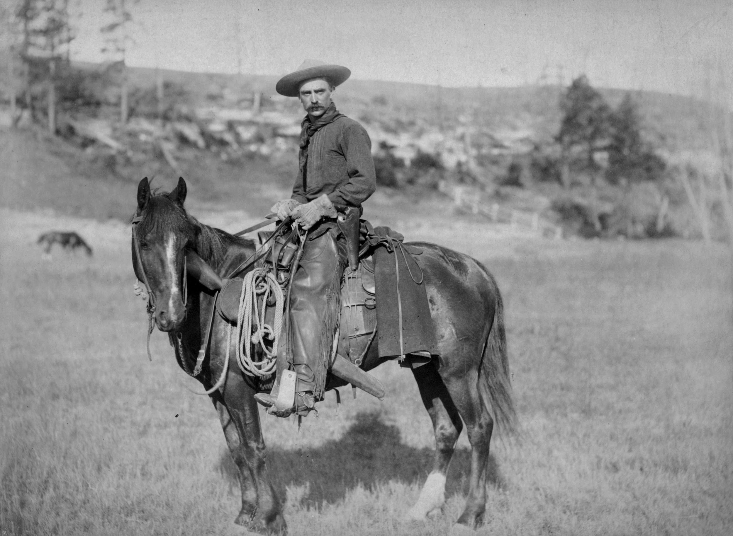

Slide 45
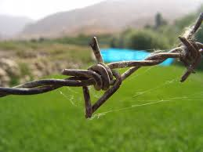
Barbed Wire
•(perfected by Joseph Glidden, 1874) brings an end to the open range.
“lighter than air,
Stronger than whiskey,
Cheaper than dirt”

Slide 46
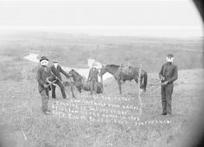
“Range Wars”
“Fence-Cutter’s War of 1883-1884” – Texas
Racial and ethinic prejudice
-Mexican, Mormon,
Basque

Slide 47
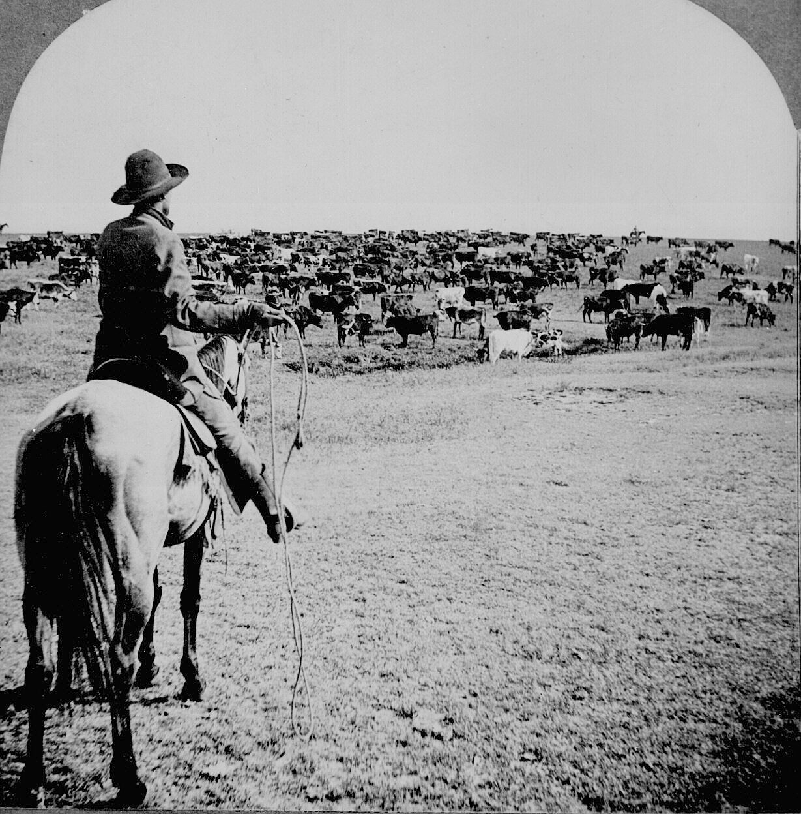
-Open grazing in TX - Roundup, Long drive
-Ended as settlers moved into west
Barbed wire, Winter of 1886-1887 (the “Big Die-Up”), Overgrazing
-Cattle became a big business venture as mining had

Slide 48
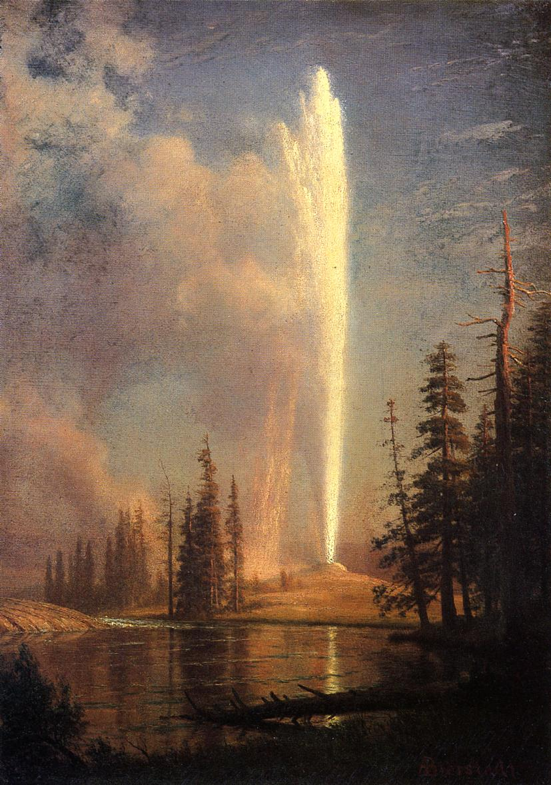
The Fading Frontier
Frontier- unsettled area
Frontier closed in 1890- end of “free” land - Census Bureau

Slide 49
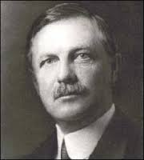
Frederick Jackson Turner’s Frontier Thesis- American history is that of westward migration

Slide 50
Trans-Mississippi most unique area (American)
Most diverse pop- Hispanic, Indian, Asian
Biggest environmental challenges
Federal govt. took biggest role in developing it socially & politically

Slide 51
Many couldn’t afford new machines- forced to sell to large companies
Became huge “bonanza” farms worked by former owners & Mexican & Chinese immigrants

