Slide 1
John D. Rockefeller (1839-1937)
Thomas Alva Edison (1847-1931)

Slide 2
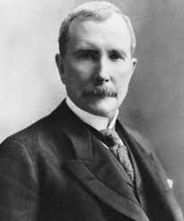
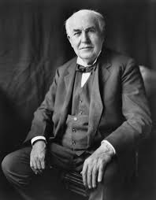

Slide 3
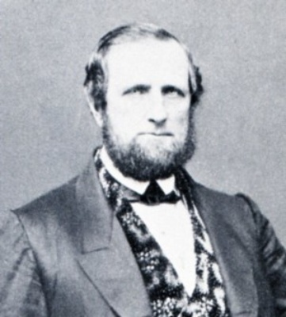
John D. Rockefeller
-father was a bigamist
-dropped out of high school (2 months before graduation)

Slide 4
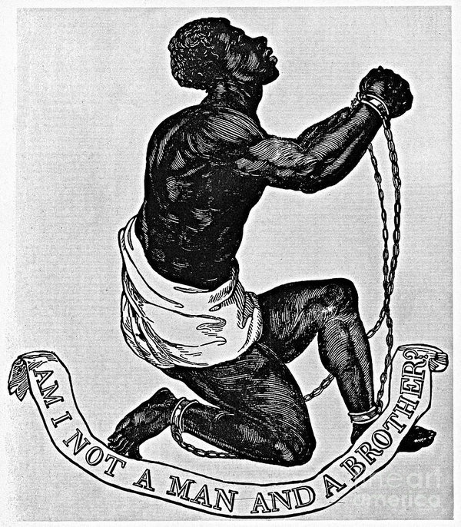
Abolitionist??
-1859 - gave money to a free black man to purchase the freedom of his enslaved wife

Slide 5
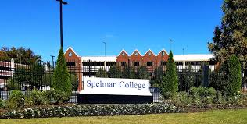
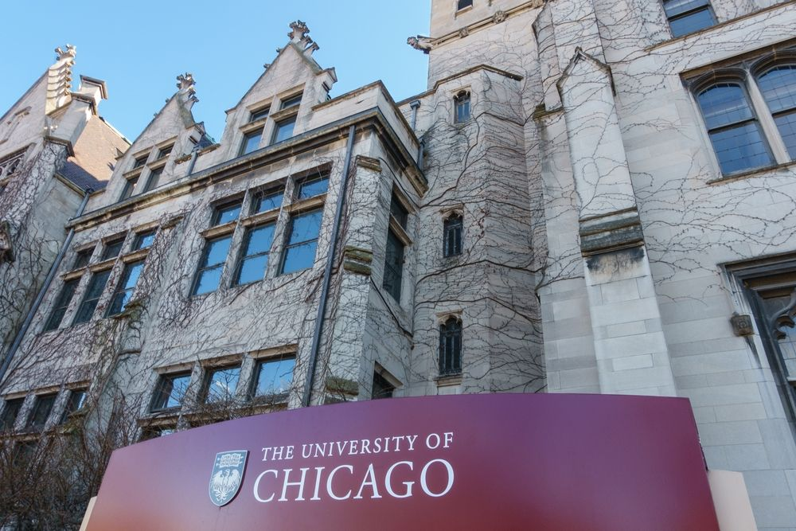
Philanthropy
-Views on Charity
-1st year working - 6% back to charity
-Preferred Private to Public Charity (no New Deal)

Slide 6
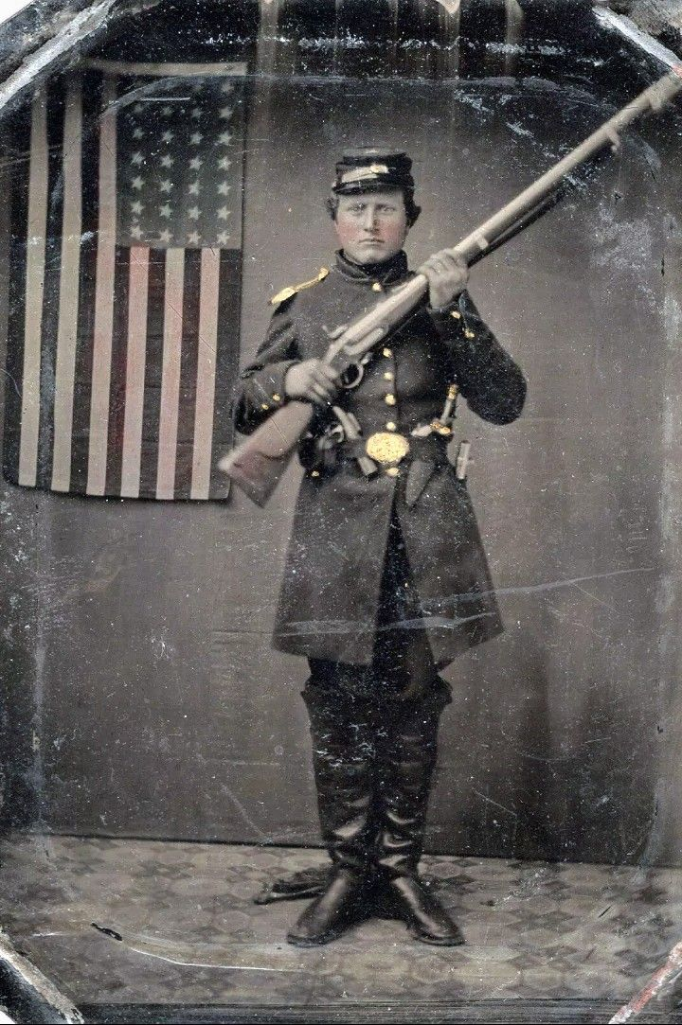
Civil War
Hired a substitute

Slide 7
Southern Improvement Company
-gave Standard Oil info on competitors
-gave Standard Oil 40% rebates on competitors’ shipments

Slide 8
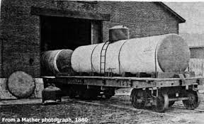
-by 1873 shipping 1 million barrels per year at profit of $1/barrel
-after absorbing competitors, made them keep their own name to deceive public, internal memos done in code
-bought his own tanker cars rather than shipping in barrels (innovative and cheaper)

Slide 9
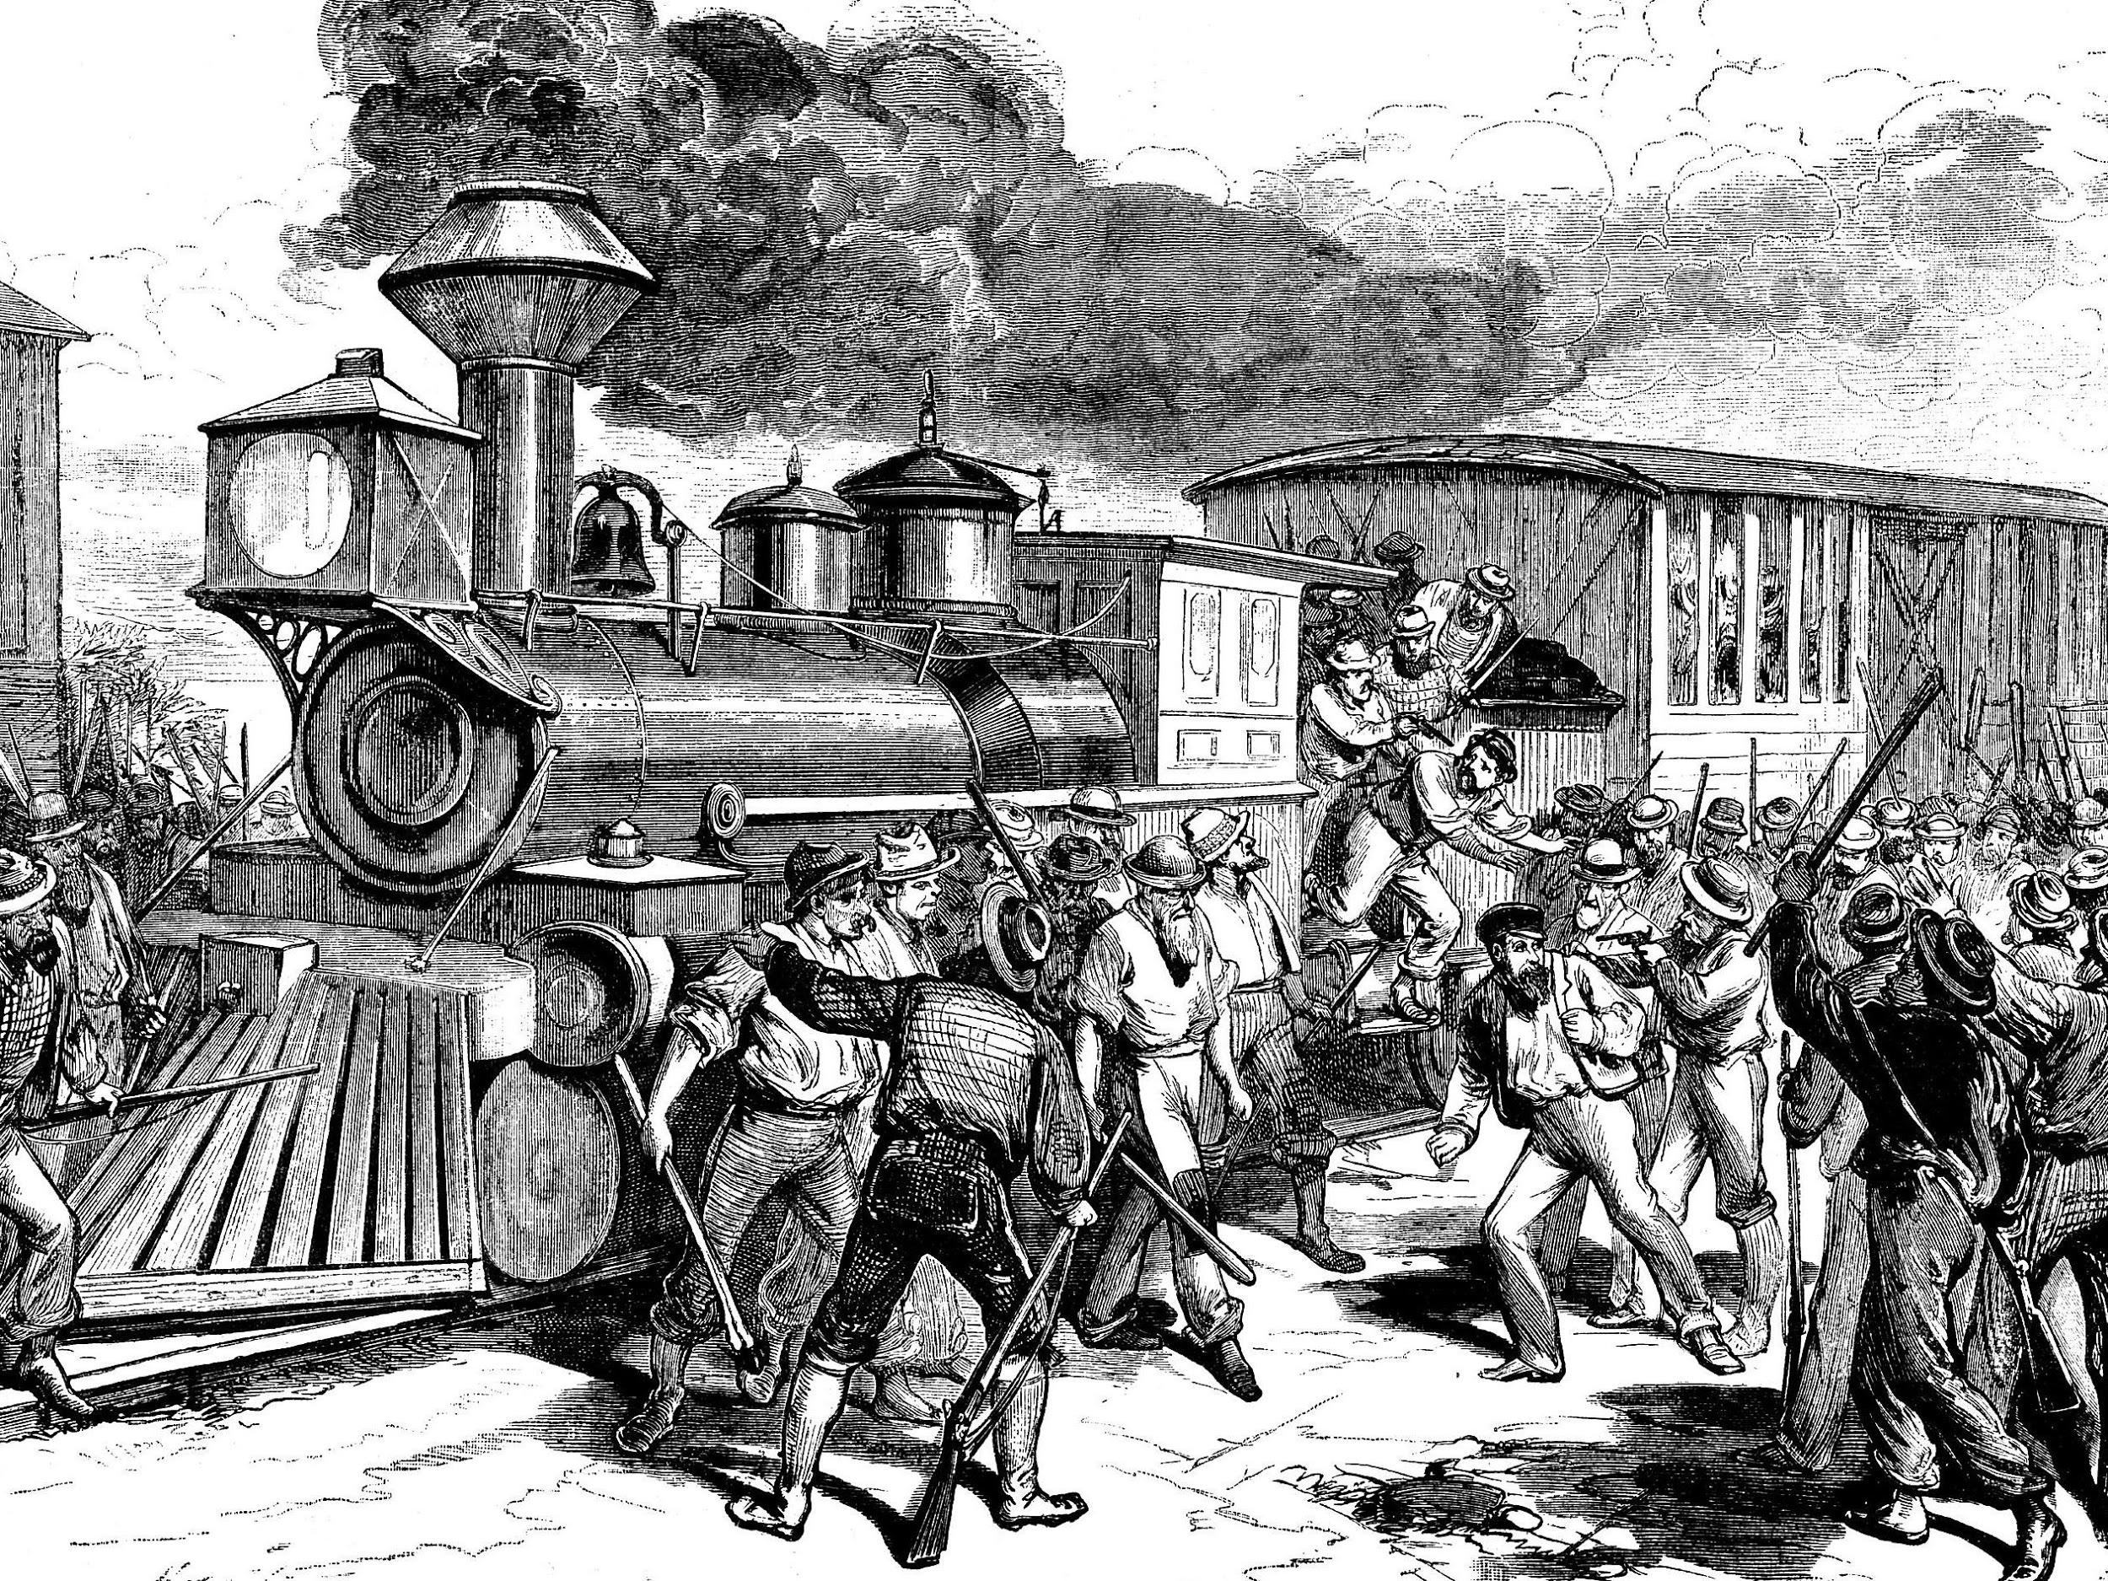
Great Strike (Railroad Strike) of 1877
-biggest strike ever to date - 100,000 workers
-more than ¾ of nation’s railroad tracks stopped
-wage cuts that led to strike were because of Rockefeller’s efforts to control railroads (B & O)

Slide 10
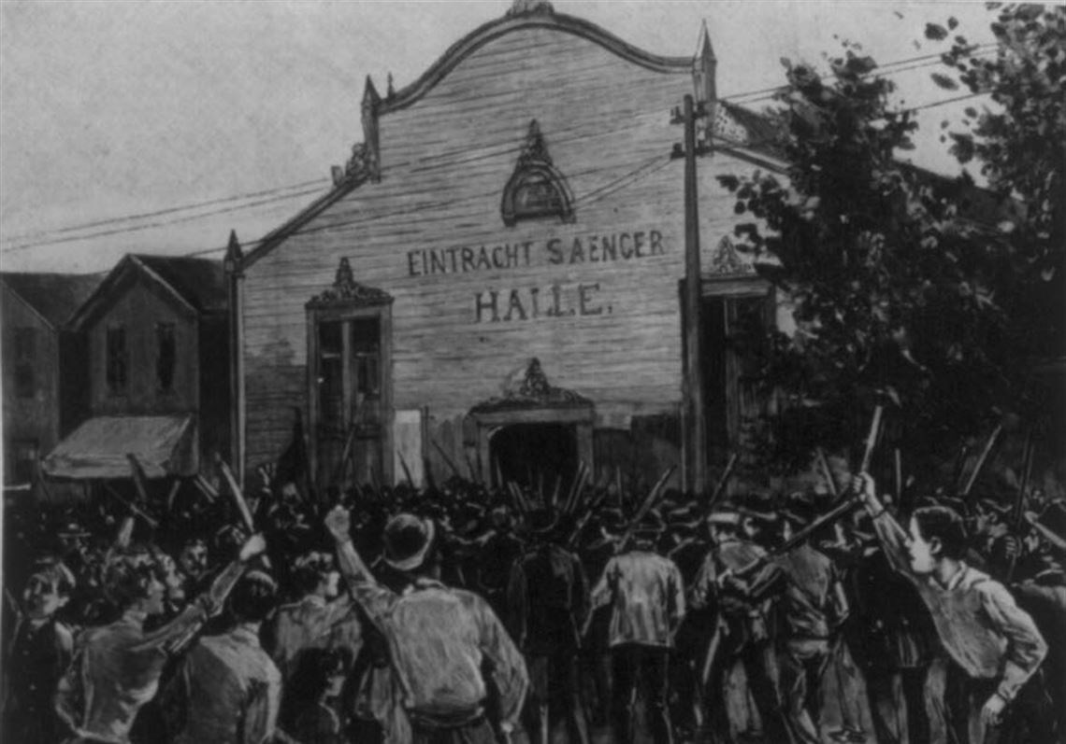
Homestead Strike
-Carnegie’s plant (managed by HC Frick) - Pinkerton’s fired on strikers
-Rockefeller sent a telegram congratulating the manager

Slide 11
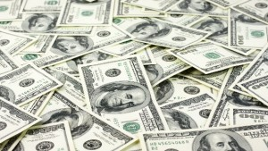
-1902 - annual untaxed income of $58 million - about $1 billion in today’s money - $1.98 per second
-1913 - net worth - more than $900 million - more than $13 billion in 1996 dollars

Slide 12
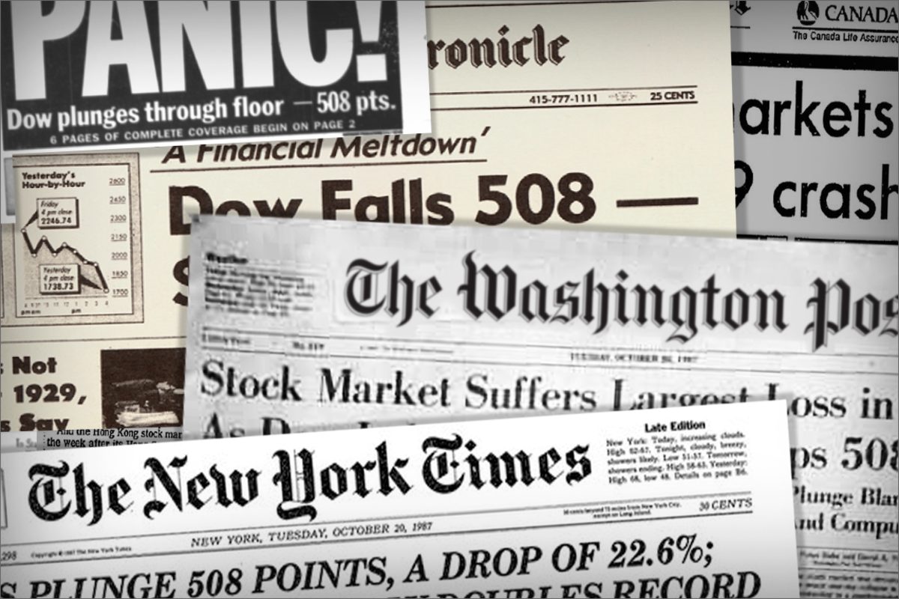
1929 Stock Market Crash
-net worth went from $25 million to $7 million

Slide 13
Rockefeller’s Beliefs about New Deal
-said he supported New Deal but preferred private charity
-thought Social Security would weaken America’s moral fiber

Slide 14
Thomas Edison
“The Wizard of Menlo Park”

Slide 15
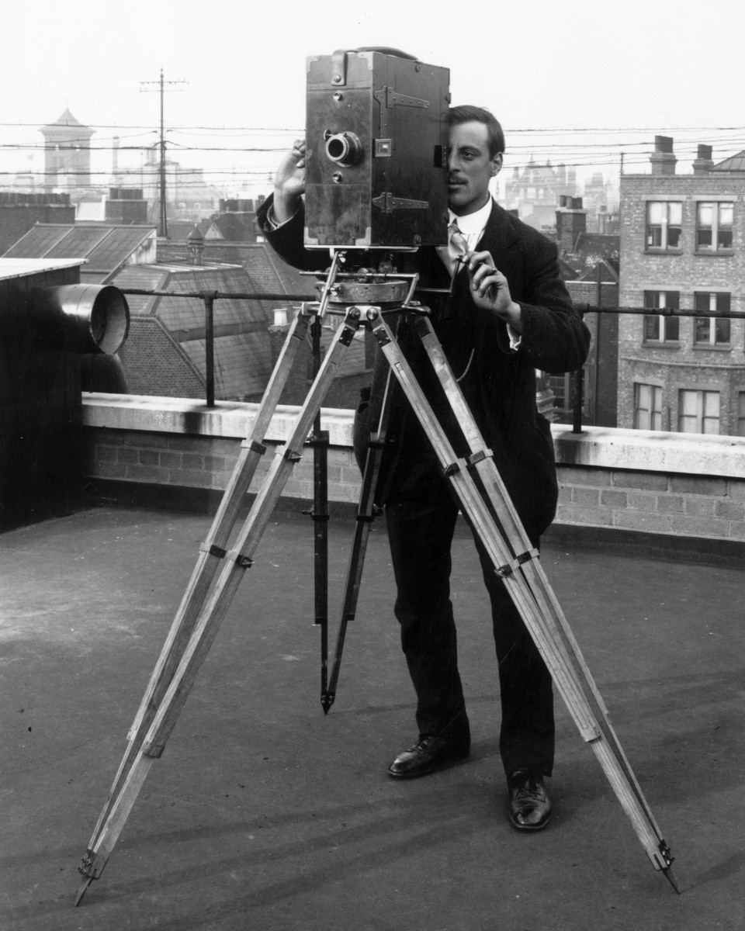
-once came up with over 100 inventions in a day
-averaged 1 patent every 11 days of his career
-thought exercise and sleep were a waste of time

Slide 16
Practical Joker
-thought hurtful practical jokes were funny
-electrified wash basin
-firecrackers at the feet of children

Slide 17
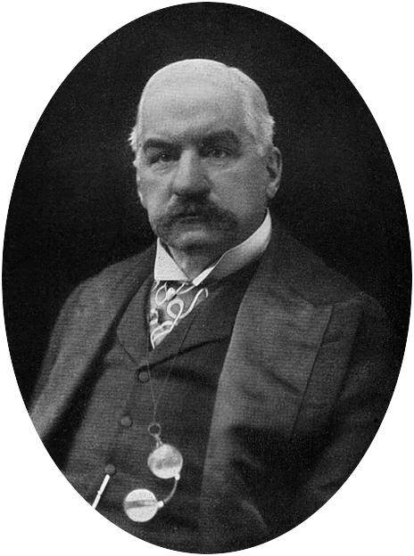
Personal Wealth
~$10 million (~125 million today)
One of his companies became General Election - merger overseen by JP Morgan

Slide 18
-in the 20s was known for generous pay and a good health plan for his workers
-reputation for firing older execs to hire younger (and cheaper) ones

Slide 19
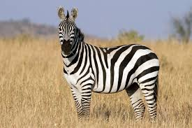
Random Questions When Interviewing
-How many stripes are on a zebra?
-Which country drank the most tea in World War I?
-Which state had the name of a violinist?
“Education is not the learning of facts, but that of training the mind to think.”

Slide 20
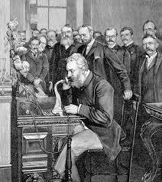
Bell’s Phone
-”Ahoy” - Bell
-”Hello” - Edison (credited with coining the term in English language 1877)

Slide 21
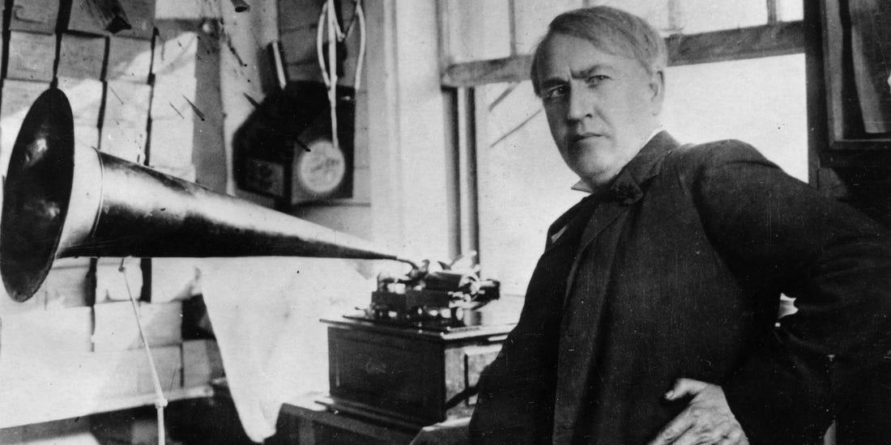
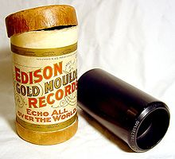
Edison’s Phonograph - 1877
-”Greatest acoustical phenomenon of the century.”
-”Mary had a little lamb”

Slide 22
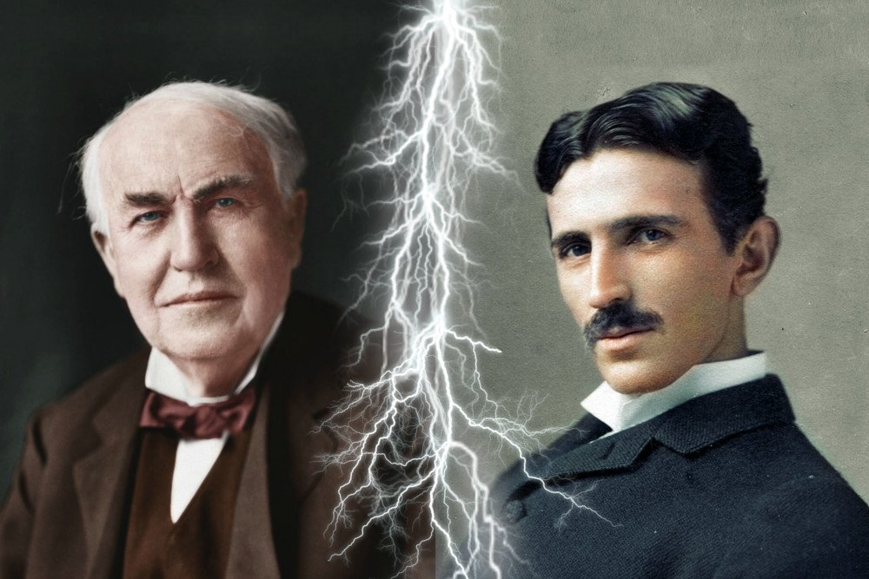
Current Wars
-lost to Tesla - Edison supported DC (less lethal) - AC not safe until transformer

Slide 23
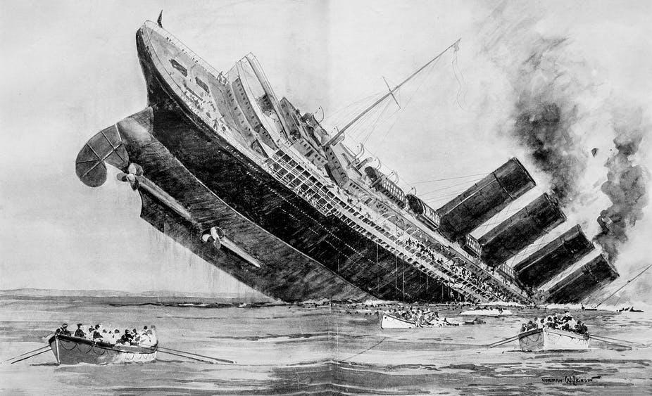
Pacifist until...

