Slide 1
Politics of Boom and Bust: 20s and 30s
AP US History

Slide 2
Key Concept 7.1
Governmental, political, and social organizations struggled to address the effects of large-scale industrialization, economic uncertainty, and related social changes such as urbanization and mass migration.

Slide 3
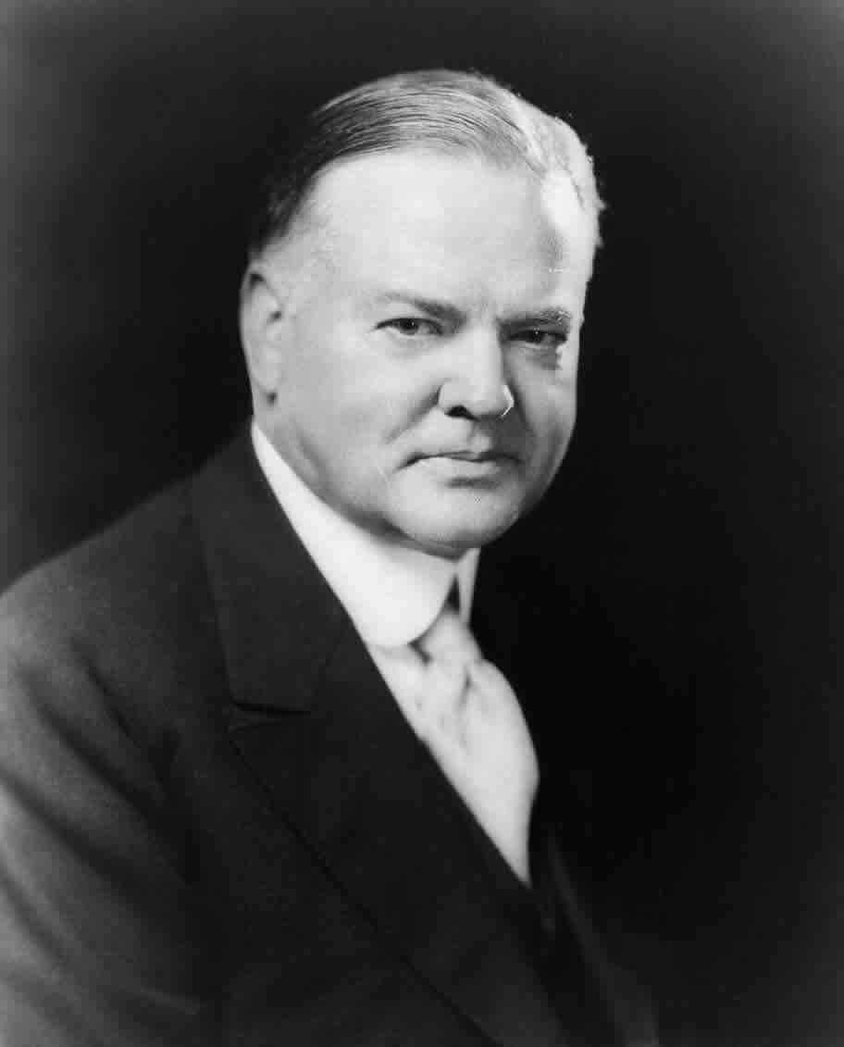
Hoover’s Triumph in 1928
Coolidge decided not to run in 1928
Republicans chose Sec. of Commerce Herbert Hoover
¡Great administrator & leader, but no good at politics
¡Believed in isolationism, capitalism, no socialism
-believed in “rugged individualism”

Slide 4
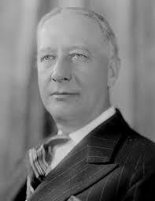
Democrats chose NY governor Al Smith
¡Catholic, “wet”, political- these hurt him
First time radio major factor
Hoover won in a landslide

Slide 5
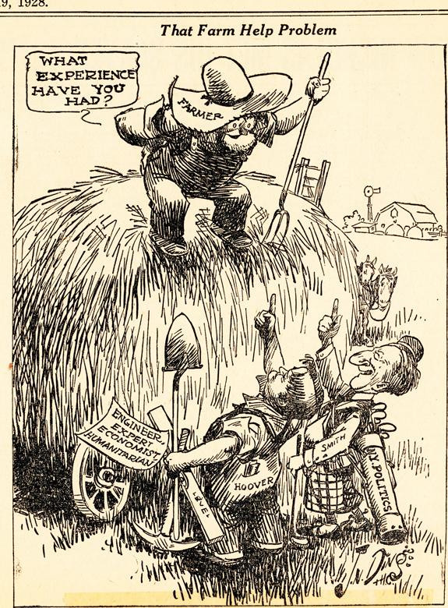
Hoover’s First Moves
Hoover took measures to protect farmers
¡Established farm co-ops
¡Govt. bought up surpluses


Slide 6
Had promised moderate tariff reduction during campaign
¡Hawley-Smoot Tariff
÷House version did this
÷Senate version ended up raising tariff on many items to about 60%
÷To foreign nations this looked like they were being blocked out- made growing depression worse
¢US was one of a few places with money to spend

Slide 7
Debt Moratorium
-1931 - Hoover proposed a moratorium on payment of international debts
-Britain and Germany accepted, France didn’t

Slide 8
The Great Crash
Huge paper earnings based on speculation of stocks
¡Made worse by margin buying
Slight decline in Oct. 1929 created orgy of selling on Oct. 29, 1929- Black Tuesday
Dec. 1929- loss of $40 billion in worth

Slide 9
Why was there a Depression?
Causes
¡Overproduction- drive prices (& wages) down
money being invested in yet more capital instead of wages
÷If $ had gone to wages people could have bought more, thus creating greater markets for surplus goods & services
¡Overexpansion of credit (installment plan) for goods & investment

Slide 10
¡Technology
¡Poor economic conditions abroad- worsened by Hawley-Smoot Tariff
¡Drought in midwest & west
Hoovervilles, Hoover flags, ragged individualists- no one understood the depression, blamed on Hoover

Slide 11
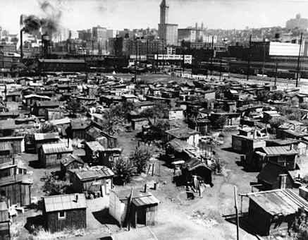

Slide 12
Rugged Times for Rugged Individuals
Herbert Hoover believed in hands-off govt.- “rugged individualism
¡Feared handouts would weaken America


Slide 13
Hoover’s Beliefs
Finally had to accept economic compromise
¡Not direct govt. handouts
¡Help out companies to have $ trickle down to poor
Critics assailed him for not helping to feed starving Americans

Slide 14
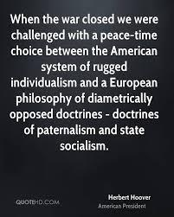

Slide 15
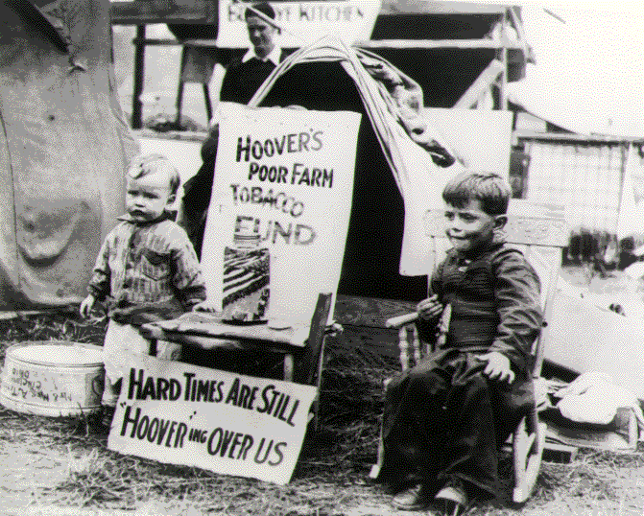

Slide 16
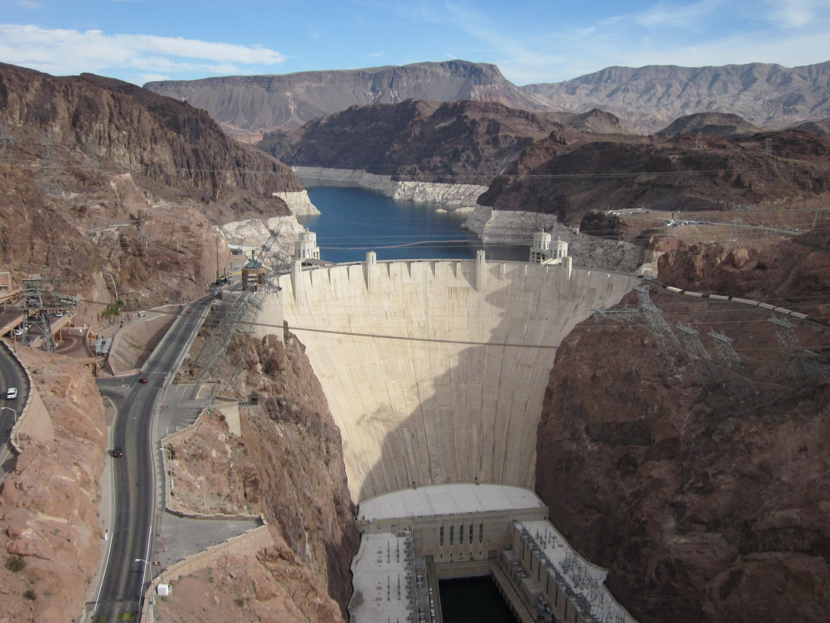
Hoover Battles the Great Depression
Got Congress to vote huge public works spending programs & relief efforts
¡Hoover Dam

Slide 17
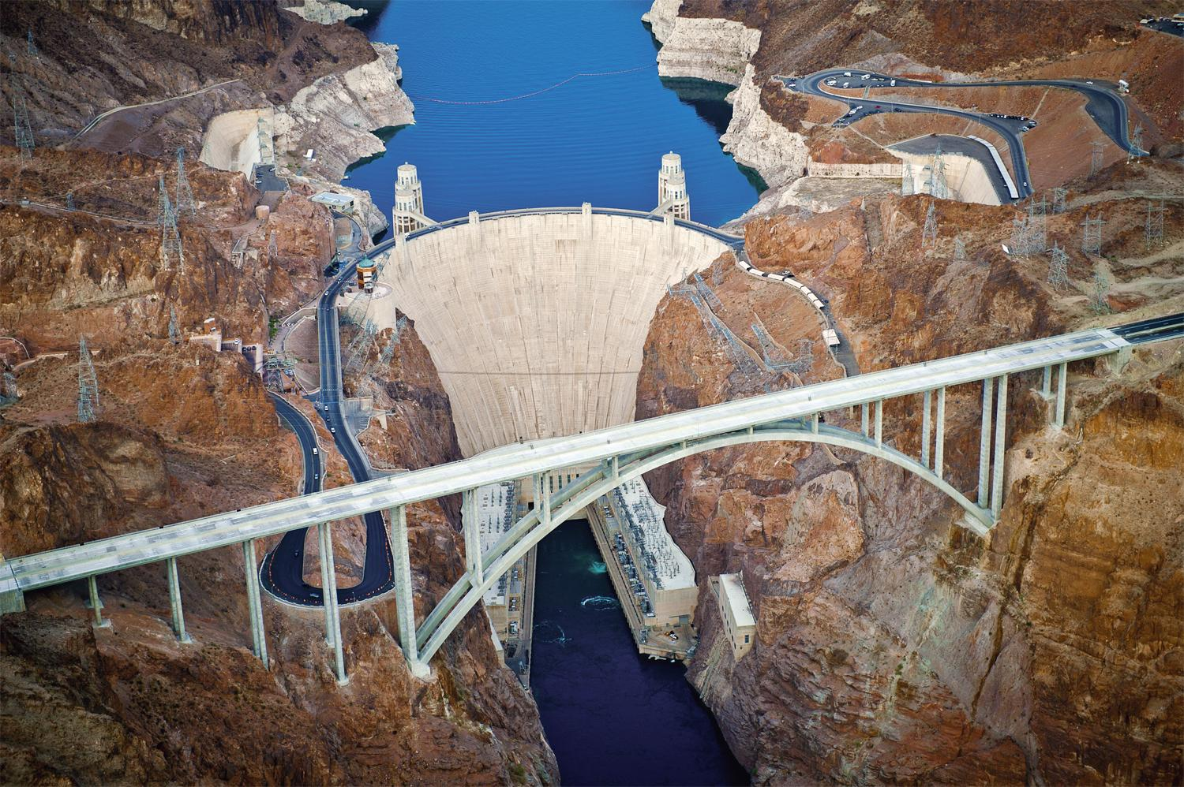
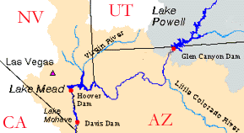

Slide 18
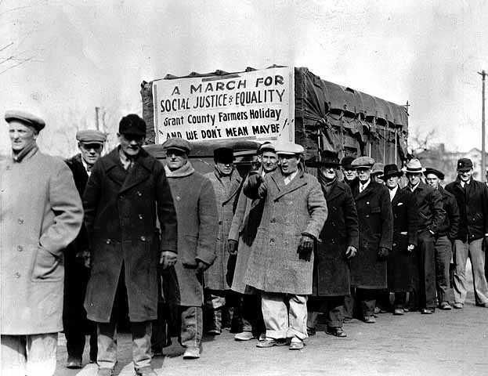
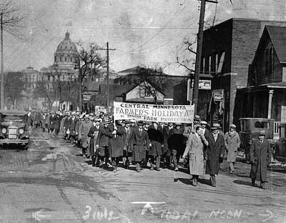
Too Little, Too Late
Federal Farm Board - created in 1929 - help farmers stabilize prices
Midwest Farmers - Farm Holiday Association - stop crops - some violence

Slide 19
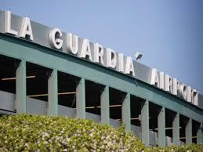
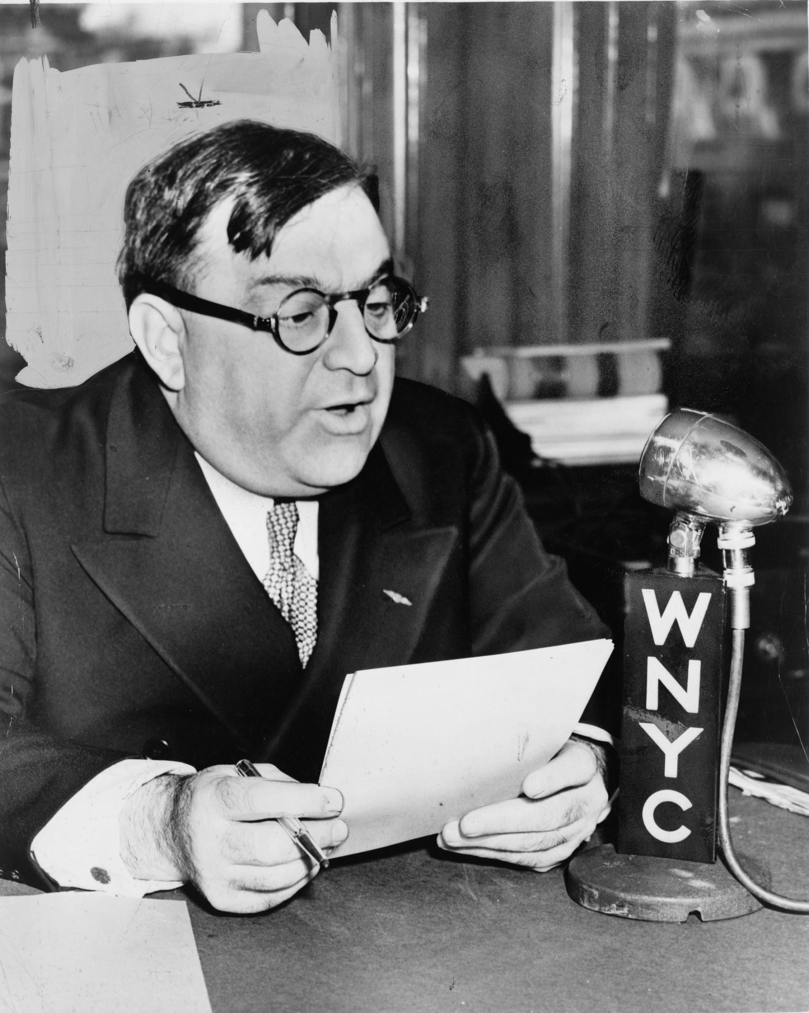
¡Reconstruction Finance Corp.- govt. lending bank for institutions (not individuals)- pump priming
¡Norris-LaGuardia Anti-Injunction Act of 1932- forbade yellow dog contracts, allowed strikes
Opened the way for FDR’s New Deal, but too little & too late for Hoover

Slide 20
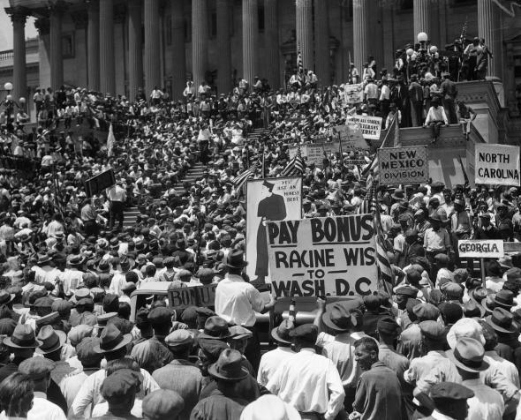
The Bonus Army
Cong. Had voted in 1924 to pay bonus to WWI vets in 1945
Vets wanted it NOW
Summer of 32 marched to DC- Bonus Expeditionary Force (BEF)- 20,000

Slide 21
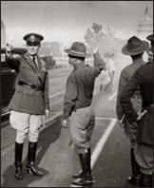
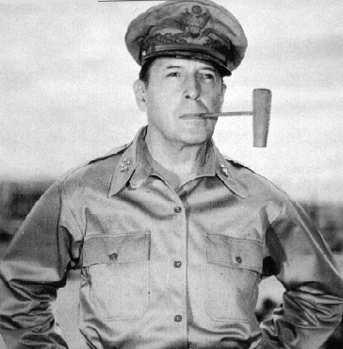
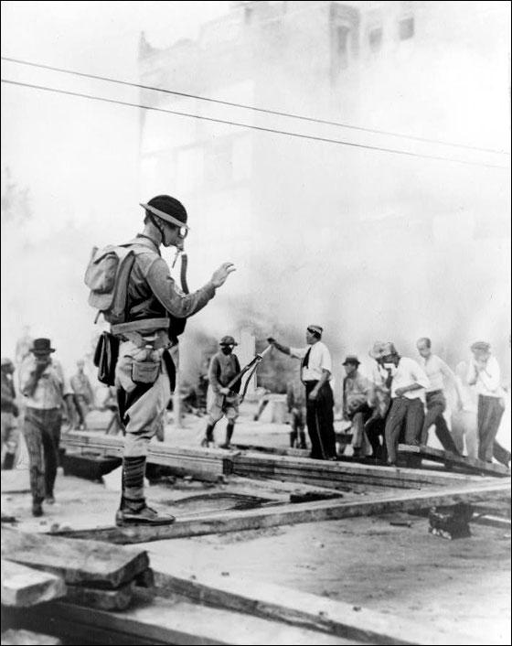
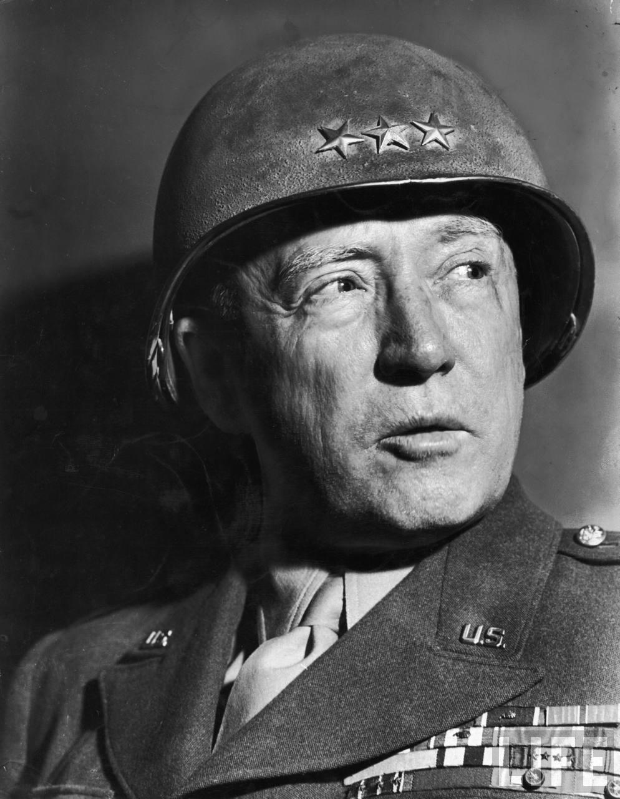
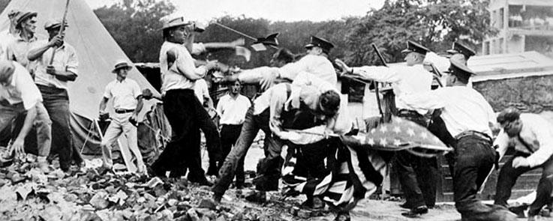
Removal of Bonus Army
Ordered to disperse- Hoover called out army
Sealed his fate for election
D. MacArthur - did he follow instructions?

Slide 22
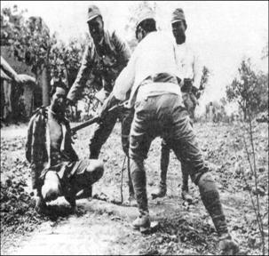
Japanese Militarists in China
Sept. 1931- Japan took over Manchuria
LoN & US didn’t stop them- responded with paper
Japan bombed Shanghai in 1932
First military actions of the coming World War

Slide 23
Hoover Pioneers the Good Neighbor Policy
Hoover withdrew American troops from Latin American nations as the Great Depression worsened
Set stage for FDR to continue Good Neighbor Policy

Slide 24
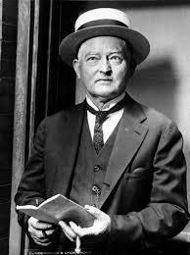
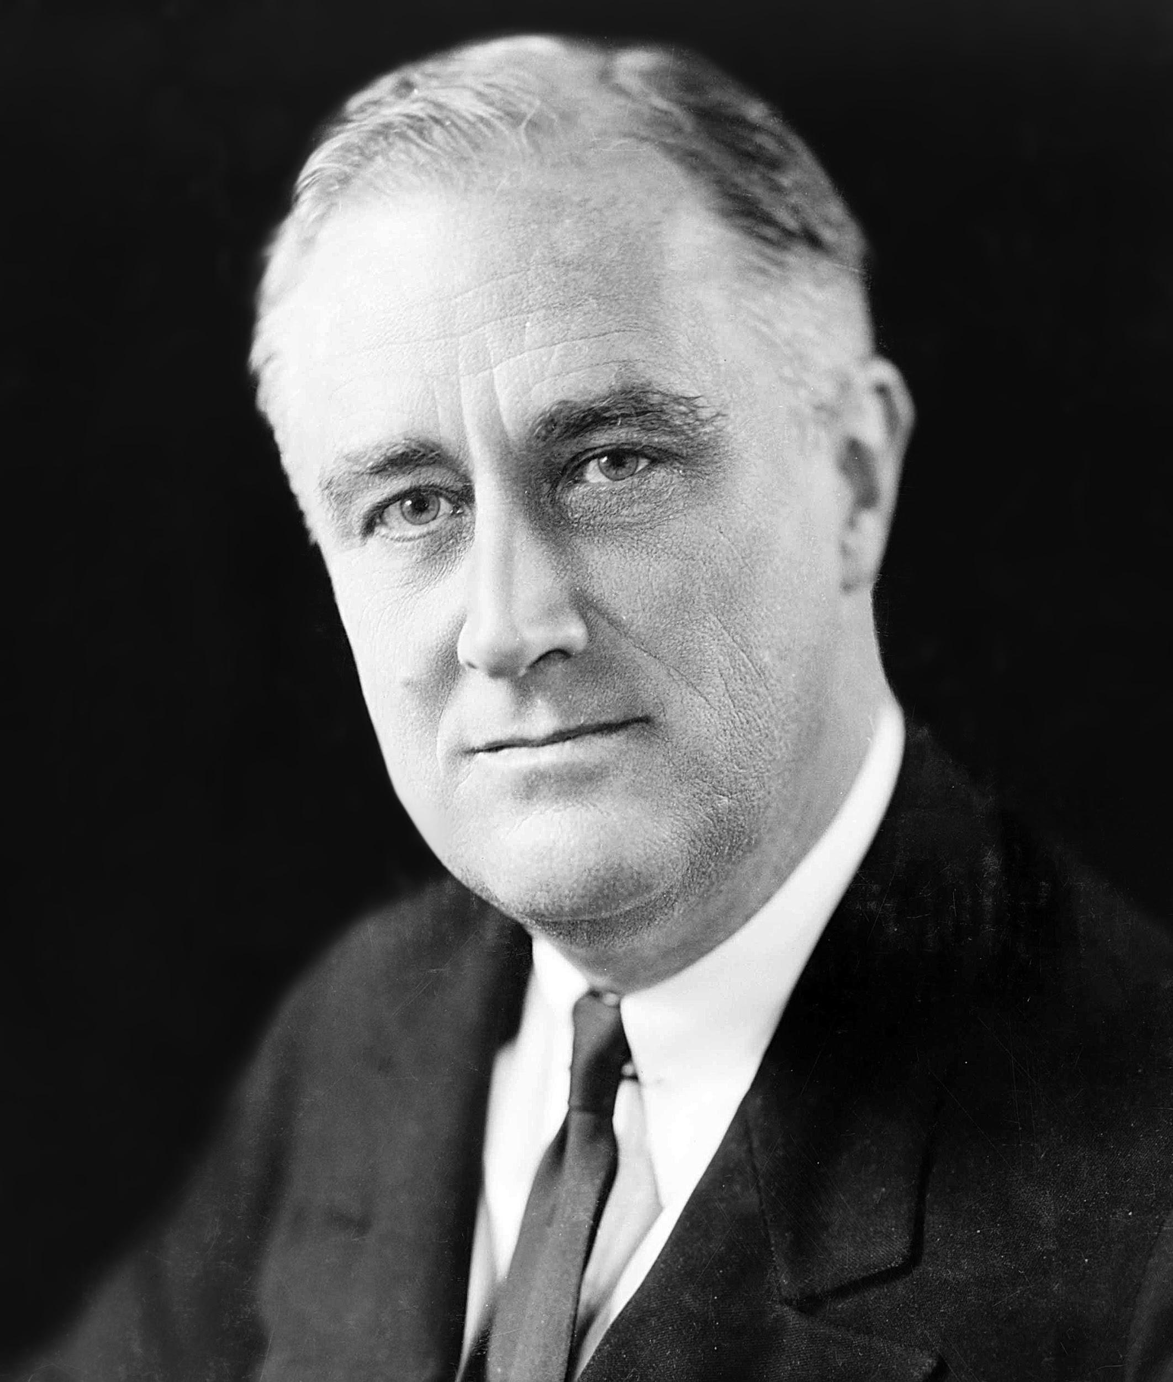
Election of 1932
Republicans renominated Hoover - said that a Democratic victory would make economic problems worse
Democrats nominated Franklin D. Roosevelt - Gov of NY with Speaker John Nance Garner of TX

Slide 25
Election of 1932
FDR’s platform
-a “new deal for the American people”
-repeal of Prohibition
-aid for unemployed
-some cuts in gov’t spending

Slide 26
FDR wins
-60% of vote
-many Socialists supported Roosevelt
-Democrats had large majorities in both houses of Congress

Slide 27
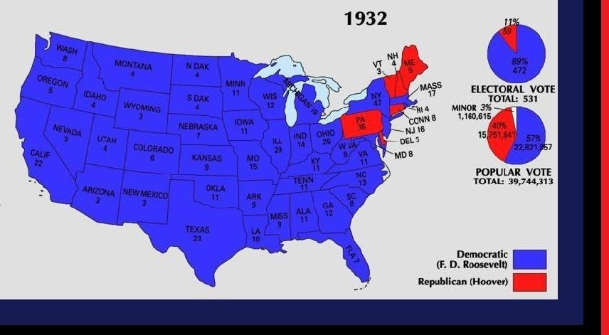

Slide 28
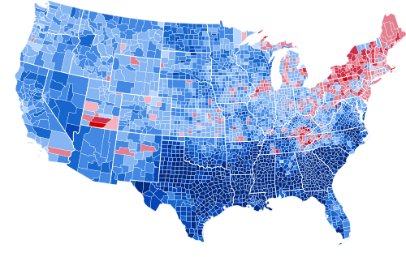

Slide 29
Hoover as “Lame Duck”
-Hoover still in office until March 1933
-20th Amendment passed in Feb 1933 and ratified March 1933
-Hoover offered to work w/ FDR
-FDR refused - didn’t want to be tied to any of Hoover’s ideas

Slide 30
