Slide 1
Mercantilism, the Empire, and Salutary Neglect

Slide 2
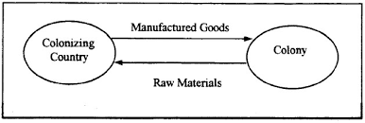
Mercantilism
Economic policy that looked upon trade, colonies, and accumulation of wealth as the basis for military and political strength
Colonies only exist to enrich parent country

Slide 3
Navigation Acts (1650-1673)
1. Trade to and from colonies can only be carried on English or colonial-built ships w/ English or colonial crews
2. (almost) all goods imported to colonies must go through ports in England
3. “enumerated” goods can be exported to England only (originally just tobacco)

Slide 4
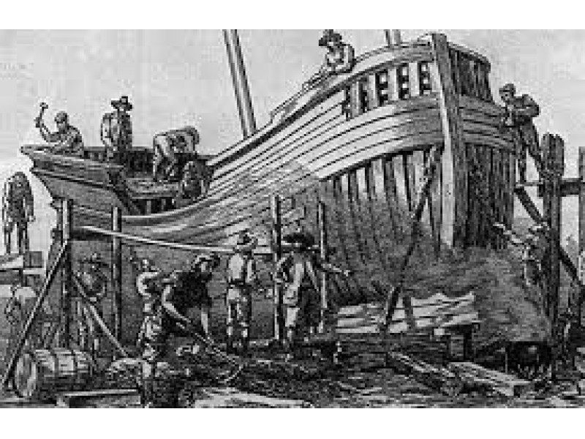
Impact of Acts?
Good for New England shipbuilding
Chesapeake tobacco had monopoly in England
Protection from French and Spanish
Hindered development of manufacturing in colonies

Slide 5
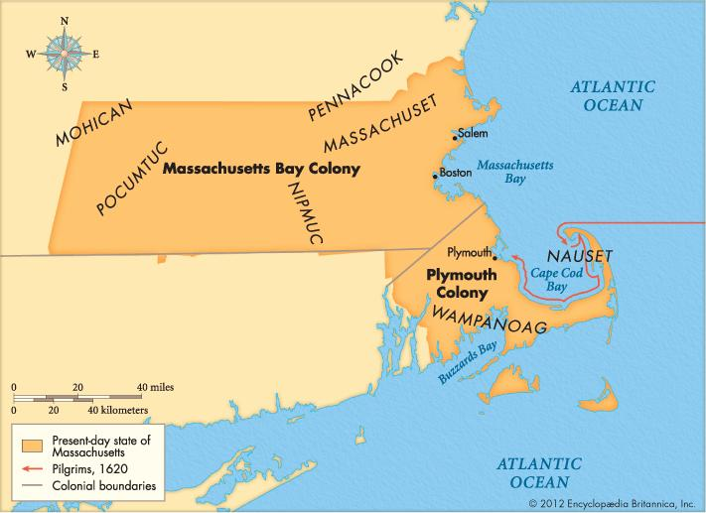
Enforcement of the Acts
Colonists engaged in smuggling with French, Dutch, and others
Enforcement lax, agents were corrupt
Crown made sporadic efforts
1684 – revoked charter of Mass. Bay colony

Slide 6
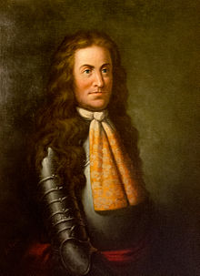
Dominion of New England
James II – 1685
Determined to increase royal control over colonies
Larger administrative units
1686 – NY, NJ, NE colonies became Dominion of New England
Sir Edmund Andros sent as governor

Slide 7
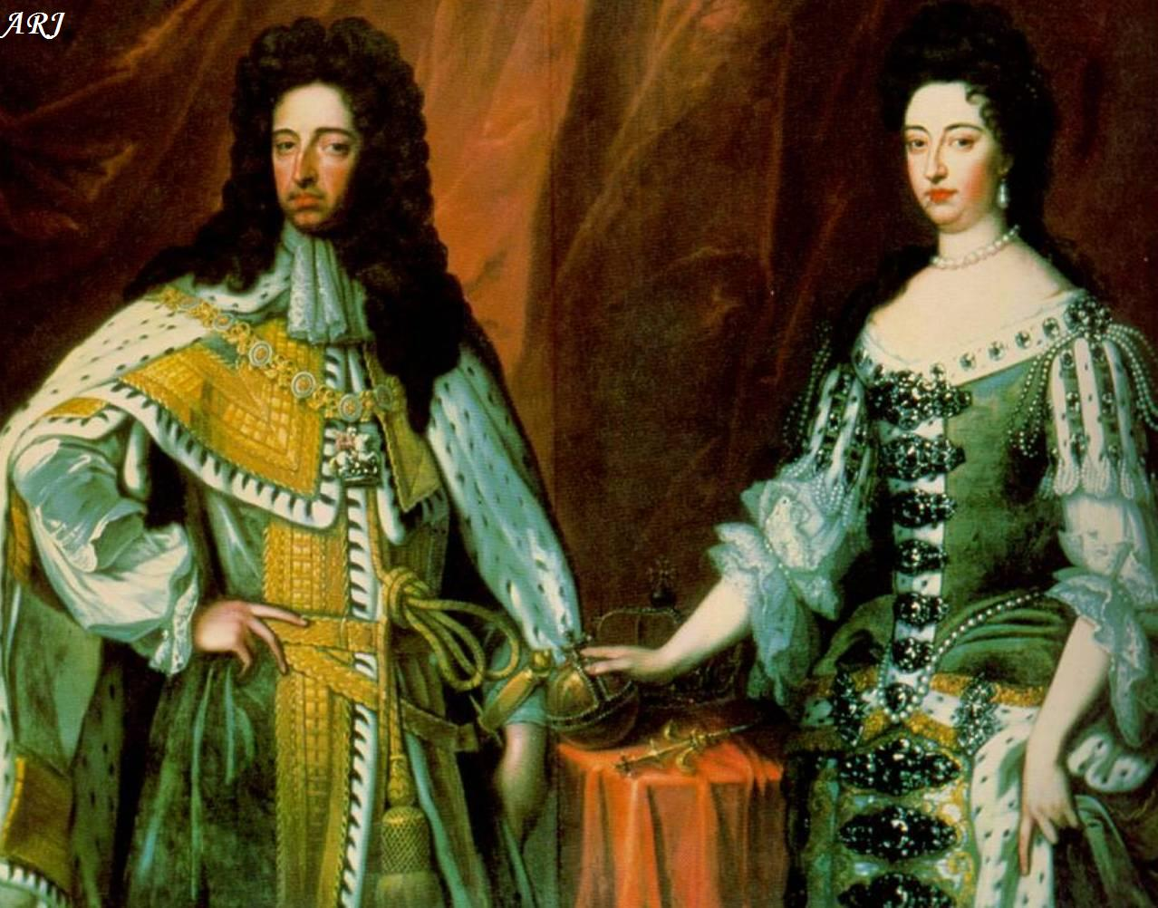
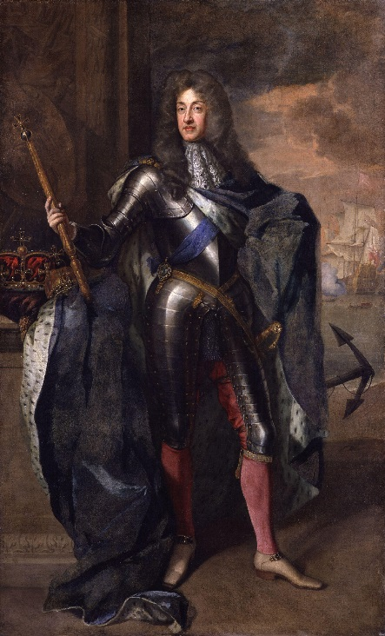
Glorious Revolution
1688 – James II deposed in favor of William and Mary
Dominion of New England ended and colonies operated separately again

Slide 8
Salutary Neglect
1607-1763 – England did not strictly enforce Parliamentary laws regarding colonies, let them act mostly as independent states

