Slide 1
McCarthyism
AP US History

Slide 2
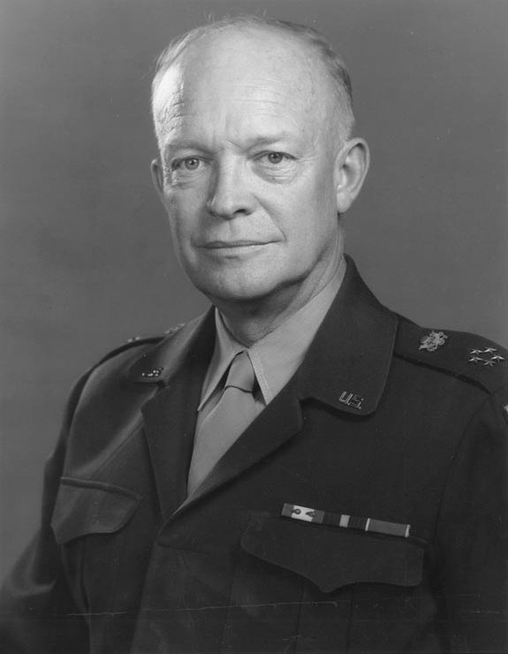
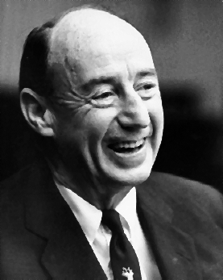
Election of 1952
Dwight D. Eisenhower - Republicans
Adlai E. Stevenson - Democrats

Slide 3
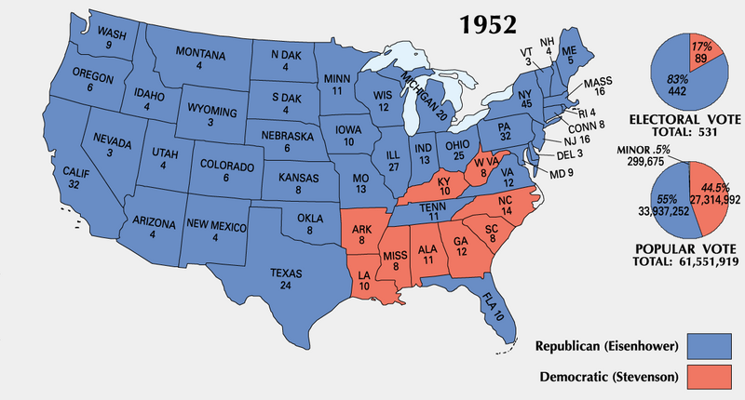

Slide 4
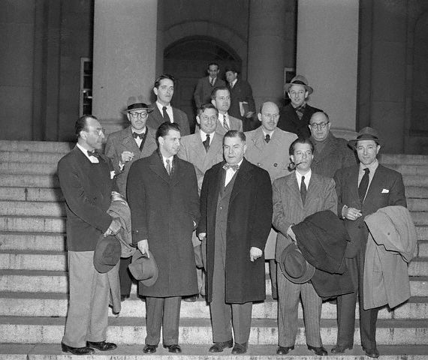
Hollywood Ten
Sent to prison for not cooperating with HUAC’s investigation

Slide 5
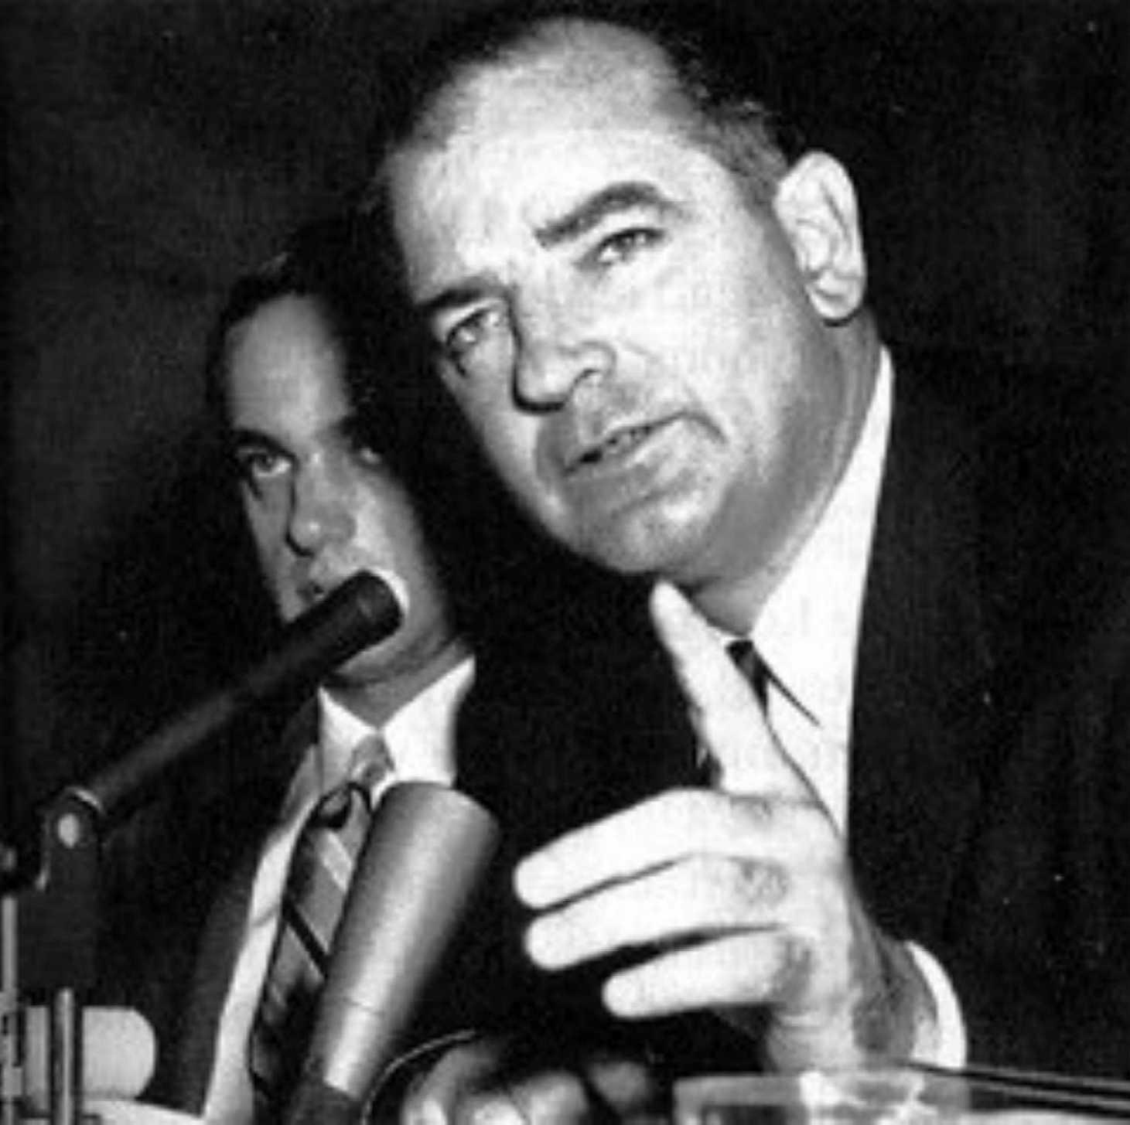
McCarthy’s “Witch Hunt”
nJoseph McCarthy – Republican from Wisconsin who said that Communists were infiltrating the government

Slide 6
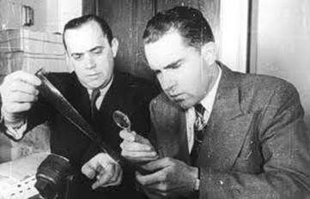

Slide 7
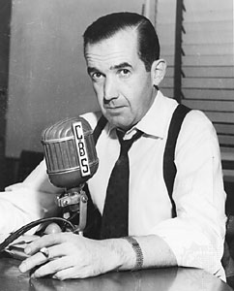
Edward R. Murrow

Slide 8
McCarthyism
nAttacks on suspected Communists
-often through unscrupulous methods

Slide 9
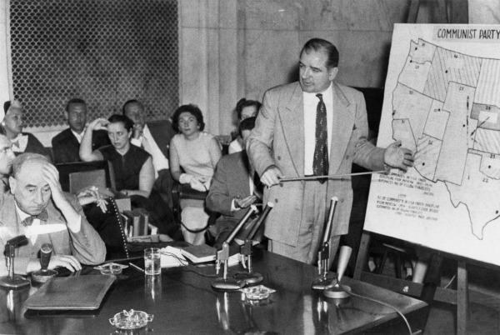
Army vs. Mccarthy
-McCarthy was condemned after attacking the U.S. Army
-”Have you no decency?”

Slide 10
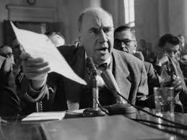
Joseph Welch
Fred Fisher
-formerly of Nat’l Lawyer’s Guild

Slide 11
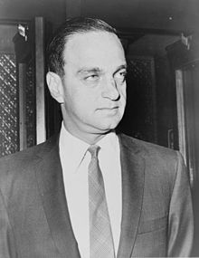
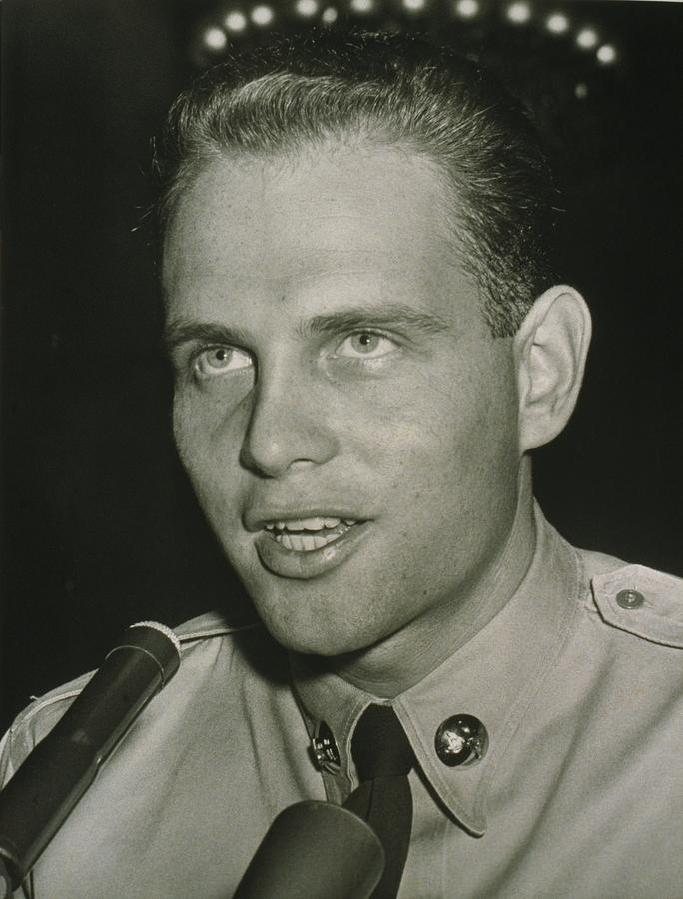
Roy Cohn
Private David Schine

Slide 12
McCarthy died of alcoholism

Slide 13
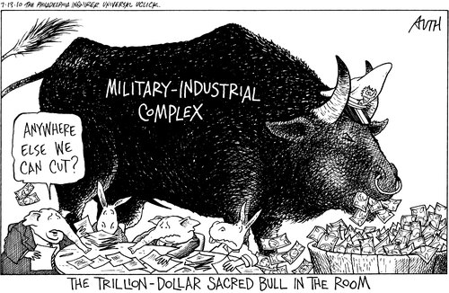

Slide 14
