Slide 1
Truman’s Fair Deal
AP US History

Slide 2
Postwar Economic Anxieties
-Crumbling relations w/ Soviets- beginning of Cold War era
-Fear that war was only temporary fix for economy

Slide 3
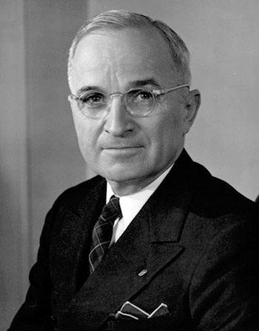
The Man from Missouri
-Baptism by fire for Harry Truman
-Not college educated, hot tempered, cocky
-Honest, authentic, unpretentious, moxie
-The buck stops here, if you can’t stand the heat get out of the kitchen

Slide 4
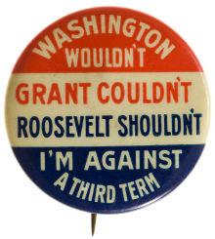
Postwar Economy
-Thought GIs would become unemployed- GI Bill of Rights- school & loans
-Employment Act of 1946
-22nd Amendment (Republican Congress reaction against FDR)
-Strikes, inflation after war

Slide 5
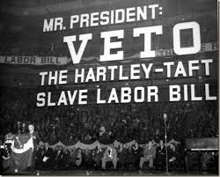
Taft-Hartley Act
-Taft-Hartley Act- 1947-
-outlawed closed shop
-allowed “right to work” states
-outlawed secondary boycotts
-gave president power of an 80 day cooling off period
-Passed over Truman’s Veto
-Antiunion fears, esp. in south

Slide 6
The Fair Deal – “out – New Dealing the New Deal”

Slide 7
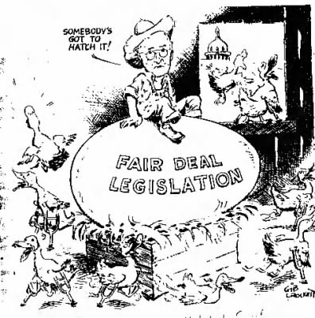
-Fair Deal (domestic)-
•Better housing, full employment, higher minimum wage, better farm supports, new TVAs, extension of Social Security
•Most fell to republicans & southern dems.- did raise min. wage, created Housing Act, extended SS

Slide 8
Postwar Economic Boom, 1950-1970
nSustained economic growth for 2 decades
nIncome doubled then again
nPaved the way for many changes- Civil Rights Movement, Medicare

Slide 9
Postwar Boom (continued)
nPlaced US as world leader
nLiving “American dream”
nWomen in work 25% of workforce- traditional roles

Slide 10
Roots of Postwar Prosperity
-Military budgets of WWII & Cold War
-New technology for defense
-Cheap energy - Lots of oil from middle east
-Huge increase in labor production
-Technology & education
-Agribusiness- made up only 2% of workforce by 1990s- fed much of the world

Slide 11
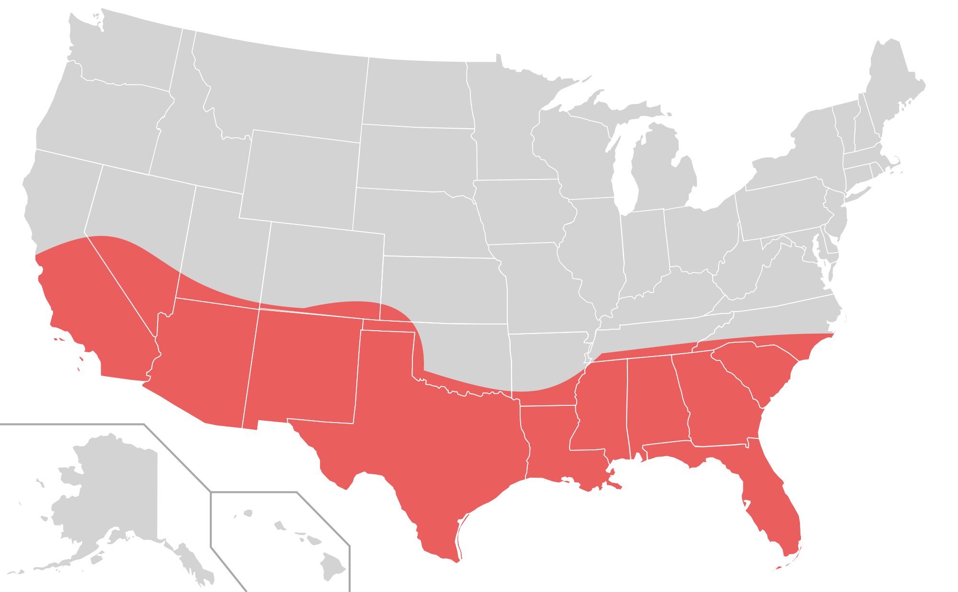
The Smiling Sunbelt
-Large migrations post-1945-1970- many to south & west (Sunbelt)
-Better climates, lower taxes
-Northeast & midwest (rustbelt)
-Changes in political power

Slide 12
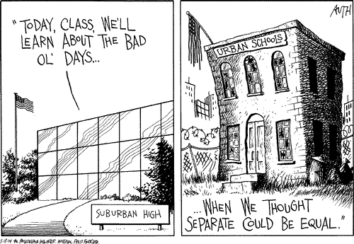
Rush to the Suburbs
-White flight after WWII- suburbs
-Federal Housing Authority & Veteran’s Affairs (risky loans & high risk areas)
-Tax write-offs for interest on home loan

Slide 13
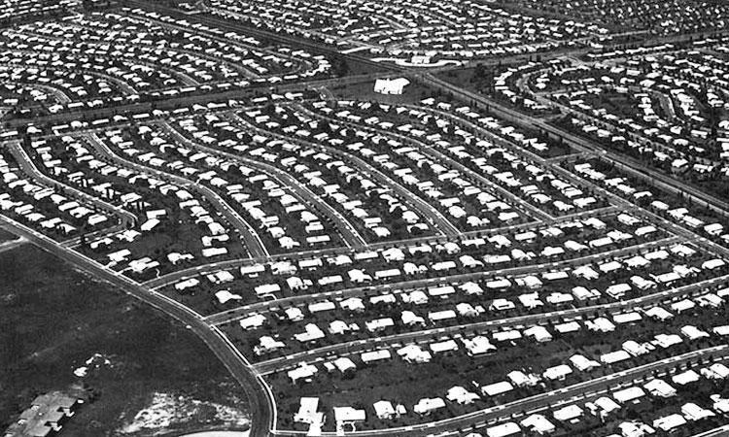
The ‘Burbs
-New highways
-Levittown- Long Island NY- late 40s
-Standardized plans & construction
-Minorities began filling urban areas
-8 cent/mile rule

Slide 14
Suburban Racism
Shelley v. Kraemer (1948) (McGhee v. Snipes)
Levittown 1953 – 70,000 residents, 0 African-American residents
1950-1960 - Detroit – gained 185,00 African-American residents, lost 361,000 white residents

Slide 15
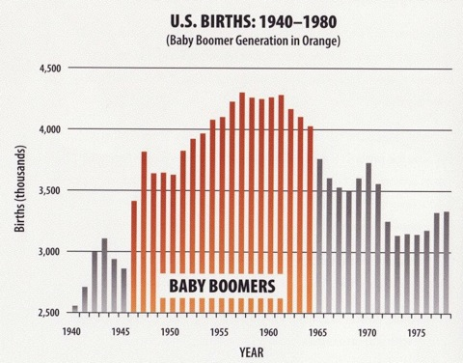
Postwar Baby Boom
-Huge increase in birthrate in 15 years following WWII- 50 million
-By 1960 birthrate dropping off
-By 1973 birthrate below point needed to maintain population
-Currently- “graying of America”
-Strain on US society

Slide 16
Democratic Divisions in 1948
nRepublicans won Congressional control in 1946
nNominated Thomas Dewey of NY in 1948
nDemocrats renominated Truman- not favored by southerners b/c of his civil rights stand

Slide 17
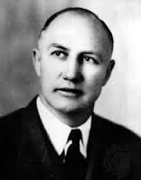
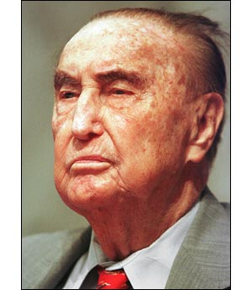
nSplit & created “Dixiecrats”- Strom Thurmond of SC
nFormer VP Henry Wallace created another Progressive party
nTruman won w/ support of labor, blacks, & farmers- nearly lost- “Dewey Defeats Truman”

Slide 18
Thurmond – claimed not to be racist, but for States’ Rights, complete segregation
said Truman wanted to “convert America into a Hitler State”
Wallace – expand welfare, international control of nukes
Dewey – bland clichés, no stance on controversial issues

Slide 19
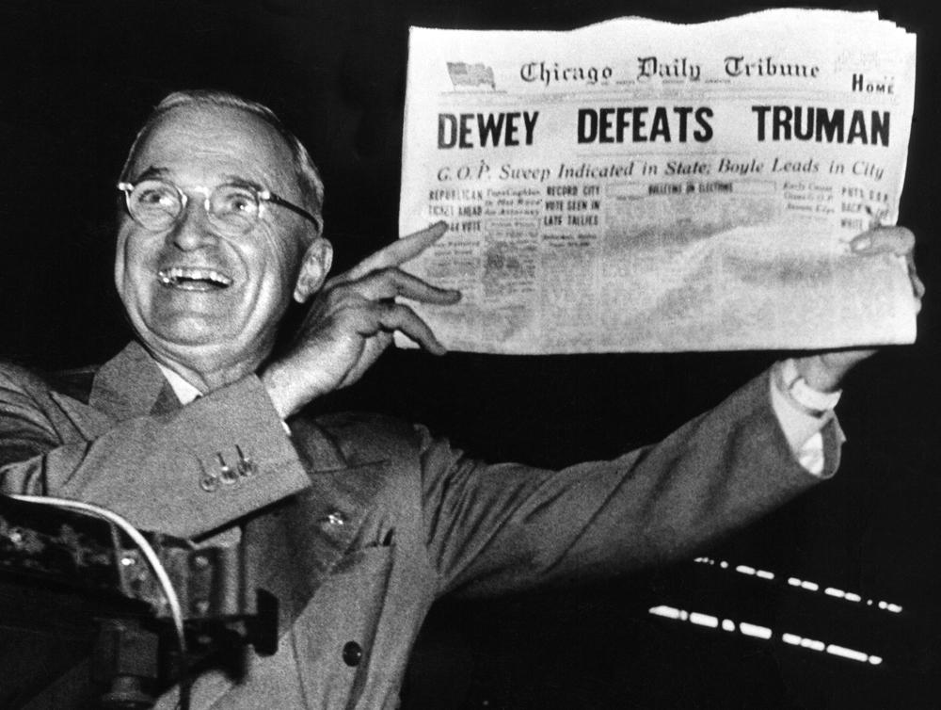

Slide 20
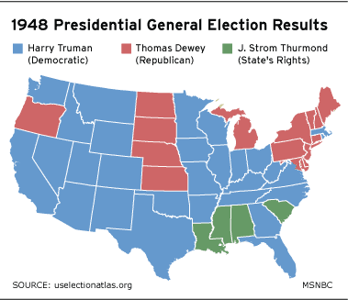

Slide 21
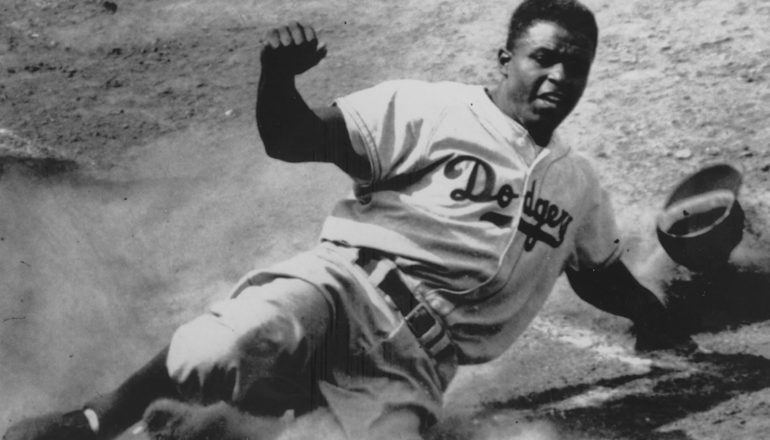
Truman and Civil Rights
July ‘48 – Exec Order desegregating armed services
Commission – To Secure These Rights
-”an American charter of human freedom”

Slide 22
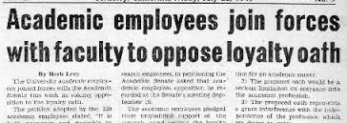
Hunting Reds
nFear of communist Spies in US
n1947- Truman created Loyalty Review Board- investigate supposed com. Groups & federal employees
Exec Order 9835 – Loyalty-Security Program
Why was it passed? Who was suspected of disloyalty? Why?
nLoyalty oaths- freedom of expression

Slide 23
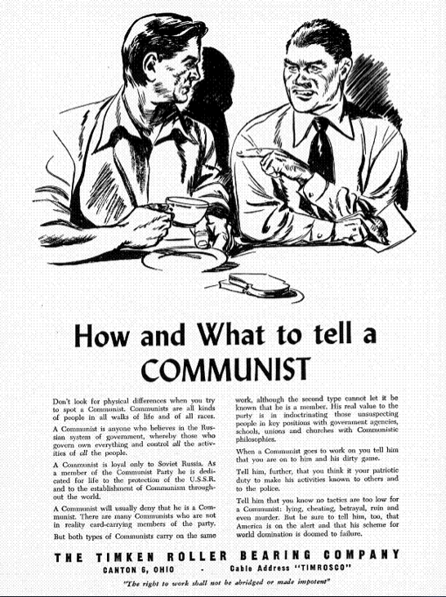

Slide 24
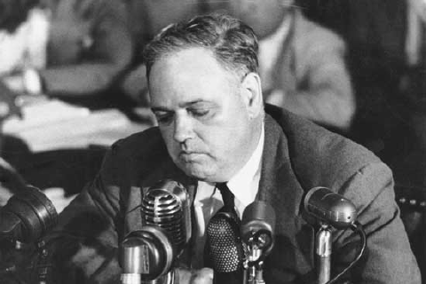
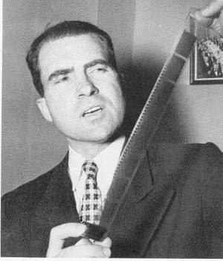
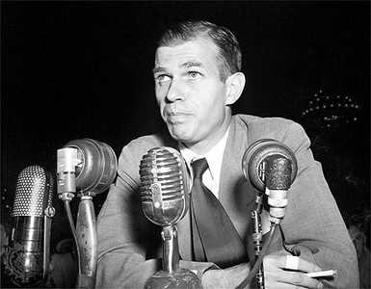
The Reds Have Landed
-Whittaker Chambers - “Pumpkin Patch Papers”
-Alger Hiss- convicted of perjury- beginning of communist witch hunts

Slide 25
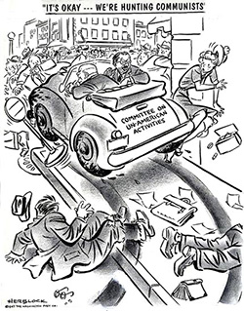
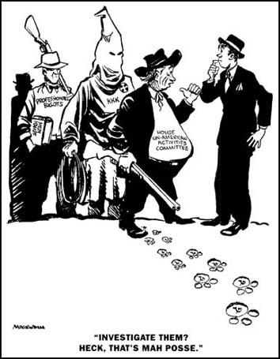
HUAC
Committee on Un-American Affairs (HUAC- 1938)- Richard Nixon

Slide 26
Truman’s new programs in 1949
-Point Four (foreign)- lend money & aid to underdeveloped nations- keep from fighting them in the future

