Slide 1
End of Reconstruction
American History 1

Slide 2
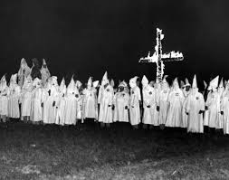
Post Civil War South
KKK – Confederate Veterans Club
Nathan Bedford Forrest
Violence and intimidation

Slide 3
“Redemption”
Democratic “Redemption”
“Lost Cause”
“Bourbon Democrats”
“White League” (Louisiana)
“Red Shirts” – MS and NC

Slide 4
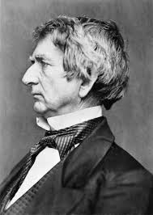
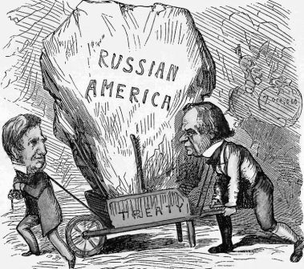
Seward’s Folly
•Russia ready to sell Alaska
•1867- Sec. of State William Seward made the deal with Russia
–$7.2 million ($.02/acre)
•Hope for resources in Alaska

Slide 5
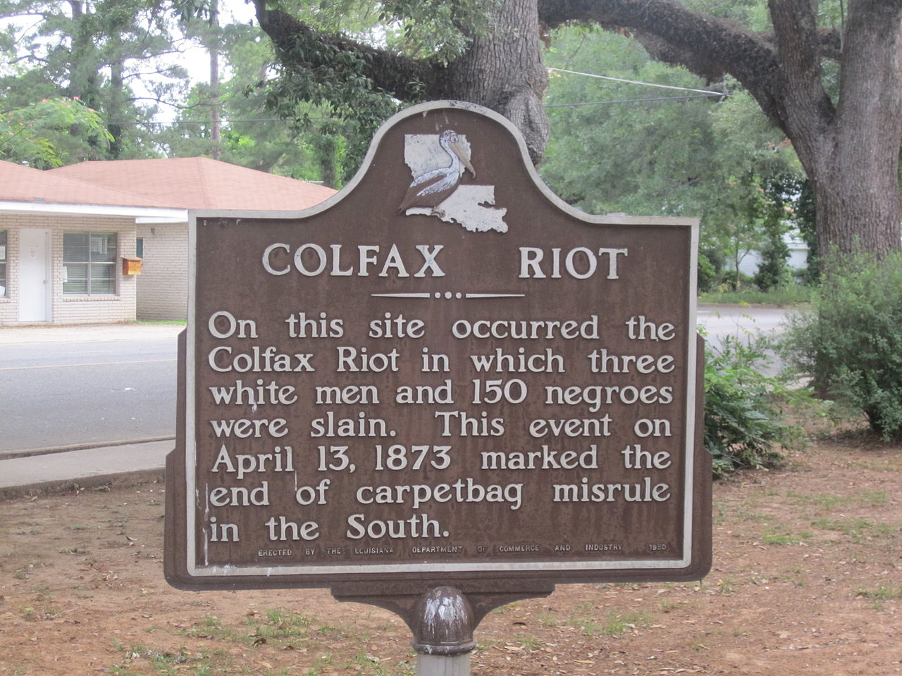
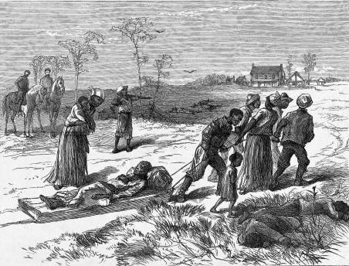
Cruikshank decision
-arose from Grant administration’s effort to punish Colfax Massacre in Louisiana
-clash between White Leaguers and freedmen loyal to gov’t on Easter Sunday (1873)
-73 whites indicted - 9 tried - 3 convicted - overturned by Supreme Court
-Cruikshank - 14th Amendment applied to state action, not individual citizens

Slide 6
US v Reese
African-American man in Kentucky not allowed to vote
Court held that 15th Amendment did not GIVE suffrage to anyone, only listed grounds on which it couldn’t be denied
Basis for later poll taxes, literacy tests, and grandfather clauses in Southern states

Slide 7
End of Reconstruction
-Compromise of 1877
-Followed disputed election of 1876 between Hayes (Republican) and Tilden (Democrat) (disputed votes in Florida, Louisiana, SC)
Commission of 5 Senators, 5 Representatives, and 5 Supreme Court Justices voted 8-7 to certify returns giving election to Hayes
In exchange for Dem acceptance, Republicans remove Federal troops from South…IMPACT?

Slide 8
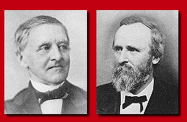
Hayes and Tilden

Slide 10
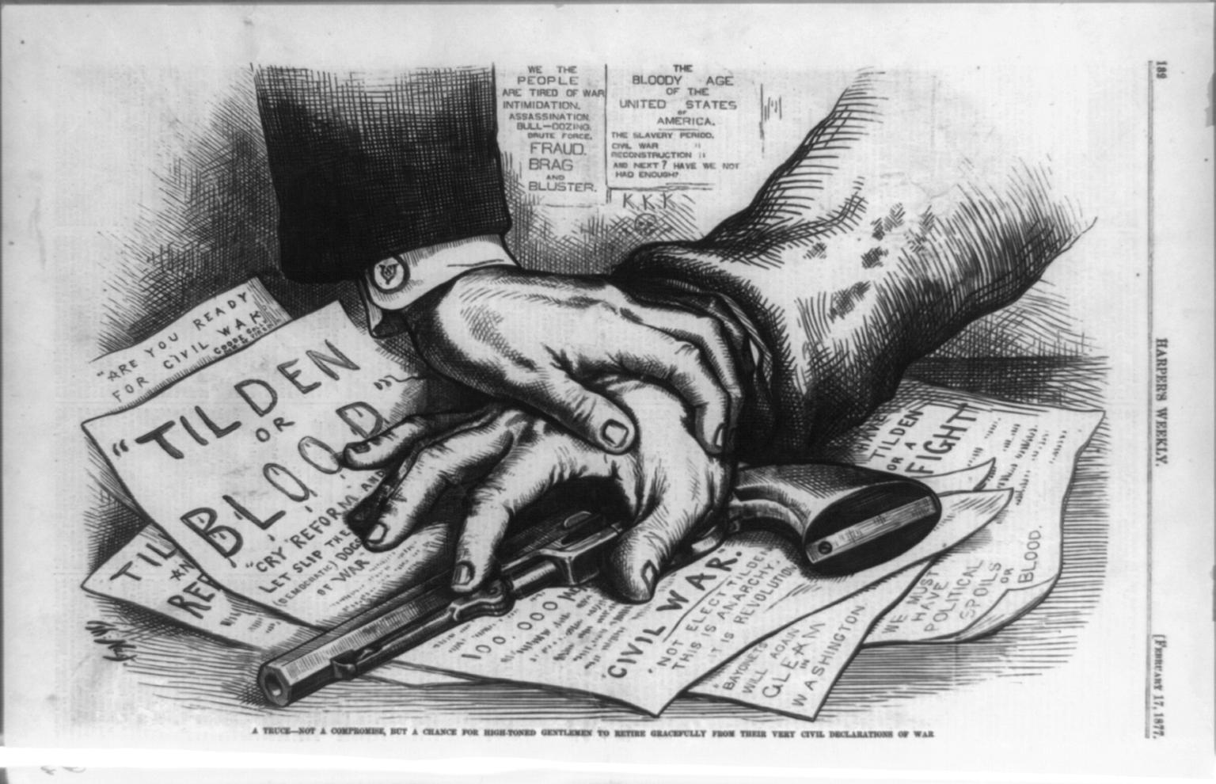

Slide 11
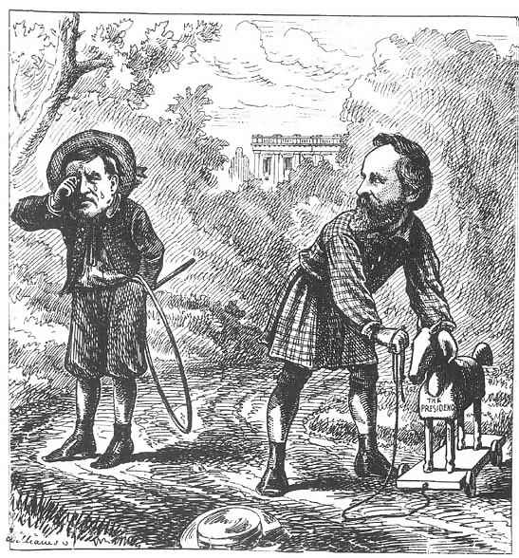

Slide 12
Legacy of Reconstruction
•Huge resentment toward North
•No clear plan for Reconstruction
•Must be considered a failure
–Only temporary benefits to blacks
–Moderates didn’t understand the protections needed for black rights
–Deep racism & indifference to the plight of blacks

Slide 13
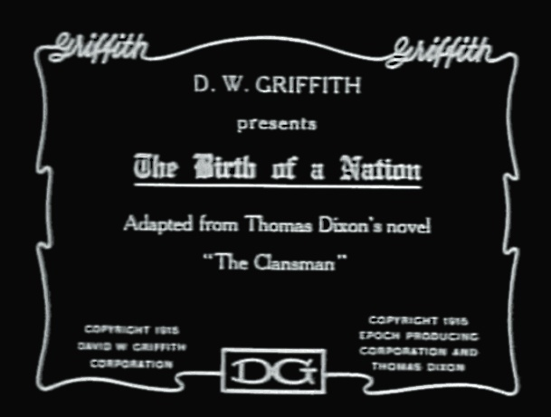
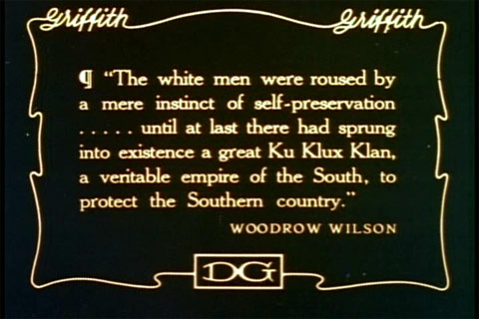
Views on Reconstruction
-Early 1900s - William A. Dunning - Reconstruction was a national disgrace and a failure - too many rights for African-Americans too soon - rationale for early 20th Century racial segregation - The Birth of a Nation

Slide 14
Views on Reconstruction (con’t)
-1930s - John Hope Franklin and WEB Du Bois - highlighted achievements of Reconstruction governments and black leaders - added to by Kenneth Stampp post-WWII - said Reconstruction was noble experiment but ultimately failed
-1970s - Michael Benedict and Leon Litwack - scrutinized motives of Northern politicians after Civil War

Slide 15
Views on Reconstruction (con’t)
-1980s - some historians criticized Congress for not being radical enough and not prolonging military occupation of the South
-Eric Foner - acknowledged limits of Reconstruction - pointed out freedmen established many long lasting institutions in African-American community - took a “2nd Reconstruction” after WWII (civil rights movement) to recognize promise of 1st Reconstruction

Slide 16
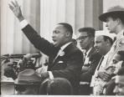
13th, 14th, and 15th Amendments provide basis for Civil Rights legislation of 1960s

