Slide 1
The Election of 1912
American History 2

Slide 2
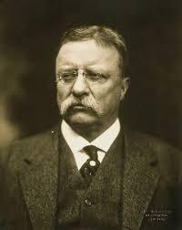
Theodore Roosevelt
President from 1901-1909
-Republican
-became President after McKinley’s assassination

Slide 3
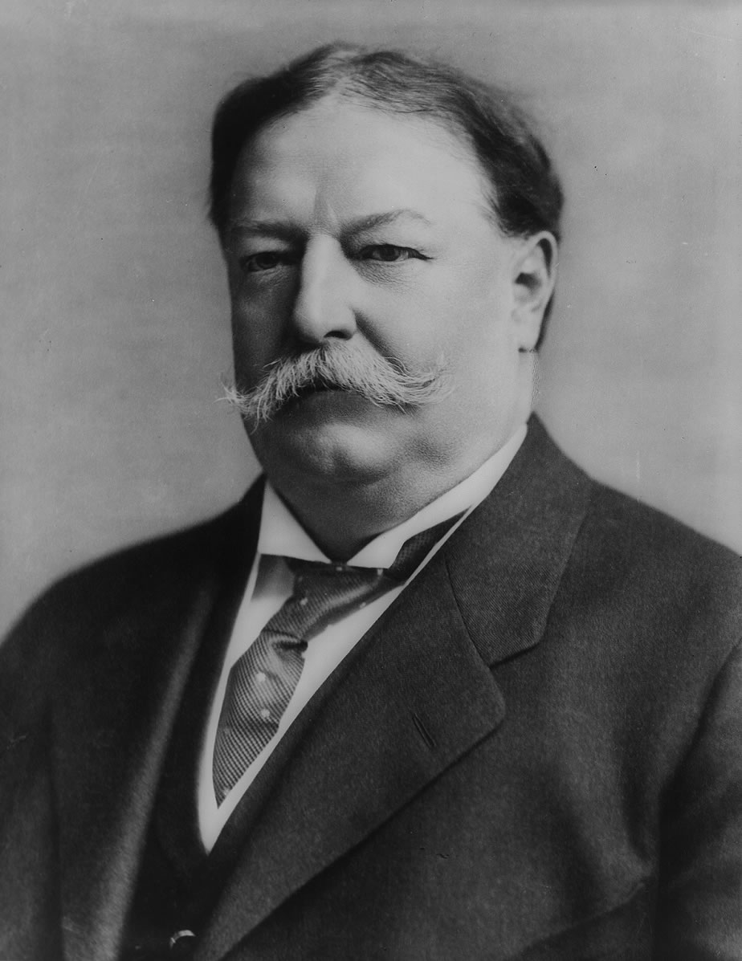
William Howard Taft
President from 1909-1913
-Republican
-hand-picked successor to Roosevelt
-Governor General of Philippines
-Roosevelt’s Sec of War

Slide 4
What caused the break between old friends?
-Tariffs
-Conservation

Slide 5
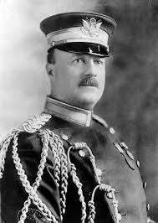
Major Archie Butt
-Military attache to both Roosevelt and Taft
-in Taft’s inner circle
-stressed by deepening TR/Taft
division

Slide 6
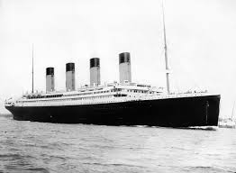
Major Archie Butt (continued)
-went to Europe on vacation - cut short
-went down with the Titanic

Slide 7
Roosevelt becomes Radical
-Feb 21, 1912 speech in Columbus, Ohio - battleground state - why?
-Roosevelt questions Judicial Independence
-said that the people, not the courts, should judge constitutionality of laws
-introduced idea for a plebiscite or popular referendum to overturn state court decisions

Slide 8
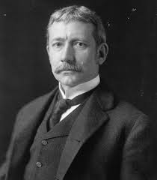
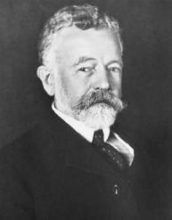
Effects of TR’s Columbus Speech
-much criticism in press
-alienated many allies
-Elihu Root
-Henry Cabot Lodge
-greatly hurt chances of Republican
nomination

Slide 9
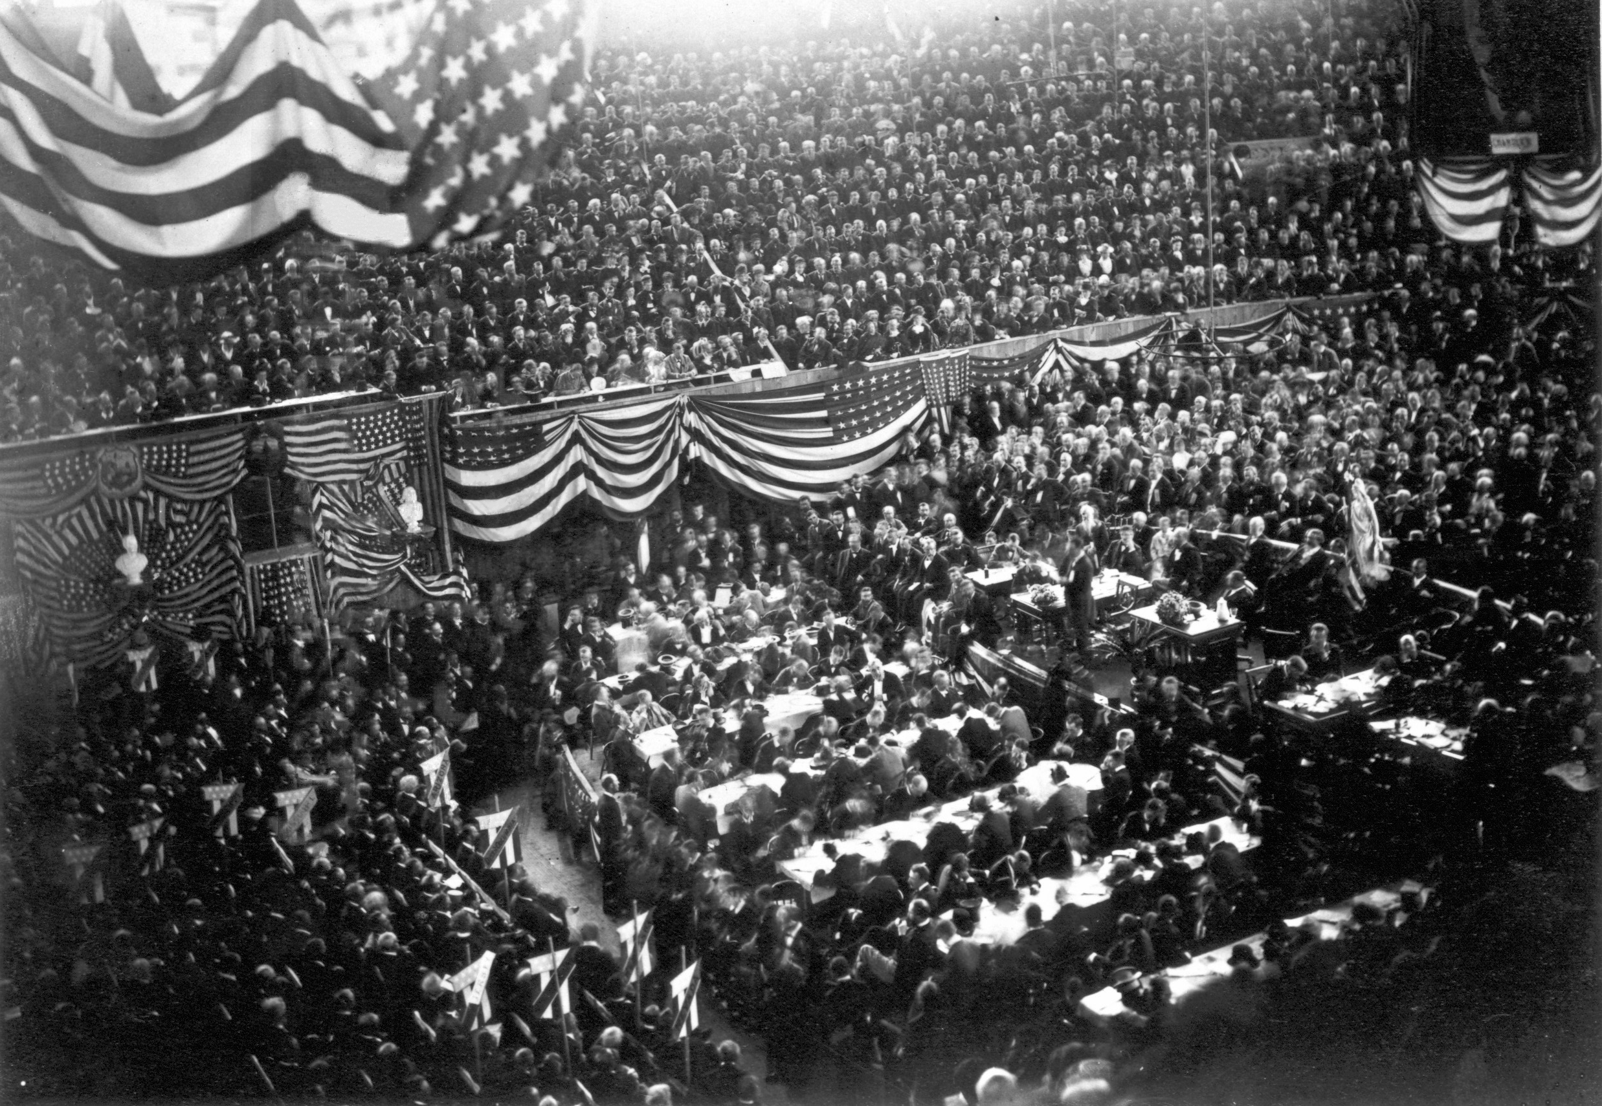
1912 Republican Convention - Chicago
-disputed
delegates
-TR claims
“stolen”
-fistfights

Slide 10
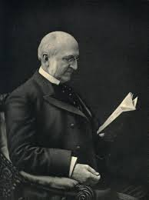
The only question now is which corpse gets the most flowers.” - former Republican Senator Chauncey Depew after Republican Convention in Chicago of 1912

Slide 11
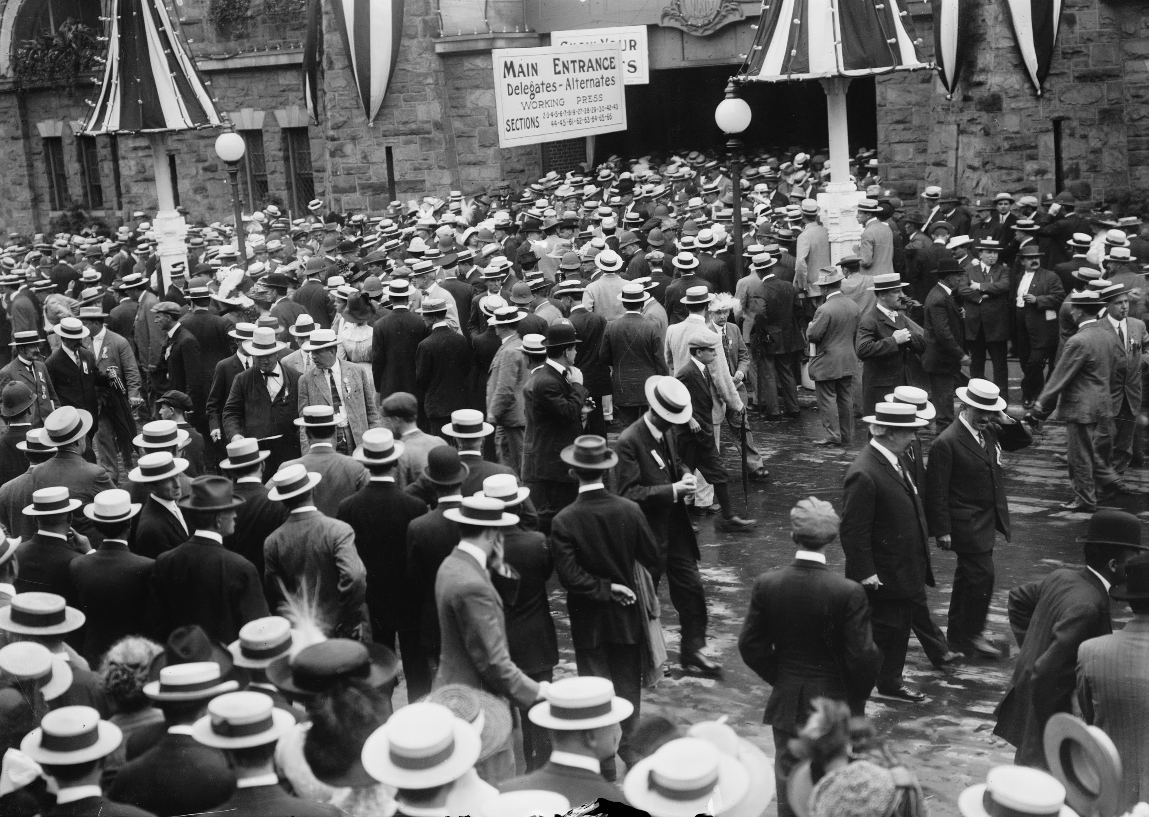
1912 Democratic Convention - Baltimore

Slide 12
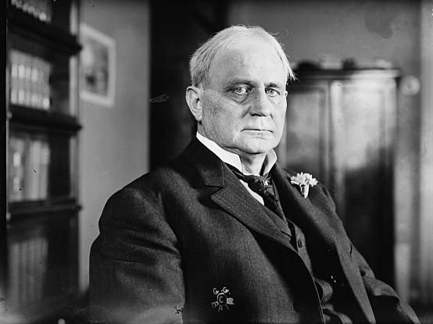
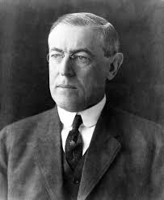
Clark vs. Wilson
-Speaker of House Champ Clark - Conservative
vs
-Governor Woodrow WIlson of New Jersey - Progressive

Slide 13
Democrats in 1912 (continued)
-Clark backed by Tammany machine
-Wilson gained necessary ⅔ vote on the 46th ballot - 8th day of voting

Slide 14
Progressives and the Race Question
-embraced some Negro delegates from the North
-Southerners allowed to send solely white delegations
-attempted to break into “Solid South”

Slide 15
Race (continued)
-Roosevelt claimed that justice would only come to Negro residents of the South through the efforts of “high-minded white men”
-Racist strategy to end racism?
-”lily-white” delegations caused conflict among progressives

Slide 16
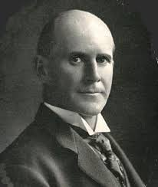
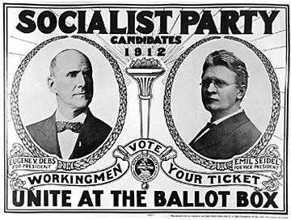
Socialist Party
-Candidate Eugene Debs (4th time)

Slide 17
Socialist Platform (continued)
-Platform
-abolish U.S. Senate
-end presidential veto power
-end Supreme Court’s ability to declare laws unconstitutional

Slide 18
Socialist Platform (continued)
-collective ownership of:
-transportation
-communication
-banking system (if practical)

Slide 19
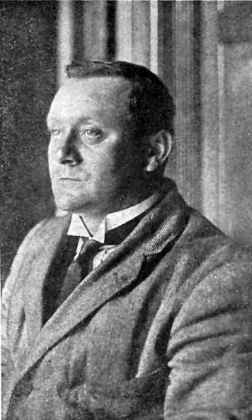
Assassination Attempt
-Monday, October 14th, 1912 - Milwaukee
-Roosevelt shot at point-blank range
-Shot by John Schrank - why?

Slide 20
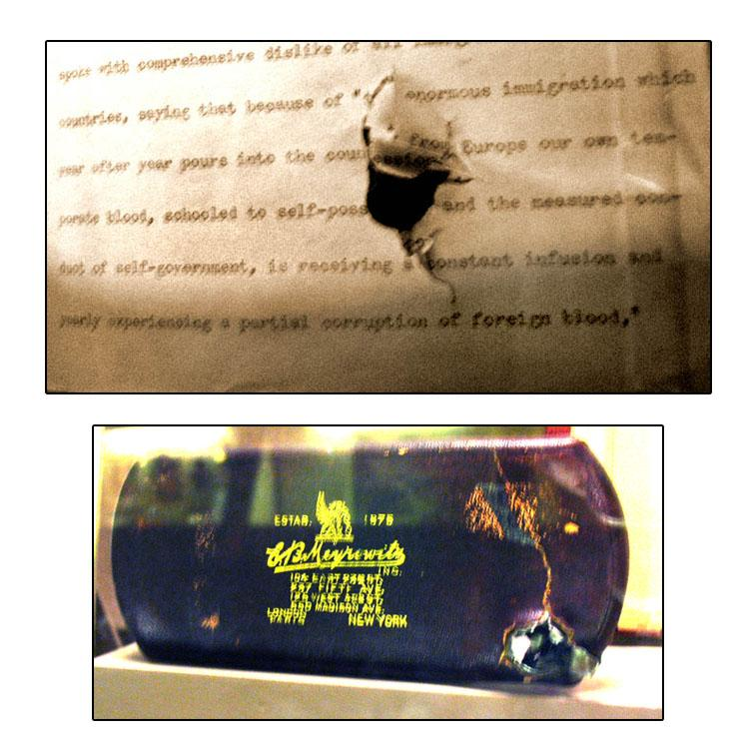

Slide 21
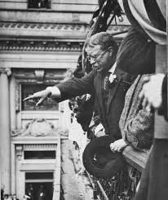
-Roosevelt still gave speech!
-rode a wave of support
-worried Wilson

Slide 22
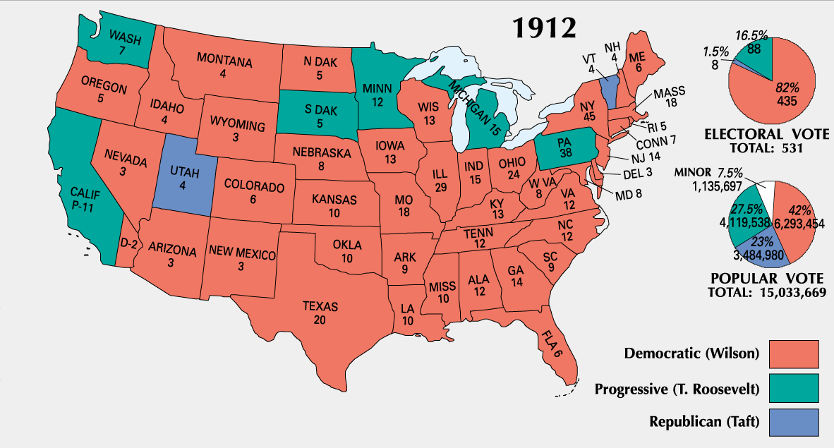

Slide 23
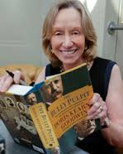
Source: The Bully Pulpit: Theodore Roosevelt, William Howard Taft, and the Golden Age of Journalism by Doris Kearns Goodwin

