Slide 1
Eisenhower Loose Ends
A.P. U.S. History

Slide 2
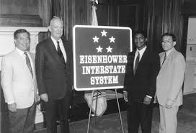
“Moderate Republicanism”
-social security extended
-minimum wage raised
-additional public housing built
-consolidated welfare programs
-first woman in a Republican cabinet
-Interstate Highway System

Slide 3
-1945-1960 - per capita disposable income of Americans tripled
-mid-1950s - average American family had twice the real income of a comparable family during boom of the 20s
-federal deficit fell in relation to national wealth

Slide 4
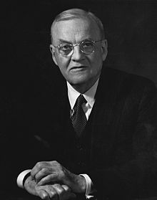
Eisenhower’s Foreign Policy
Sec of State - John Foster Dulles
-experienced diplomat
-criticized Truman’s containment
-”Brinkmanship”
-moderated by Ike

Slide 5
Third World Unrest
What is “Third World”?
Why all the unrest?
-India, Pakistan, Ghana

Slide 6
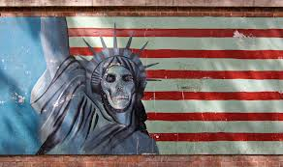
Covert Action
1953 - Iran - restored shah
1954 - Guatemala

Slide 7
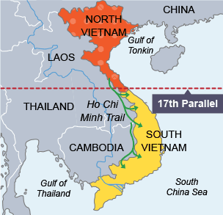
Asia
-Korean Armistice
-Fall of Indochina
-Division of Vietnam - 17th parallel
-SEATO

Slide 8
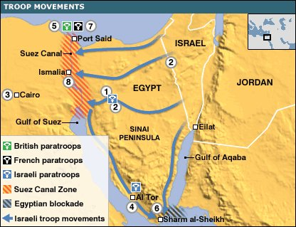
The Middle East
-Suez Crisis
-Eisenhower Doctrine
-OPEC
-Saudi Arabia, Kuwait, Iraq, Iran, Venezuela

Slide 9
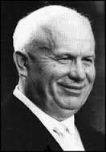
“Spirit of Geneva”
-1955 summit between Ike and Bulganin
-open skies proposal
-Khrushchev - peaceful coexistence

Slide 10
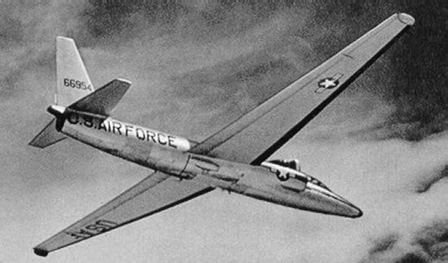
Other Cold War Flare-Ups
-Hungary - 1956 - leave Warsaw Pact?
-Sputnik
-2nd Berlin Crisis
-”We will bury capitalism”
-Camp David invitation
-scheduled another summit
-U-2 Incident
Who buried who?

Slide 11
Legacy of Eisenhower
grandfatherly overseer of a “passive generation”?
hidden hand approach to leadership?
oversaw social postwar reconstruction?

