Slide 1
An Era of Social Change

Slide 2
UFWOC – United Farm Workers Organizing Committee
Cesar Chavez - grape boycott
La Raza Unida – Mexican American United

Slide 4
AIM (American Indian Movement) – 1968 – militant N.A. movement
Occupation of Alcatraz – 1969
Second Wounded Knee – 1973
Outrage over a light sentence given to several local whites who had killed a Sioux in 1972
Indian Self-Determination Act - 1975

Slide 6
BIA (Bureau of Indian Affairs) - “Trail of Broken Treaties”
Feminism – women more equality
NOW – (National Organization for Women)
Gloria Steinem – women’s lib. movement leader
WITCH, Redstockings, New York Radical Women

Slide 8
Sexual Revolution
The Pill
First approved by FDA 1960
More sexual freedom for women
1960-1975 - # of college women engaging in sexual intercourse doubled
Rise in STDs

Slide 9
Betty Friedan – The Feminine Mystique
Sarah Brownmiller
Said Friedan was “hopelessly bourgeois”
Too preoccupied w/ conventional marriage and rampantly homophobic
ERA – Equal Rights Amendment – to give women and men equal rights

Slide 10
Feminist Backlash
Roe v. Wade – 1973 – woman’s right to an abortion
support for ERA died down – roadblock in several state legislatures – died in 1982
Roman Catholic and Fundamentalist Protestant resistance to NOW, “right-to-life” crusade
Conservative resurgence late 70s and 80s

Slide 11
Phyllis Schlafly – conservative thought feminism went too far
Supported Goldwater 1964
Warned ERA could allow husbands to leave wives w/o $ support
ERA could force women into military
Would allow gay marriage
Counterculture – anti-mainstream

Slide 13
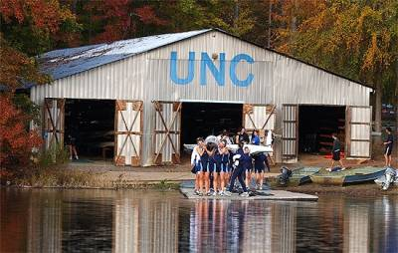
Title IX
Educational Amendments of 1972
Colleges required to ensure equal opportunities for women in admissions and athletics

Slide 16
Haight-Ashbury – hippy neighborhood of San Francisco
NY East Village
ATL’s Fourteenth St
Woodstock- hippy rock concert
Altamont Speedway near SF, CA
Hippie Culture – upper middle class white kids experimenting
Conservative Response – stability and order

Slide 21
Radical Student Groups
Students for a Democratic Society (SDS) – Tom Hayden
Port Huron Statement
Democracy at Universities

Slide 22
Free Speech Movement
Univ of Cal (Berkeley)
Protest university rules

Slide 23
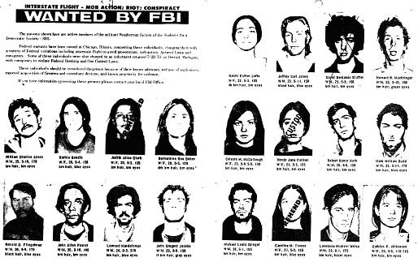
Weathermen
Most radical fringe of the SDS
Embraced violence and vandalism
Began to discredit the New Left

Slide 24
Abbie Hoffman
Radical
Protested at DNC 1968
Founded Youth International Party (“Yippies”)

Slide 25
Yippies
Called for
Immediate legalization of marijuana and psychedelic drugs
Student-run schools
Unregulated sex
Abolition of money
Threw urine-filled plastic bags at police

Slide 27
Mark Rudd and SDS at Columbia (1968)

Slide 28
Timothy Leary
“Turn on, tune in, drop out”
One-time Harvard scientist
Advocated LSD for therapeutic use in psychiatry
29 different prisons
“Most dangerous man in American” – Richard Nixon

Slide 29
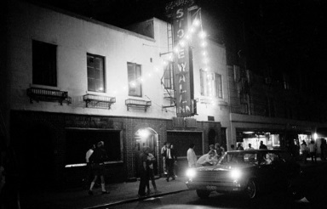
Gay Liberation Movement
1951 – Mattachine Society
1969 police raid on Stonewall Inn
Gay bar in NYC
Sparked a riot
By mid 1970s no longer classified as a mental illness, Civil Service ban dropped
1993 – Clinton – “don’t ask, don’t tell”
Supreme Court Summer 2015

Slide 31
Environmental Movement
First Earth Day – 1970
Oil spills
Santa Barbara 1969
Exxon Valdez – 1989
Three Mile Island – 1979
Chernobyl – 1986
EPA Created 1970
Endangered Species Act 1973

