Slide 1
AP US History
Unit 1 – Part 2 Notes

Slide 2
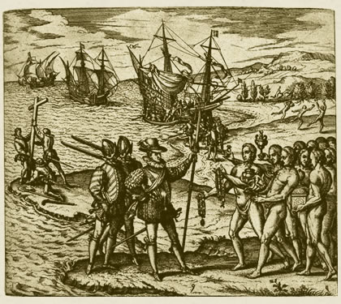
Requerimiento - ordered defiant Indians to immediately accept Spanish rule and Christian conversion - ignoring the order was justification for the “just war”

Slide 4
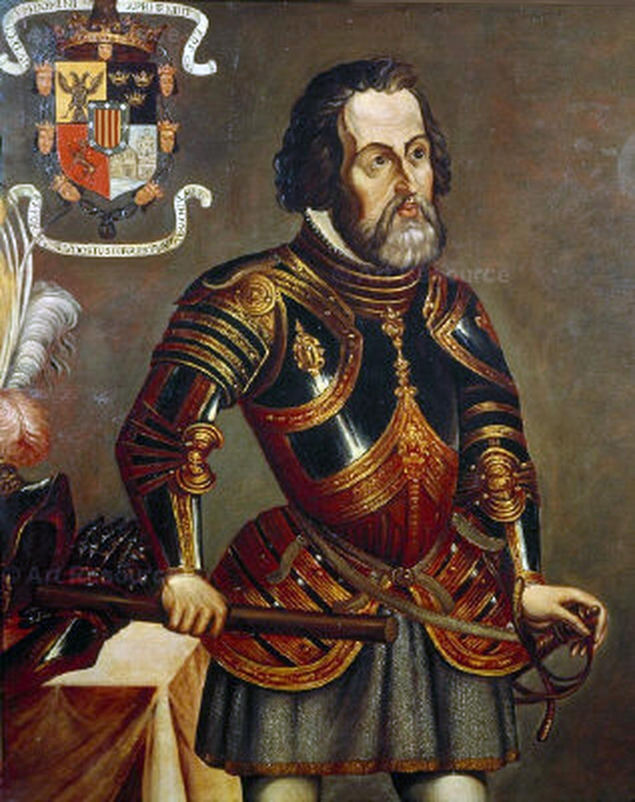
The Spanish in North America – mostly looking for gold or riches
-Conquistadores
-private enterprises
-adelantado - holder of a license from the crown (kept 1/5th) (Carlos V)
-Cortes (Tenochtitlan - Moctezuma II)
-Soto, Cabeza de Vaca
San Augustin (St Augustine) - 1565

Slide 7
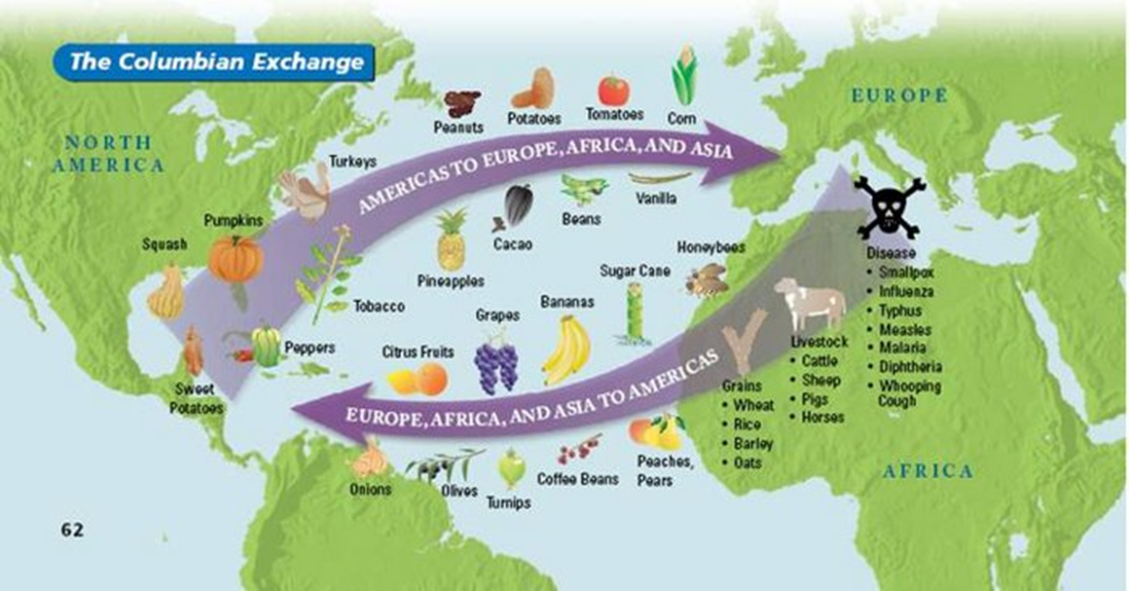

Slide 10
-Old World hunger >>>>>
New World Crops introduced to Old World>>>>>>
population increases>>>>>
renewed hunger>>>>>
Emigrate to settle Americas>>>>>
Find underpopulated lands - Why?

