Slide 1
AP US History
The West

Slide 2
Period 6: 1865-1898
The transformation of the United States from an
agricultural to an increasingly industrialized and urbanized
society brought about significant economic, political,
diplomatic, social, environmental, and cultural changes.

Slide 3
Key Concept 6.2
The emergence of an industrial culture in the
United States led to both greater opportunities for, and restrictions
on, immigrants, minorities, and women.
II. As transcontinental railroads were completed, bringing more settlers west,
U.S. military actions, the destruction of the buffalo, the confinement of
American Indians to reservations, and assimilationist policies reduced the
number of American Indians and threatened native culture and identity.
(PEO-4) (ENV-5) (POL-6)

Slide 5
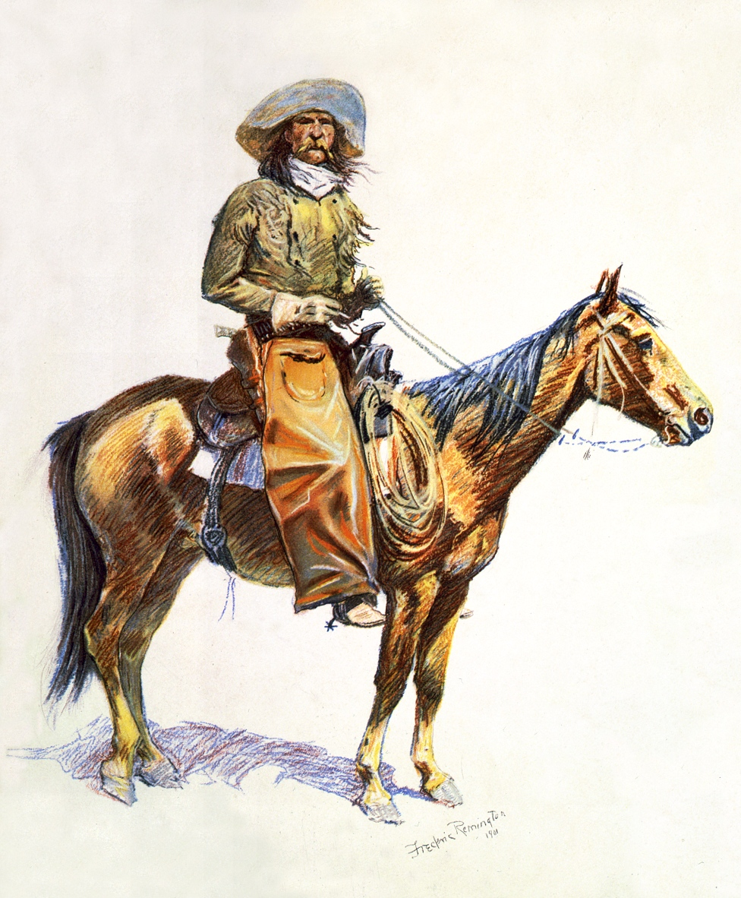
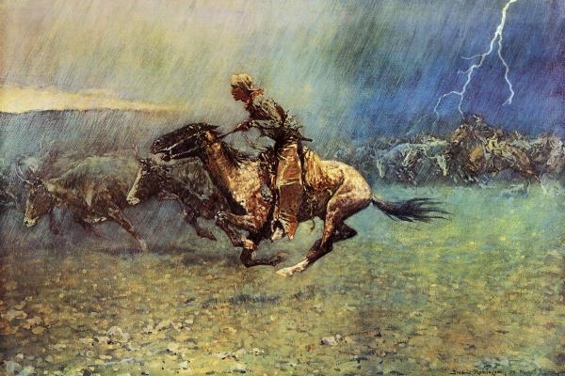
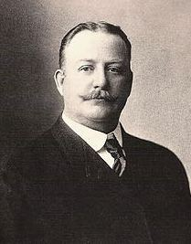
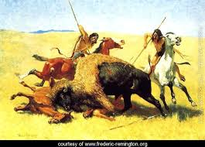
Frederic Remington

Slide 6
Government Policy
Mid 1800s policy changed from relocating tribes farther west to seizing land and sending them to reservations

Slide 7
Disappearance of the Buffalo
1800 - ~60 million buffalo on the Plains
1894 – as few as 25 remained
Why?

Slide 8
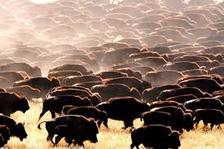

Slide 9
Destruction of Herds
-White settlement reduced grazing lands and cut migration routes

-Settler’s livestock carried diseases that destroyed herds


Slide 10
More Destruction of Herds
-US Army encouraged destruction of herds to wipe out Plains Indians’ food supply

-Demand for hides in east

-Sport hunting – railroad “hunting specials”

Slide 11
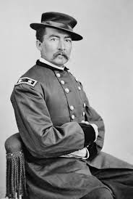
"Let them kill, skin, and sell until the buffalo is exterminated, as it is the only way to bring lasting peace and allow civilization to advance."
- General Philip Sheridan

Slide 13
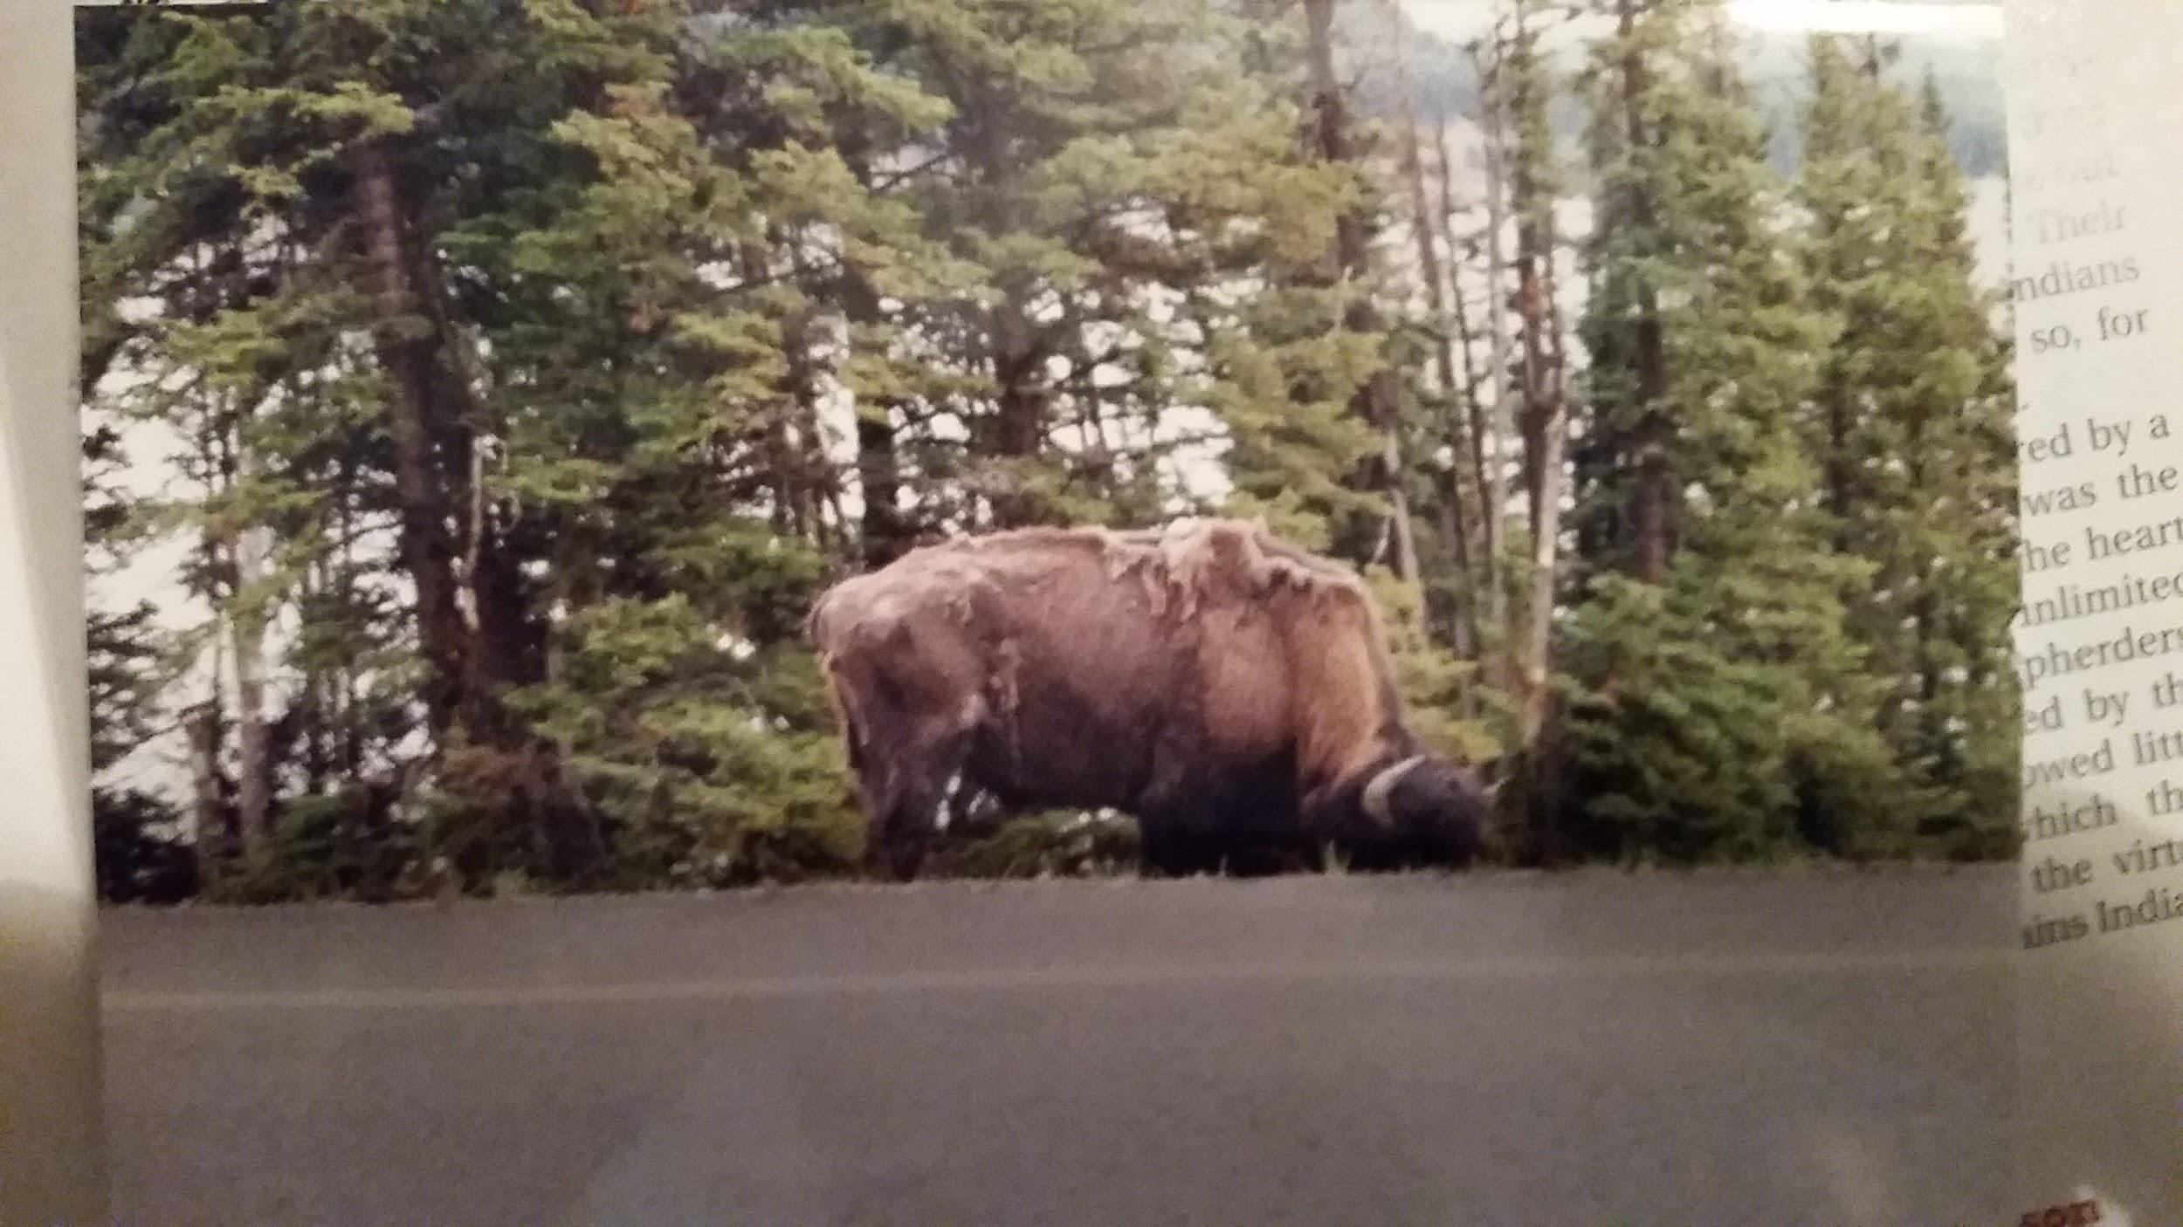

Slide 14
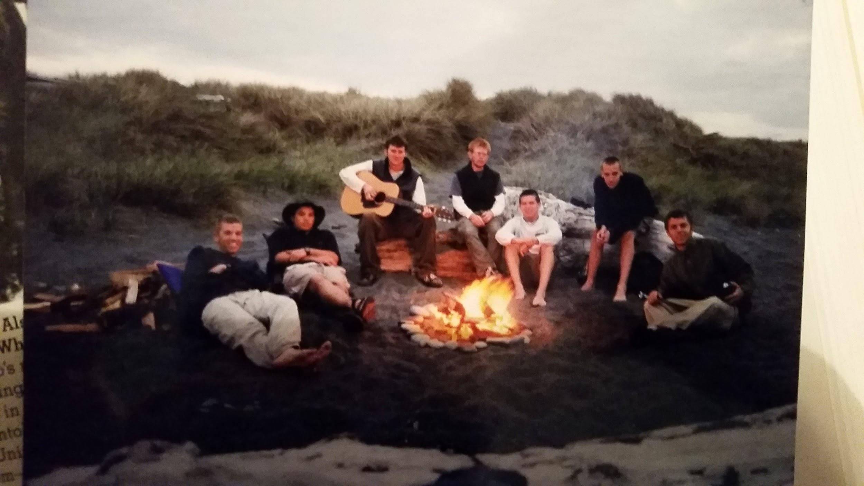

Slide 16
-T. Roosevelt Quote

Slide 17
Fetterman “Massacre”
-1866
-Sioux War Party blocks Bozeman Trail to Montana goldfields
-ambushed Capt. William J. Fetterman’s 81 soldiers and civilians in Wyoming’s Big Horn Mountains
-mutilated corpses

Slide 18
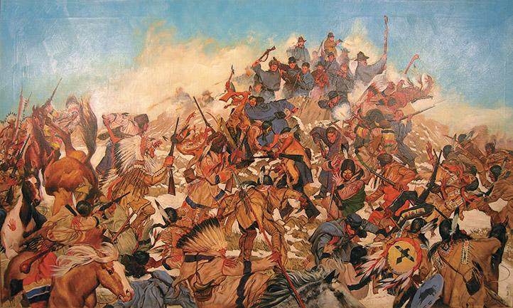
Also known as “Battle of the Hundred Slain”
Part of Red Cloud War

Slide 19
-At the time, conflicts with high Native American casualties were “battles”
-conflicts with high American civilian or Army deaths were “massacres”

Slide 20
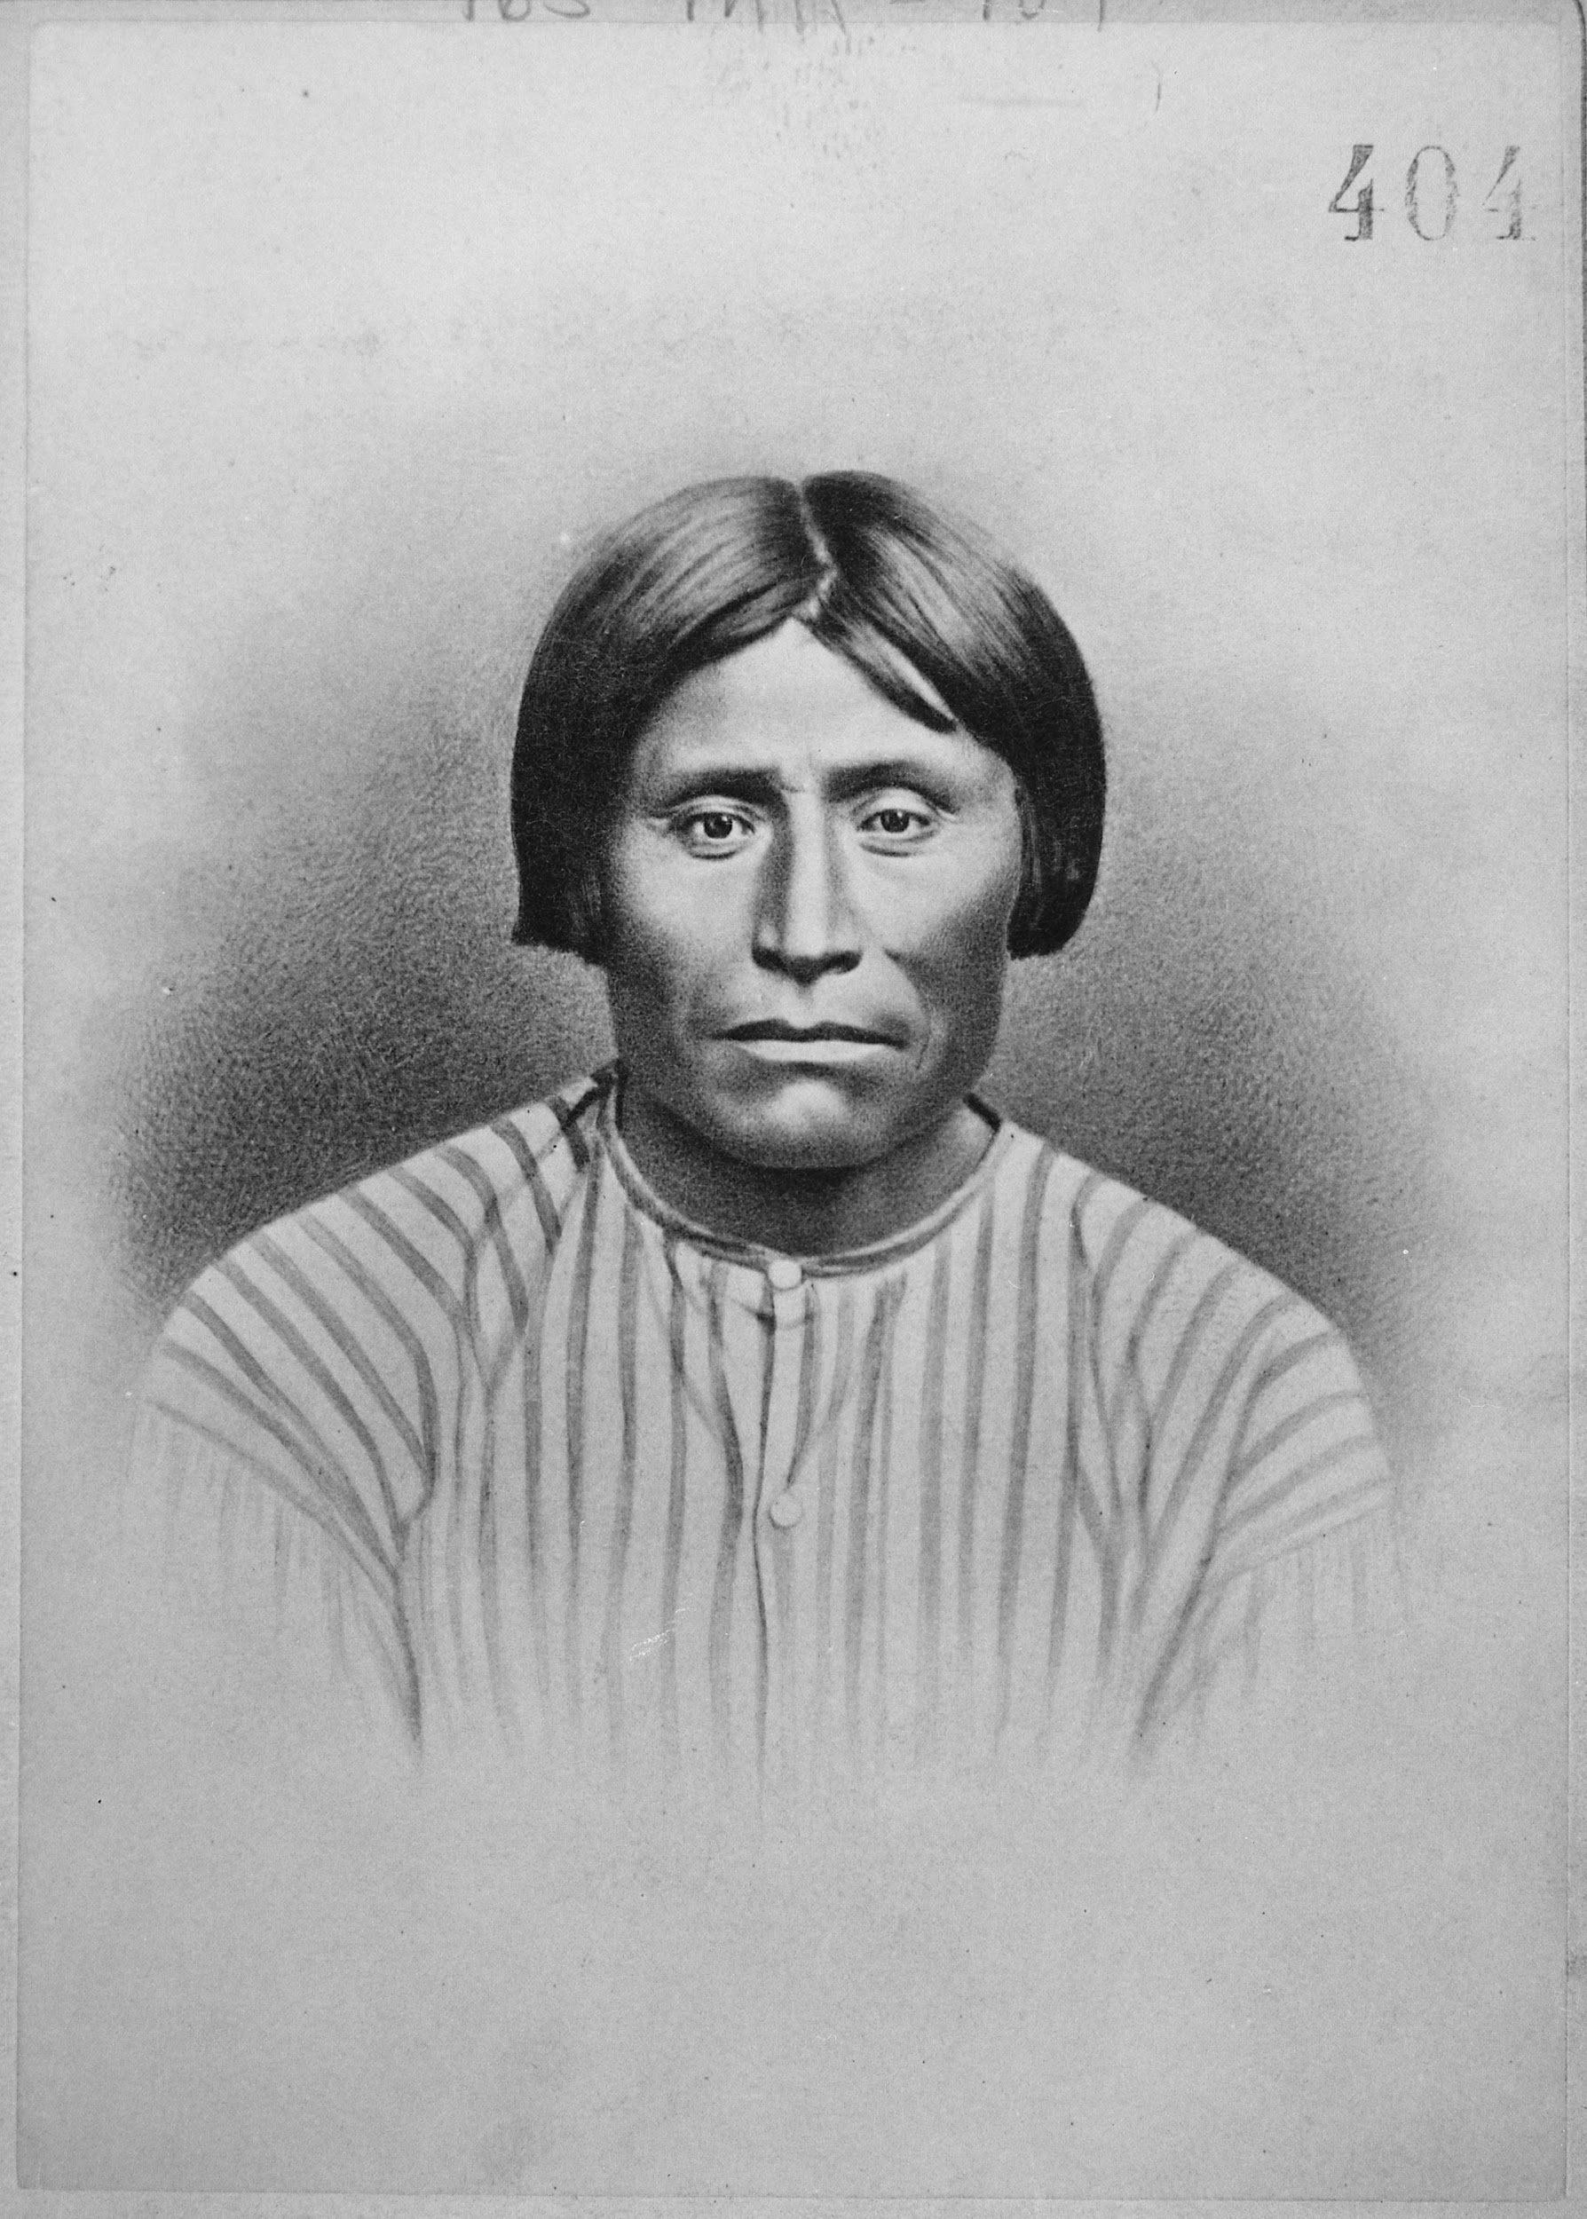
Modoc War (Captain Jack’s War)
Good Friday - April 11, 1873
-Cali-Oregon Border
-Cap’n Jack gave order at
peace negotiations for Modocs
to begin firing - later executed

Slide 24
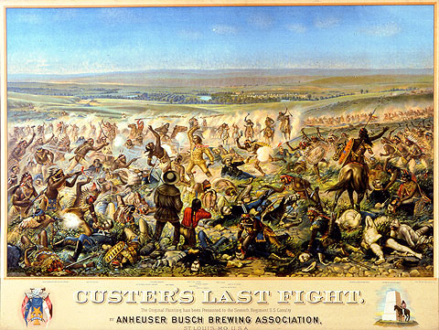

Slide 28
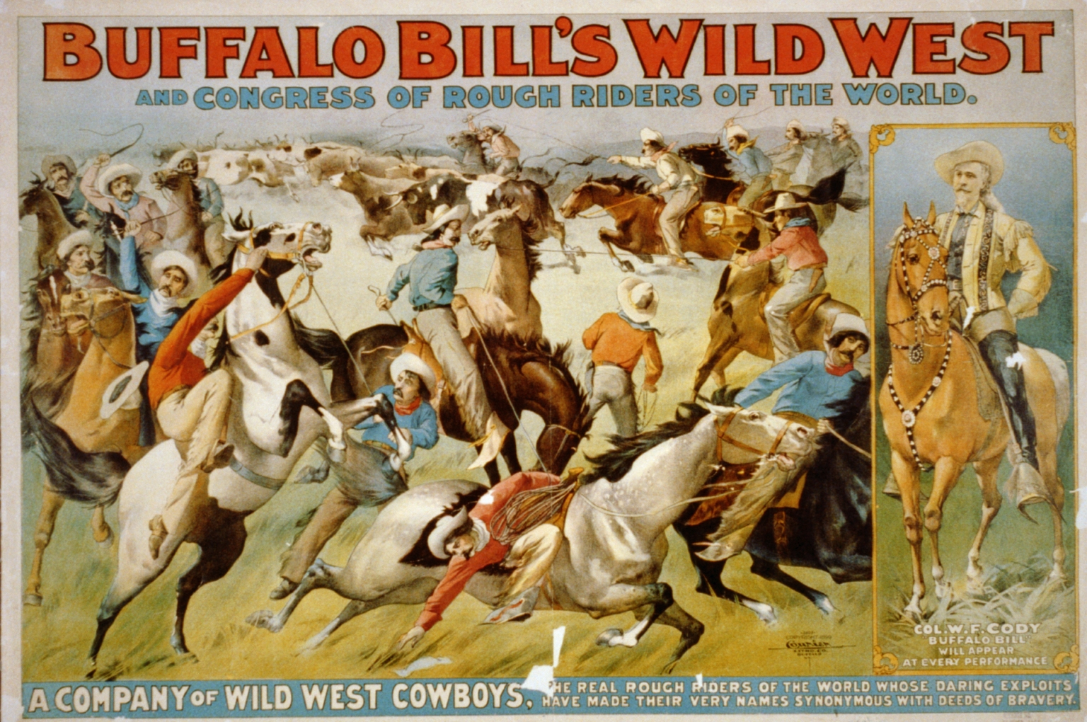
Buffalo Bill’s Wild West Show

Slide 31
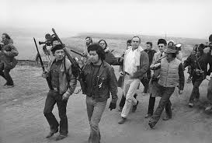
Wounded Knee Massacre marked the end of the “Indian Wars” – bloody conflict between US Army and Plains Indians
(until 1973)

Slide 32
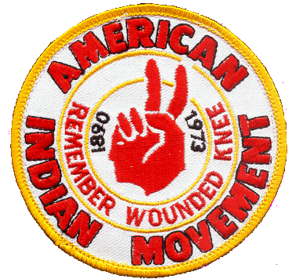

Slide 33
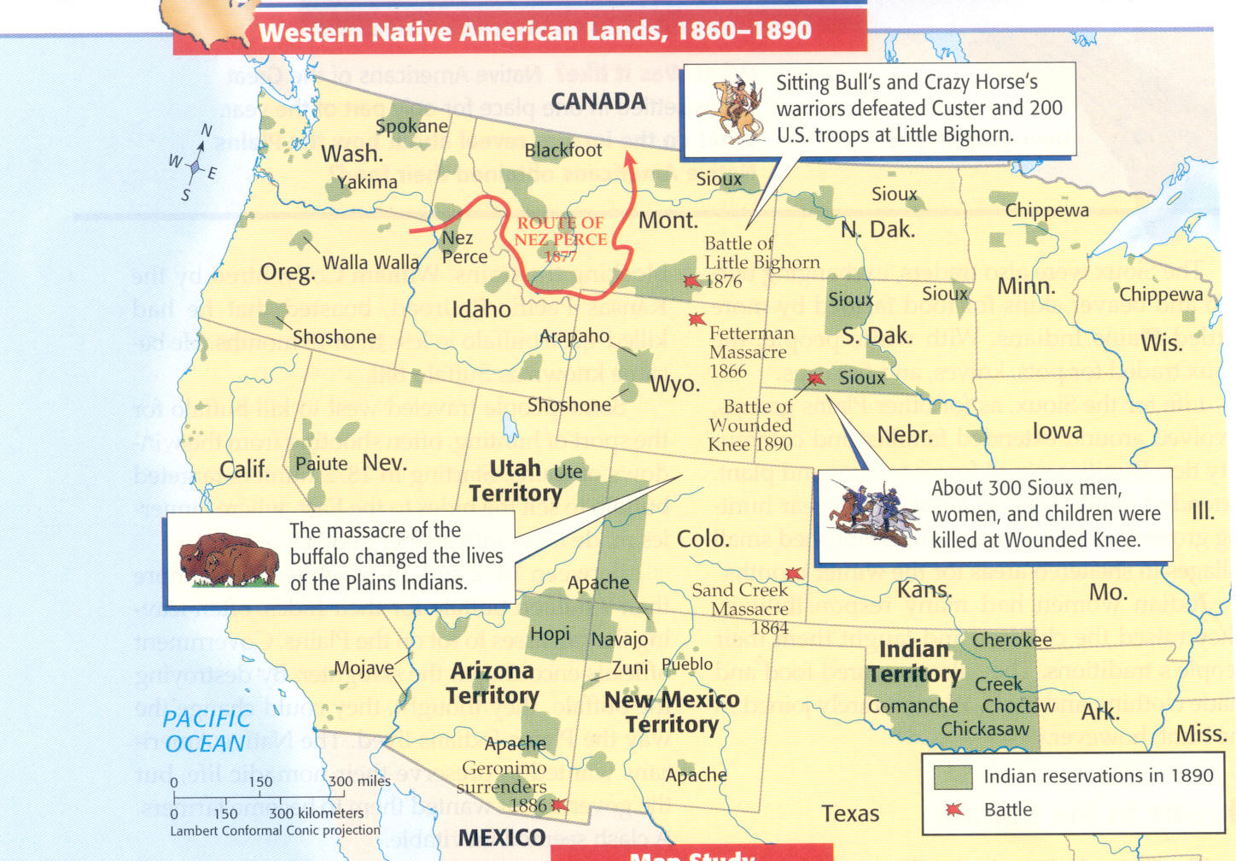

Slide 34
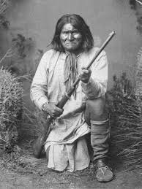
Geronimo
Surrendered 1896

Slide 37
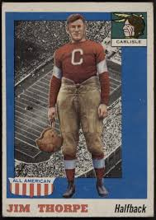
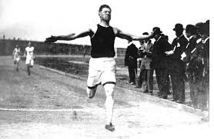

Slide 38
Dawes Severalty Act (Dawes Act)
-1887
-Significant step from Congress towards assimilation
-Broke up Native American reservation lands and turned them over to individual Native Americans
• Could be bought by settlers
• Forced a white method of land ownership

Slide 39
Dawes Act (continued)
no tribal land
Male head of household given 160 acres of land
Federal govt. schools, starting w/ Carlisle School in 1879
People who administered the act were dishonest

Slide 40
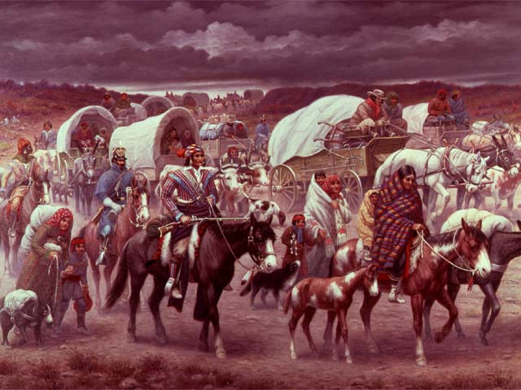
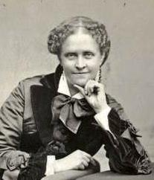
Helen Hunt Jackson - A Century of Dishonor
•1881 work outlining the unfair treatment of American Indians by the US government.

Slide 41
Buffalo Soldiers
•First black professional soldiers in a peacetime army became known as “buffalo soldiers.”
•9th and 10th cavalry units used to fight hostile Native Americans in the west.
–Cheyenne called them “buffalo soldiers” after their hair.

Slide 42
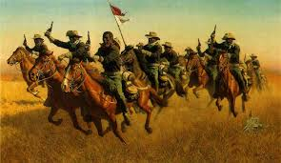

Slide 43
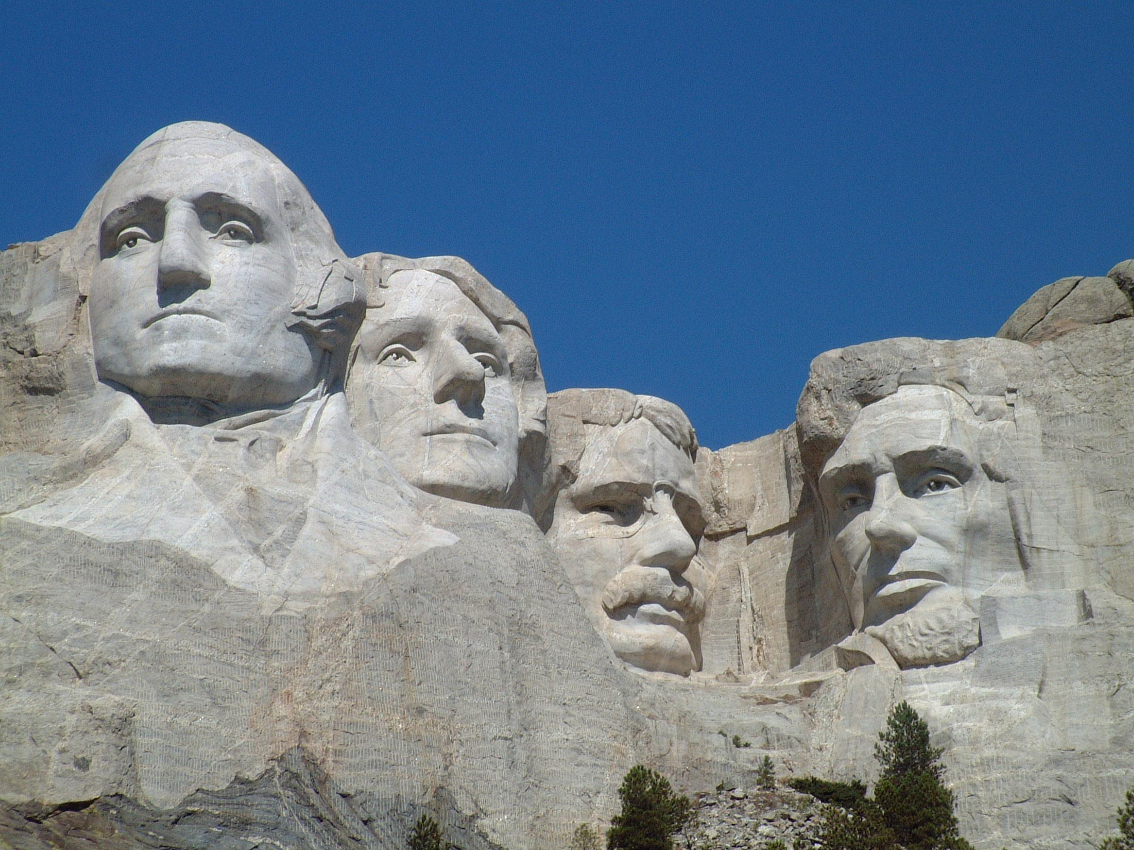

Slide 44
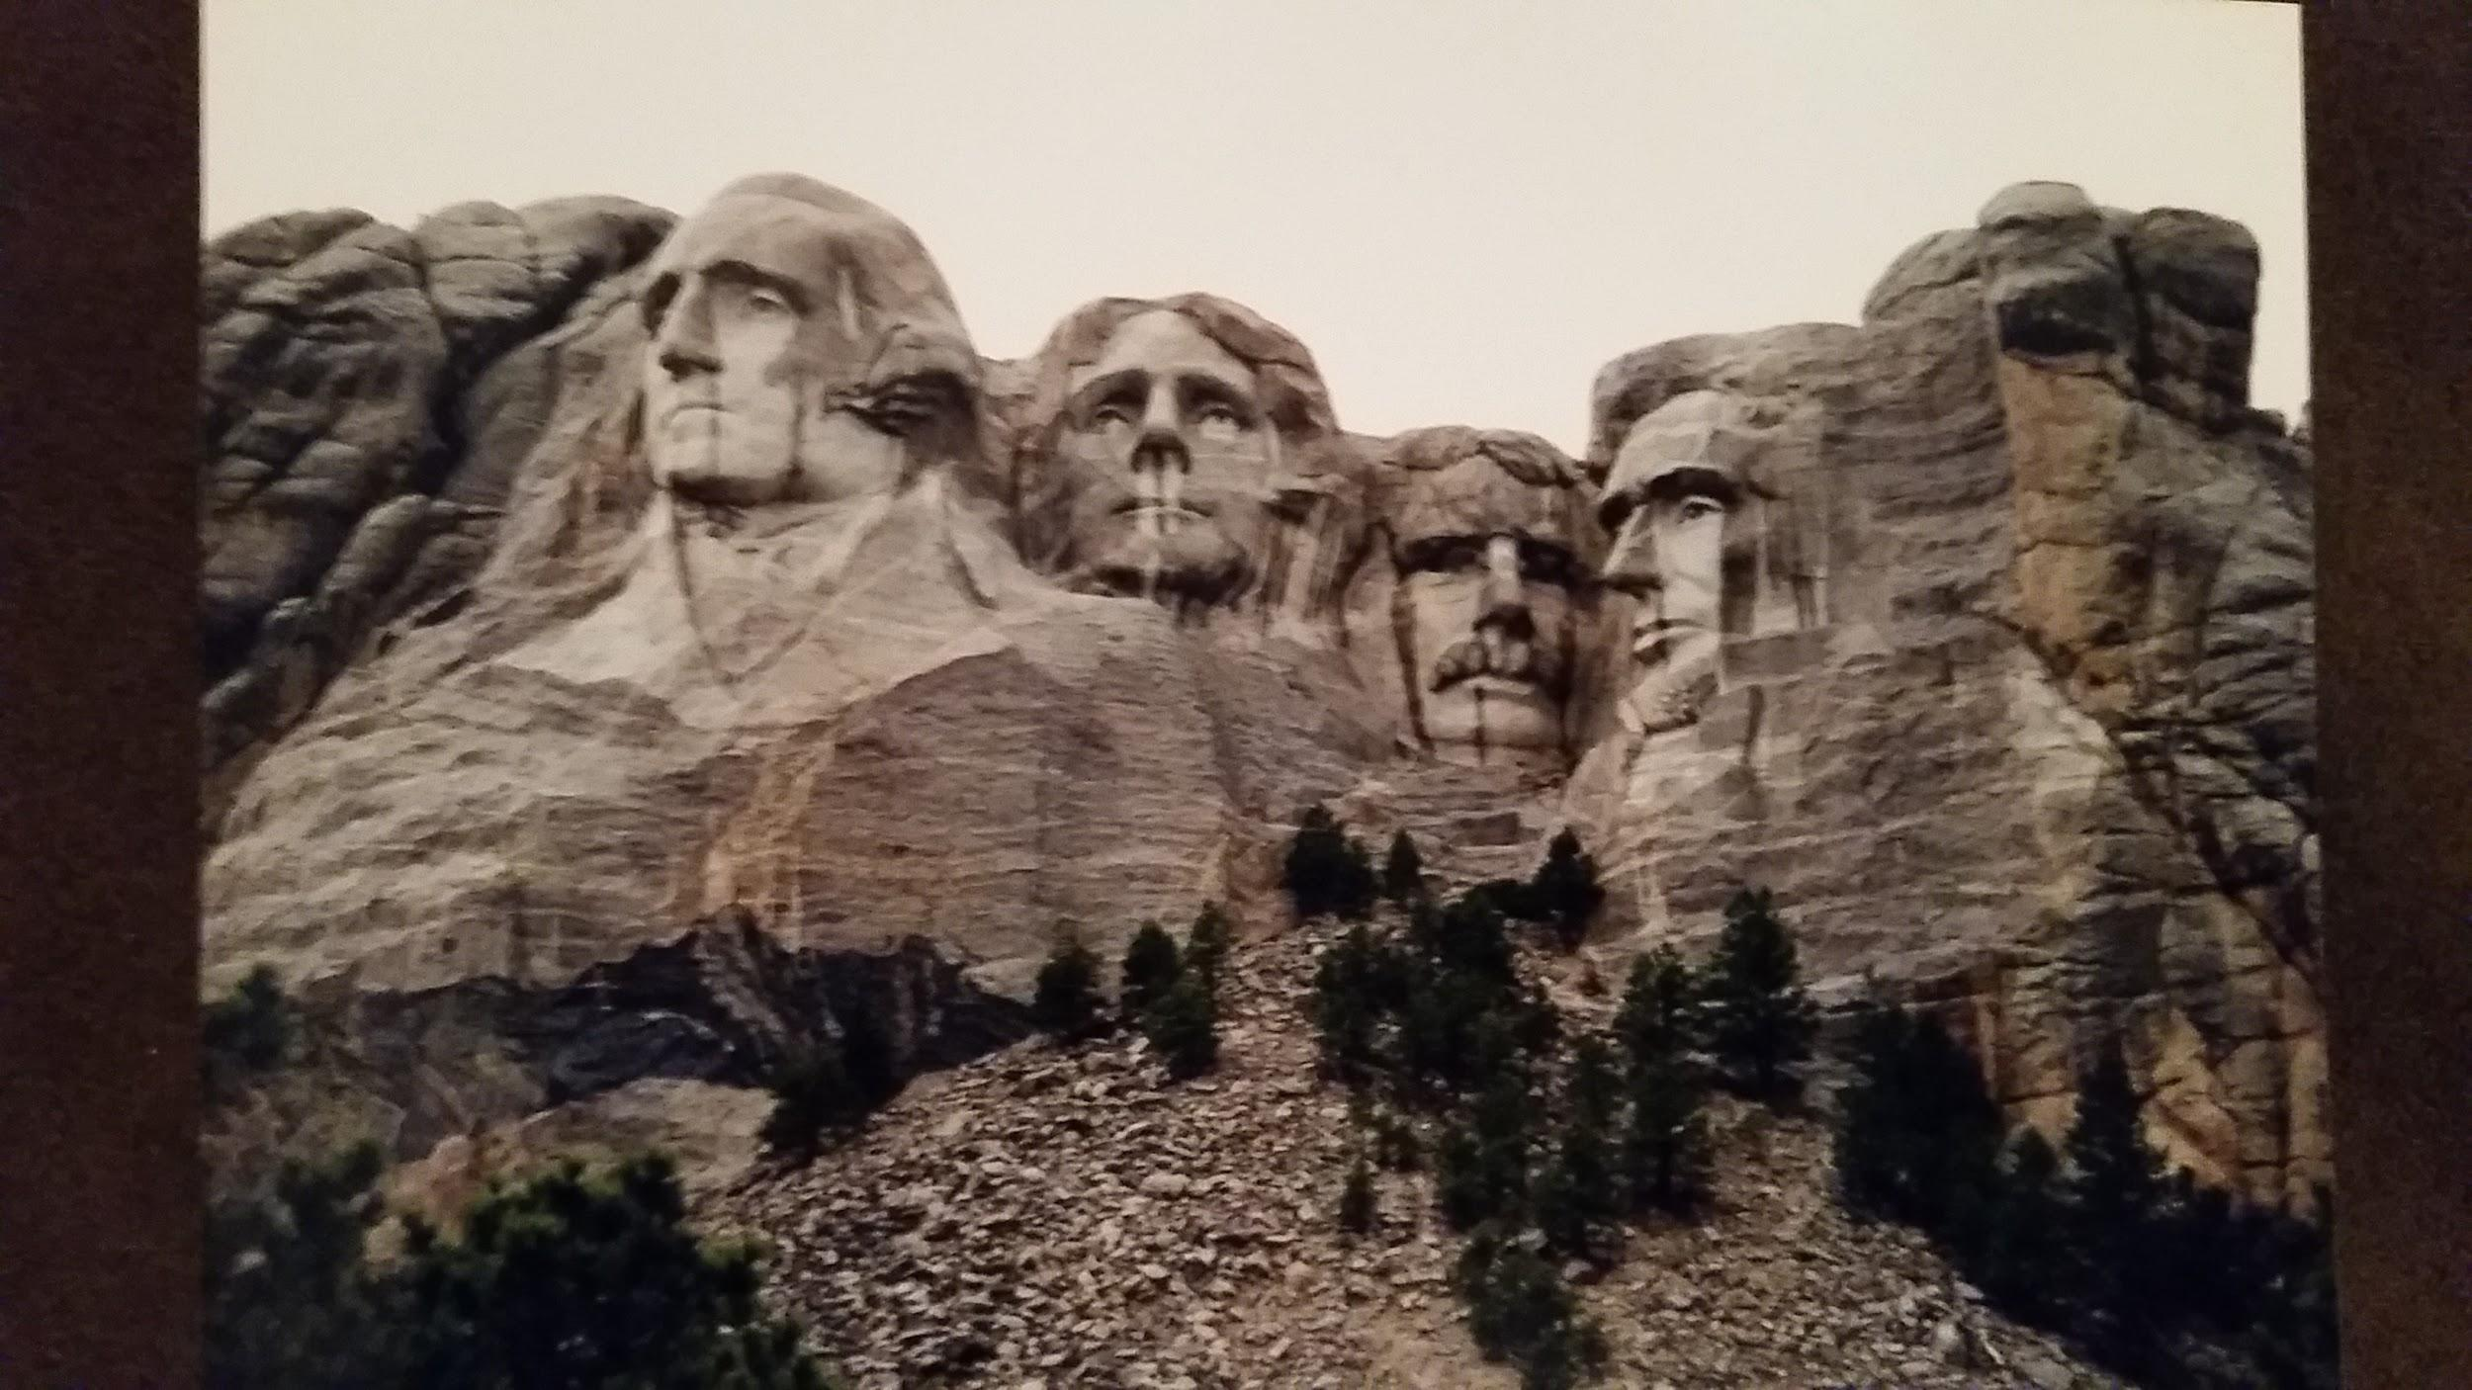

Slide 45
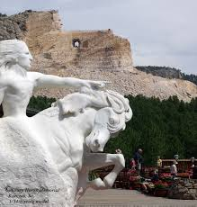
Projected completion??? – begun in 1948

Slide 46
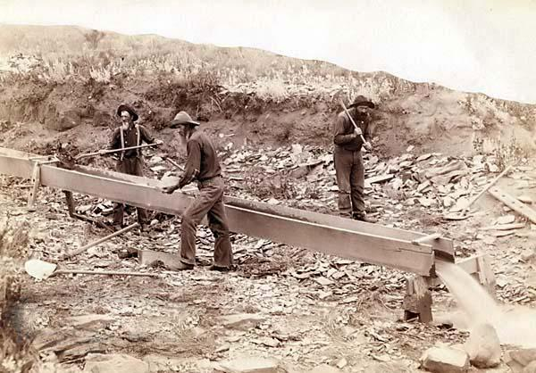
Mining
-originally “placer” mining or “panning” in CA gold rush
-placer deposits exhausted
-companies - hydraulic mining, dredging, deep-shaft “hard-rock” mining

Slide 47
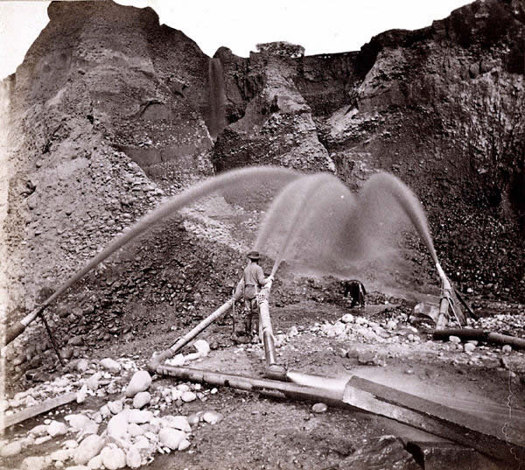
Hyrdralicking, Dredging, shaft mining
-high pressure water – strip topsoil and gravel
-barren canyons w/o vegetation
-debris covered farmland, clogged rivers, killed fish

Slide 48
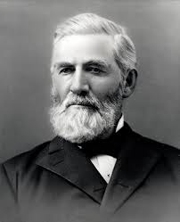
CA farmers protest
1878 – Anti-Debris Assoc.
Jan 1884 – fed judge & former miner – Woodruff v. North Bloomfield Gravel Mining Company
Hydraulic mining dries up

Slide 49
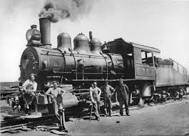
Railroads Open The West
•Federal Government gave large land grants to railroads (to assist in the settlement of the west).
•Railroads received 10 square miles of public land for every mile of track in a state and 20 square miles for every mile of track laid in a territory.

Slide 50
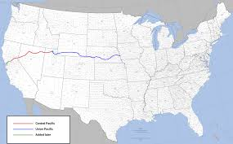
Union Pacific and Central Pacific create a transcontinental railroad
•Central Pacific moved east from Sacramento and Union Pacific moved west from Omaha.
•Many workers were immigrants (Irish and Chinese).

Slide 51
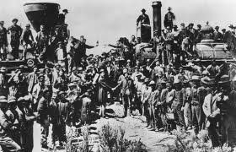
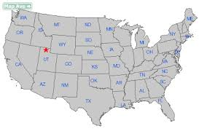
Promontory, Utah
•Central Pacific and Union Pacific met on May 10, 1869 at Promontory, Utah.

Slide 52
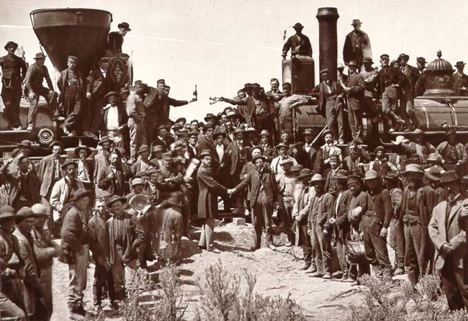

Slide 53
Gov’t Support of Western Settlement
•Homestead Act of 1862 – offered 160 acres of land in the West to any head of a household (citizen or intended citizen) if he would cultivate land for five years. ($30 fee)
-Republican platform on 1860 - fewer Dems. in Congress

Slide 54
Homestead Act (continued)
5 x as many families purchased land

Slide 55
Problems w/ Homestead Act
Not great land, Fraud- corporations & dummy homesteaders
Hardships on plains
Little water- 100th meridian
Dry farming & the Dust Bowl, Hard soil, No trees
Adaptations- sod houses, new grains, barbed wire, federally funded irrigation & dam projects

Slide 56
Problems w/ Homestead Act
Not great land, Fraud- corporations & dummy homesteaders
Hardships on plains
Little water- 100th meridian
Dry farming & the Dust Bowl, Hard soil, No trees
Adaptations- sod houses, new grains, barbed wire, federally funded irrigation & dam projects

Slide 57
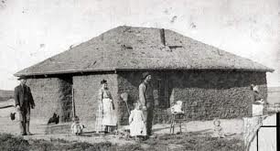

Slide 58
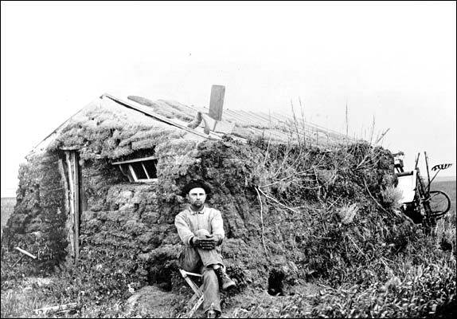

Slide 59
Morill Land Grant Act (1862)
•Gave federal land to the states to establish agricultural colleges.

Slide 60
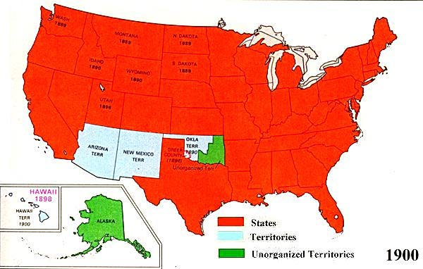
New Western States
By 1900 only 3 of the 48 contiguous states had not reached statehood (NM, OK, & AZ)

Slide 61
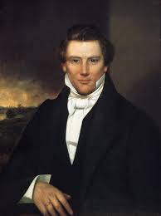
Mormons

Slide 62
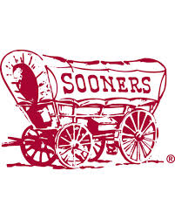
Oklahoma - former Indian Territory
Plan to open OK for settlement in 1889
Squatters or “Sooners”- had to be evicted
Formally opened on April 22, 1889
“89ers” poured in at noon
Became “Sooner State” in 1907

Slide 63
Mining
CA- 1849, Pikes Peak, CO & the Comstock Lode in NV- 1859
“Pikes Peakers”
“Fifty-Niners”

Slide 64
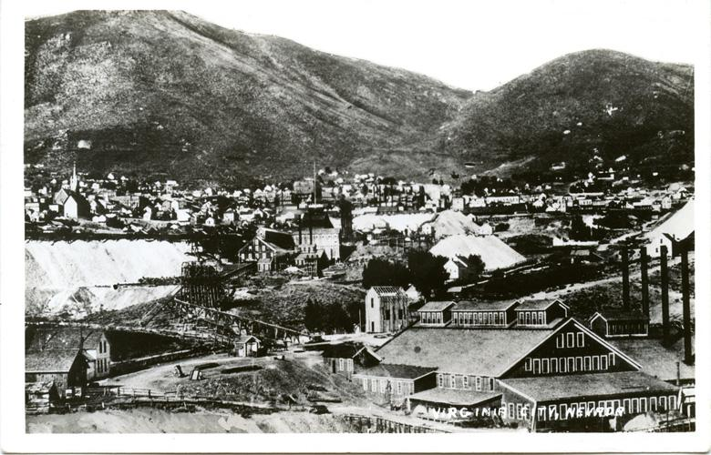
Small strikes led to boom towns turned bust towns all over the west
Lawless & raucous

Slide 65
Effects of Mineral Discoveries
When precious metals on top ran out, big companies came in to dig into the ground
Added to treasury of US, & encouraged cries for free coinage of silver

Slide 66
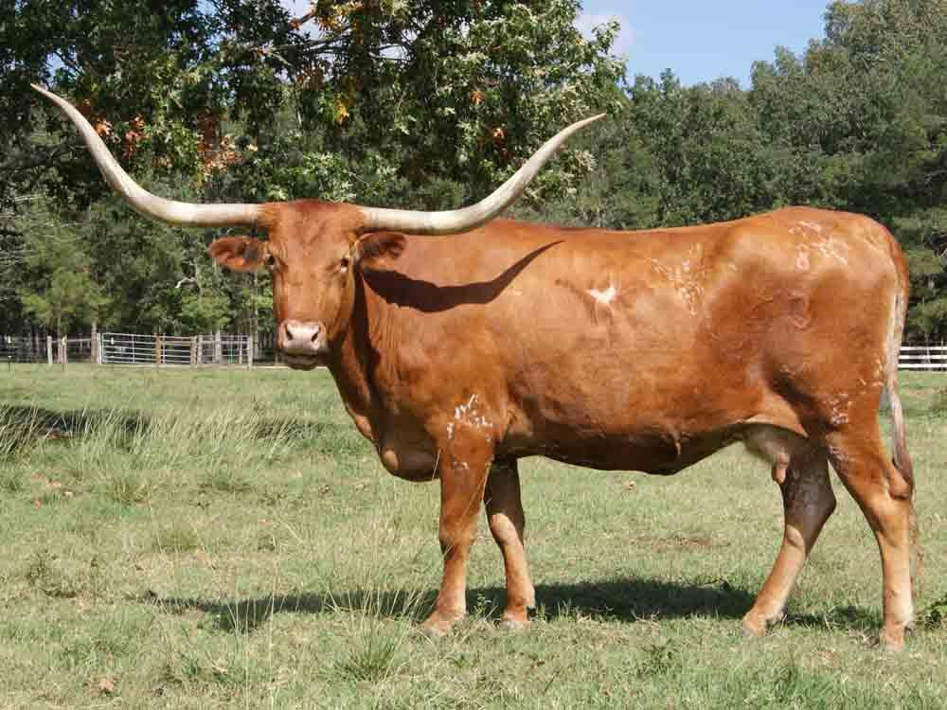
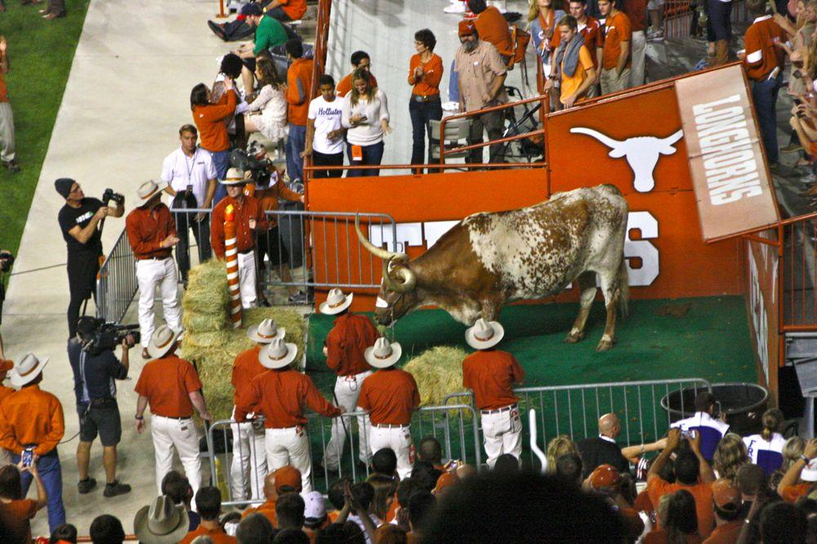
Long horns in TX- hides vs meat after Civil War
Transcontinental RR & cow towns
Refrigerated RR cars- meatpacking

Slide 67
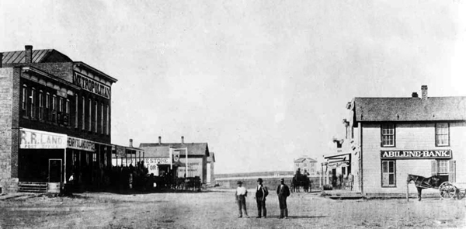
Abilene, Kansas
Joseph McCoy – 1867
Illinois livestock dealer
-200,000/10 > 2 mil/4
“The Real McCoy”

Slide 68
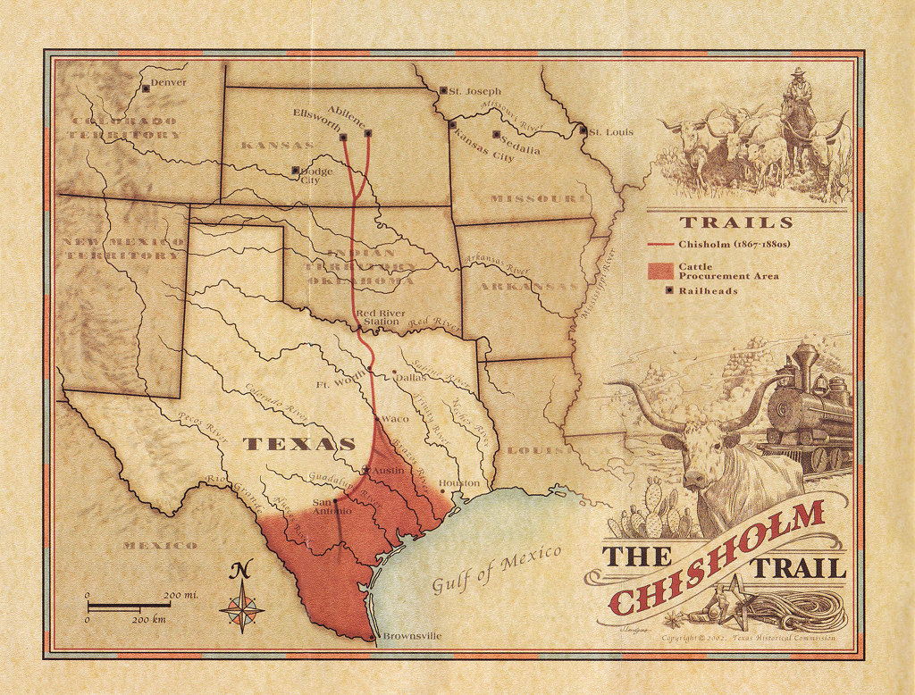

Slide 69
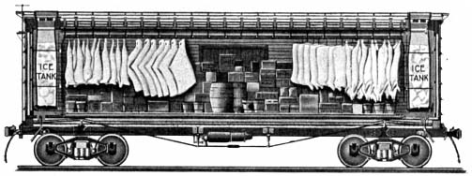
Refrigerated RR Car
1869 – GH Hammond
-Chicago meat packer – Chi to Boston
-1877 - Gustavus Swift – efficient mechanical refrigeration

Slide 70
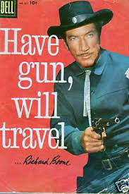
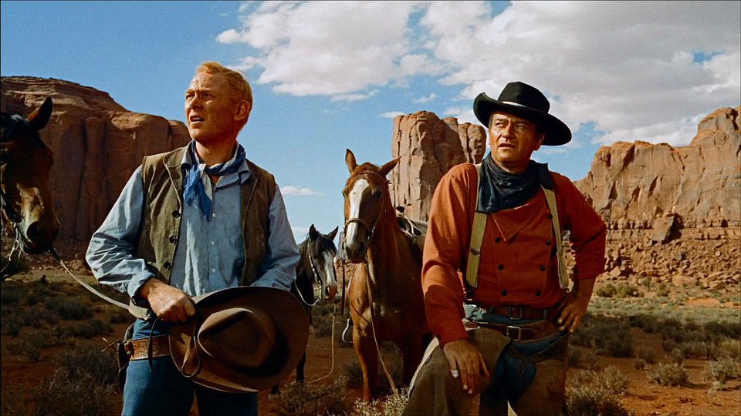
Cowboys – Myth and Reality

Slide 71
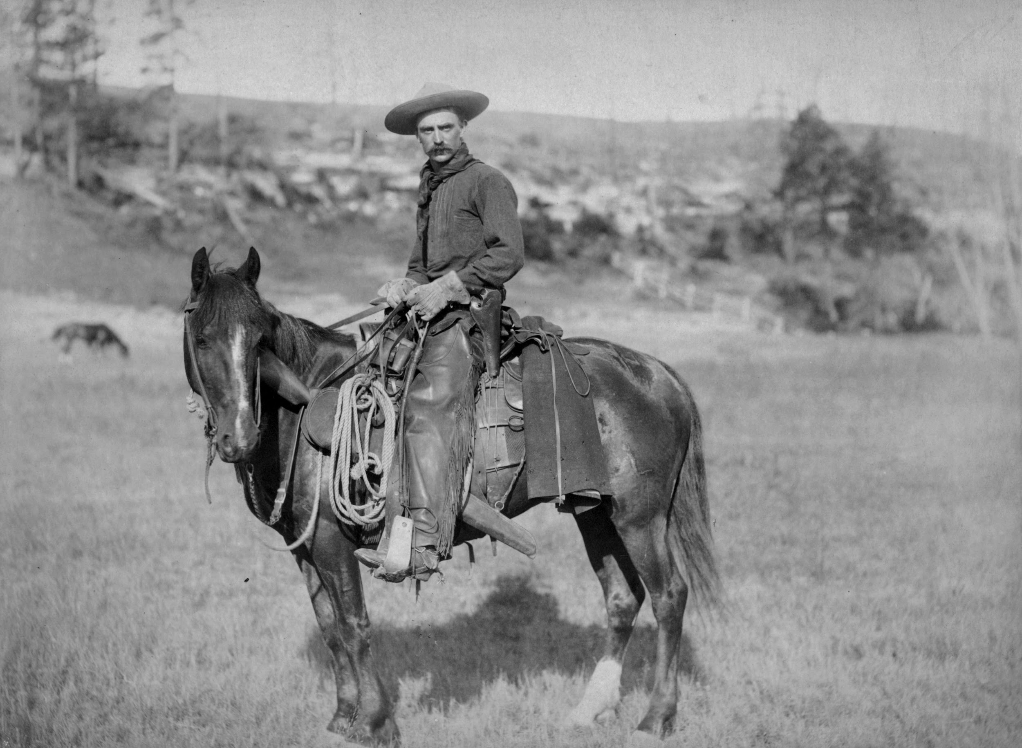

Slide 72
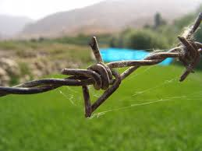
Barbed Wire
•(perfected by Joseph Glidden, 1874) brings an end to the open range.
“lighter than air,
Stronger than whiskey,
Cheaper than dirt”

Slide 73
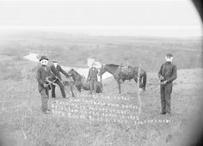
“Range Wars”
“Fence-Cutter’s War of 1883-1884” – Texas
Racial and ethinic prejudice
-Mexican, Mormon,
Basque

Slide 74
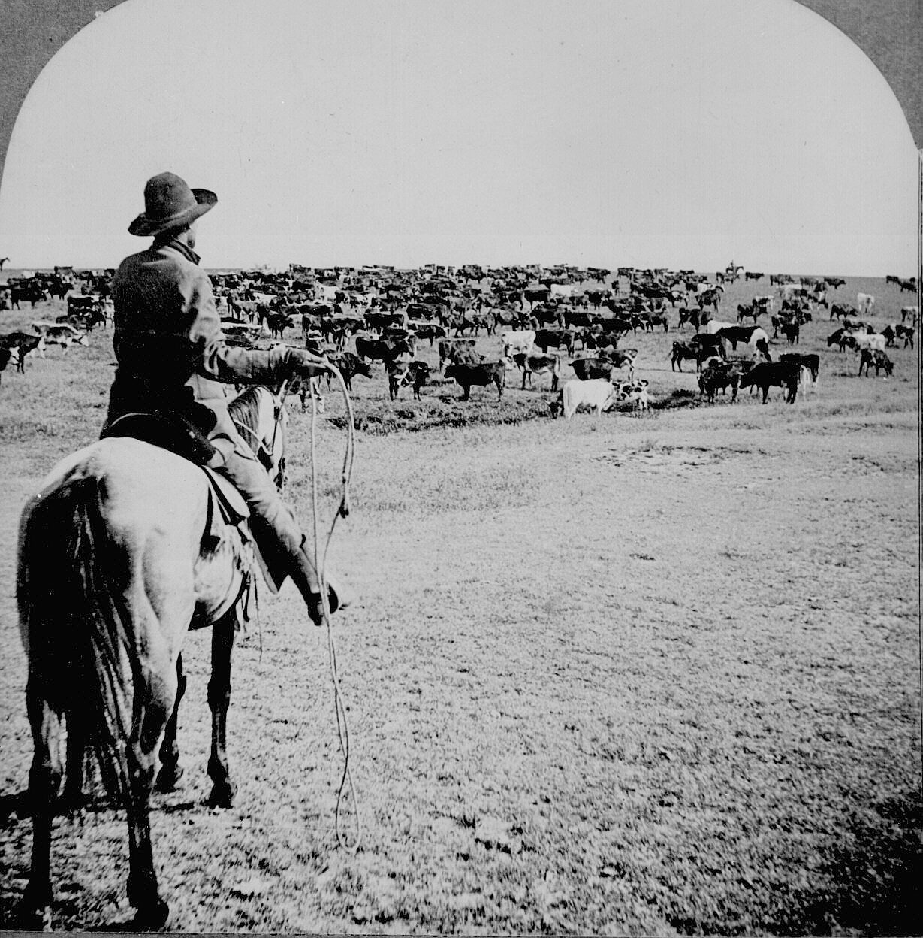
-Open grazing in TX - Roundup, Long drive
-Ended as settlers moved into west
Barbed wire, Winter of 1886-1887 (the “Big Die-Up”), Overgrazing
-Cattle became a big business venture as mining had

Slide 75
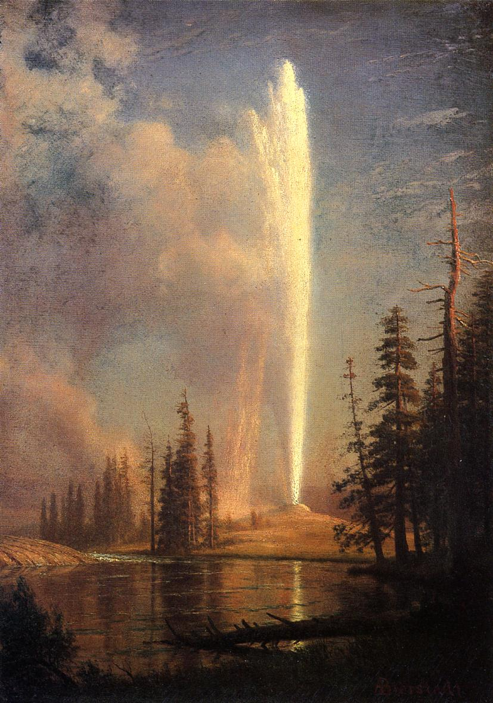
The Fading Frontier
Frontier- unsettled area
Frontier closed in 1890- end of “free” land - Census Bureau

Slide 76
Americans started to realize land & resources not inexhaustible
Land set aside for parks
Safety valve theory debunked- if eastern workers not happy, they relocate to western farms
Growth of western cities

Slide 77
Frederick Jackson Turner’s Frontier Thesis- American history is that of westward migration

Slide 78
Trans-Mississippi most unique area (American)
Most diverse pop- Hispanic, Indian, Asian
Biggest environmental challenges
Federal govt. took biggest role in developing it socially & politically

Slide 79
Many couldn’t afford new machines- forced to sell to large companies
Became huge “bonanza” farms worked by former owners & Mexican & Chinese immigrants

Slide 80
Views on the West
-Frederick Jackson Turner - Frontier Thesis
-David Weber - not a dividing line bt civilized and uncivilized, but boundary bt diverse cultures w/ claims to legitimacy
-New Western historians - West is still unique; West wasn’t tamed, but conquered

