Slide 1
AP US History
Imperialism Notes

Slide 2
Period 7 - 1898-1945
Key Concept 7.3 - Global conflicts over resources, territories, and ideologies renewed debates over the nation’s values and its role in the world, while simultaneously propelling the United States into a dominant international military, political, cultural, and economic position.

Slide 3
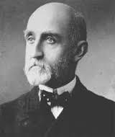
Imperialism
-expansion of territory into new lands- often overseas
 -New markets
 -Source of materials/resources
 -Missions/White Man’s Burden
-Militarism- navy- Alfred T. Mahan- Influence of Sea Power Upon History

Slide 4
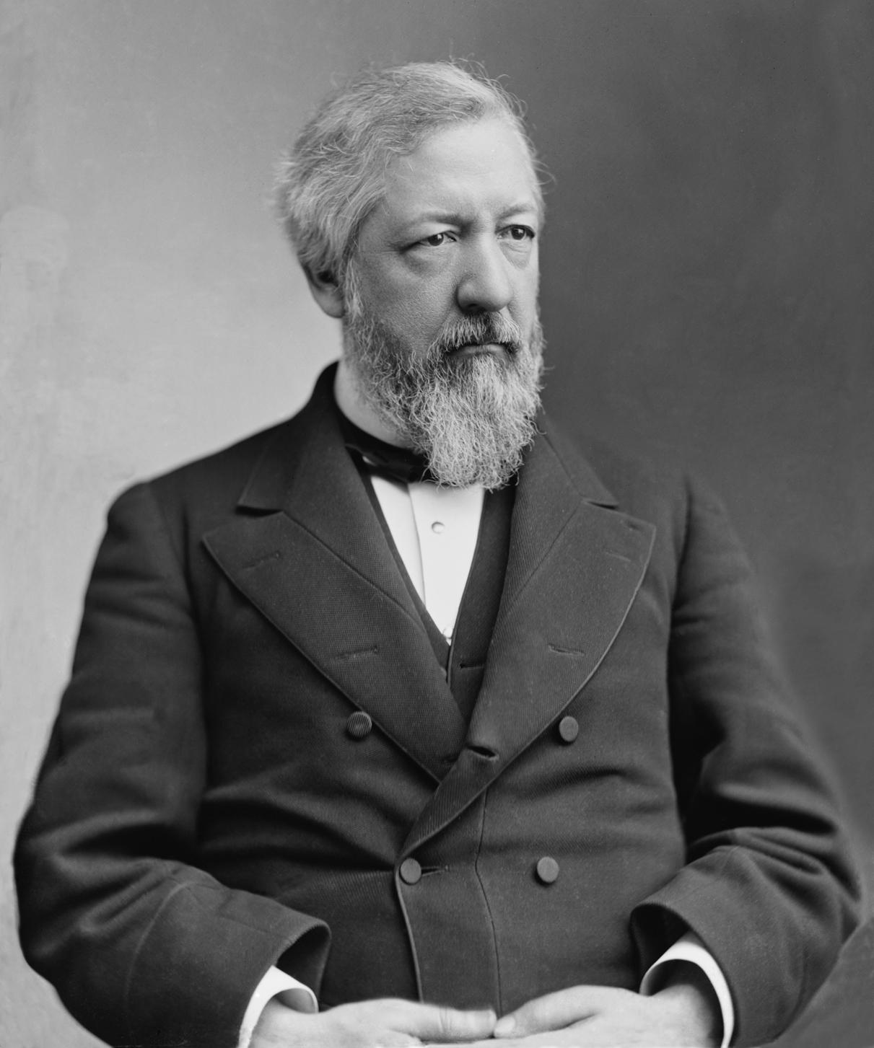
Extending the Monroe Doctrine
-Benjamin Harrison’s Sec of State James Blaine
-1889 Pan-American Conference met in DC
-greater Western Hemisphere cooperation

Slide 5
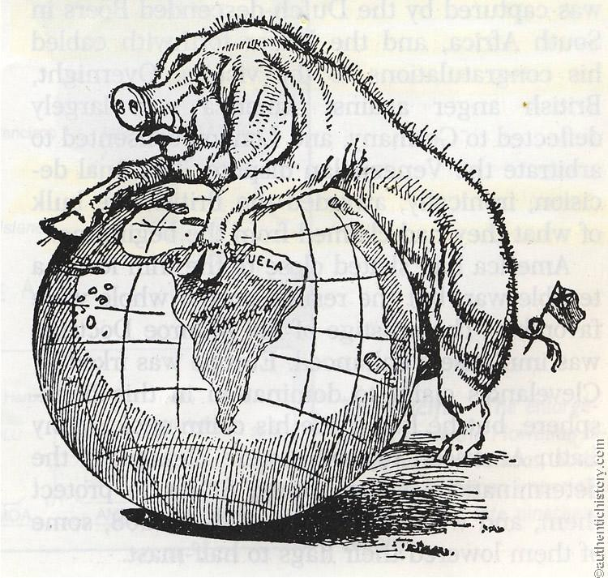
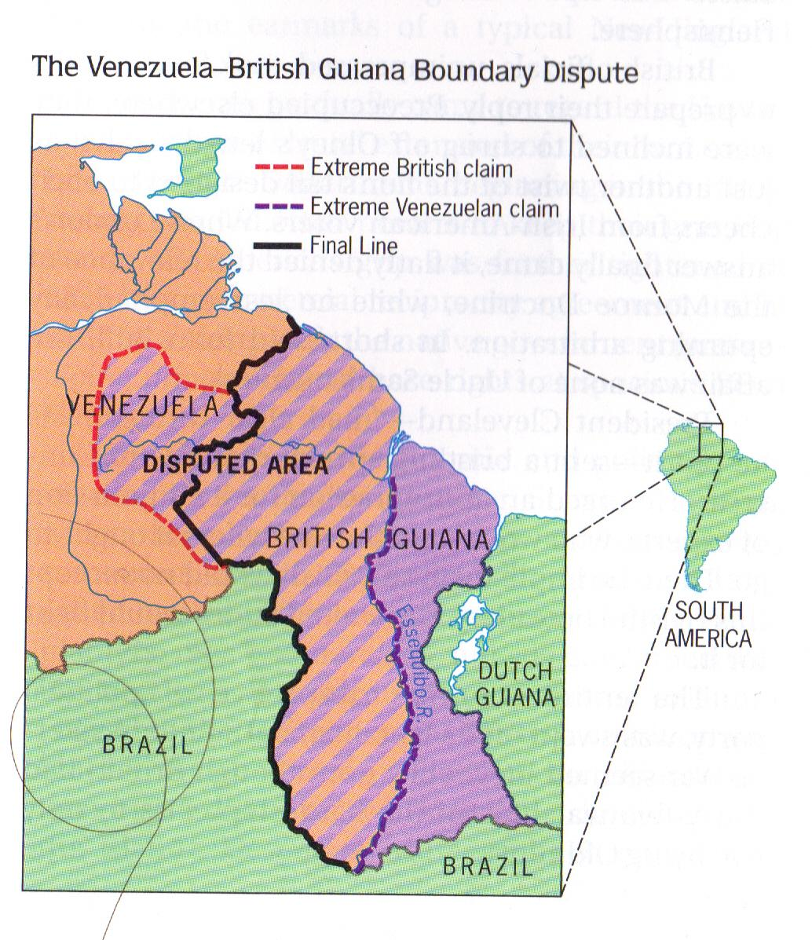
¢British/Venezuelan border crisis (1895-1896)
-Cleveland, Olney (Sec of State), and the Monroe Doctrine
-Ended in better British/American relationship

Slide 6
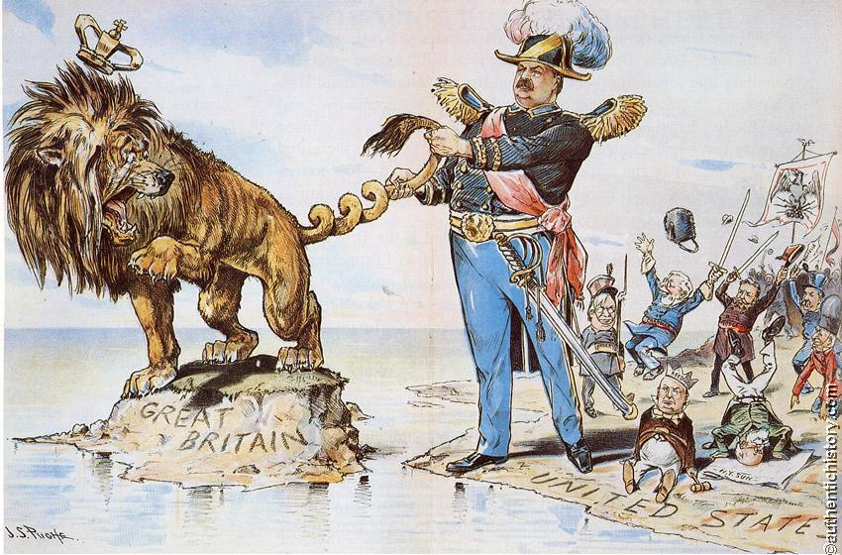

Slide 7
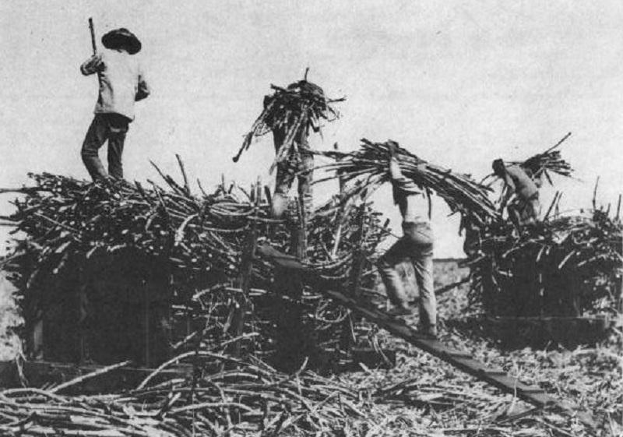
Spurning the Hawaiian Pear
-Early 19th century- way station
-1820- missionaries
-1840s- white sugar planters

Slide 8
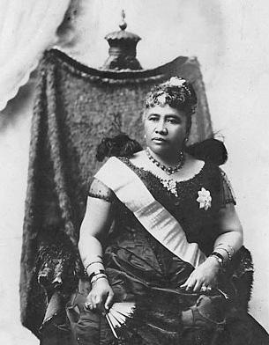
¢1880s- treaty giving naval base rights
Queen Liliukalani blocked annexation
¢1890- McKinley Tariff & sugar planters
¢1893- rebellion- annexation denied by
Cleveland

Slide 9
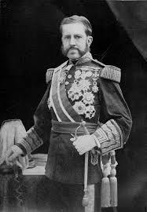
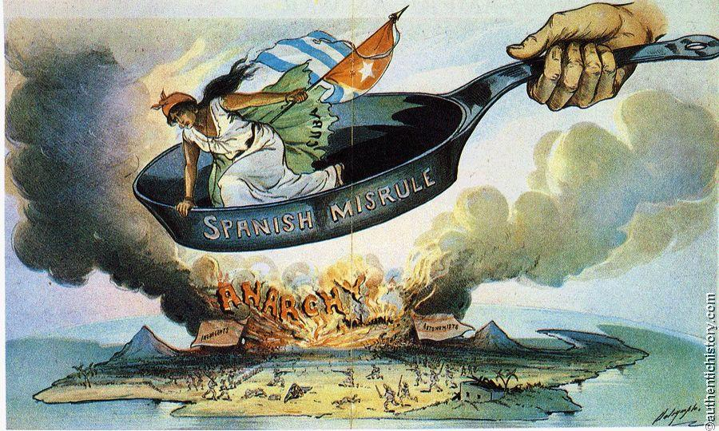
Cubans Rise in Revolt
¢1895- Cuban revolt
¢1896- Butcher Valeriano Weyler

Slide 10
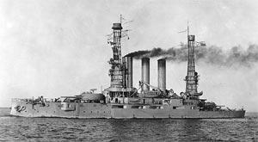
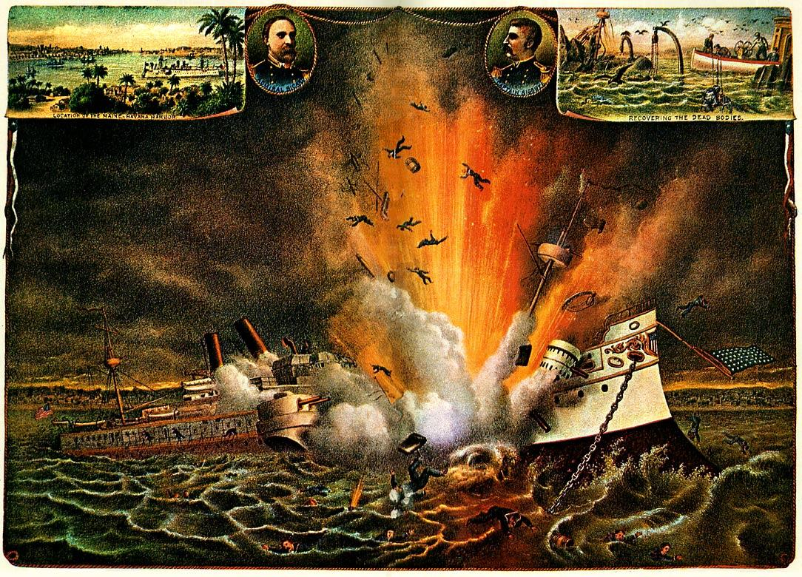
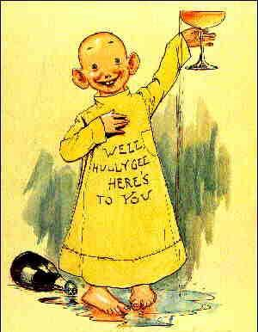
Causes of Spanish-American War
¢Hearst & Pulitzer- yellow journalism
¢De Lome Letter
¢Feb. 1898- USS Maine- war fever

Slide 11
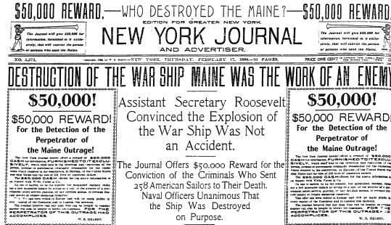

Slide 12
¢McKinley’s war message
Four Reasons for US intervention
“Put an end to the barbarities…” in Cuba
Protect lives and property of US Citizens in Cuba
End “the very serious injury to the commerce, trade, and business of our people”
End “the constant menace to our peace” arising from disorder in Cuba

Slide 13
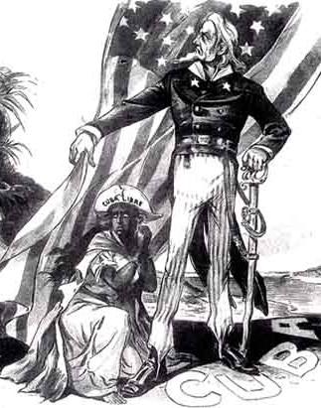
Teller Amendment
-Part of Congressional joint resolution authorizing war
-declared US had no intention of taking political control of Cuba and that once peace was restored Cubans would control own government

Slide 14
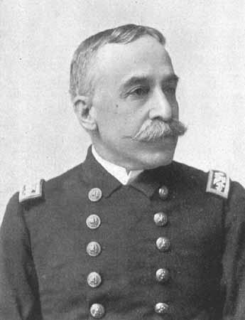
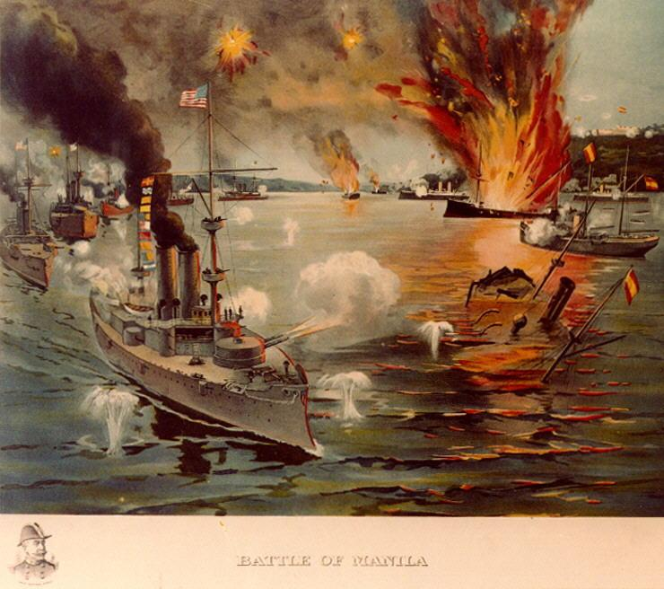
Dewey’s May Day Victory at Manila
¢Feb. 25, 1898- Asst. Sec. of Navy T. Roosevelt ordered attack to begin on Spanish Philippines
Free Cuba?
Commodore George Dewey
Spanish fleet quickly destroyed

Slide 15
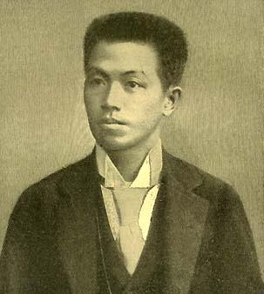
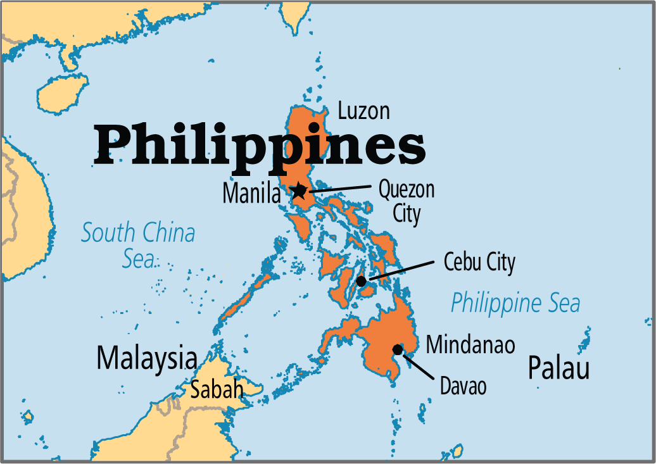
Philippines (continued)
American troops captured Manila Aug. 1898
¢Emilio Aguinaldo
Interest in Hawaii - annexation ordered July 1898

Slide 16
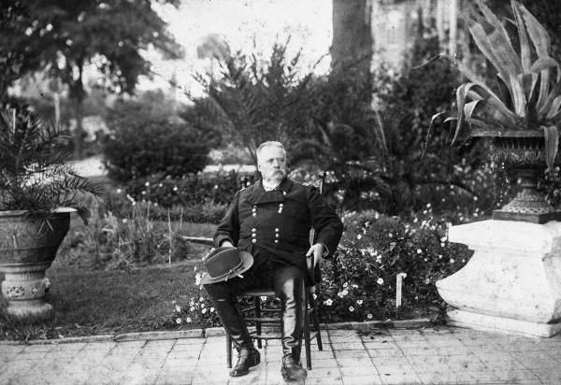
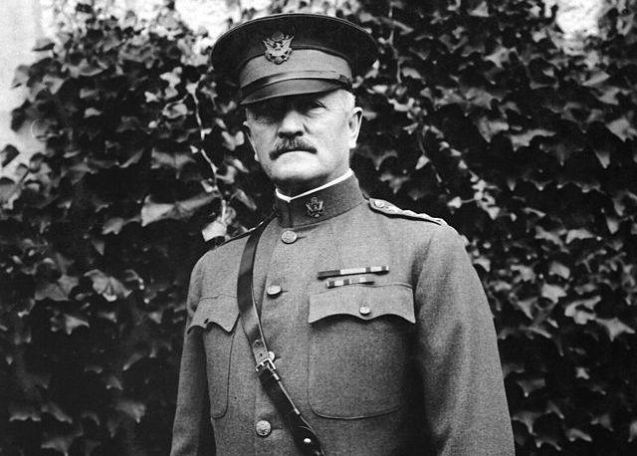
The Confused Invasion of Cuba
¢Army ill-prepared for fighting- Gen. Shafter
¢Rough Riders- volunteer regiment
Leonard Wood & TR
¢10th & 11th cavalries- Af. Am. Regiments & Col. John J. Pershing

Slide 17
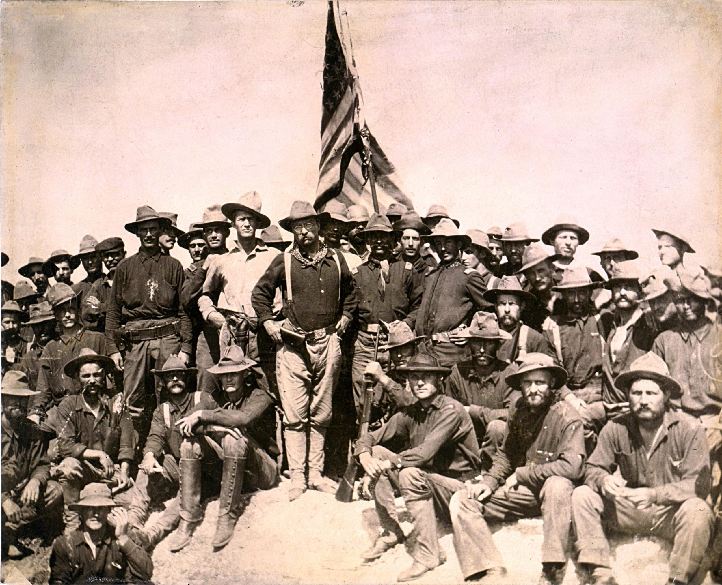

Slide 18
¢Charge up San Juan Hill
¢Spain & armistice Aug. 12, 1898
¢Casualties far worse from disease & unpreparedness
-5,000 American deaths from malaria, typhoid, and dystentery
-fewer than 500 American deaths in battle

Slide 19
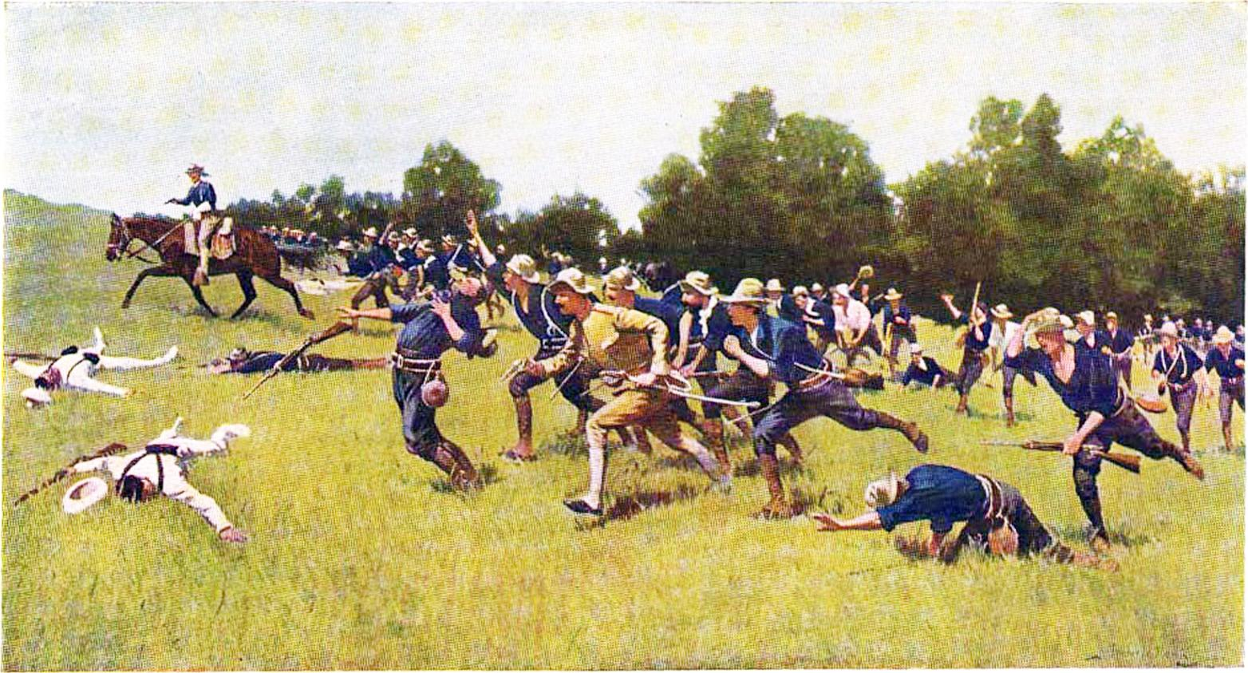
Charge of the Rough Riders Up San Juan Hill by Frederic Remington

Slide 20
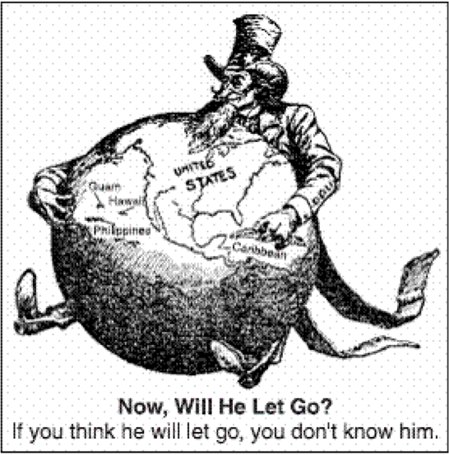
America’s Course (Curse) of Empire
Peace treaty- 1898
Cuba freed
US gained Puerto Rico & Guam
US gained Philippines for $20 mil.
-Became controversy over American imperialism
-Anti-Imperialist League

Slide 21
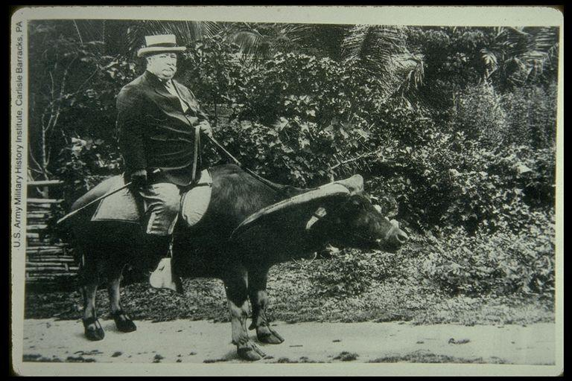
Filipino Insurrection - 1900
-Emilio Aguinaldo
-$400 mil. & millions of lives
-William Howard Taft - appointed Governor-General by Pres. McKinley

Slide 22
Puerto Rico
¢Puerto Rico- Foraker Act of 1900- popular govt. & eventual territorial status
Puerto Ricans gained citizenship in 1917
¢Insular (island) cases- people under the American flag not necessarily protected by Constitution

Slide 23
Cuba
¢US withdrew from Cuba 1902
Had written its Constitution In 1901 w/ Platt Amend.
¢No treaties w/out US consent
¢Not allowed to borrow w/out consent of US
¢Promised to give US land for naval stations

Slide 24
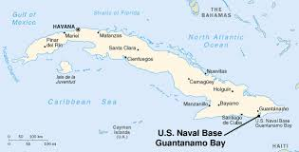

Slide 25
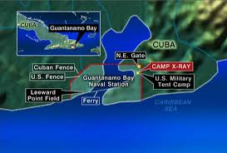

Slide 27
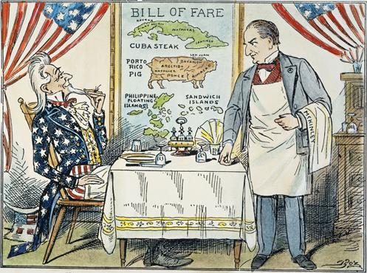

Slide 28
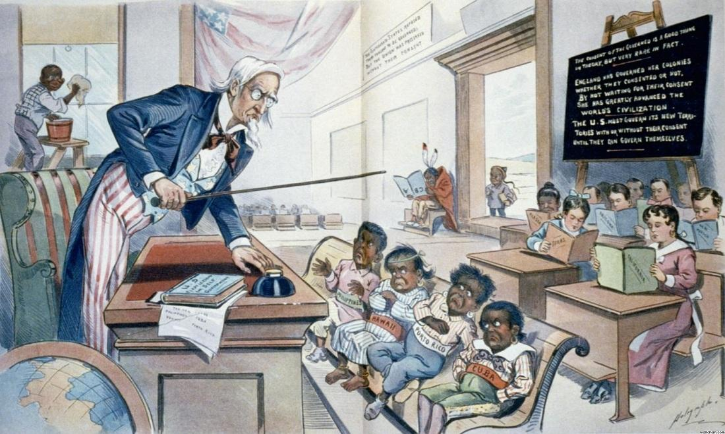

Slide 29
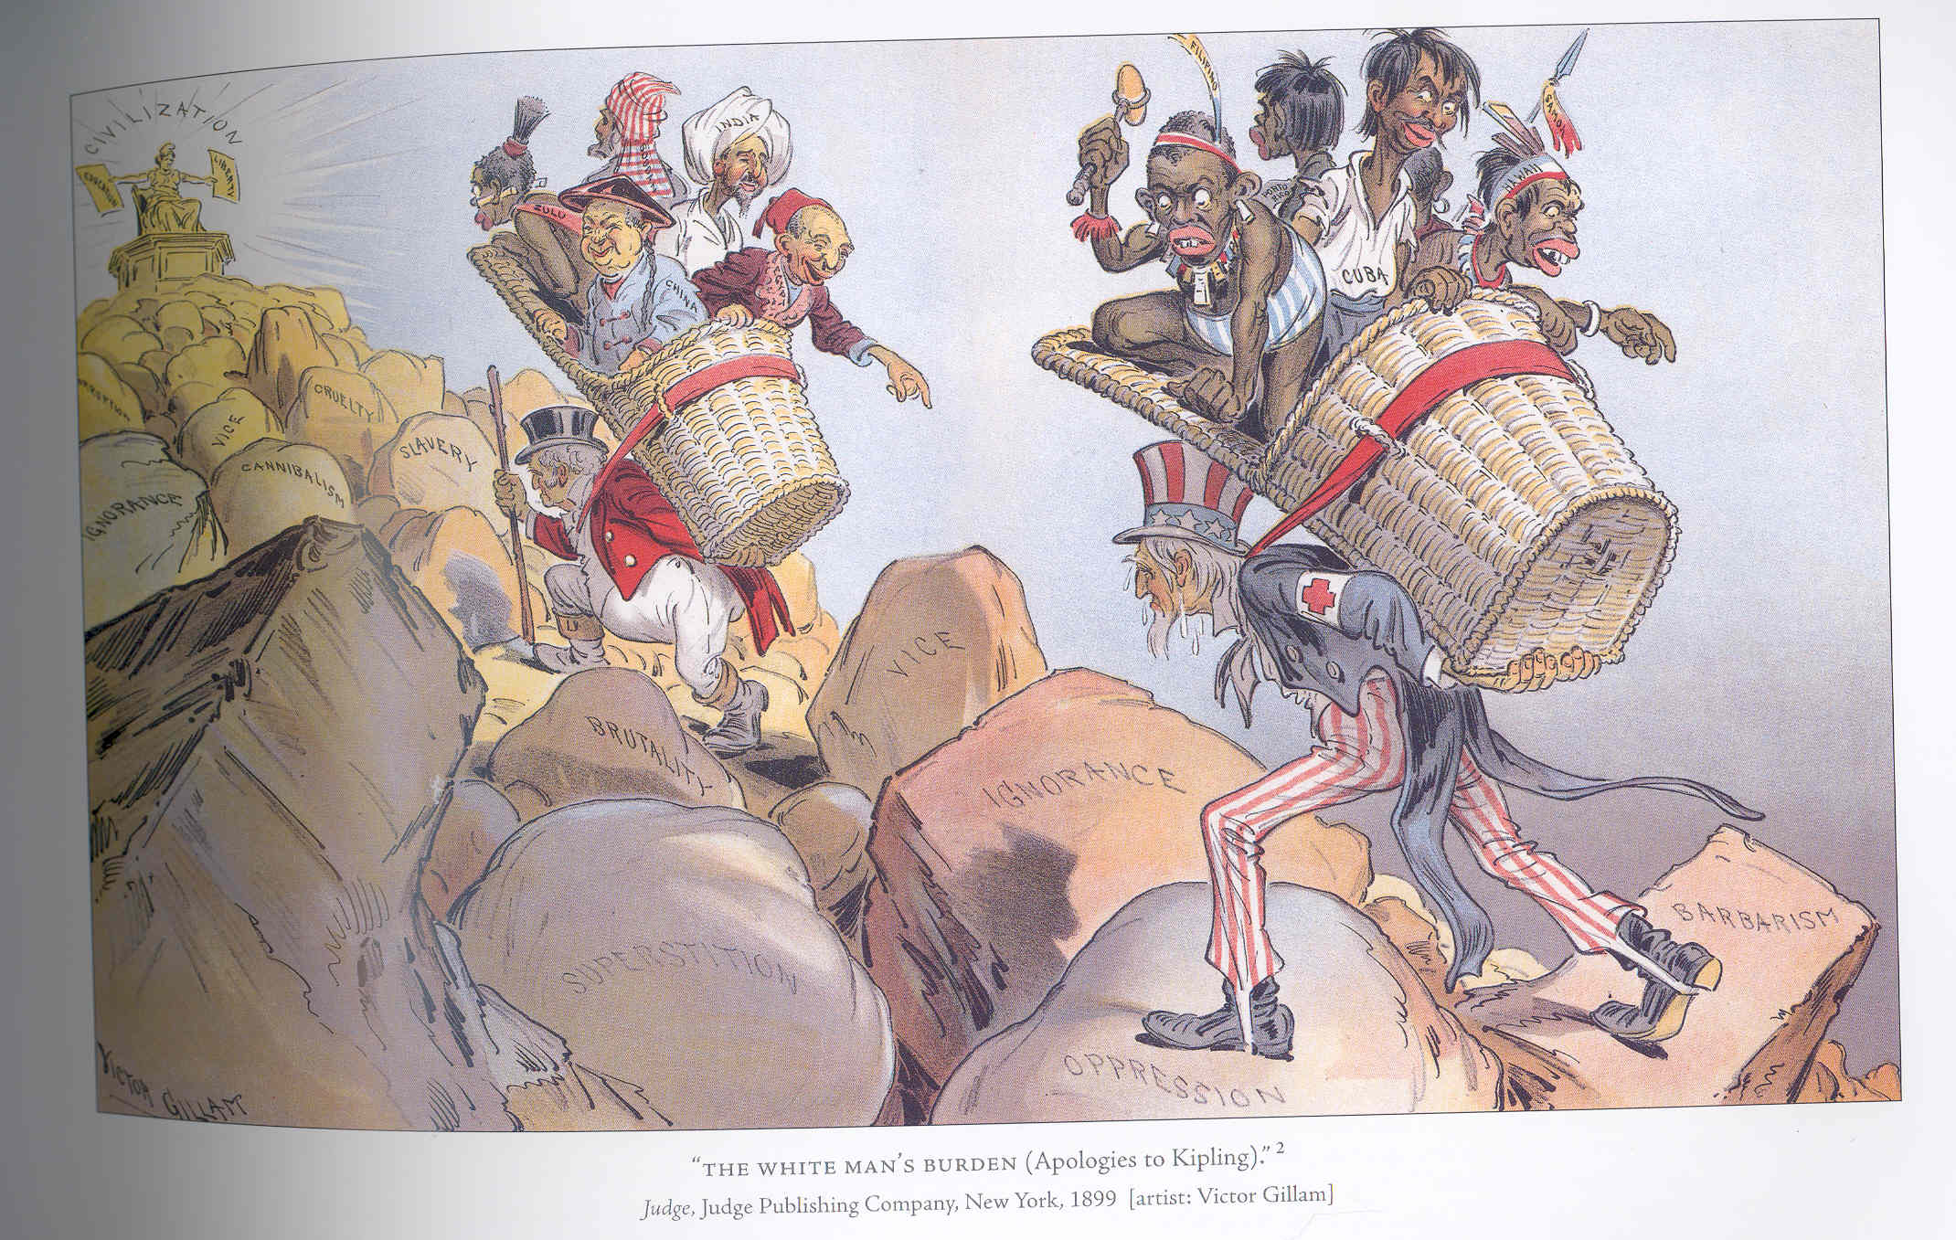

Slide 30
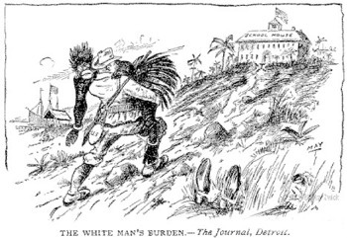

Slide 31
New Horizons in 2 Hemispheres
¢War made US an emerging power & promoted idea of imperialism
¢Helped heal the old Civil War wounds b/t North & South
¢Not fully ready for colonial responsibilities

Slide 32
“Little Brown Brothers” in the Philippines
¢US remained in Philippines Indefinitely- they thought they’d be freed
¢Filipino insurrection- 1899-1901
Emilio Aguinaldo
Cost nearly $400 mil
Nearly 5,000 Americans, 600,000 Filipions
¢W. H. Taft- Little Brown Brothers

Slide 33
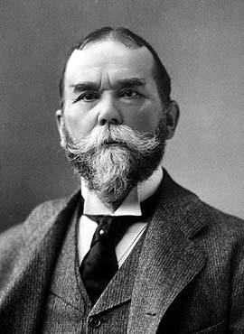
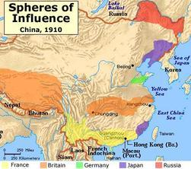
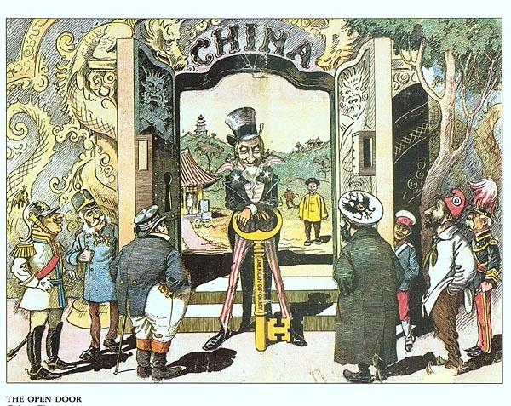
Open Door in China
¢China weakened by war w/ Japan- Europeans moved in
¢US concerned about free trade
¢Sec. of State John Hay & the Open Door note- 1899

Slide 34
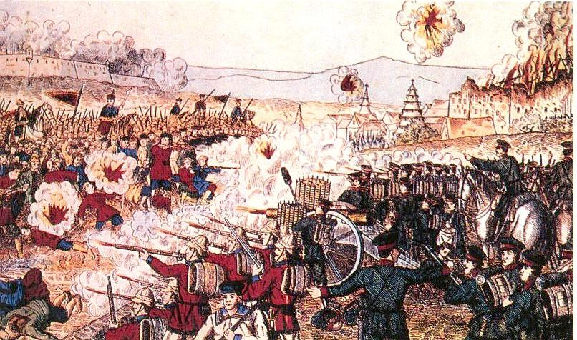
Chinese Resistance
¢Chinese Boxer Rebellion of 1900
Kill the Foreign Devils
Multinational group of soldiers
China forced to pay for damages
-overpaid - US made half-hearted gesture to repay
¢2nd Open Door Note- 1900- China not to be partitioned

Slide 35
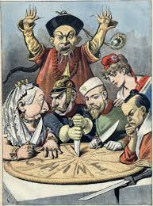

Slide 36
Imperialism or Bryanism in 1900
¢McKinley renominated 1900- T. Roosevelt VP
-Why TR? - NY bosses wanted to shut him up
¢Bryan for Democrats Again
¢McKinley Won by large margin

Slide 37
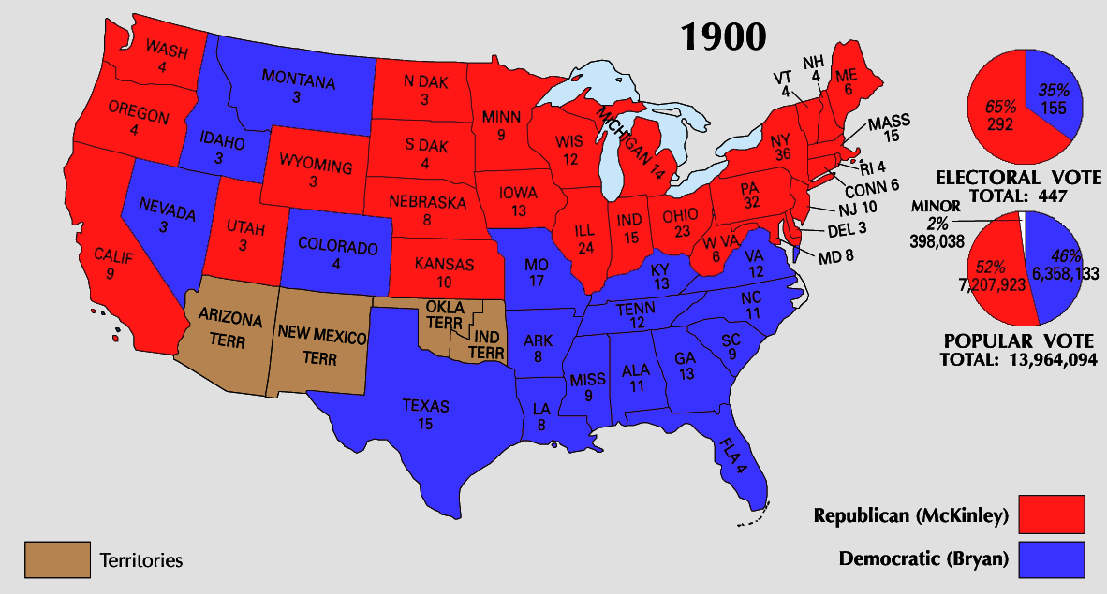

Slide 38
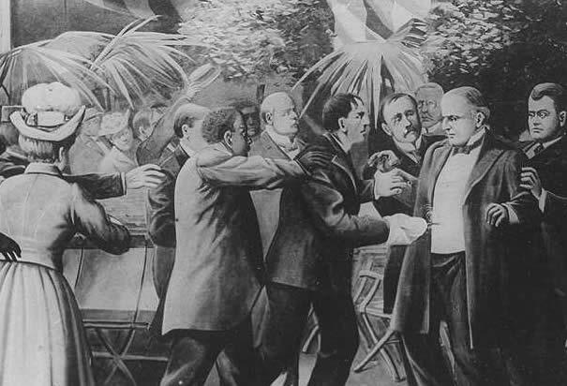
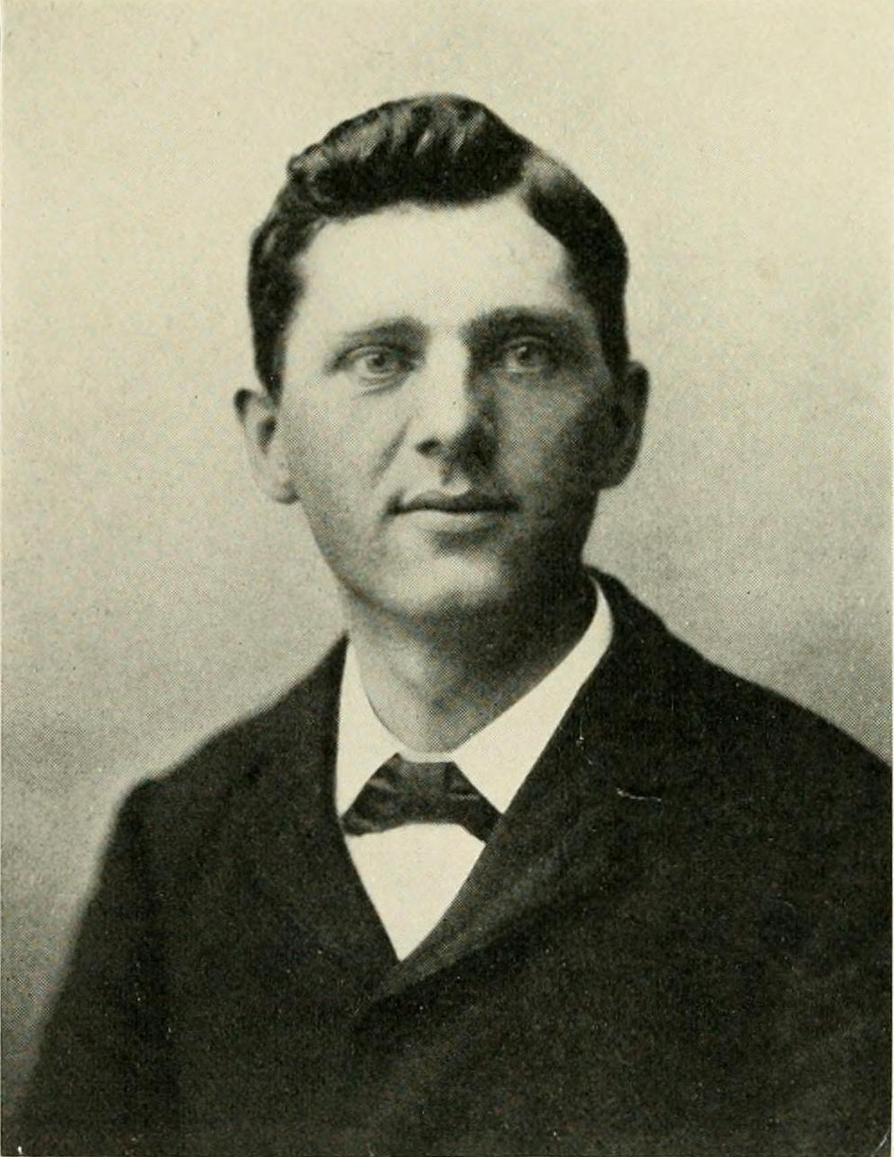
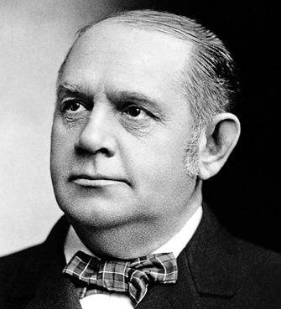
“That damned cowboy is President!”
¢McKinley- killed Sept. 1901
Leon Czolgosz
-Mark Hanna
- “That damned cowboy…”

Slide 39
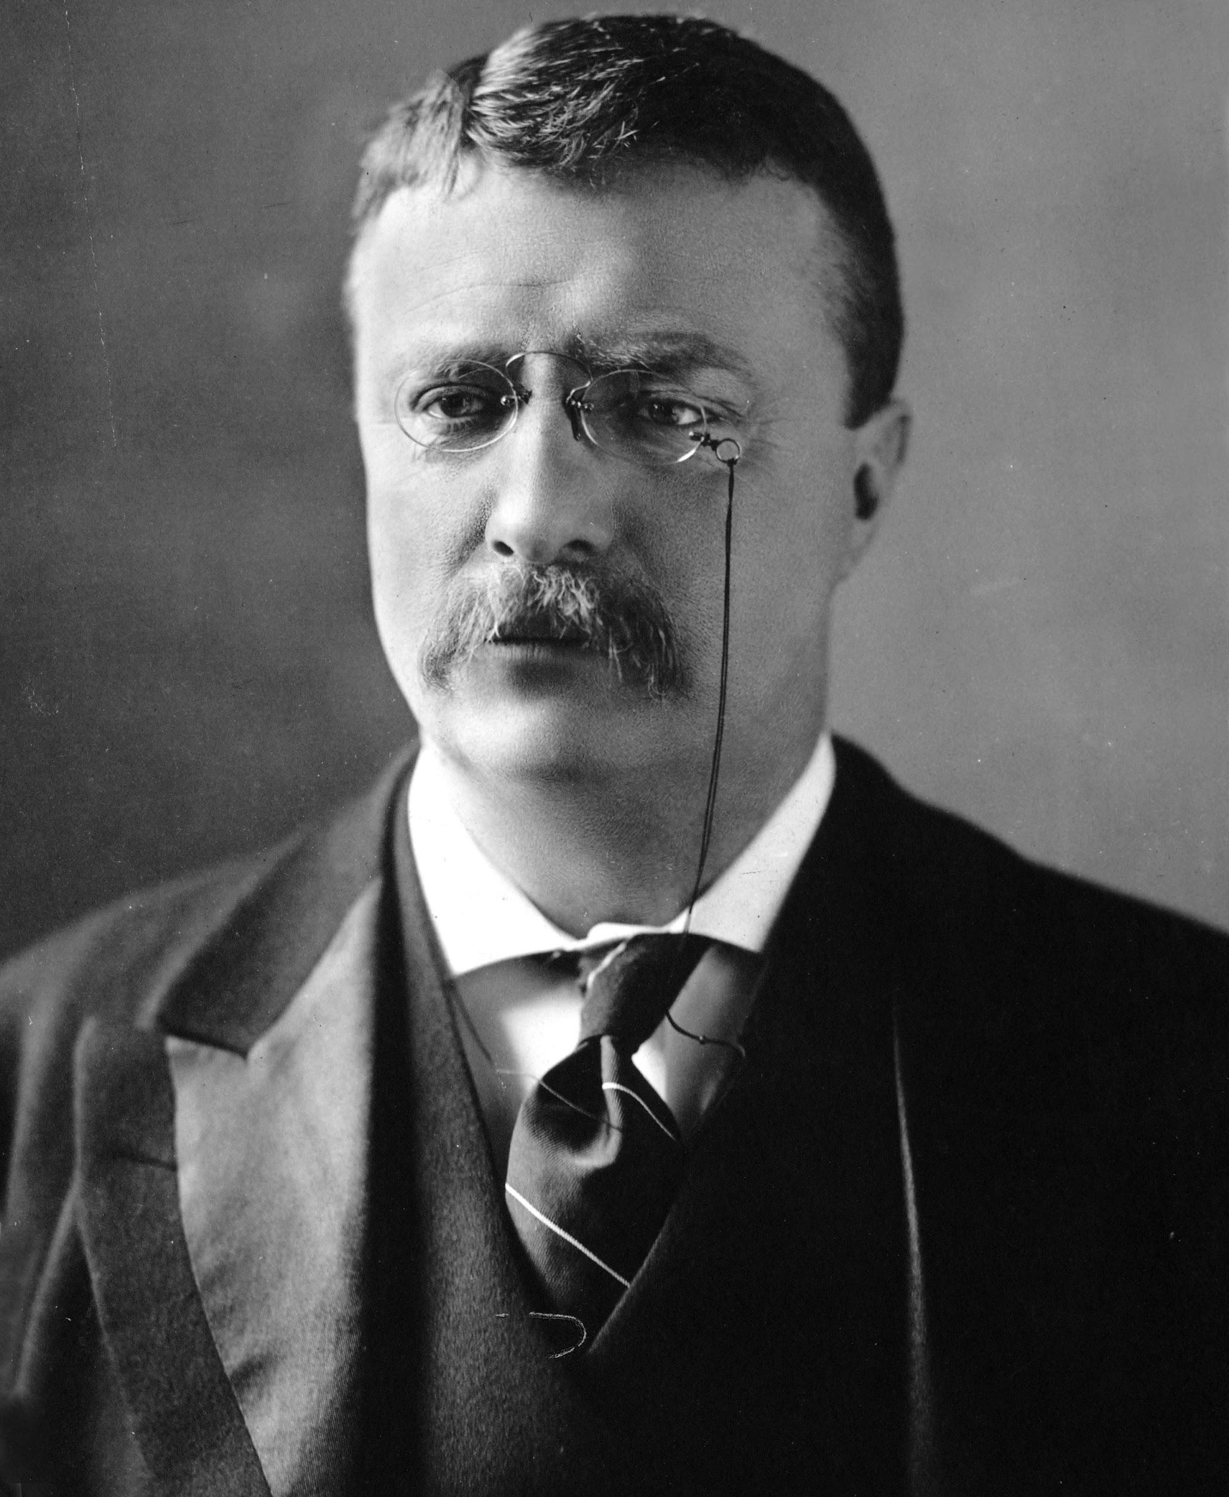

Slide 40
TR - Brandisher of the Big Stick
TR sworn in at age 42- Youngest
Huge ego
People person
High energy
Athleltic
Educated & intelligent
Believed in strong executive leadership

Slide 41
Building the Panama Canal
¢Possibility of canal- military & trade
¢British agreed to US construction
-Hay-Pauncefote Treaty - 1901

Slide 42
Canal Zone (continued)
1902- decided on Panama route- Colombia
US made $10 mil. Offer to buy Panama- rejected
Panamanians wanted away from Colombia
Rebelled 1903- US Navy blocked Colombia troops from stopping
(French company didn’t want to lose its investments)

Slide 43
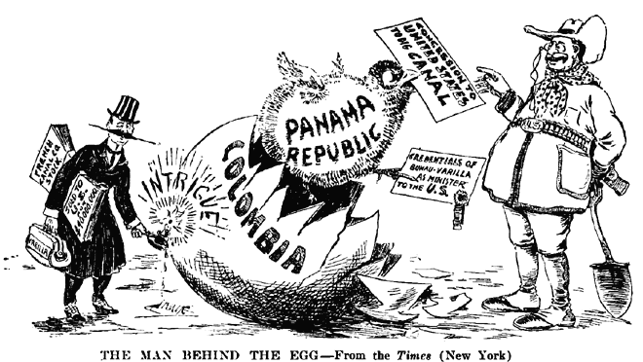

Slide 44
-T. Roosevelt recognized Panama as a nation
-Hay-Bunau-Varilla Treaty - 1903
-gave US rights over 51 mile long and 10 mile wide Canal Zone
-Made people believe US had planned the rebellion

Slide 45
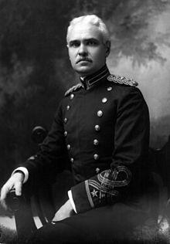
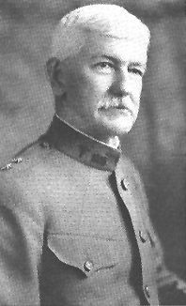
Canal Construction 1904-1914
-deaths of hundreds of laborers
-two Army colonels
-George Washington Goethals
-chief engineer
-Dr. William Gorgas
-helped eliminate yellow fever

Slide 46
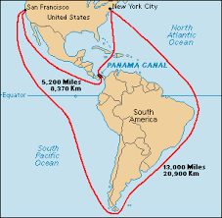
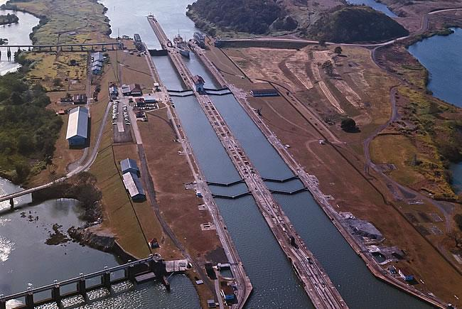

Slide 47
TR’s Perversion of the Monroe Doctrine
¢Latin American nations in debt to European powers
US afraid those nations would fall under European control
¢1905- Roosevelt Corollary to Monroe Doctrine

Slide 48
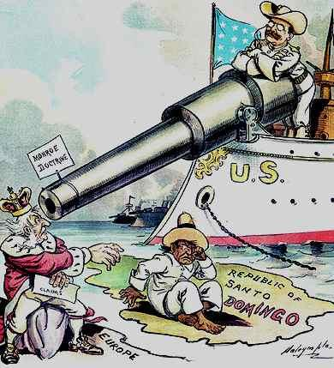
1905- Roosevelt Corollary to Monroe Doctrine
US would pay off existing debts
Latin Am. nations not allowed to take on new debt
”Bad neighbor policy”

Slide 49
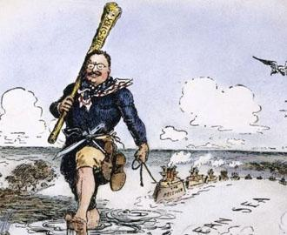

Slide 50
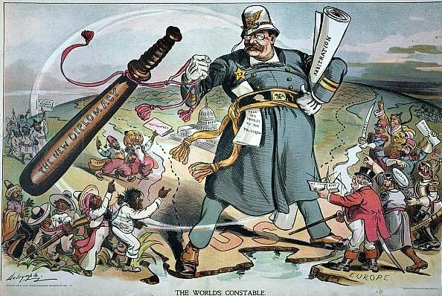

Slide 51
Roosevelt on the World Stage
¢Russo-Japanese War- 1904
¢TR asked to mediate
¢1905- treaty negotiated- neither side happy w/ agreement
US relations withered w/ both nations
¢1906- TR received Nobel Peace Prize

Slide 52
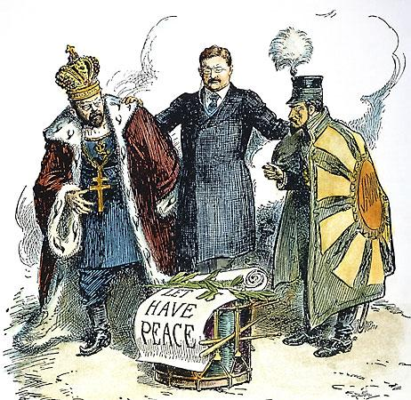

Slide 53
Japanese Laborers in CA
¢White CA’s feared Japanese immigrants
¢1906- San Francisco segregated its school system
¢Japanese took offense- war talk on both sides
¢TR & the Gentleman’s Agreement- 1907-08
CA desegregated & Tokyo promised to stop flow of immigrants
¢TR’s Great White Fleet- 1907

Slide 54
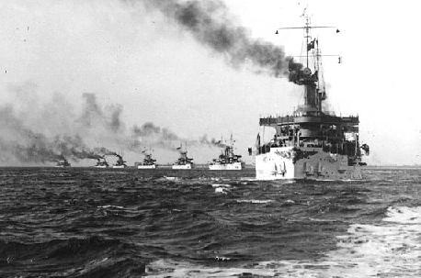

Slide 55
Taft’s “Dollar Diplomacy”
-mildly expansionist foreign policy depended more on investors’ dollars than battleships
-US investment in Chinese RR
-Nicaragua - US marines 1912-1933

Slide 56
Lodge Corollary
-response to Japanese investors’ attempt to buy part of Mexico’s Baja Peninsula
-Senate passed a resolution in 1912 stating that non-European powers would be excluded from owning territory in Western Hemisphere
-Taft opposed, Japan/Latin American countries offended

Slide 57
Wilson and Foreign Affairs
Woodrow Wilson and his Sec of State WJ Bryan disagreed with previous Republican policies

Slide 58
WIlson’s Moral (“Missionary”) Diplomacy
-Philippines - Jones Act of 1916 - Territorial status, bill of rights/male suffrage, eventual independence
-Puerto Rico - 1917 - US citizenship

Slide 59
Moral Diplomacy (continued)
-Panama Canal - 1914 - American exemption from tolls repealed - nationalists angered
Conciliation Treaties - Bryan - “cooling off” period

Slide 60
Moral? Diplomacy
Troops sent into Haiti and Dominican Republic

Slide 61
Wilson and Mexico
-Wilson refused to recognize Huerta
-arms embargo to aid revolutionaries, blockaded Vera Cruz
-U.S. Sailors - Tampico incident - mediation by “ABC” powers

Slide 62
Pancho Villa
-challenged Carranza
-raided across border
-chased by Pershing, Carranza protests

Slide 63
Differing View on Imperialism
Julius Pratt - irresponsible behavior of the yellow press
Howard Beale - US succumbed to international peer pressure
Richard Hofstadter - “psychic crisis of the 1890s” brought on by a decade of economic strain/rise of business/closing of frontier

Slide 64
Differing Views on Imperialism (continued)
Williams/LaFeber - expansion abroad due to economic expansion at home
More recent historians - race/gender - TR and others spoke of Americans becoming too “feminine”

