Slide 1
Short Answer Questions Samples & Responses 2016 AP Exam Q2 Markham 2018

Slide 3
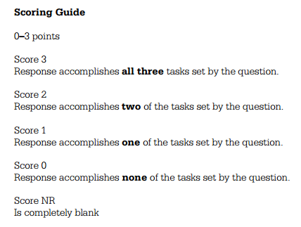

Slide 5
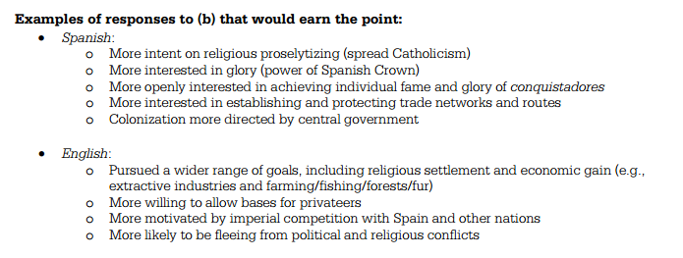

Slide 7
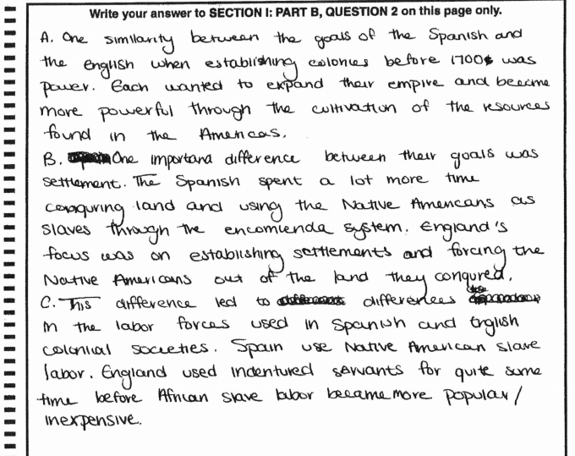

Slide 8
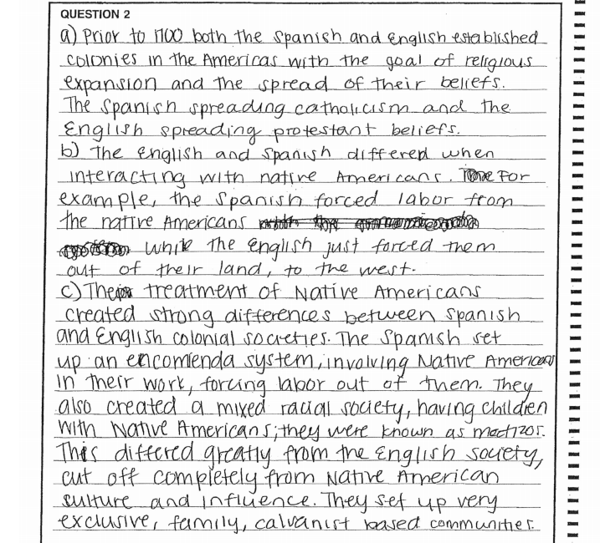

Slide 9
