Slide 1
Wilson’s New Freedom
American History 2

Slide 2
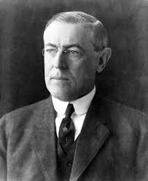
Woodrow Wilson
-2nd Democrat elected since the Civil War
-1st Southerner since Zachary Taylor (d. 1850)

Slide 3
1913 Inaugural Address
Wilson attacked “the triple wall of privilege”
-tariffs, banking, and trusts

Slide 4
Tariff Reduction
Broke tradition by addressing Congress in person
-need for lower tariff rates to bring consumer prices down
Underwood Tariff - 1913 - substantially reduced tariff rates for 1st time in 50 years - compensated w/ a graduated income tax - rates from 1 - 6%

Slide 5
Banking Reform
-Proposed a national banking system with 12 district banks supervised by a Federal Reserve Board - (Chairman 2nd most powerful person in America)
-Federal Reserve Act - 1914

Slide 6
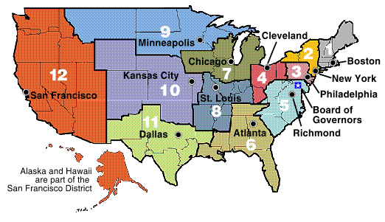

Slide 7
Business Regulation
-Clayton Antitrust Act - strengthened Sherman Act and contained a clause exempting unions from being prosecuted as trusts
-Federal Trade Commission - empowered to investigate and take action against any “unfair trade practice” (except in banking and transportation)

Slide 8
Child Labor
-Child Labor Act - 1916 - prohibited shipment in interstate commerce of products manufactured by children under 14.
-Supreme Court found act unconstitutional in 1918 in Hammer v. Dagenhart

Slide 9
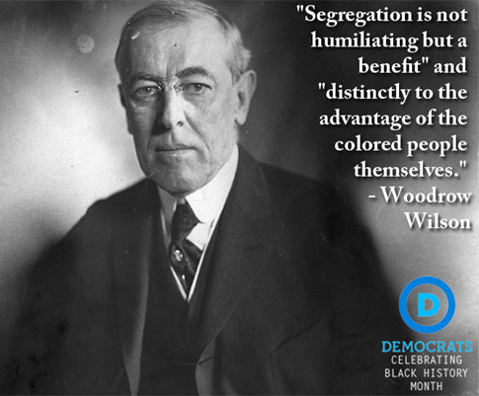
Limits to Wilson’s Progressivism
Southerner by birth, maintained racial prejudice
Wilson opposed federal anti-lynching campaigns
Resegregated the Capitol and federal offices
Appointed segregationists to his cabinet

