Slide 1
American Life in the “Roaring Twenties”: 1919-1929

Slide 2
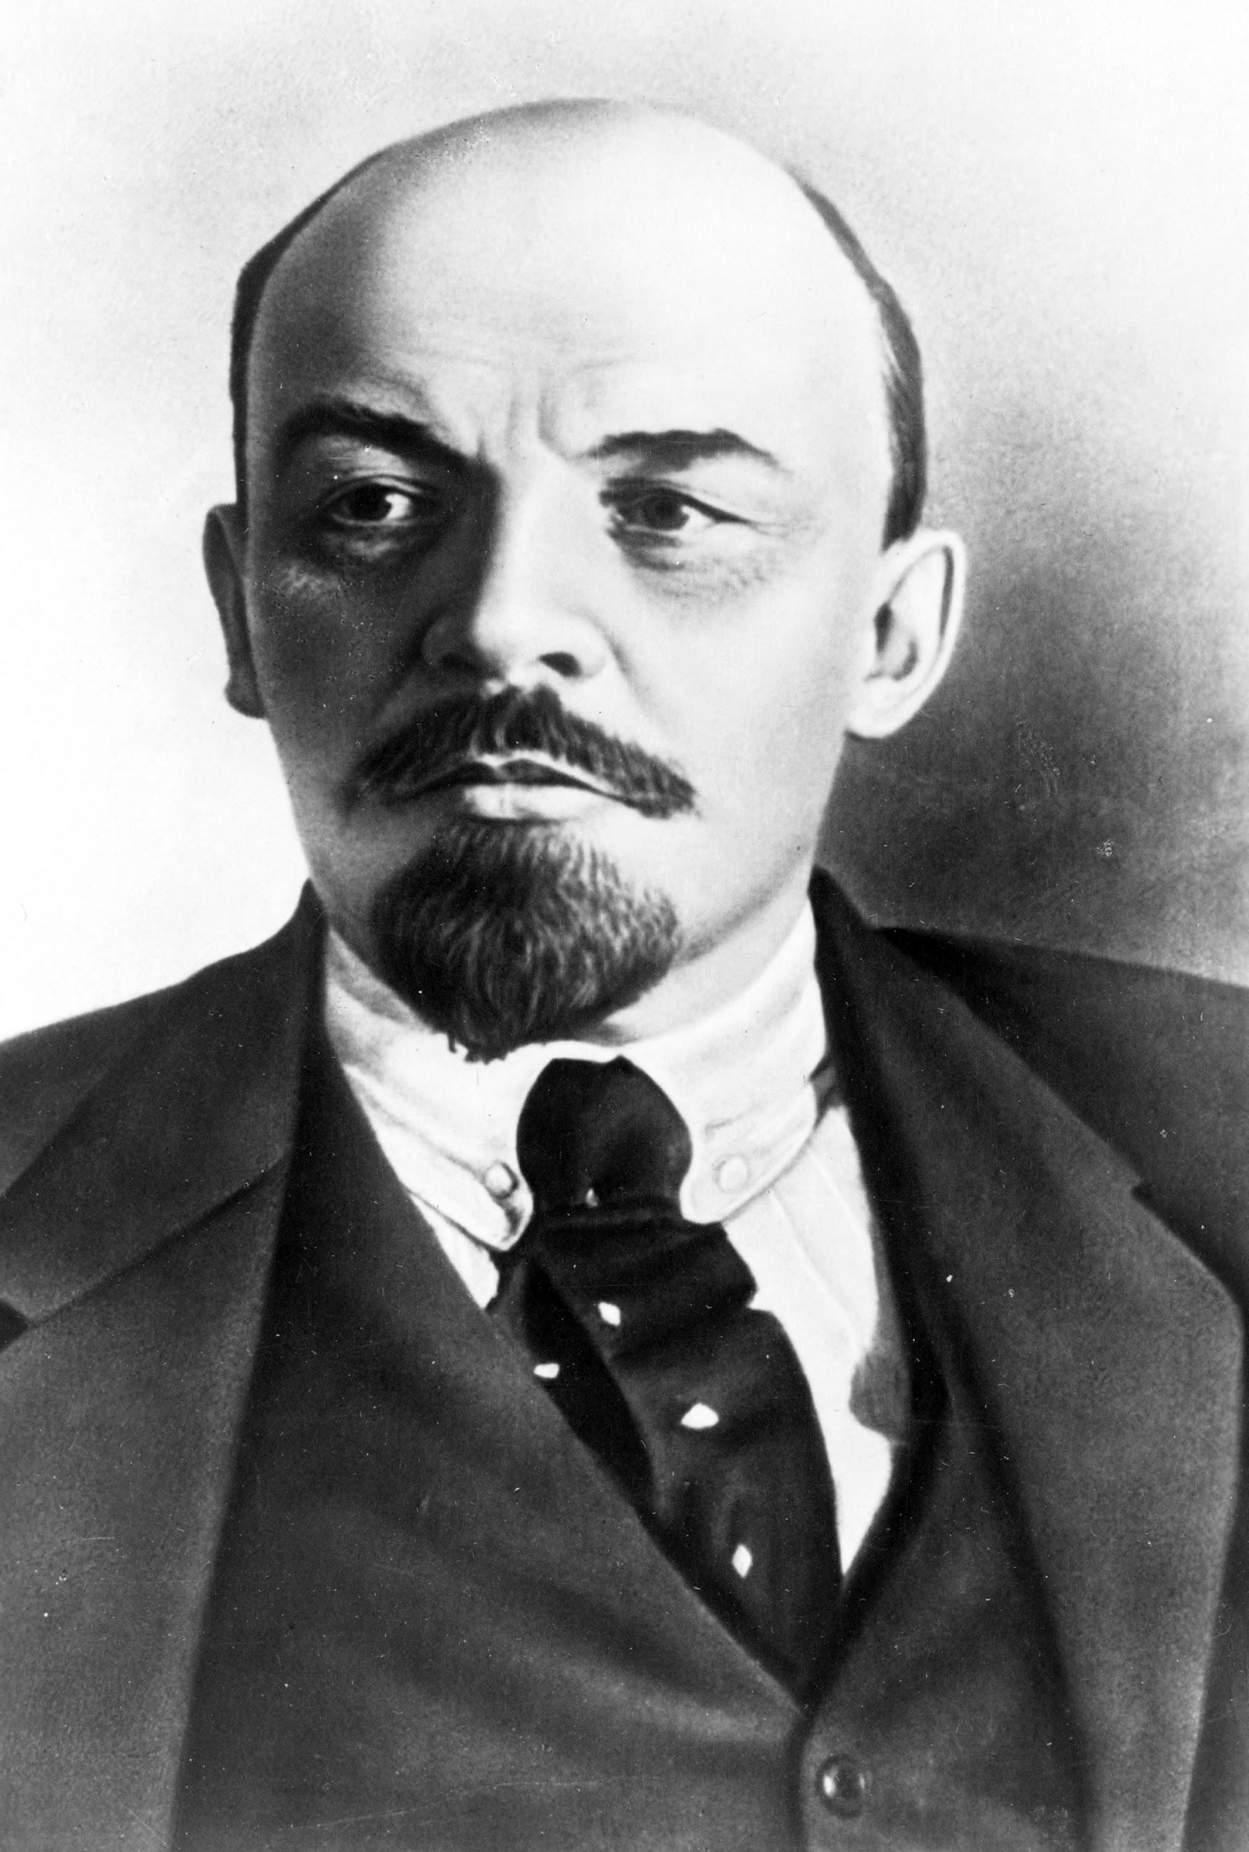
Seeing Red
vAmerica turned in after the war again- disillusion
vFear of Communist Russia
vSmall party in US
vBelieved takeover in US
v

Slide 3
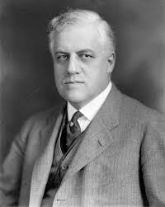
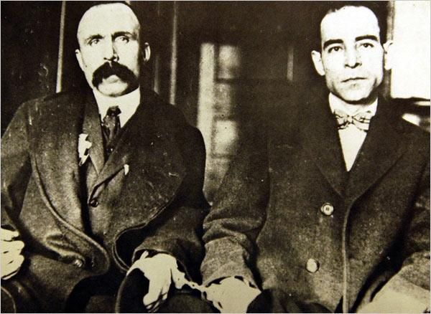
Palmer Raids- 1919-1920- Attorney Gen. A. Mitchell Palmer
vDeported Communists, anti-Communist laws
vUsed against labor unions
vSacco & Vanzetti- 1921

Slide 4
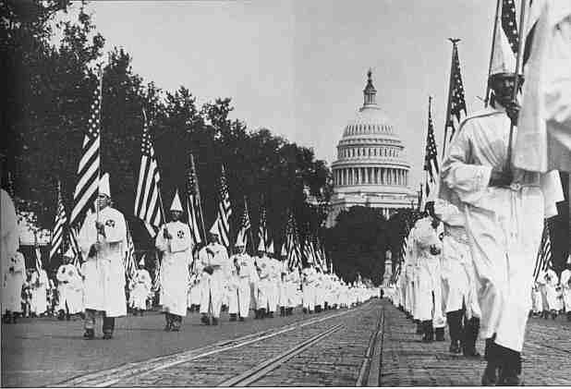
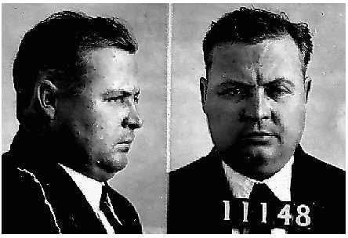
Hoodlums of the KKK
vNew kind of KKK after WWI- antiforeigner
-recruiting boost from “Birth of a Nation”
vSouth & mid-west
v5 million by mid 1920s
vDownfall by late 20s
vembezzlement

Slide 5
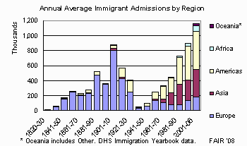
Stemming the Foreign Flood
vImmigrant fears
v800,000 in 1920-21
vSouthern & eastern Europe
vEmergency Quota Act of 1921
vImmigration Act of 1924- further limited immigrants (allowed for more northern & western immigrants)- no Japanese immigrants
vEnd of unrestricted immigration

Slide 6
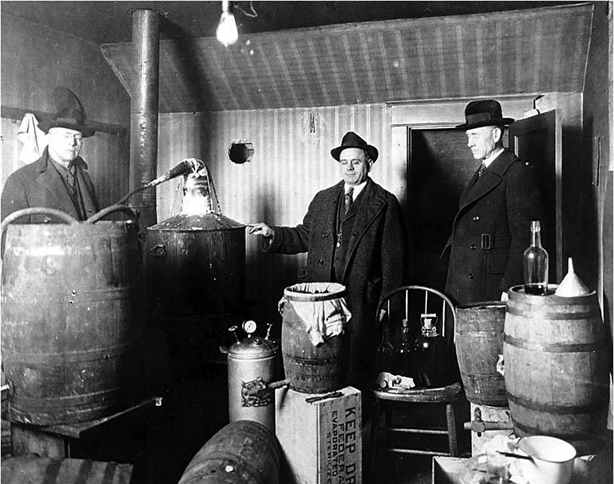
The Prohibition “Experiment”
v18th Amen- 1919, Volstead Act- 1920
vSouth & West
vOpposed in Northeast & midwest
vIllegal overnight?
vHypocritical legislators, returning soldiers, poor vs. rich, jazz age youth
vSpeakeasies
vRumrunners, bootleggers, home brew, bathtub gin
vpositives

Slide 7
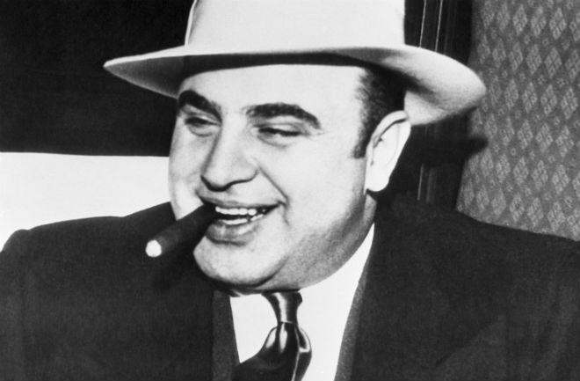

Slide 8
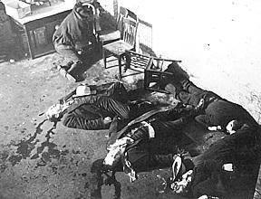
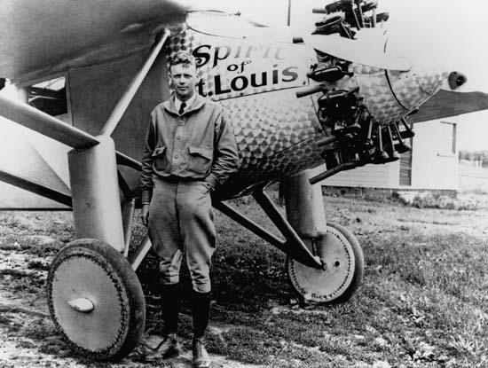
The Golden Age of Gangsterism
vOrganized crime
vCity wars- Chicago & Scarface Al Capone
vCrooked police
vOther areas of vice for crime
vProtection money
vKidnapping of Lindberg’s son

Slide 9
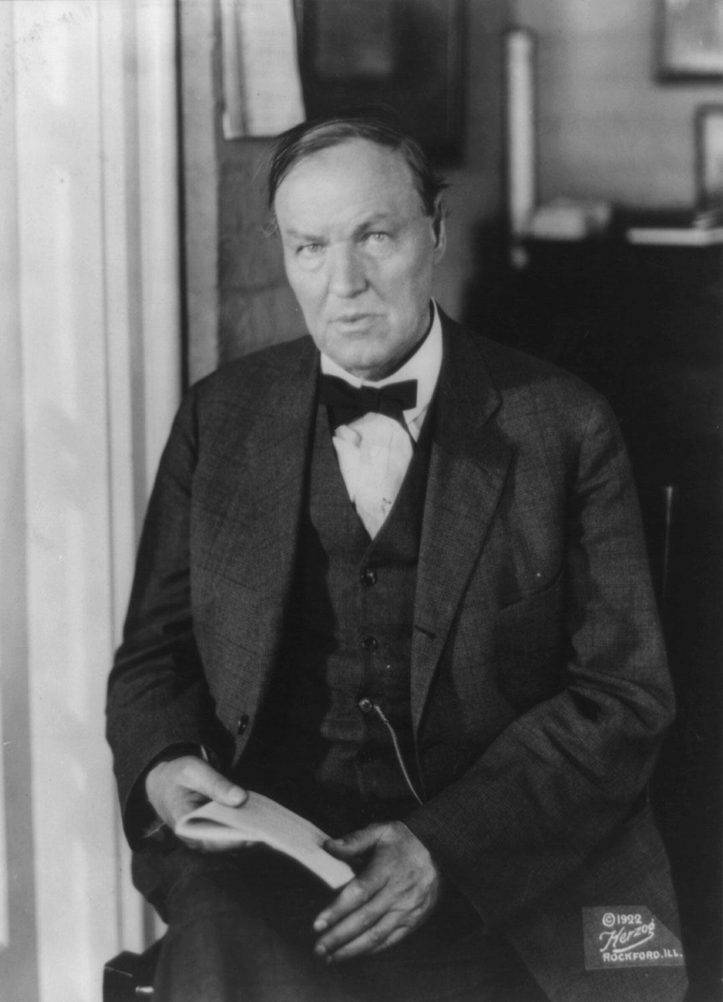
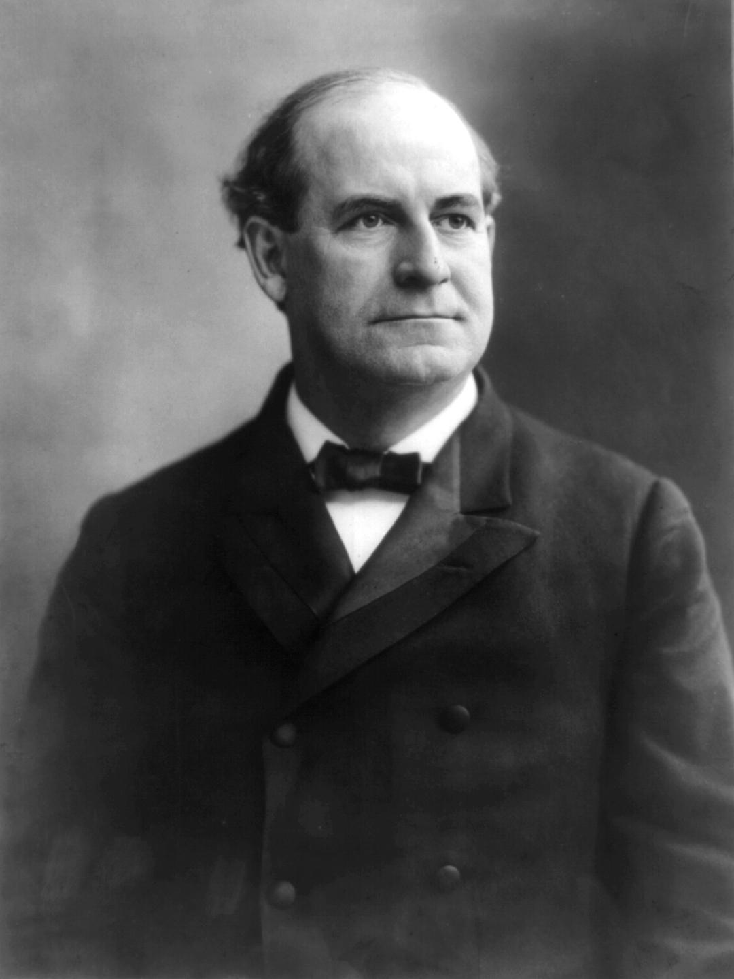
Monkey Business In Tennessee
vIncrease in high school ed. & grad.
vJohn Dewey- learning by doing
v1920s- Fundamentalists vs. Evolutionists
vLaws passed to stop teaching of evolution- TN
vJohn T. Scopes- defended by Clarence Darrow
vProsecuted by William Jennings Bryan
vScopes found guilty- law upheld
vReconciliation b//t Christianity & science

Slide 10
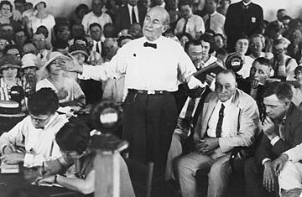
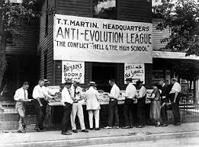
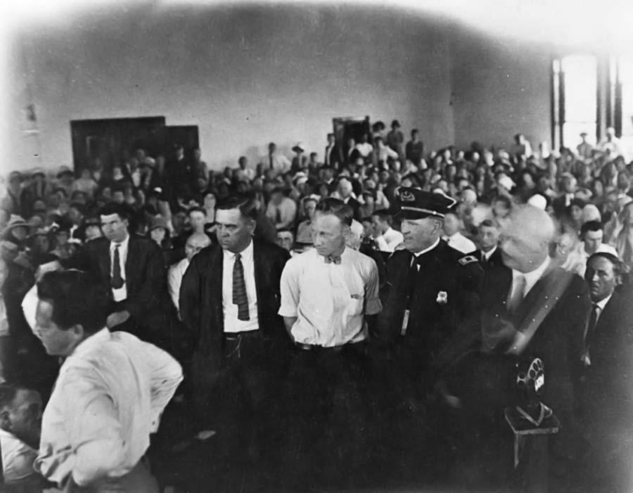
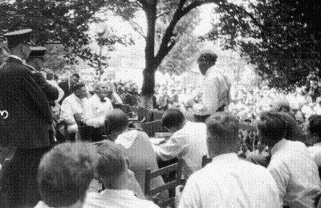

Slide 11
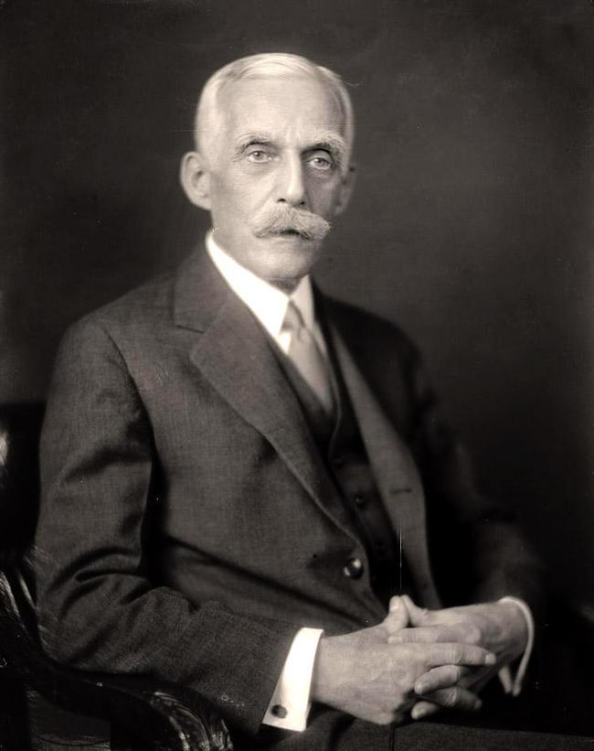
The Mass Consumption Economy
vHuge prosperity of the 20s- US only major power after WWI- Europe depended on US
vEconomic expansion & capital investment
vSec. Of Treasury Andrew Mellon & Henry Ford
vAutomobile
vMarkets?- advertising
vInstallments- credit
vSpectator sports

Slide 12
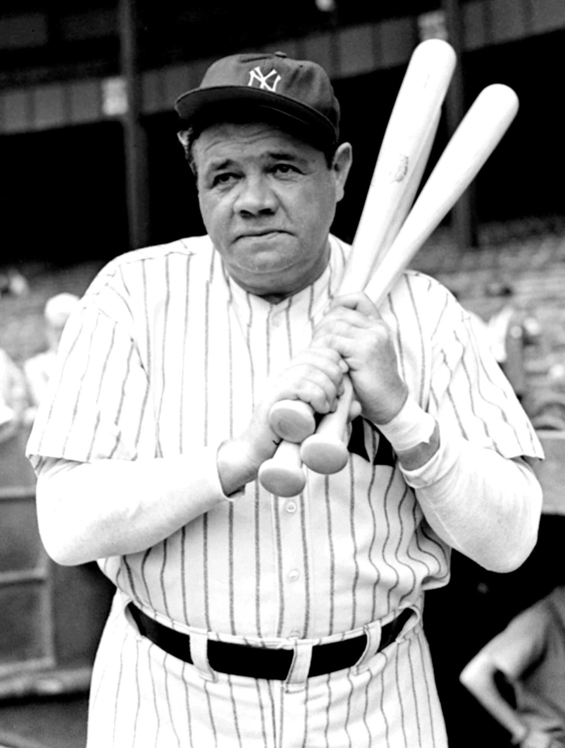
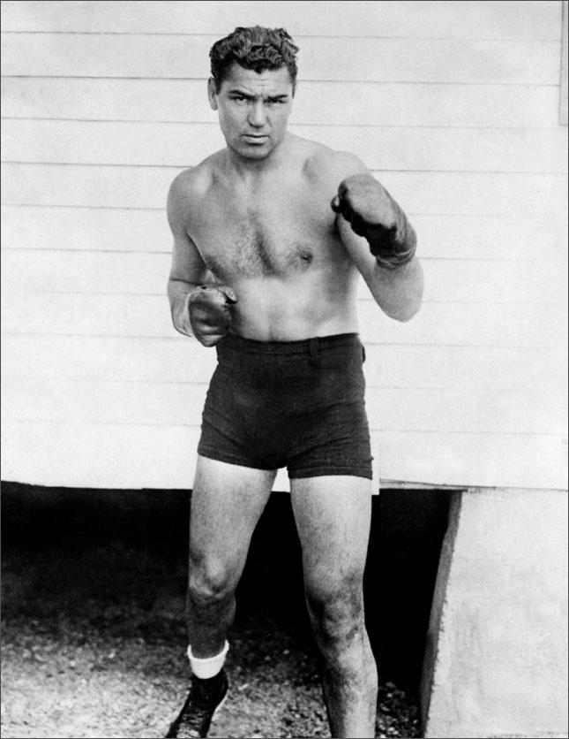

Slide 13
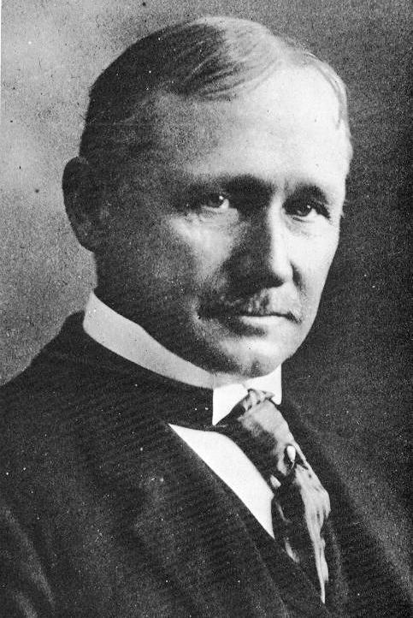
Putting America on Rubber Tires
vAutomobile drove American industrialization of 20th century more than anything
vAssembly line & mass production
vJobs- 6 million
vFrederick Taylor- Taylorism, scientific management
vCars for all- mid 20s- new Ford- $260
vBy 1929- 26 million cars

Slide 14
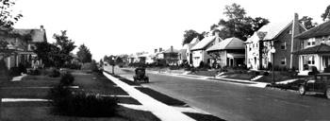
The Advent of the Gasoline Age
vOther industries benefitted
vRR withered
vTransportation of goods
vNew paved roads
vNew freedoms
vMore growth of suburbs
vdangers
Indianapolis suburb, 1928

Slide 15
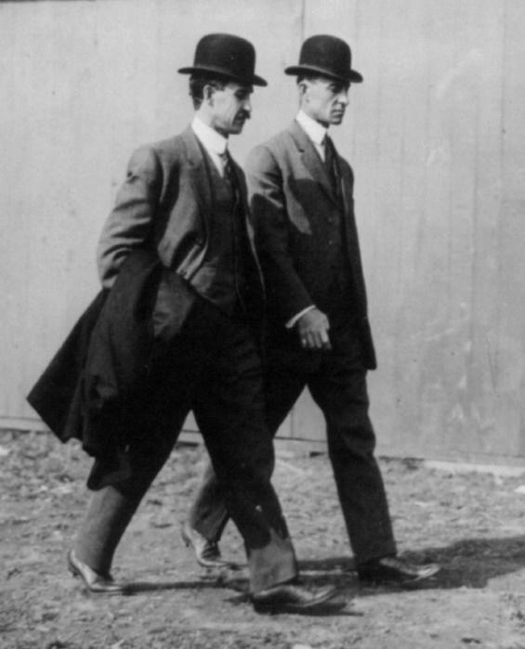
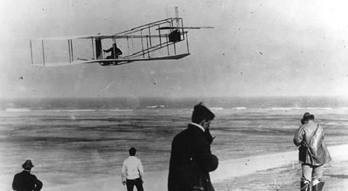
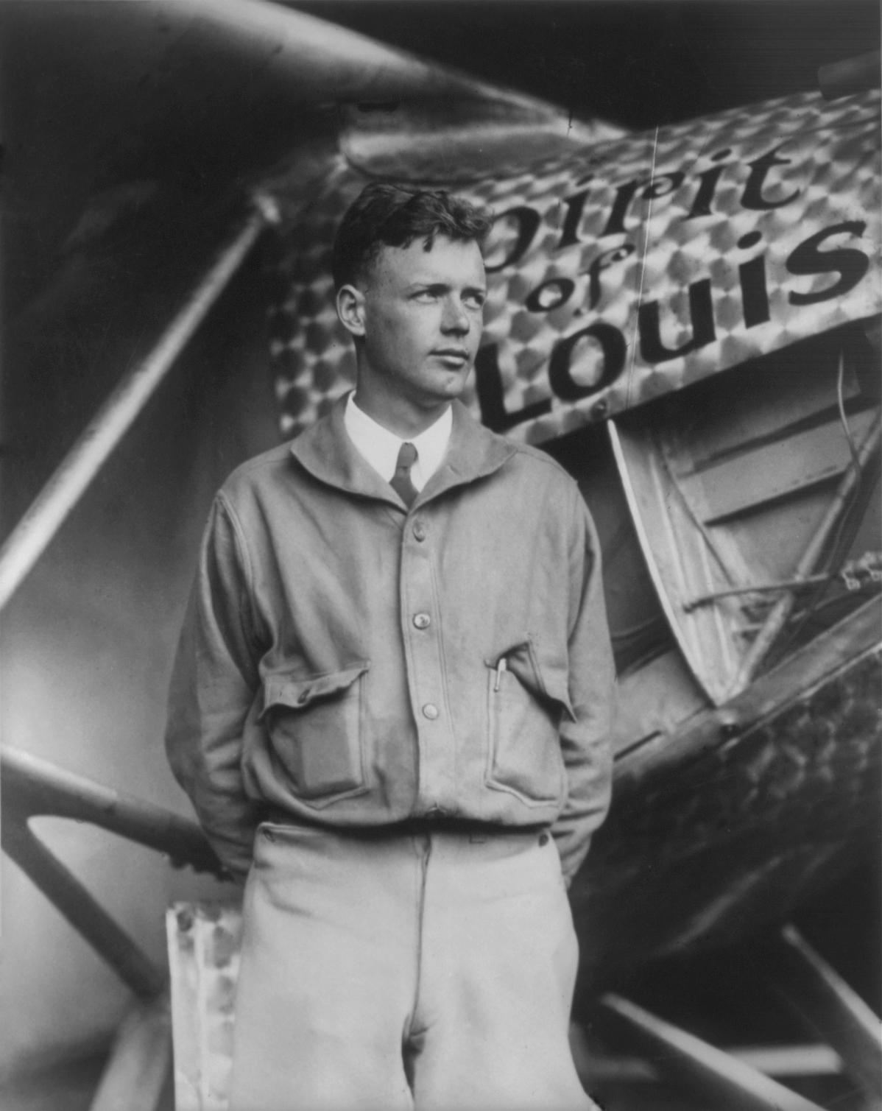
Humans Develop Wings
vWright brothers at Kitty Hawk- Dec. 1903
vUse in WWI
vPassenger liners & airmail
vCharles Lindberg’s transatlantic flight- 1927
vBy 30s safer than driving

Slide 16
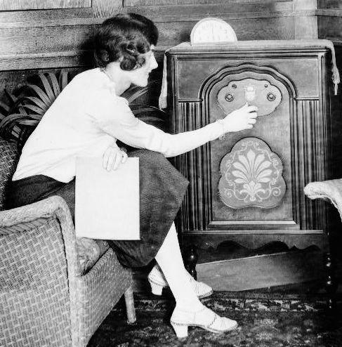
The Radio Revolution
vRadio broadcast- 1890s
vRadio stations common by 1920s- shows & advertising- Amos n Andy
vSports
vPoliticians
vNews

Slide 17
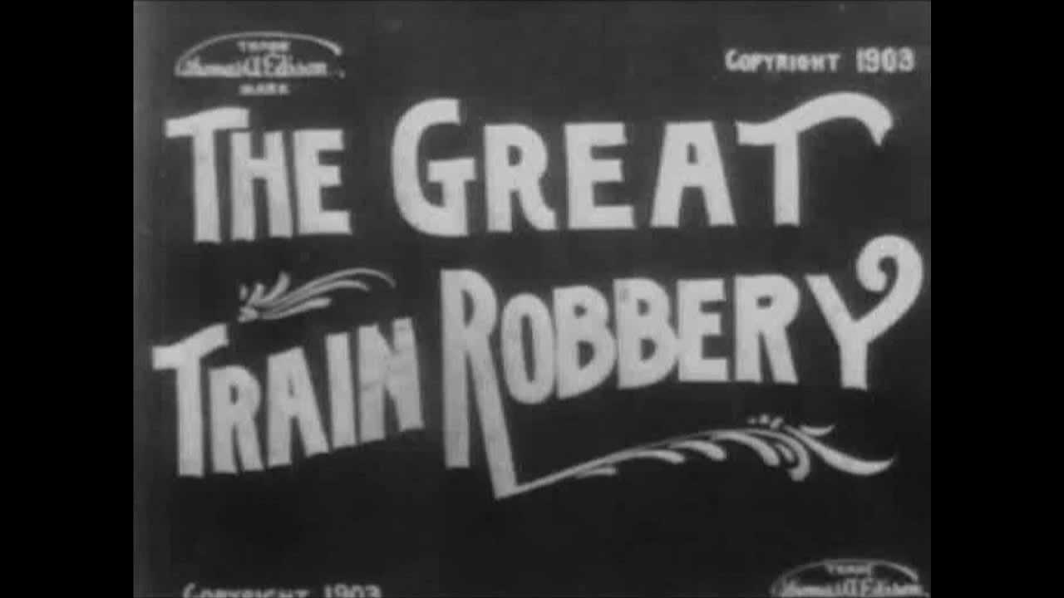
Hollywood’s Filmland Fantasies
v1st moving pictures- Edison- 1890s
v1st story film- 1903- The Great Train Robbery
v1st feature length- 1915- Birth of a Nation
vHollywood
vWWI made movies popular- propaganda
v1st “talkie”- 1927- The Jazz Singer
vMovies began to break down ethnic barriers

Slide 18
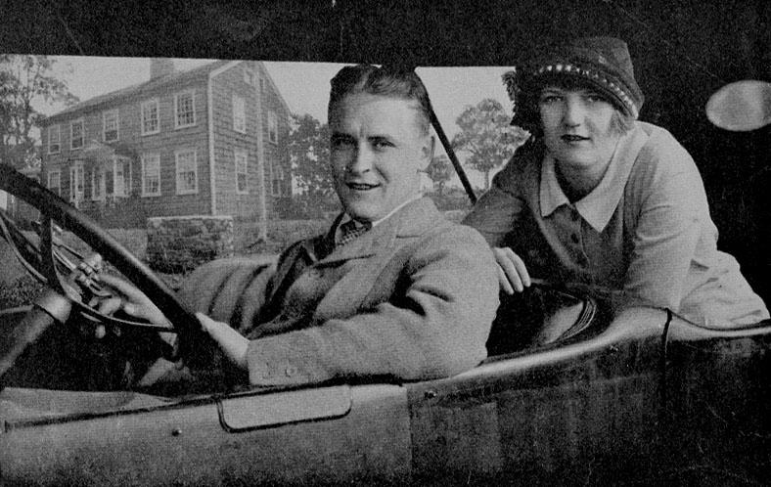
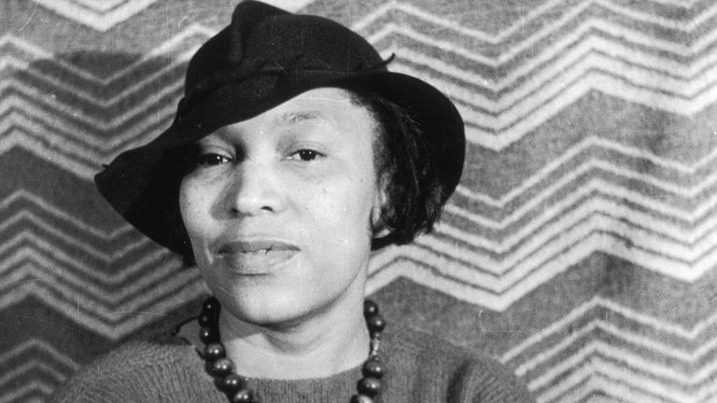
Cultural Liberation
vNew writers- the Lost Generation
vF. Scott Fitzgerald- This Side of Paradise (1920), The Great Gatsby (1925)
vErnest Hemingway- Old Man & the Sea, A Farewell to Arms (1929)
vLangston Hughes- poet- The Weary Blues (1926)
vZora Neale Hurston- Their Eyes Were Watching God (1937)

Slide 19
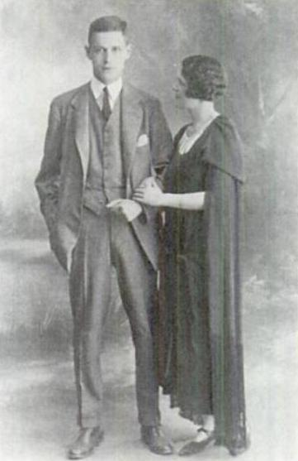
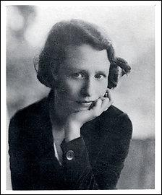
Harry Crosby
Edna St. Vincent Millay

Slide 20
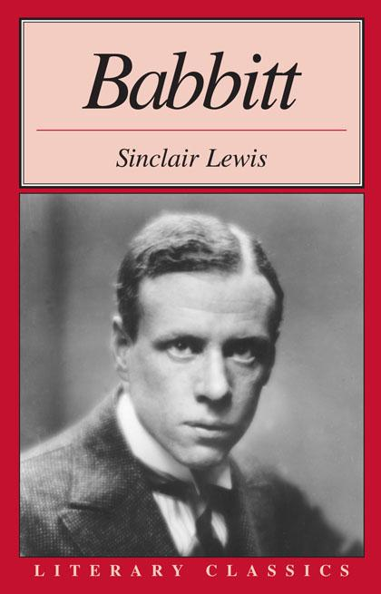
“Babbitry”

Slide 21
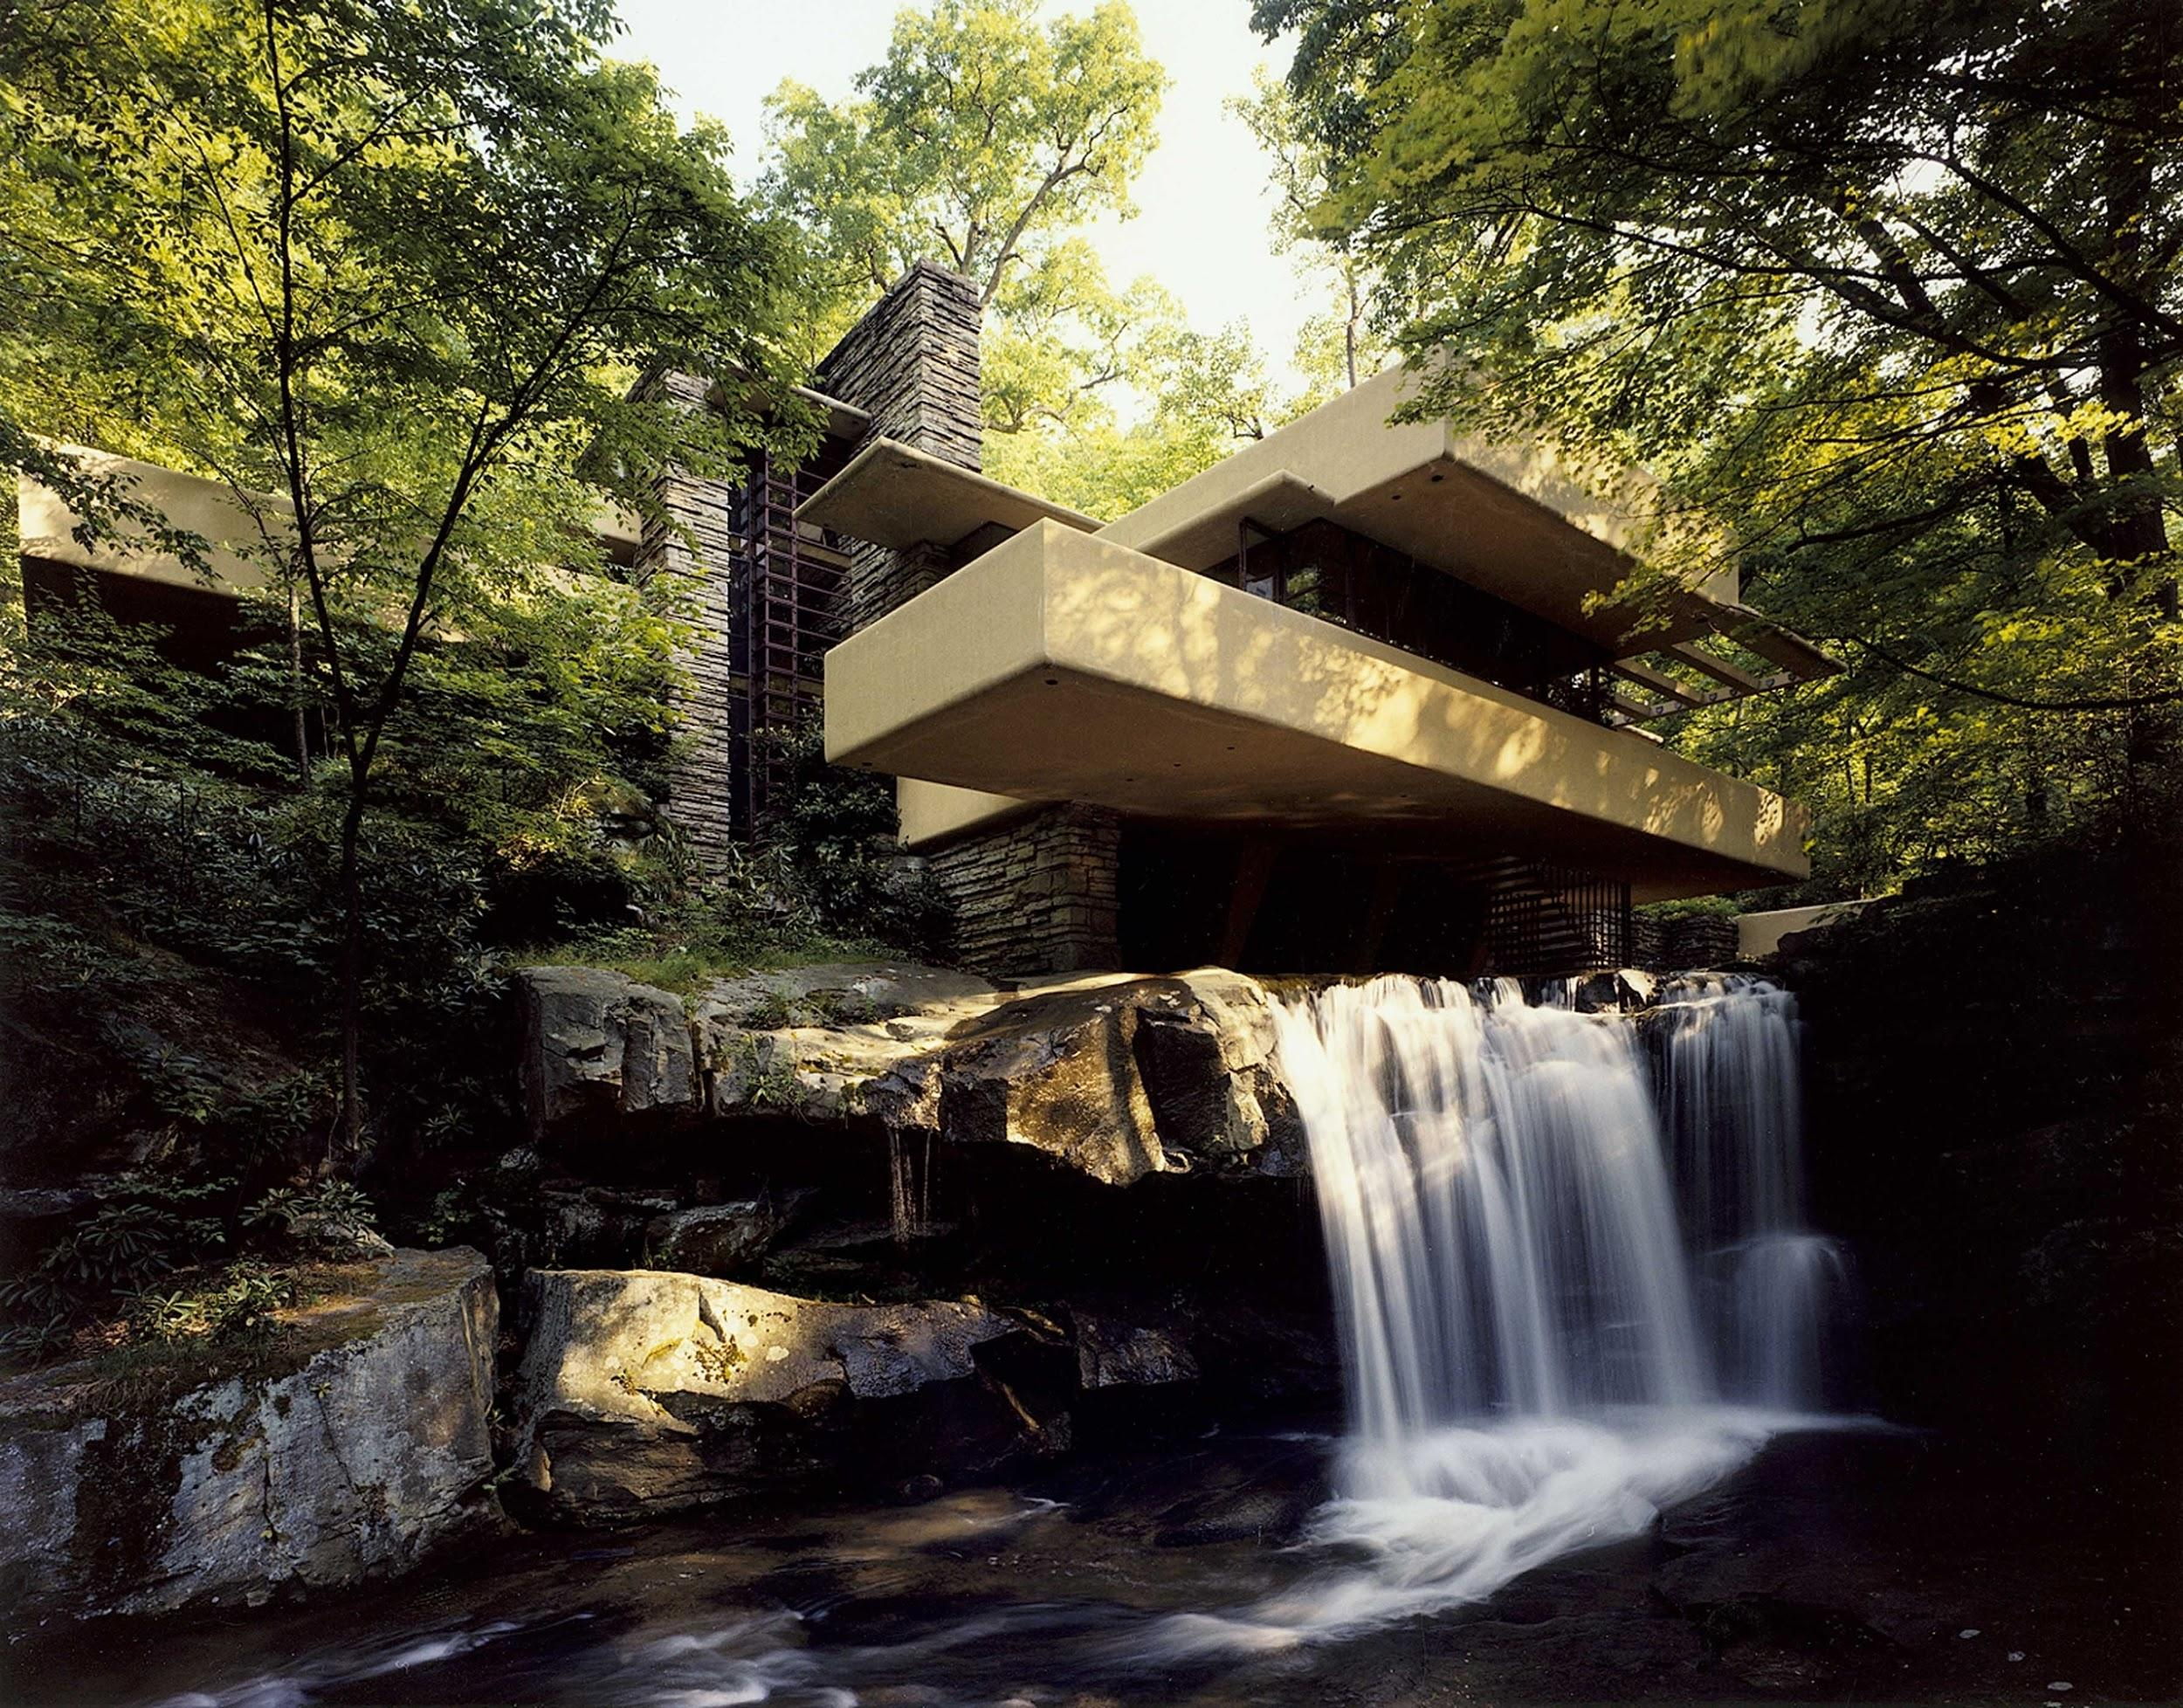
Cultural Liberation
vFrank Lloyd Wright- architecture
vGeorgia O’Keefe- art

Slide 22
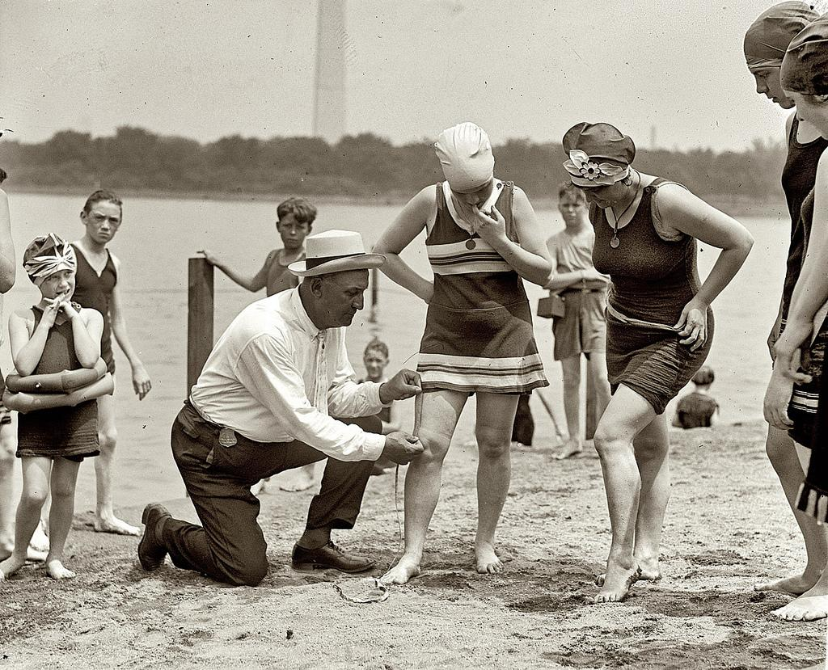
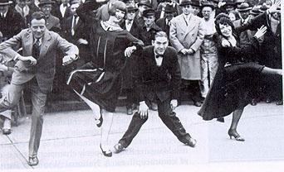
https://www.youtube.com/watch?v=pUpAcPAipDA

Slide 23
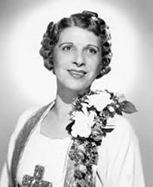
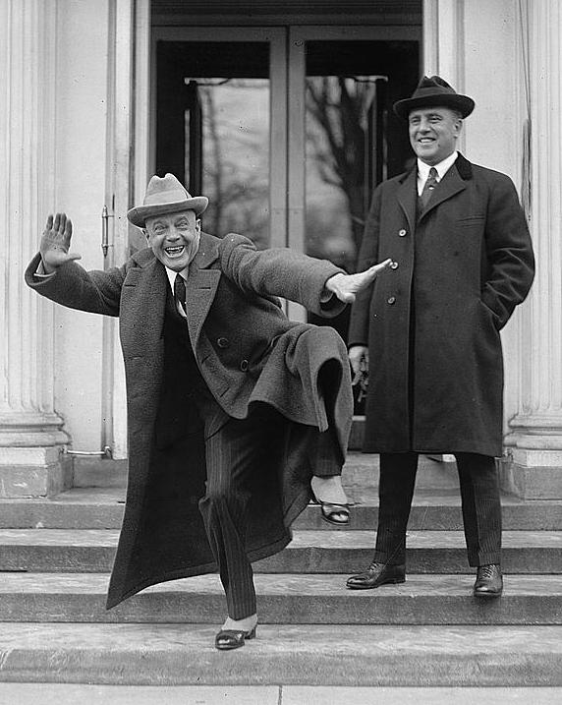
Fundamental Evangelists
Aimee Semple McPherson
Billy Sunday

Slide 24
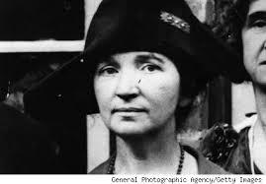
Margaret Sanger
-Trained as a nurse
-championed women’s right to birth control and family planning
-opened the nation’s first birth control clinic in New York.

Slide 25
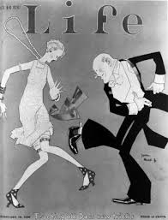

Slide 26
Harlem Renaissance
A Literary and Artistic Movement celebrating African-American Culture
African-Americans had moved North during the Great Migration. Phrase “Black is beautiful” comes into use

Slide 27
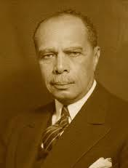
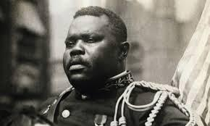
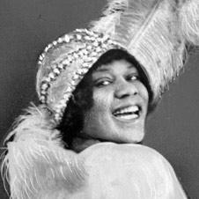
James Weldon Johnson
Marcus Garvey
Bessie Smith

Slide 28
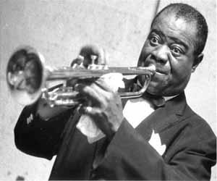
Harlem Renaissance Performers
Paul Robeson – famous stage actor
Louis Armstrong – Jazz
“Duke” Ellington – jazz pianist, composer

Slide 29
Wall Street’s Big Bull Market
vOverspeculation in real estate & stocks
vBuying on margin- 10% down
vTax burden placed on middle class by Sec. Of Treas. Mellon- allowed rich to keep more money for speculation
vBlamed for Bull Market & eventual downfall
vOverall probusiness govt. of 1920s

