Slide 1
The Cold War
AP US History

Slide 2
Period 8

Slide 3
Postwar Economic Anxieties
-Crumbling relations w/ Soviets- beginning of Cold War era
-Fear that war was only temporary fix for economy

Slide 4
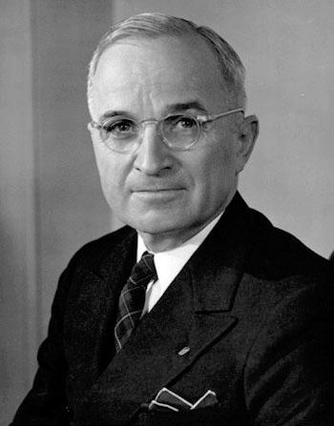
The Man from Missouri
-Baptism by fire for Harry Truman
-Not college educated, hot tempered, cocky
-Honest, authentic, unpretentious, moxie
-The buck stops here, if you can’t stand the heat get out of the kitchen

Slide 5
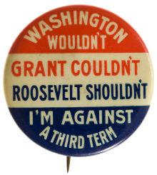
Postwar Economy
-Thought GIs would become unemployed- GI Bill of Rights- school & loans
-Employment Act of 1946
-22nd Amendment (Republican Congress reaction against FDR)
-Strikes, inflation after war

Slide 6
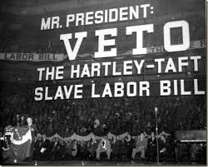
Taft-Hartley Act
-Taft-Hartley Act- 1947-
-outlawed closed shop
-allowed “right to work” states
-outlawed secondary boycotts
-gave president power of an 80 day cooling off period
-Passed over Truman’s Veto
-Antiunion fears, esp. in south

Slide 7
The Fair Deal – “out – New Dealing the New Deal”

Slide 8
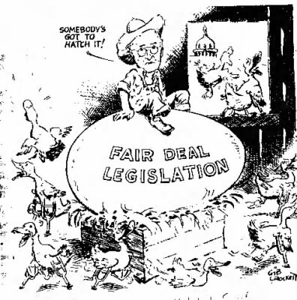
-Fair Deal (domestic)-
•Better housing, full employment, higher minimum wage, better farm supports, new TVAs, extension of Social Security
•Most fell to republicans & southern dems.- did raise min. wage, created Housing Act, extended SS

Slide 9
Postwar Economic Boom, 1950-1970
nSustained economic growth for 2 decades
nIncome doubled then again
nPaved the way for many changes- Civil Rights Movement, Medicare

Slide 10
Postwar Boom (continued)
nPlaced US as world leader
nLiving “American dream”
nWomen in work 25% of workforce- traditional roles

Slide 11
Roots of Postwar Prosperity
-Military budgets of WWII & Cold War
-New technology for defense
-Cheap energy - Lots of oil from middle east
-Huge increase in labor production
-Technology & education
-Agribusiness- made up only 2% of workforce by 1990s- fed much of the world

Slide 12
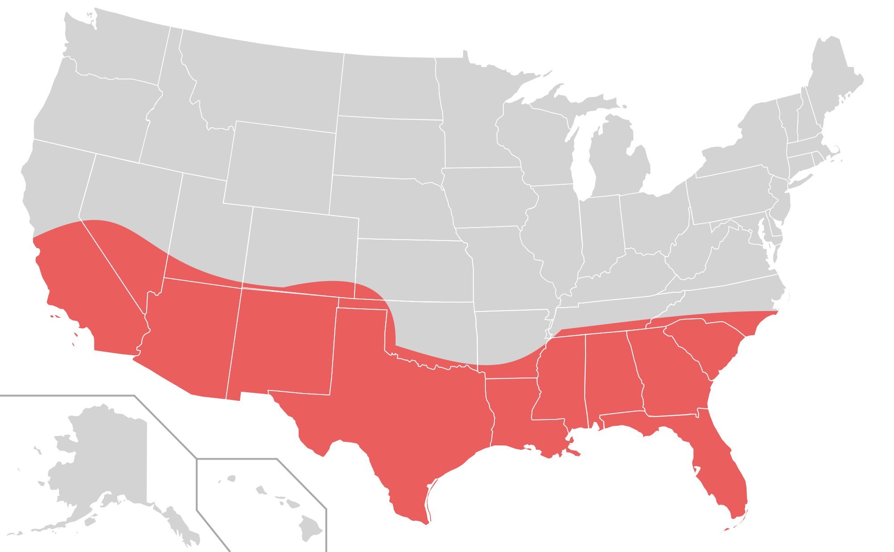
The Smiling Sunbelt
-Large migrations post-1945-1970- many to south & west (Sunbelt)
-Better climates, lower taxes
-Northeast & midwest (rustbelt)
-Changes in political power

Slide 13
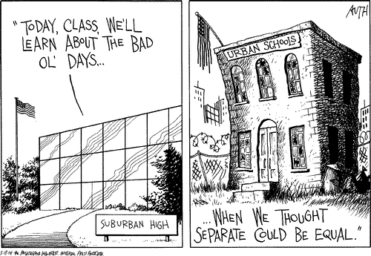
Rush to the Suburbs
-White flight after WWII- suburbs
-Federal Housing Authority & Veteran’s Affairs (risky loans & high risk areas)
-Tax write-offs for interest on home loan

Slide 14
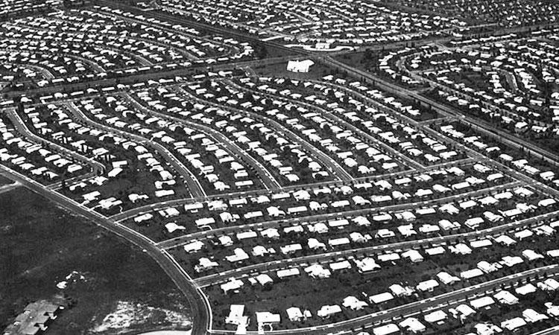
The ‘Burbs
-New highways
-Levittown- Long Island NY- late 40s
-Standardized plans & construction
-Minorities began filling urban areas

Slide 15
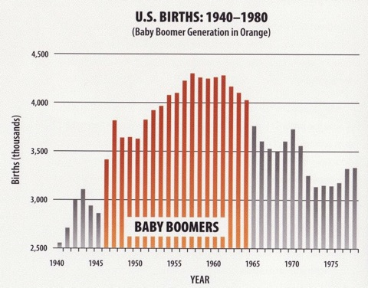
Postwar Baby Boom
-Huge increase in birthrate in 15 years following WWII- 50 million
-By 1960 birthrate dropping off
-By 1973 birthrate below point needed to maintain population
-Currently- “graying of America”
-Strain on US society

Slide 16
Democratic Divisions in 1948
nRepublicans won Congressional control in 1946
nNominated Thomas Dewey of NY in 1948
nDemocrats renominated Truman- not favored by southerners b/c of his civil rights stand

Slide 17
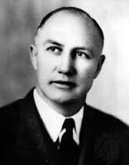
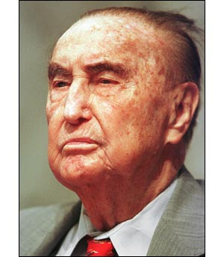
nSplit & created “Dixiecrats”- Strom Thurmond of SC
nFormer VP Henry Wallace created another Progressive party
nTruman won w/ support of labor, blacks, & farmers- nearly lost- “Dewey Defeats Truman”

Slide 18
Thurmond – claimed not to be racist, but for States’ Rights, complete segregation
said Truman wanted to “convert America into a Hitler State”
Wallace – expand welfare, international control of nukes
Dewey – bland clichés, no stance on controversial issues

Slide 19
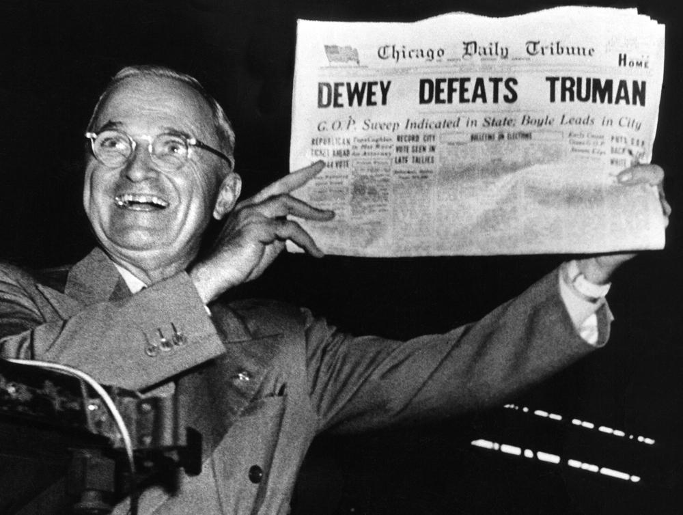

Slide 20
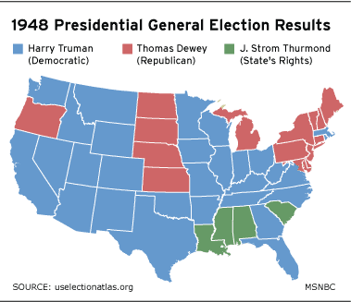

Slide 21
Truman and Civil Rights
July ‘48 – Exec Order desegregating armed services
Commission – To Secure These Rights
-”an American charter of human freedom”

Slide 22
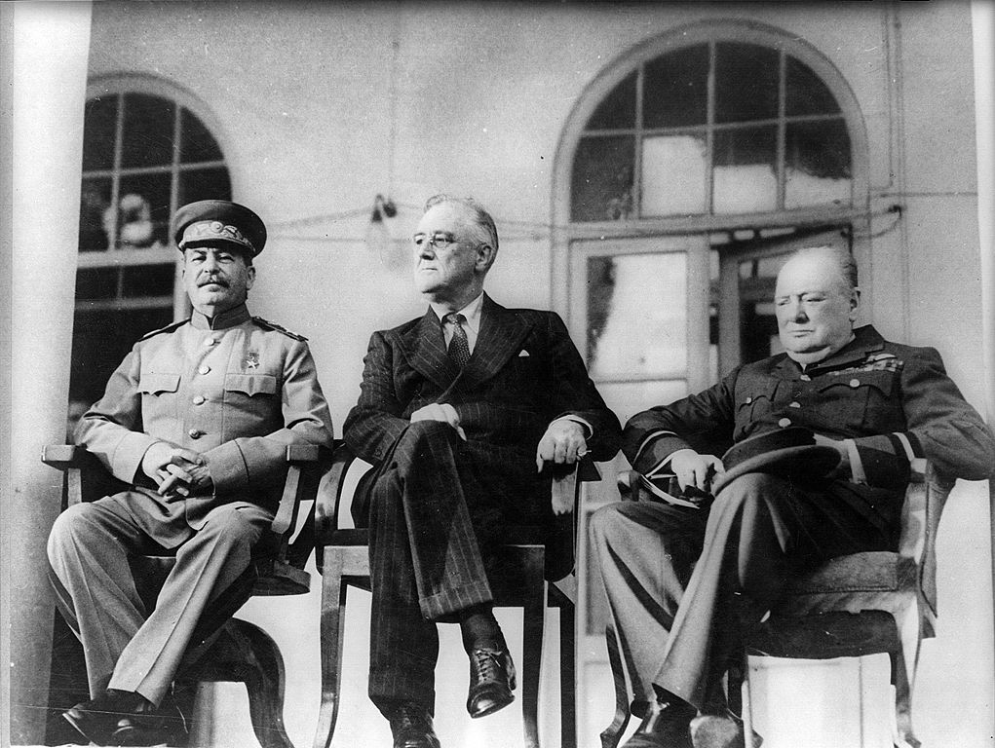
Tehran Conference
-1943
-FDR, Churchill, Stalin
-open Western Front
-Soviets free reign in the East?
-FDR - self-determination

Slide 23
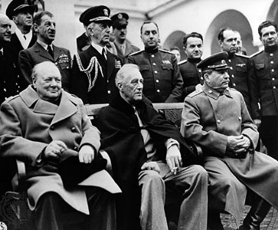
Yalta - Bargain or Betrayal?
nYalta Conference- Feb. 1945
nStalin, Churchill, FDR (near death)

Slide 24
Yalta
Important agreements about postwar Europe
•Occupied German zones (Berlin)
•Poland, Bulgaria, Romania would be allowed to have free elections
•Plans for United Nations
•Stalin agreed to enter war against Japan after Germany’s defeat- favorable to FDR

Slide 25
Yalta (continued)
•Stalin would gain control over some Japanese territory & Manchuria- control in East Asia
•critics said FDR sold out Chinese rebel leader called Chiang Kaishek & Poland
nYalta set stage for conflict b/t US & USSR after war (dropping of atomic bomb)

Slide 26
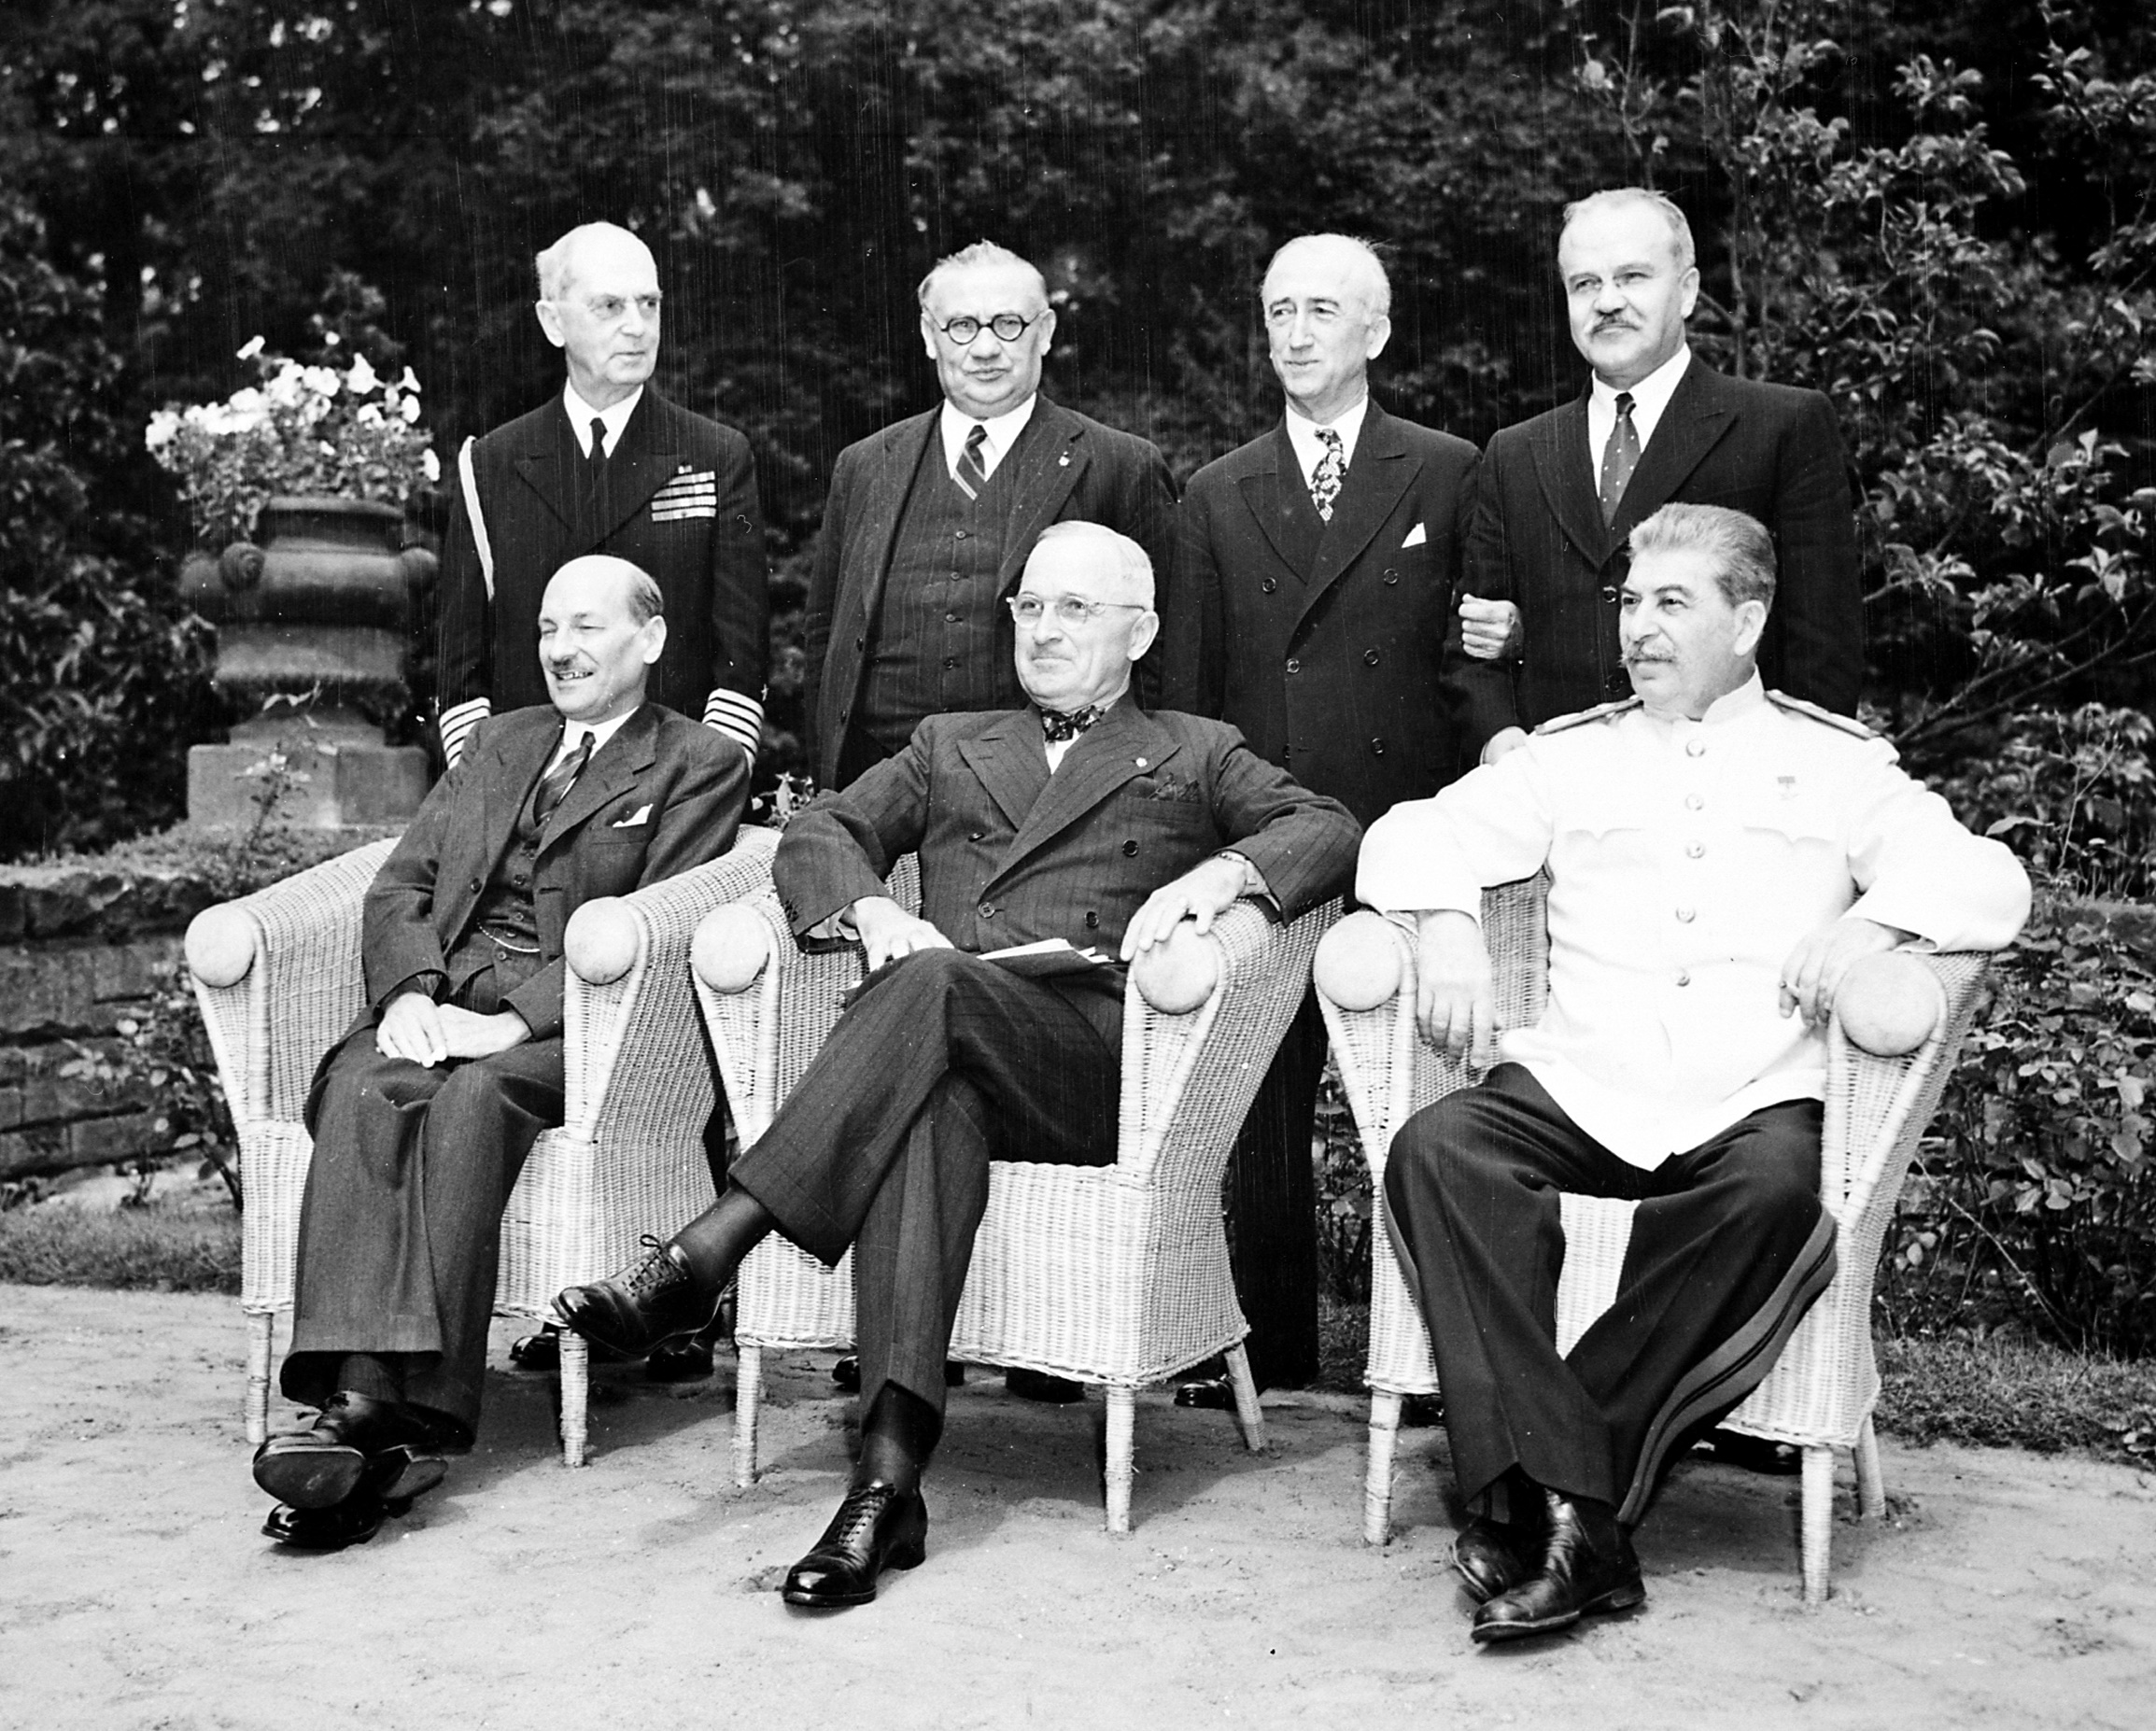
Potsdam - bomb secrets?
-Truman thought he had a secret
-Stalin had Fuchs
Stalin - no free elections?

Slide 27
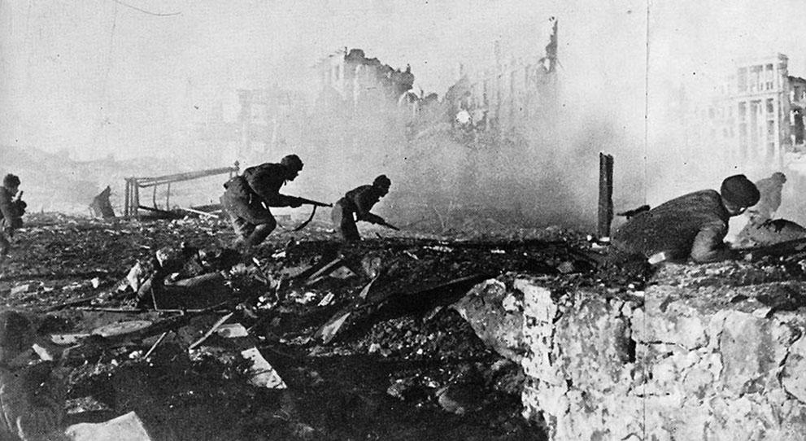
US and USSR
-Huge mistrust b/t east (Soviets) & west (GB & US)
-Capitalism vs. communism
-US hadn’t recognized USSR until 1933
-US & British balked on opening 2nd front
-US & British blocked Soviets out of bomb development

Slide 28
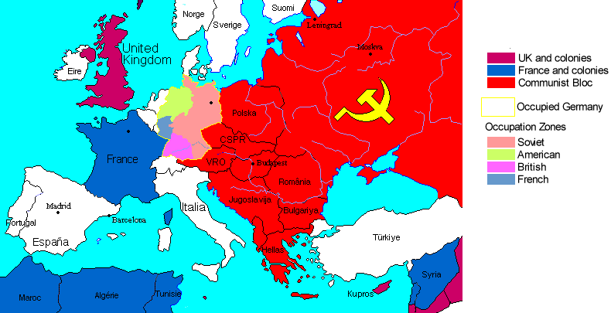
nStalin proclaimed that he would have “friendly borders”- eastern Europe & Asia
nAmericans felt like Stalin wasn’t allowing for choice
nBoth nations wanted to “export” their own philosophies
nConflict over control of Europe & Asia- Cold War

Slide 29
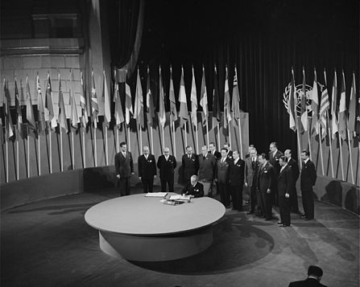
Shaping the Postwar World
-1st UN Conference in April ‘45
-Before end of war (FDR wanted to capitalize on war time cooperation)
-Permanent 5-Member Security Council-US, USSR, GB, Fr, Ch
-Assembly of countries (like a legislature)
-Based on idea of cooperation- approved by Senate
-Debate of atomic weapons- US vs. USSR

Slide 30
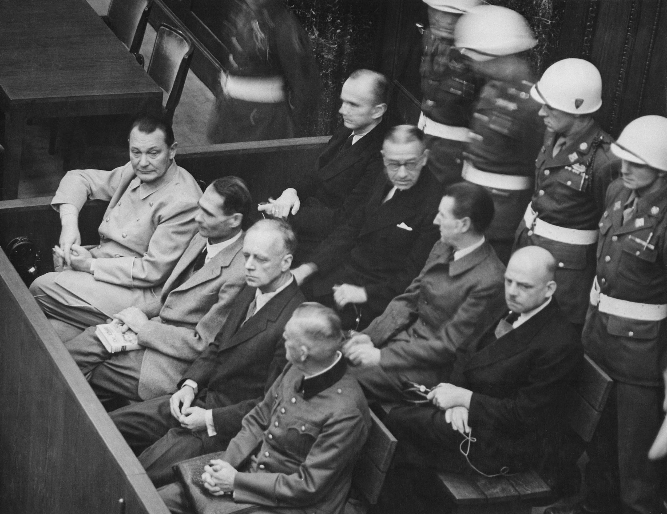
The Problem of Germany
Allies wished to rid world of Nazism
War crimes trials for leaders- Nuremburg, Germany
-22 tried- 12 hanged, 7 sentenced to long prison terms
-Idea of “following orders”

Slide 31
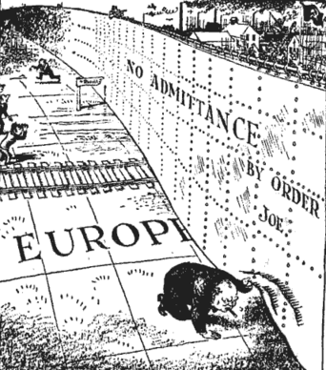
Divided Europe
-German occupation zones
-Eastern “satellite states”
-Iron Curtain- Churchill, 1948
-Berlin Occupation Zones

Slide 32
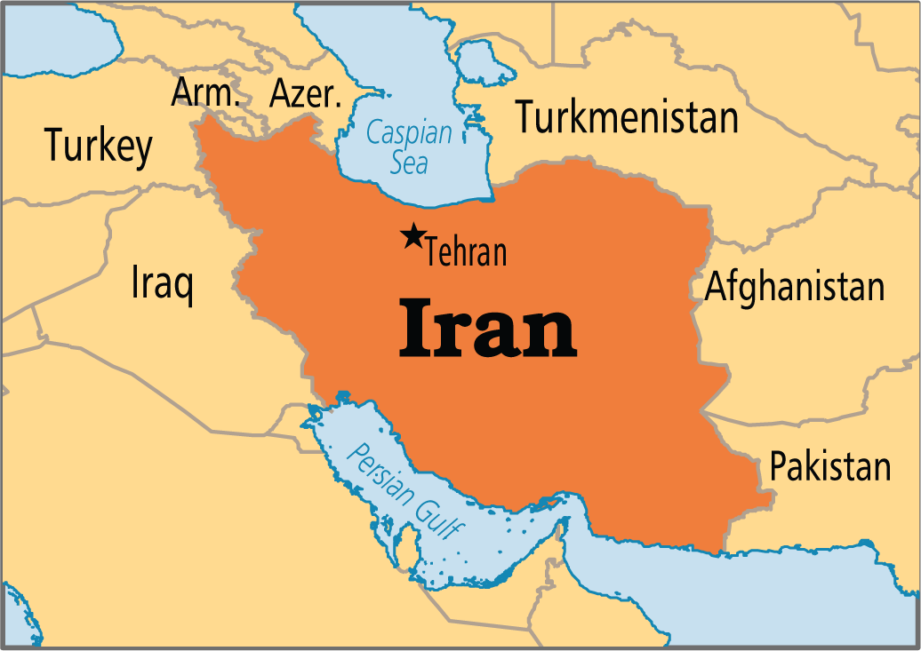
The Cold War Congeals
USSR’s cooperation gone by 1946
-Iran- oil
-Germany

Slide 33
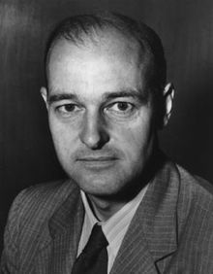
Truman and “Containment” - 1947
-George F. Kennan
-”Long Telegram”
-Russia was expansionist- contain Soviet power
-“get tough with Russia”

Slide 34
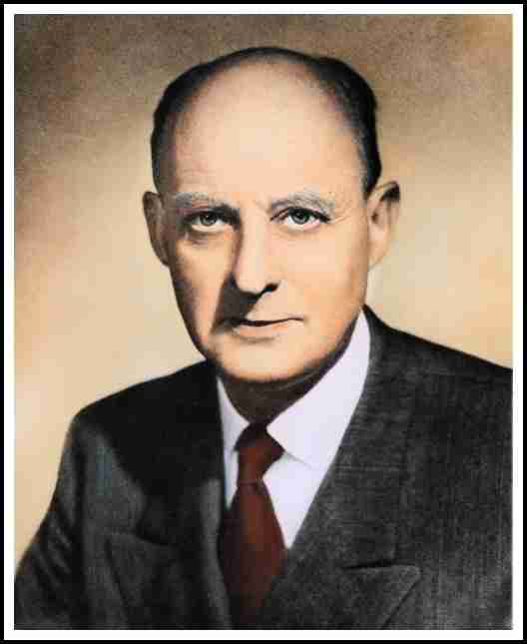
Truman Doctrine
1947 - $400 Million to safeguard Greece and Turkey
-Protect anyone fighting against communism
-Reinhold Niebuhr- Truman’s supporter in fight against communism

Slide 35
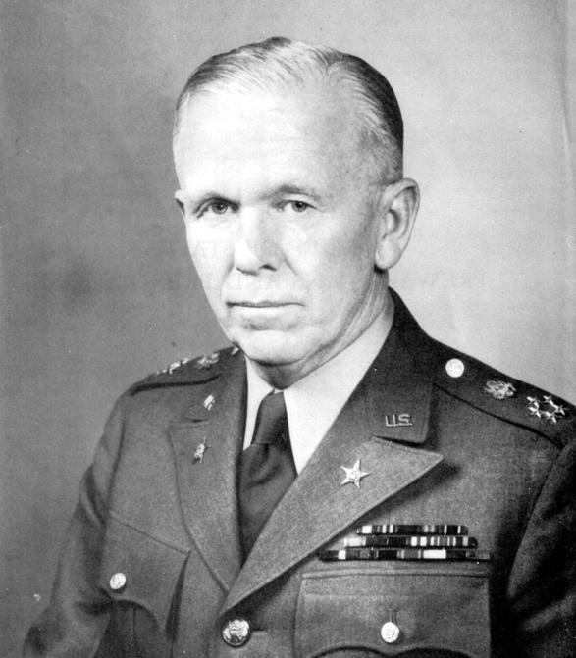
-Ravaged post-war Europe- in danger of communist takeover
-1947- Sec. Of State G. C. Marshall- Marshall Plan- $12.5 bill. To rebuild Europe
-Approved by Cong. April 1948
-Slowed growth of communism in western Europe

Slide 36
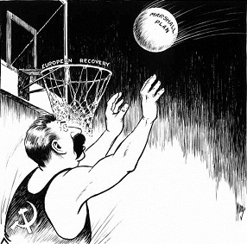
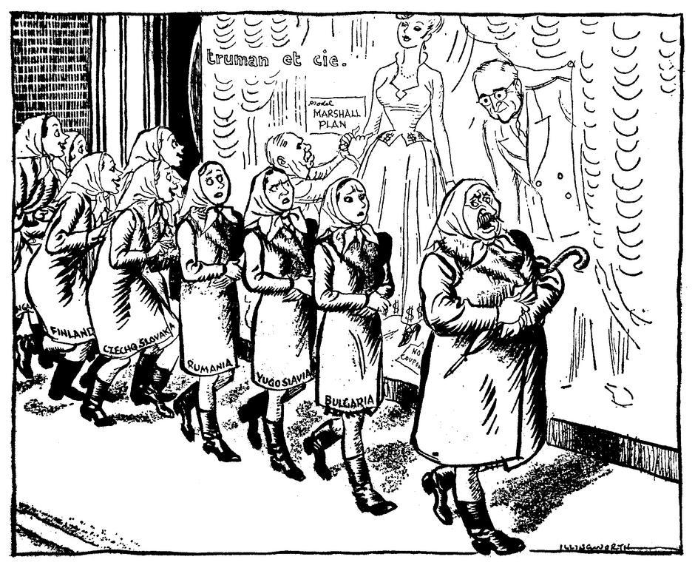

Slide 37
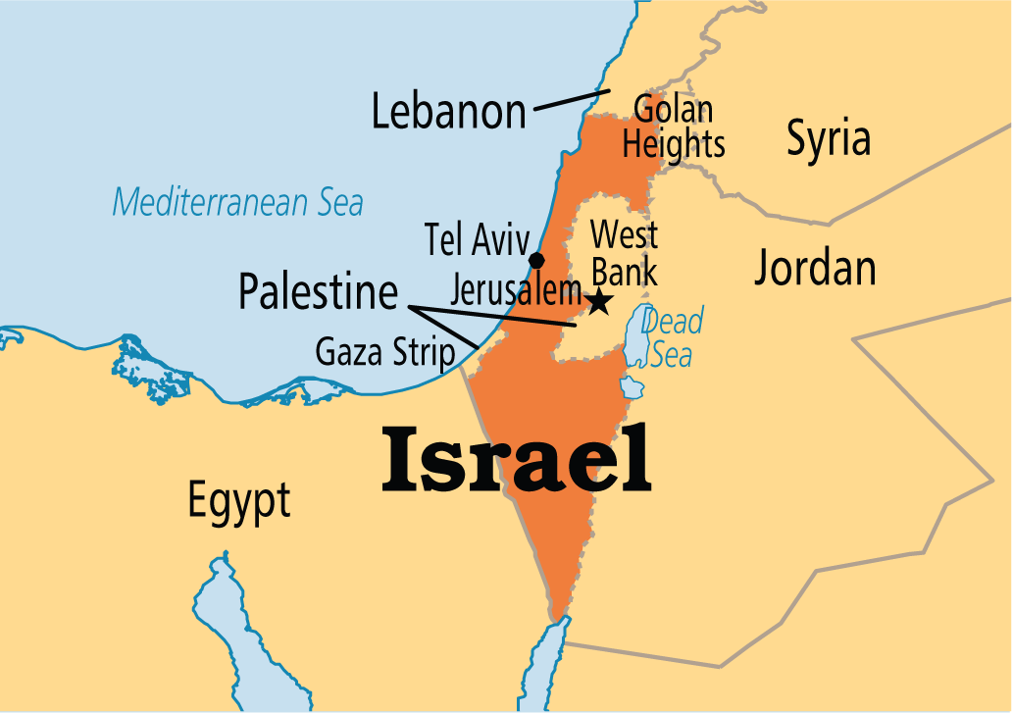
Israel
-US needed Middle Eastern oil
-Arab oil producers warned about establishing nation of Israel (Palestine)
-Truman threw support to proposed nation- born May 1948

Slide 38
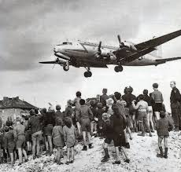
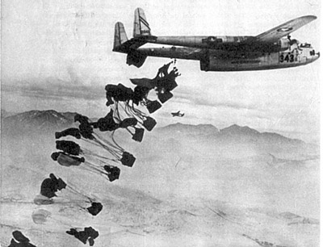
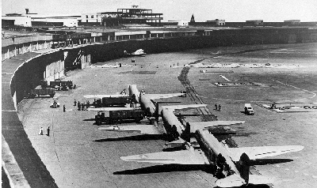
Berlin Airlift
-June 1948 -Soviets cut off all access to Berlin
-11 month supply airlift
-60 bombers sent to England
-after 11 months highways reopened

Slide 39
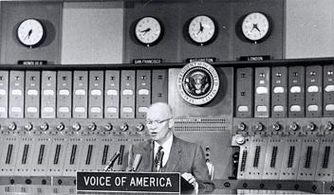
America Begins to Rearm
-No return to peacetime economy (Soviet threat)
-1947- National Security Act- Created dept. of defense & natl. Security Council & CIA
-Voice of America 1948- American broadcasts behind iron curtain
-Draft reinstated in 1948 (Selective Service System)

Slide 40
1949- US joined North Atlantic Treaty Organization (NATO)- collective western European security against Soviet threat
-Strengthen containment
-Bring Germany back into European affairs
-Showed US not abandoning wartime allies
-*isolationists feared- dramatic change from isolationist policies

Slide 41
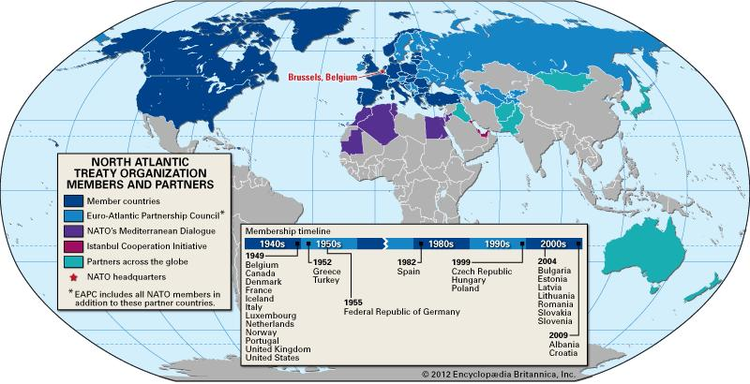

Slide 42
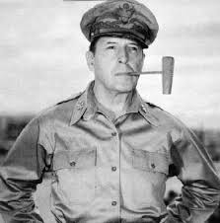
Rebuilding Japan
Gen. Douglas MacArthur- democratization of Japan
-Against wishes of USSR
-War crimes trials of high Japanese officials- 7 sent to death

Slide 43
Japanese Cooperation
Understood cooperation Would end occupation sooner
MacArthur constitution
•Renounced militarism
•Female equality
•Western democracy (led to economic success)
Japan in 2nd half of 20th Century - Economic Miracle

Slide 44
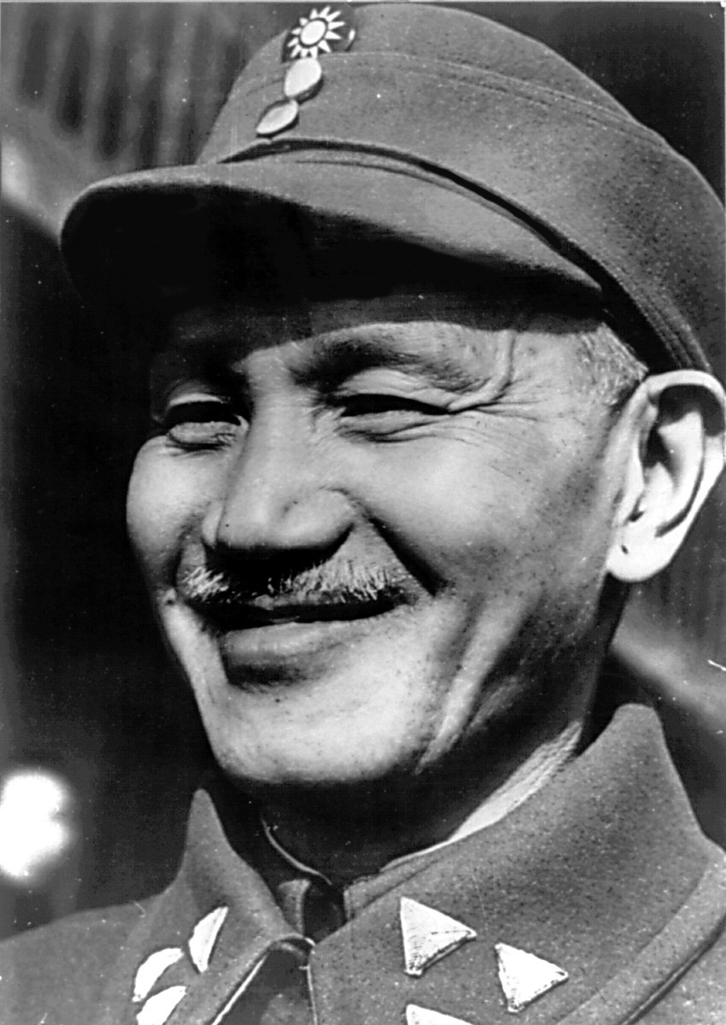
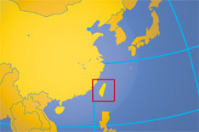
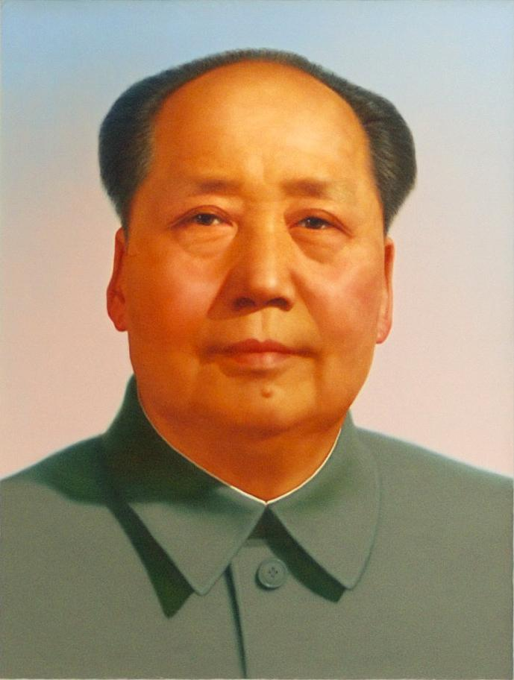
Chinese Civil War
-US supported Chiang Kaishek
-Communist leader Mao Tse-tung
-1949- Comm. took over, Chiang fled to Formosa (Taiwan)
-Became a partisan struggle in US

Slide 45
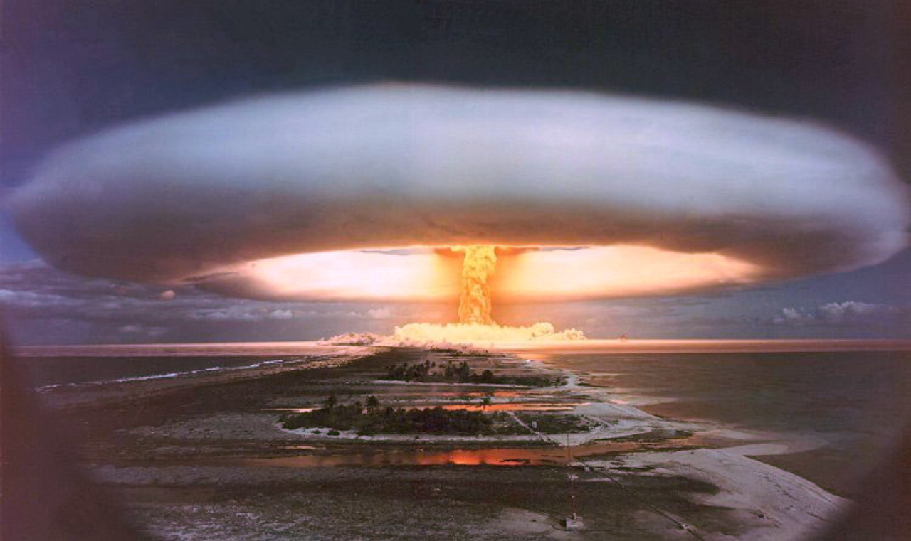
Soviets explode bomb - 1949
Truman ordered development of H-bomb
•US in 1952, Soviets in 1953
Beginning of atomic arms race b/t USSR & US
Opposition to atomic weapons- destroy world

Slide 46
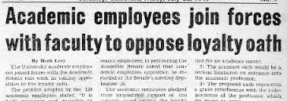
Hunting Reds
nFear of communist Spies in US
n1947- Truman created Loyalty Review Board- investigate supposed com. Groups & federal employees
Exec Order 9835 – Loyalty-Security Program
nLoyalty oaths- freedom of expression

Slide 47
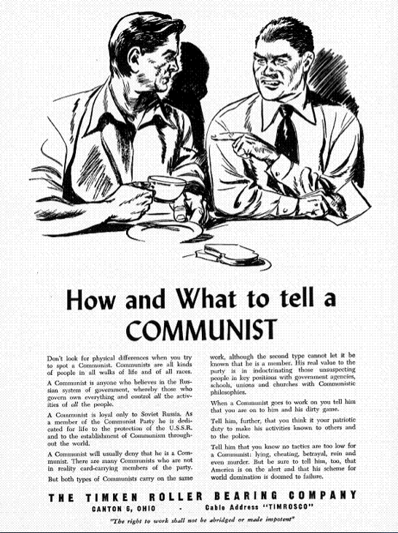

Slide 48
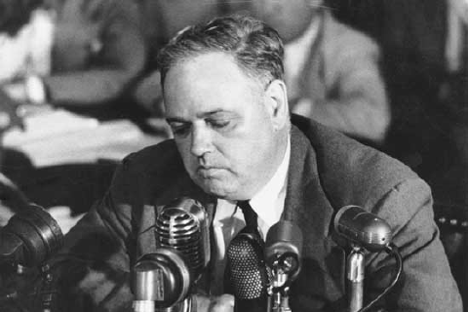
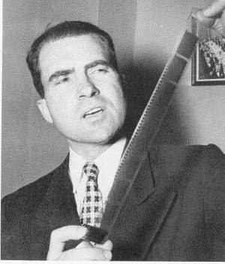
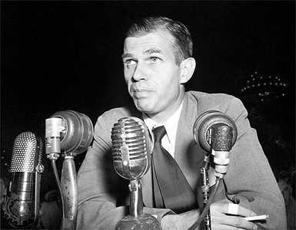
The Reds Have Landed
-Whittaker Chambers - “Pumpkin Patch Papers”
-Alger Hiss- convicted of perjury- beginning of communist witch hunts

Slide 49
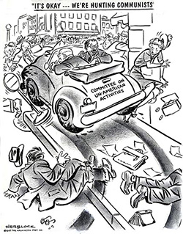
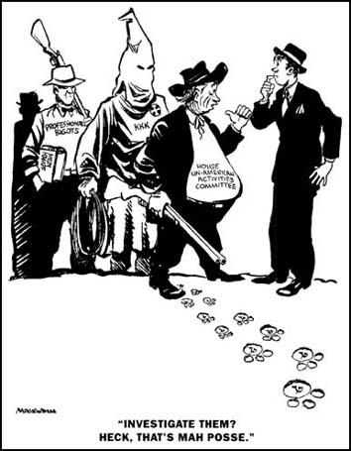
HUAC
Committee on Un-American Affairs (HUAC- 1938)- Richard Nixon

Slide 50
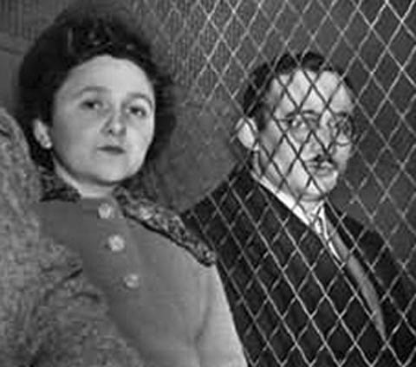
More Red Hunting
-All sorts of new ideas condemned by traditionals in govt. (seemed like communism)
-1950 McCarran Internal Security Bill
-Julius & Ethel Rosenberg- spies convicted in 1951- executed

Slide 51
Truman’s new programs in 1949
-Point Four (foreign)- lend money & aid to underdeveloped nations- keep from fighting them in the future

Slide 52
Cold War - Who Started It?
-Traditional view - US as defender of the “free world”
-Gar Alperovitz - Truman dropped bomb on Japan as a warning to Soviets
-John Gaddis - failure to reconcile divergent political objectives - credits Truman and Stalin for avoiding a nuclear war

