Slide 1
Prohibition

Slide 2
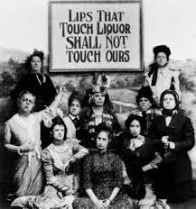
Roots of Prohibition
Temperance movement
WCTU

Slide 3
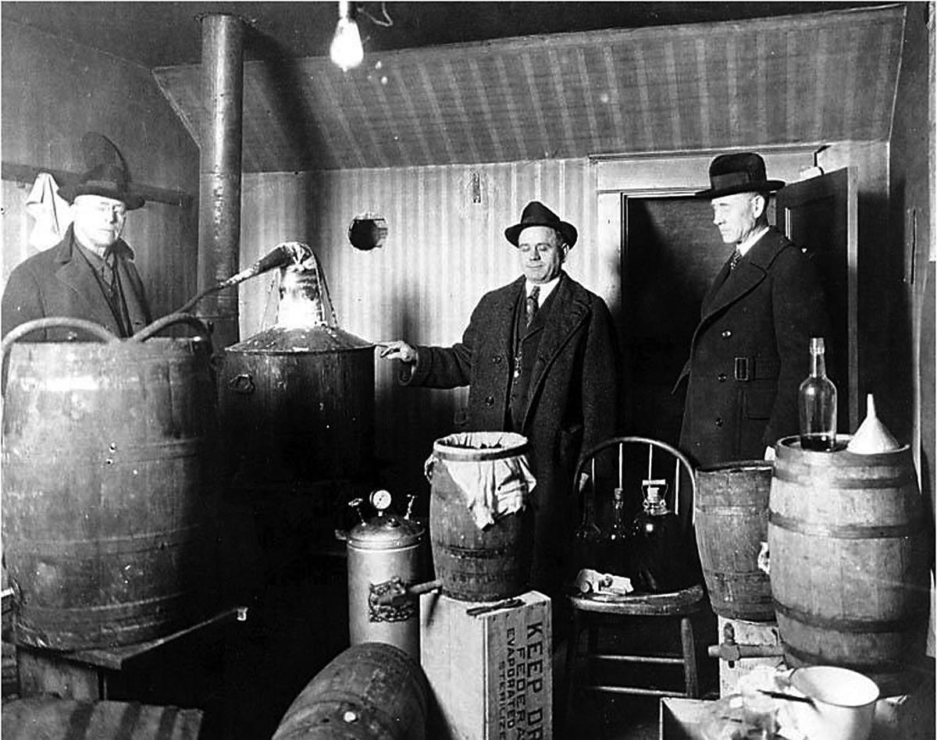
The Prohibition “Experiment”
v18th Amendment- 1919,
Volstead Act- 1920
vSouth & West supported it
vOpposed in Northeast & midwest
vIllegal overnight?
vHypocritical legislators, returning soldiers, poor vs. rich, jazz age youth
vSpeakeasies
vRumrunners, bootleggers, home brew, bathtub gin
vpositives

Slide 4
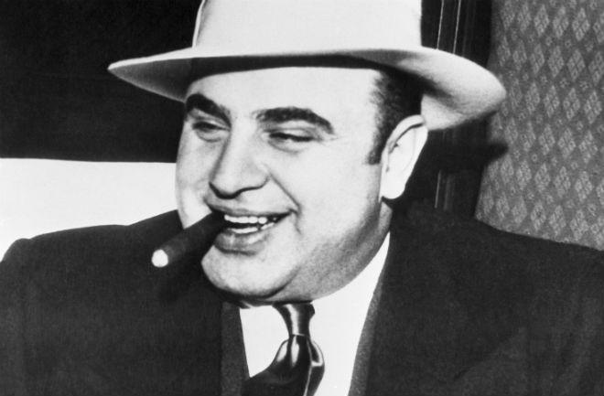

Slide 5
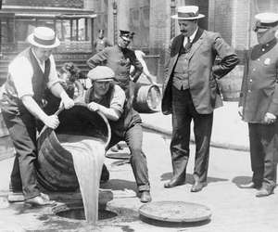
Hypocritical legislators, returning soldiers, poor vs. rich, jazz age youth
Speakeasies
Rumrunners, bootleggers, home brew, bathtub gin
positives

Slide 6
16th Amendment
Paved the way for Prohibition – part of Progressive agenda
Allowed first national income tax
Had to find a way to replace lost revenue from excise taxes on liquor

Slide 7
Repeal of Prohibition
1933 – 21st Amendment

