Slide 1
Progressivism
American History 2

Slide 3
What is it?
●Reform movement of the late 1800’s and early 1900’s
●Believed efficient government could protect public interest and restore order to society
●Government is an agency of human welfare
●Major departure from Jeffersonian America
●Life had become to complex and the federal gov’t had to get more involved

Slide 4
Causes
-Began with reforms at the local state level in 1880s
-Socialist immigrants from Europe
-Economic and Social Injustice
-Muckrakers

Slide 5
Progressive Goals
●Limit power of Trusts/Monopolies
●Improve work and living conditions for “working” America
●Protect consumers
●Conservation movement

Slide 6
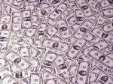
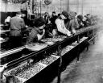
4 Goals of Progressivism
Protect Social Welfare
Promote Moral Improvement
Create Economic Reform
Foster Efficiency

Slide 7
Regulation of Corporations
●Roosevelt attacked the Northern Securities Company
●Holding company owned by JP Morgan and James G Hill of railroads in the northwest

Slide 8
Progressive Roots
Progressivism - late 19th & early 20th cent reform movement to change society for better - related to Greenback movement/Populists

Slide 9
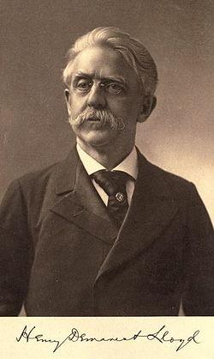
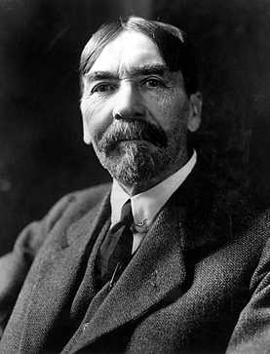
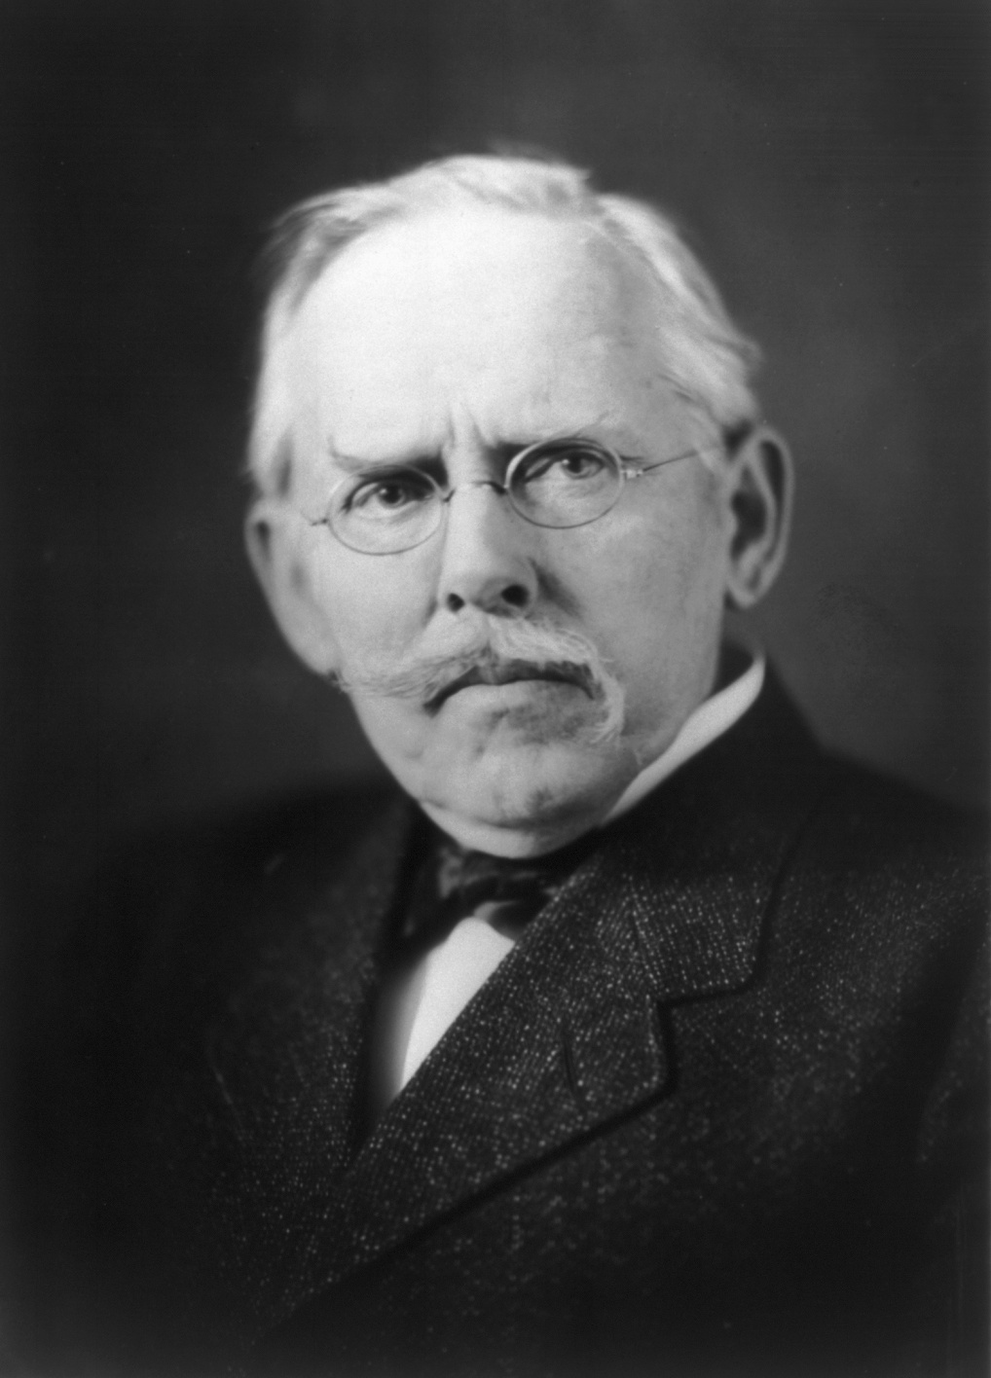
Early Progressive Writers
-Henry Lloyd - Wealth Against Commonwealth
-Thornstein Veblen - Theory of the Leisure Class
-Jacob Riis - How the Other Half Lives

Slide 10
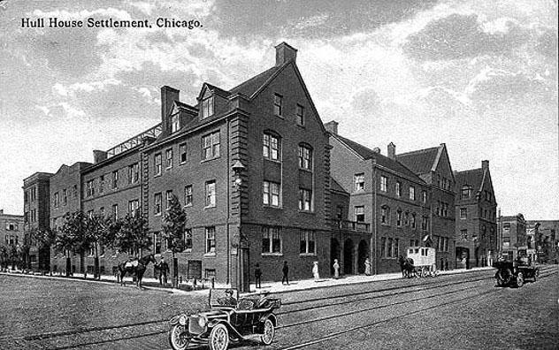
Social Gospel Movement
mostly females - Jane Addams, Florence Kelley

Slide 11
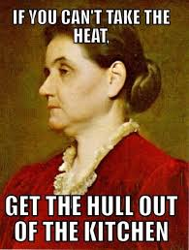

Slide 12
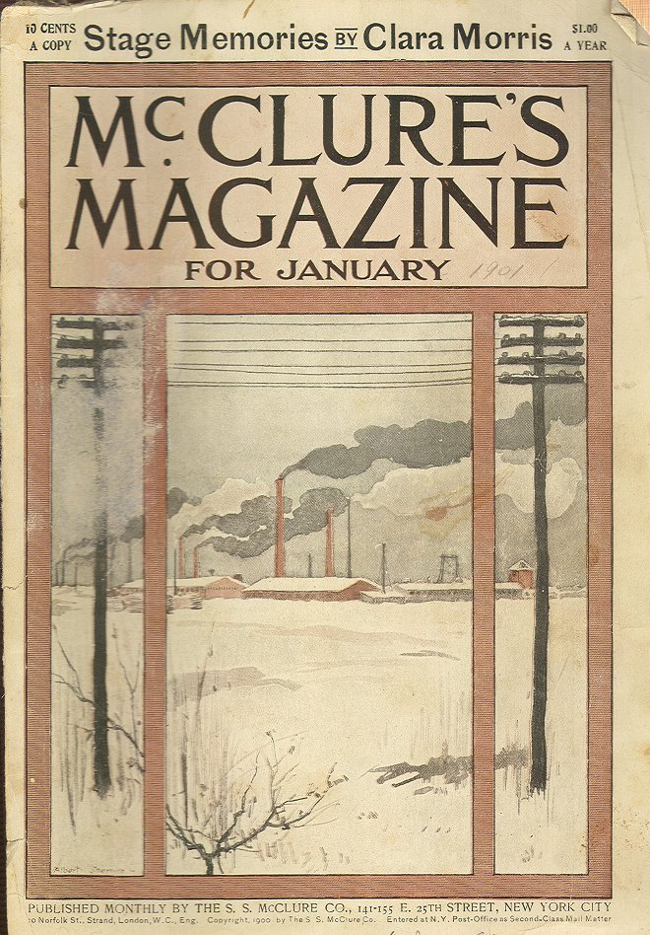
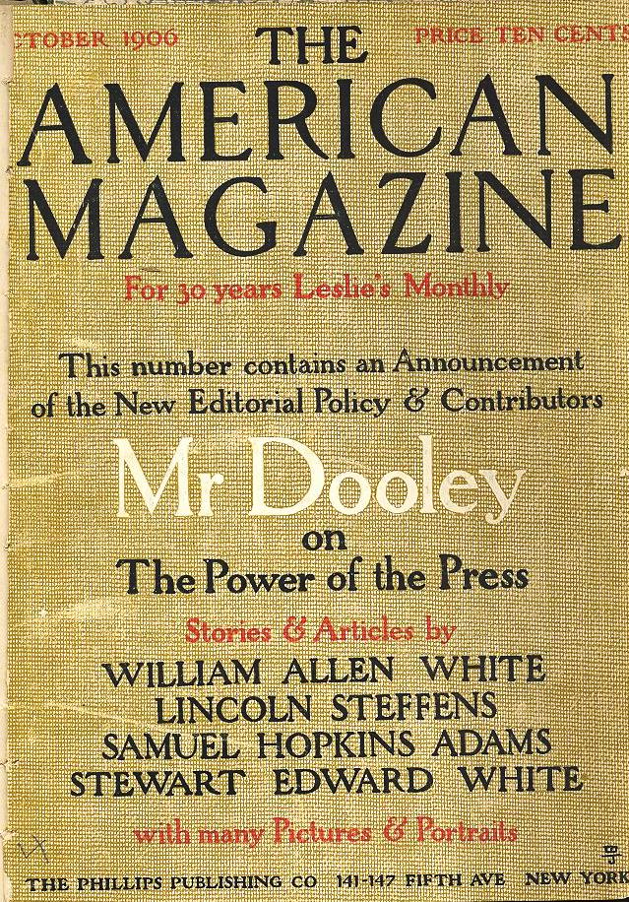
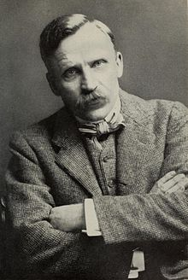
Muckrakers
S.S. McClure

Slide 13
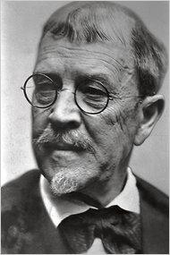
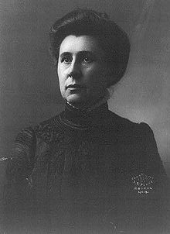
-Lincoln Steffens (The Shame of the Cities)
Ida Tarbell (History of Standard Oil)

Slide 14
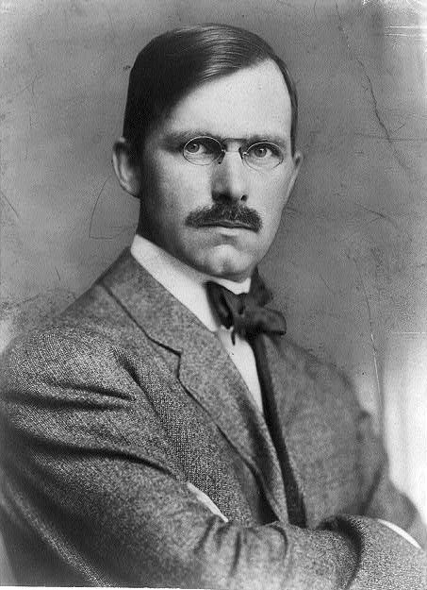
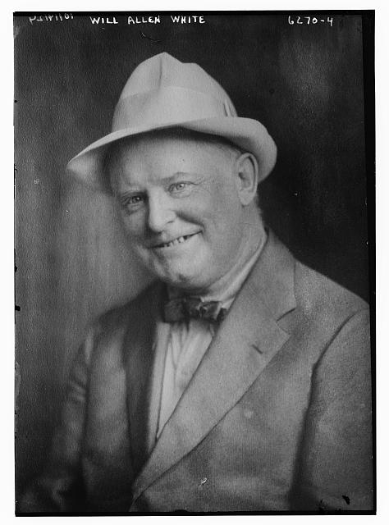
Ray Stannard Baker
William Allen White

Slide 15
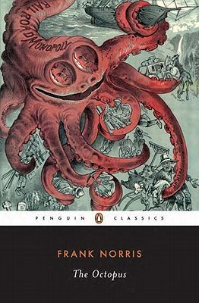
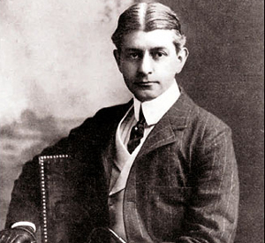
Frank Norris - The Octopus

Slide 16
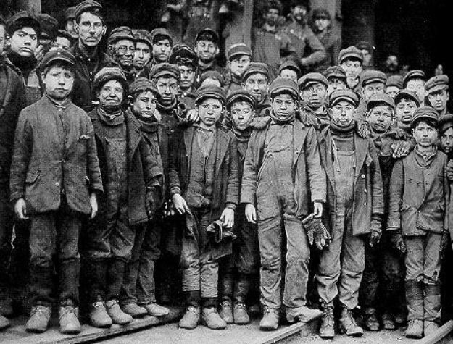
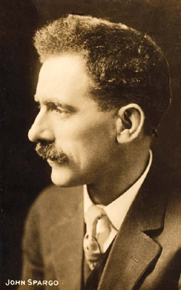
John Spargo’s The Bitter Cry of the Children

Slide 17
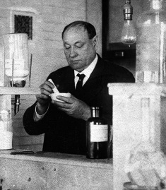
Dr. Harvey Wiley
“Poison Squad”

Slide 18
Regain Political Power for People
-Initiative, Referendum, and Recall
-Stop graft, make campaign finance reform
-Secret (Australian) ballot
-Direct Election of US Senators (17th Amendment)
-Female Suffrage (19th Amendment)

Slide 19
Progressive Cities
Efficiency and Reform
-Galveston, TX - expert commissions, 1901
-City-Manager System
-Slumlords, Juvenile Delinquent, Prostitution

Slide 20
“Golden Rule” Jones
Toledo, Ohio
Self-Made Millionaire
paid vacations for workers

Slide 21
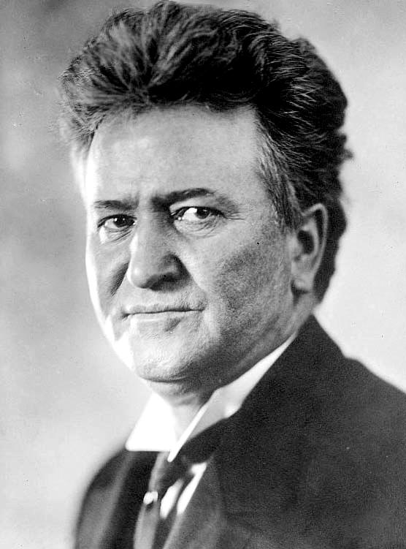
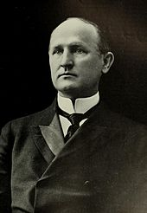
Progressive States
-Wisconsin - Gov Robert LaFollette
-OR, CA, NY (Charles E. Hughes)
-NC - CB Aycock

Slide 22
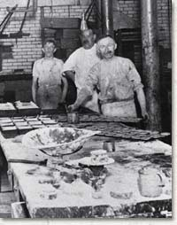
Lochner v. New York
-1905 case challenging a NY law limiting a baker’s hours to 10 each day and 60 per week
-SC rejected law by a 5-4 vote (14th Amendment)
-”Lochner” Era - SC began a series of invalidating state working regulation laws

Slide 23
Muller v. Oregon
1908 Supreme Court Case
-were women and men equal?
“woman’s physical structure...place her at a disadvantage”

Slide 24
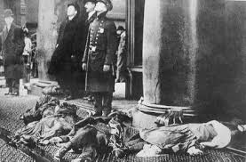
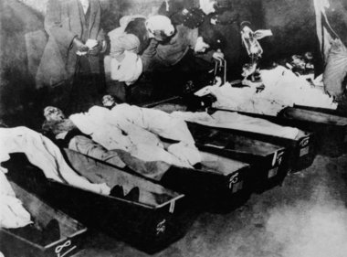
Triangle Shirtwaist Fire

Slide 25
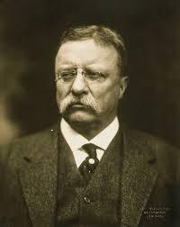
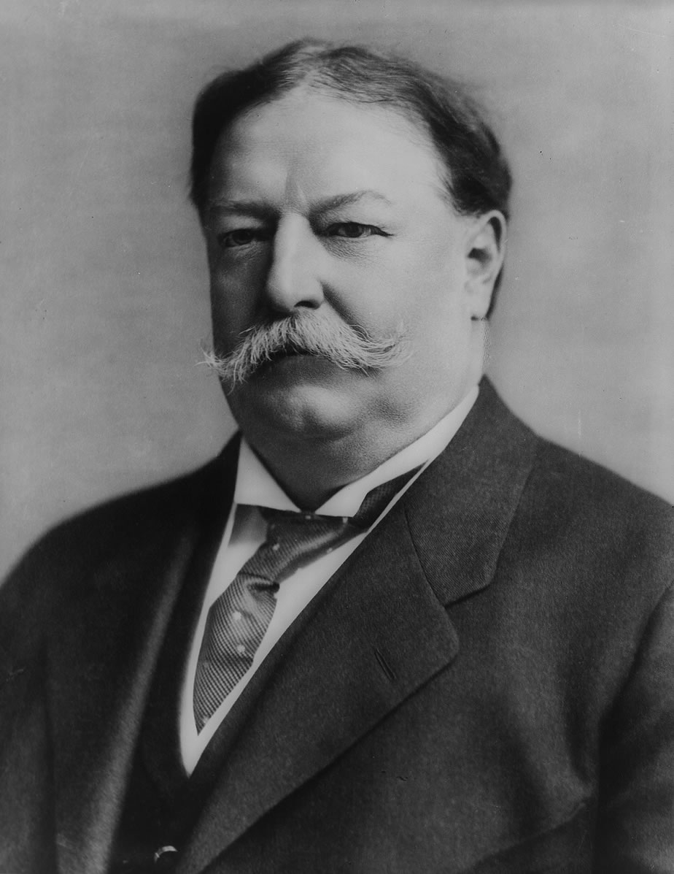
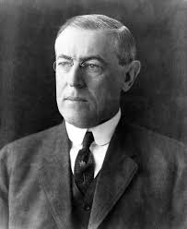
Extended to National Level Under 3 Presidents
●Theodore Roosevelt (1901-1909)
●William Howard Taft (1909-1913)
●Woodrow Wilson (1913-1921)

Slide 26
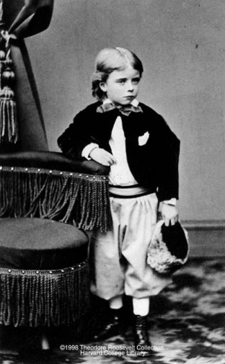
Roosevelt’s Bio
●Born into wealthy New York family
●1858-1919
●Sickly boy
●Asthma
●Skinny/Weak
●Father convinces him to build his body
●Uncommon energy

Slide 27
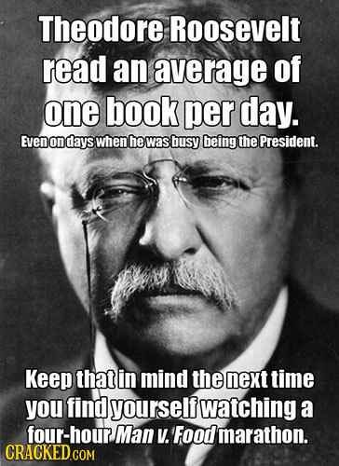
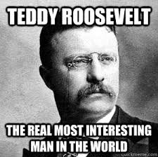

Slide 28
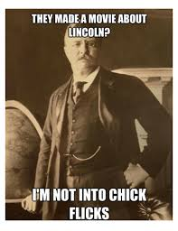
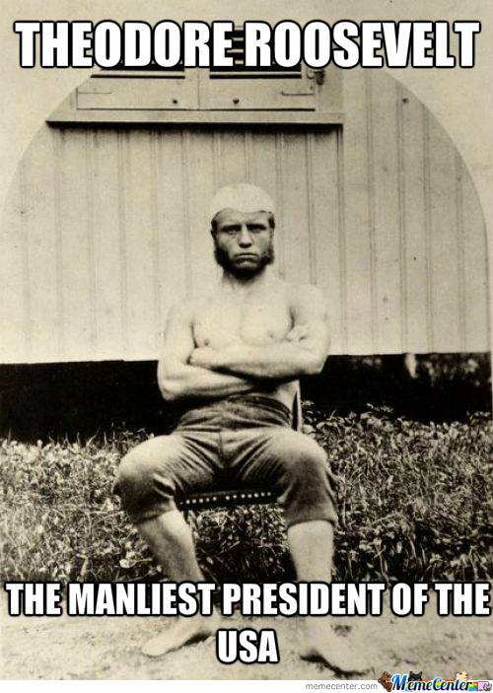

Slide 29
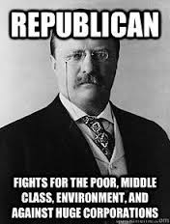

Slide 30
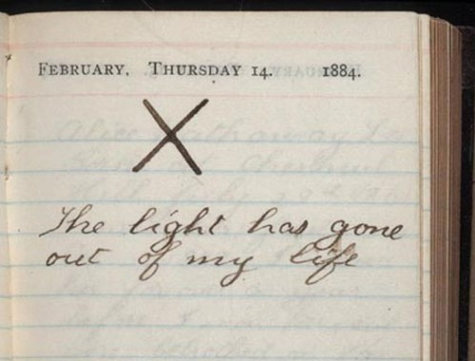
Tragedy in Roosevelt’s Life
-February 14th, 1884 - Wife Alice died of kidney disease; mother died of typhoid fever
-had been serving as NY assemblyman
-left for Badlands
-father “Thee” had died of stomach cancer in 1878 at 46

Slide 31
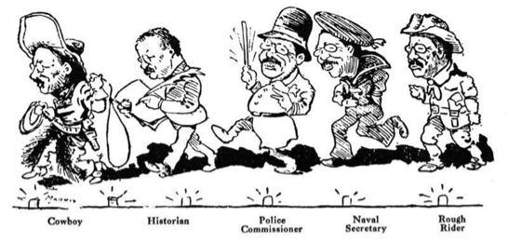
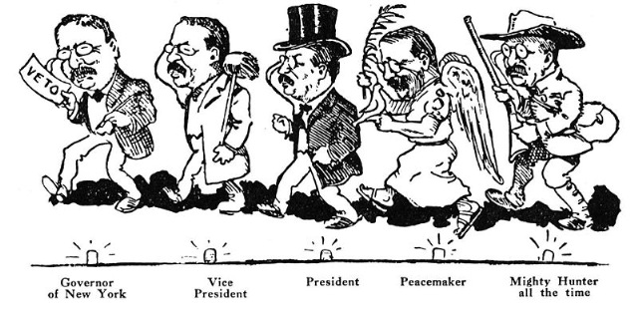
*also Head of
Civil Service
Commission

Slide 32
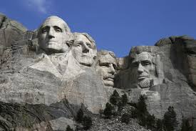

Slide 33
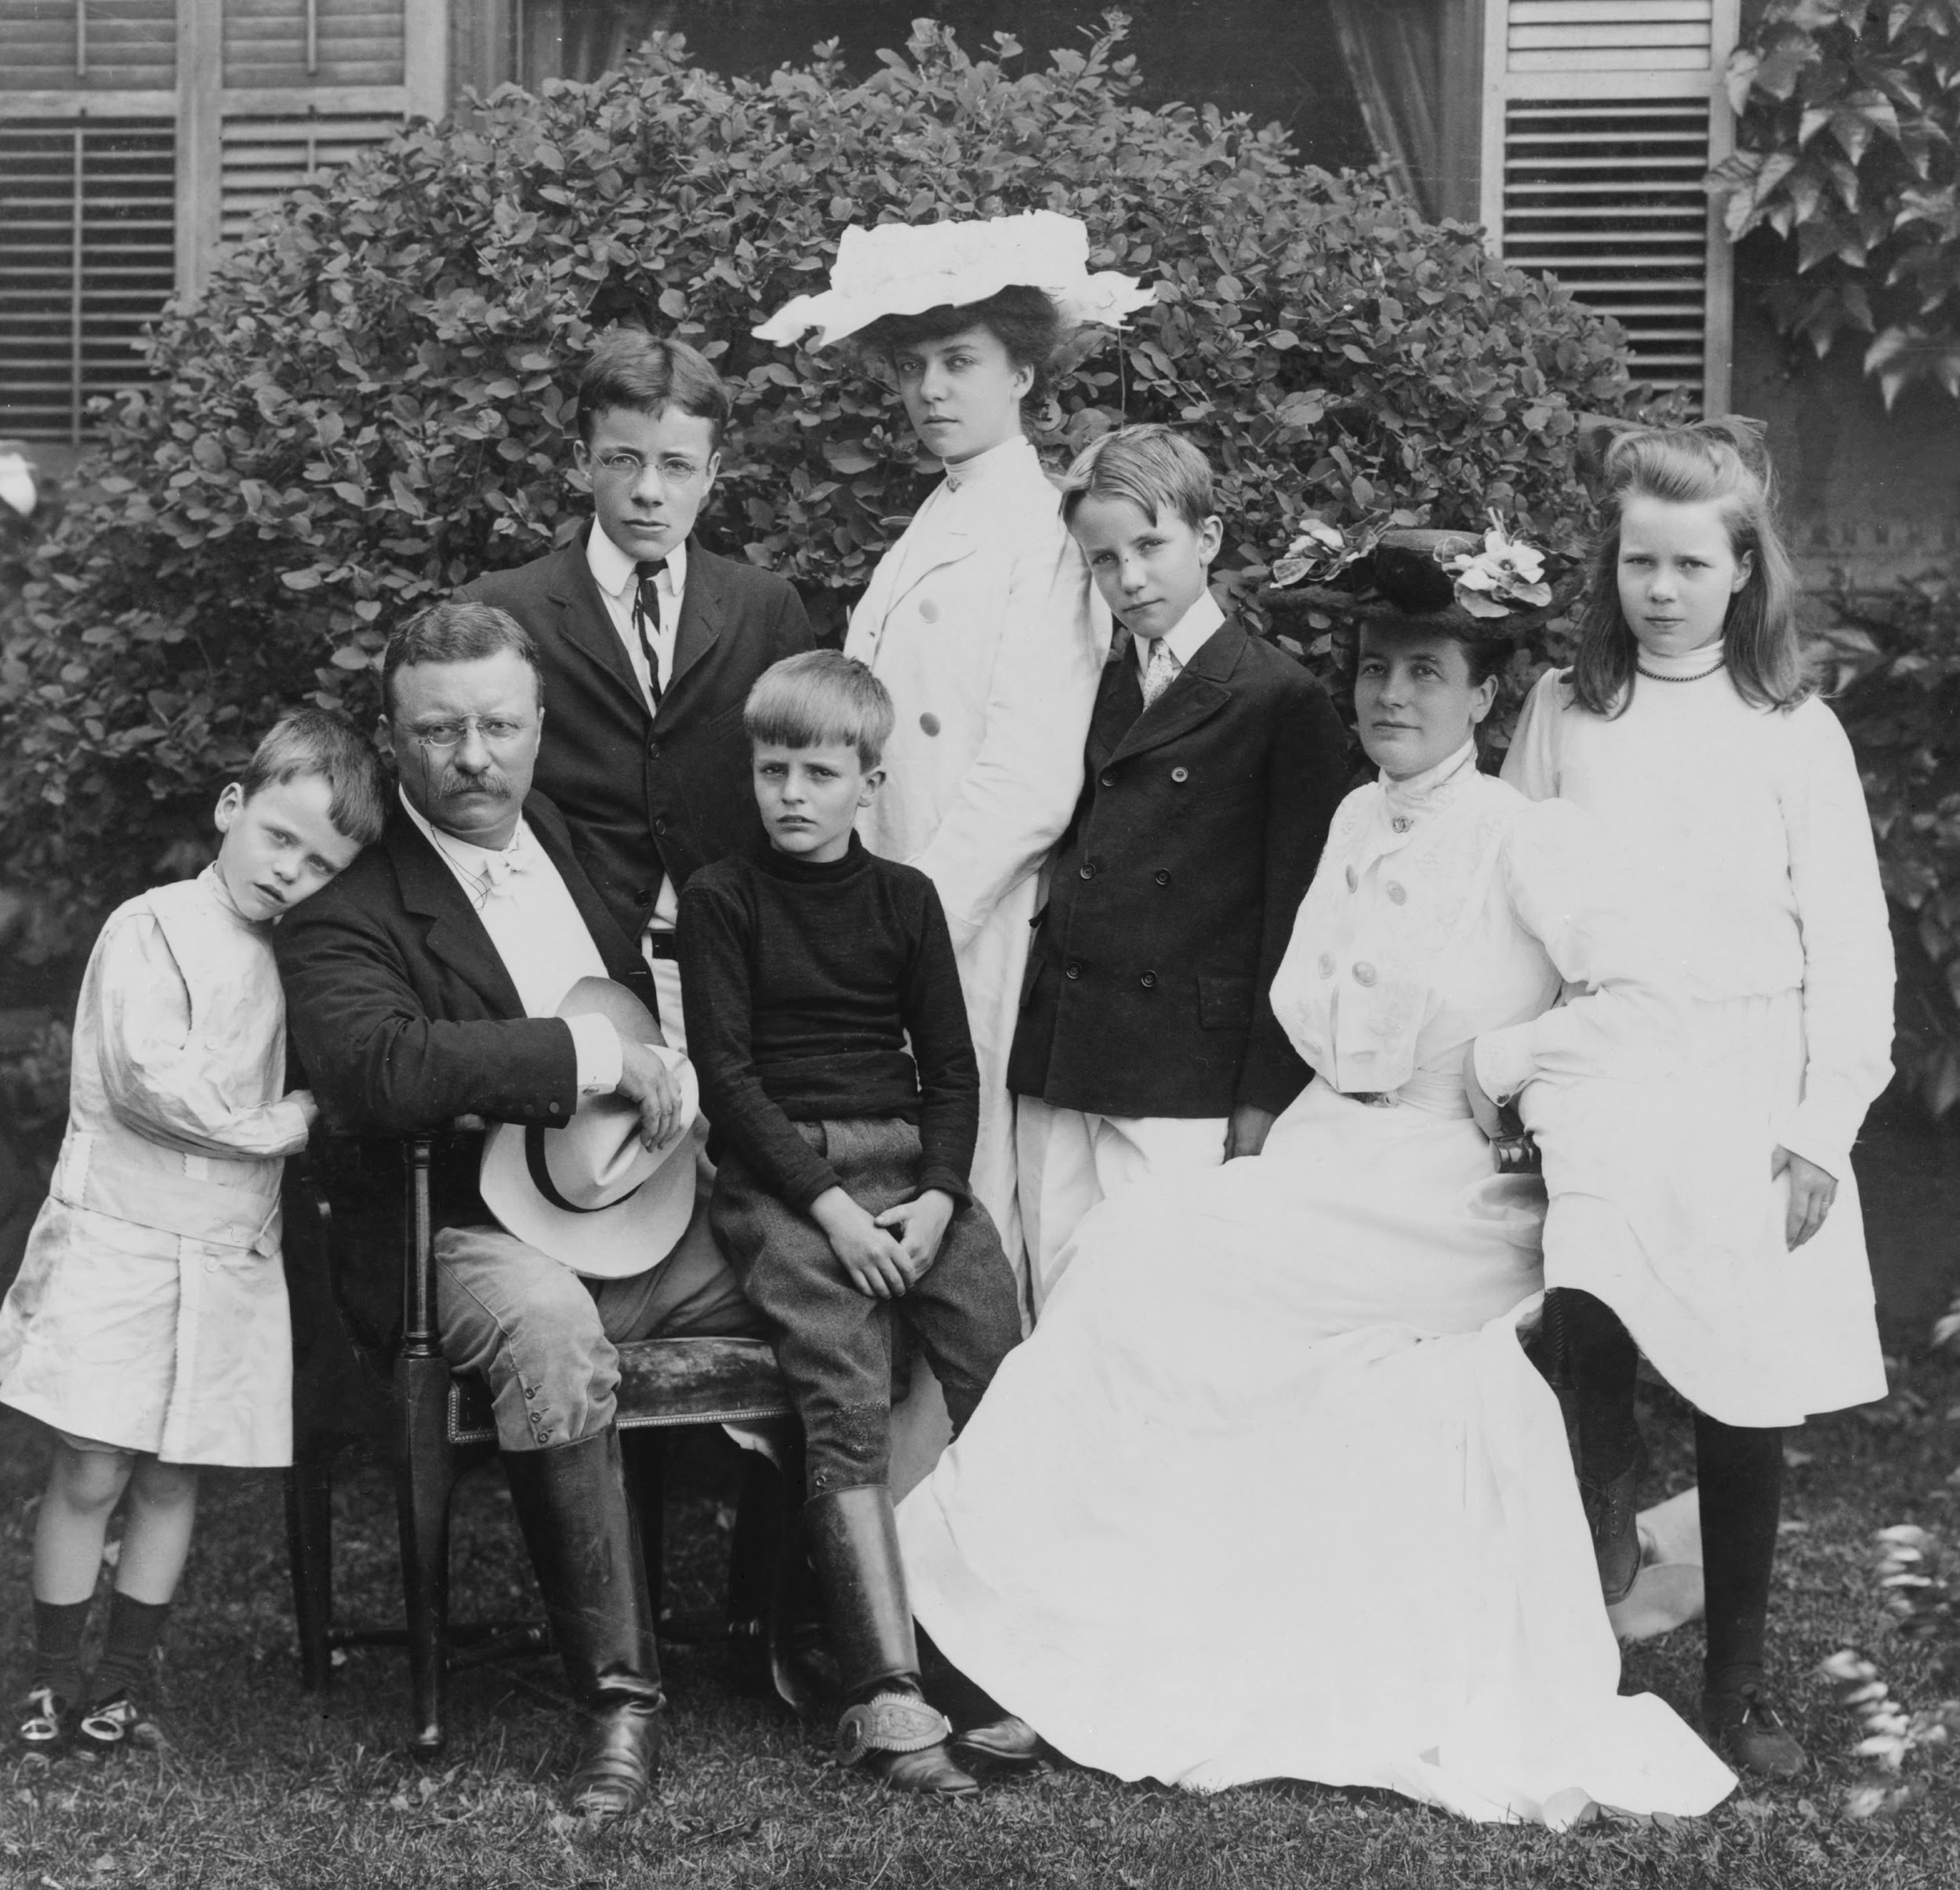

Slide 34
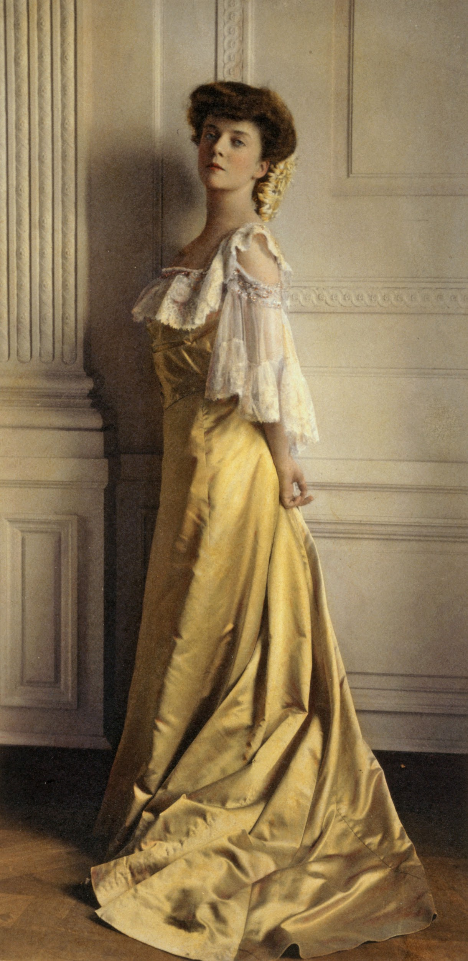
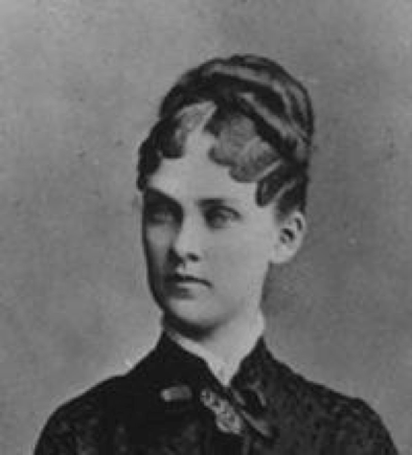
"I can either run the country or I can attend to Alice, but I cannot possibly do both."

Slide 35
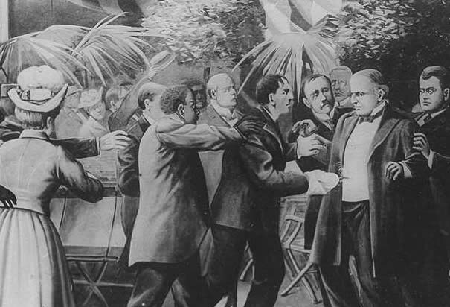
TR as President

Slide 36
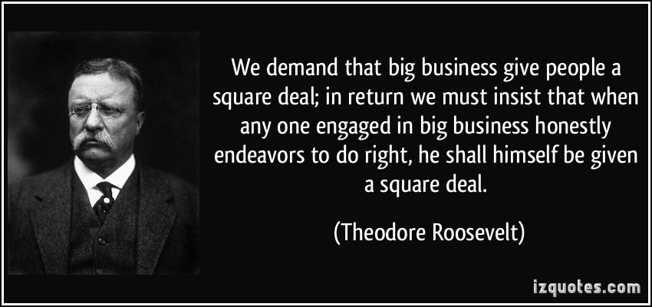

Slide 37
TR and the Coal Strike
●Anthracite Coal Strike 1902
●TR threatened to seize mines and operate them with federal troops
●TR rationalized that the public at large was at jeopardy
●Owners consented to arbitration
●Department of Commerce and Labor created

Slide 38
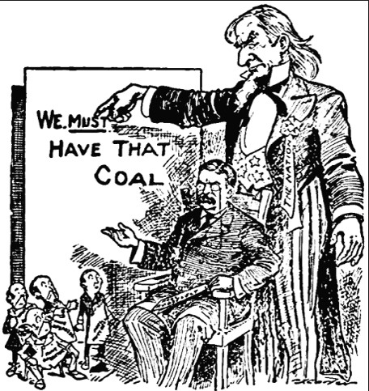

Slide 39
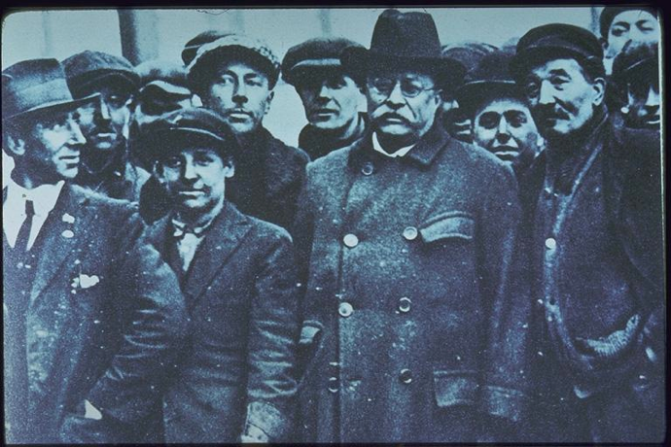
TR and Mine Workers, 1902

Slide 40
TR Limits the Power of the Corporations/Trusts
●Elkins Act of 1903: did not allow railroads to give “deals” to certain businesses
●Hepburn Act of 1906: did not allow “free passes” to be given for railroads
*******TR does make a distinction between “Good Trusts and Bad Trusts”*******

Slide 41
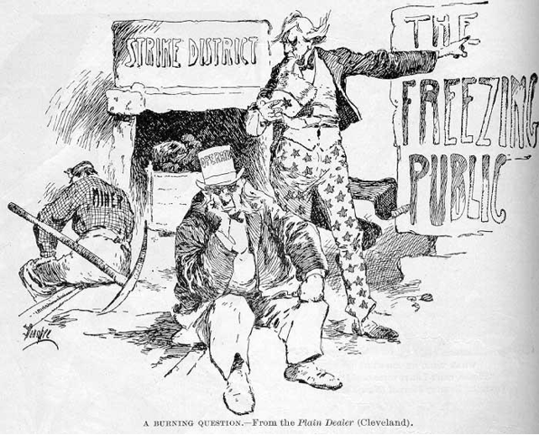

Slide 42
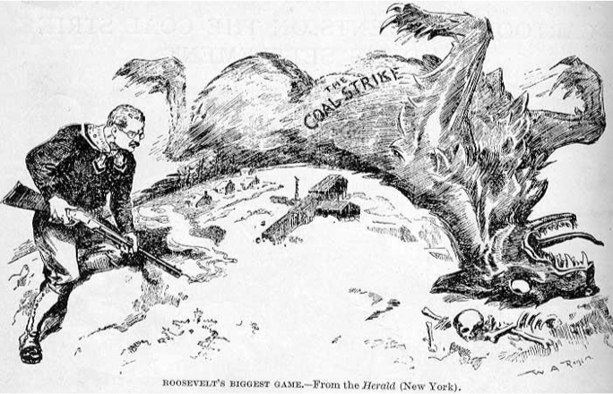

Slide 43
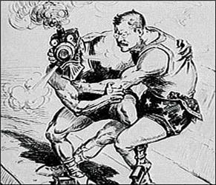

Slide 44
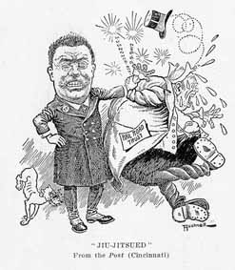

Slide 45
TR the Trustbuster?
●Roosevelt seen as a trustbuster
●Reputation exaggerated
●Actions more symbolic to prove power of government
●TR did not consider trust-busting as sound economic policy
●Believed in regulating not fragmenting trusts
●In reality, trusts healthier at end of TR than anytime before
●Taft busted more trusts than TR
TR believed in good trusts and bad trusts

Slide 46
Unlikely Bedfellows
TR and JP Morgan
US Steel merger with Tennessee Coal and Iron Company

Slide 47
ICC
-weak
-Elkins Act of 1903 (rebates)
-Hepburn Act of 1906 (free passes)
-ICC Strengthened

Slide 48
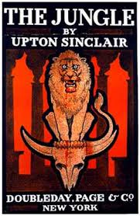
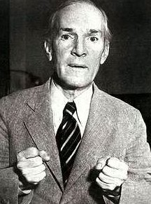
Consumer Protection
-Upton Sinclair’s The Jungle
-showcase workers’ lives
-TR pushed for Meat Inspection Act and Pure Food & Drug Act

Slide 49
TR’s Conservation
-Believed in responsible use of resources
-Gifford Pinchot
-Management Projects

Slide 51
Brownsville Incident (1906)
-Soldiers transferred in from Nebraska
-caused racial tensions in town - (sidewalks, rape accusations, assaults)
-White bartender shot by black soldiers? - soldiers wouldn’t give up the names

Slide 52
Racism from TR’s administration?
-entire unit dishonorably discharged
-Taft urged Roosevelt to reconsider (had been traveling in the west)
-When Taft returned, TR was in Panama
-soldiers eventually allowed to apply for individual reinstatement
-six decades later Army cleared records of all 167 men - only documented mass punishment in Army history

Slide 54
TR and the Black Community
-TR had invited Booker T. Washington to White House and had fought for high-level black appointees
-Betrayal?
-went ”from Moses to Judas”

Slide 55
Nobel Peace Prize
Helped end Russo-Japanese War
Treaty of Portsmouth

Slide 56
Roosevelt Panic of 1907
-Won election of 1904 - announced he wouldn’t run again
-Panic of 1907 blamed on his trust policies

Slide 57
The Rough Rider Thunders Out
-William Howard Taft - hand-picked successor to carry out policies
-TR’s Secretary of War
-Former Governor-General of
Philippines
-From Ohio
-”Sat on the Lid” for Roosevelt

Slide 59
Election of 1908
-Democrats - WJ Bryan
-Socialists - Eugene Debs
Taft won w/ TR’s support

Slide 60
Taft Didn’t Have TR’s Traits
Taft - Quiet, hated campaigning; Hated politics in general
-wanted to be a SC Justice

Slide 61
Taft the Trustbuster
brought twice as many suits against businesses as TR
-1911 - SC broke up Standard Oil
-Suit against US Steel

Slide 62
Taft Splits the Republicans
Ballinger-Pinchot argument
-Ballinger accused of impropriety?
-Taft dismissed Pinchot (TR’s boy)
-Pinchot insubordinate?

Slide 64
Tariff Reduction
-Taft had promised Tariff reduction (staple of the Progressive agenda)
-Signed Payne-Aldrich Bill - increased tariffs
-maintained/raised rates on cotton, wool, coal, iron ore - patronage
-lowered rates on others
-compromise that kept no one happy
-lowered 650, raised 220, left 1550 unchanged

Slide 66
Winona, Minnesota
-Sept 1909 - Taft described Payne-Aldrich Act as the “best tariff bill the Republican Party ever passed”
-brought attention to it and cost him support
-”if the country really wants free trade it can vote Democratic”

Slide 67
Joseph Cannon
-Taft’s support of political boss and House Speaker Cannon split the Republican Party
-Reform-minded Republicans tried to reduce his dictatorial powers

Slide 68
Women’s Suffrage
Carrie Chapman Catt
-NAWSA
-attempted state level change before national change

Slide 69
Militant Suffragettes
Alice Paul (NJ)
-National Woman’s Party
-mass pickets, parades, hunger strikes

Slide 70
19th Amendment
-⅔ of Congress agreed to it after seeing women’s efforts on the homefront during WW1
-ratified 1920
-Catt’s League of Women Voters - keep women informed

Slide 71
Other Progressive Women’s Efforts
-Margaret Sanger - birth control and planned parenthood
-educational equality
-liberalized marriage and divorce laws
-business discrimination
-property ownership

Slide 72
Historical Perspectives of Progressivism
Tradition?
-Jeffersonians > Jacksonians > Populists > Progressives
William Allen White - Progressives adopted all of Populist agenda except for free silver

