Slide 1
The Populist Movement
American History II

Slide 2
Depression, Deflation, and Inflation
-Panic of 1873 - overspeculation
-Dropped coinage of silver dollars - 1873
“The Crime of ‘73” - when Congress stopped coining silver

Slide 3
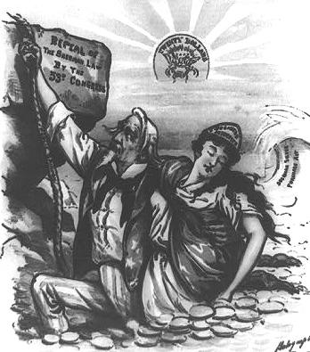

Slide 4
Resumption Act of 1875
-withdraw greenbacks, resume gold
-debtors and farmers against this
-helped elect a Democratic House (1st since Civil War)

Slide 5
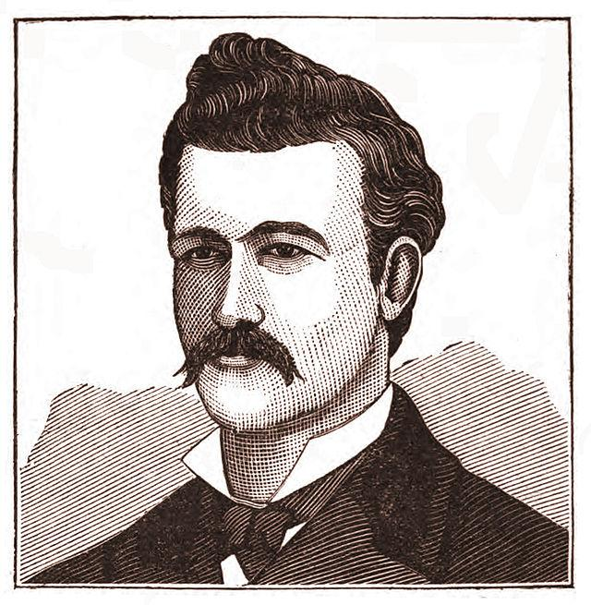
Class Conflict and Ethnic Clashes
-Railroad Strike of 1877 - Hayes called in Fed troops
-Chinese Immigrants to CA
-Railroads and mines
-Conflicts w/ Irish immigrants (Denis Kearney)
-Chinese Exclusion Act of 1882
-US v Wong Kim Ark (1882) – 14th Amendment/Citizenship
-Tape v Hurley (1885) – public schools

Slide 6
The Billion-Dollar Congress
-Sherman Silver Purchase Act of 1890 - Congress had to purchase $4 million in silver every month
-Higher tariff (McKinley Tariff)
hurt farmers
-Sherman Anti-Trust Act

Slide 11
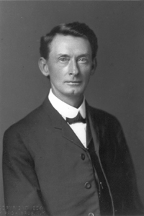
Tom Watson
Populist from Georgia
-appealed to poor farmers
of both races to unite
against common
grievances

Slide 12
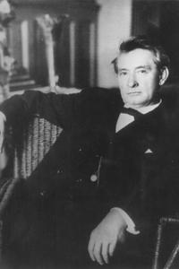
Tom Watson (continued)
-became an outspoken racist
“the Negro has no
comprehension of virtue...The
South has to lynch him
occasionally...to keep him from
blaspheming the Almighty”

Slide 13
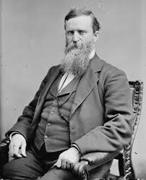
Election of 1892
James Weaver (Iowa) - Populist
-one of few 3rd parties to win electoral votes
Benjamin Harrison - Republican
-hurt by anger over McKinley Tariff
Grover Cleveland - Democrat
-only 2x non-consecutive winner

Slide 14
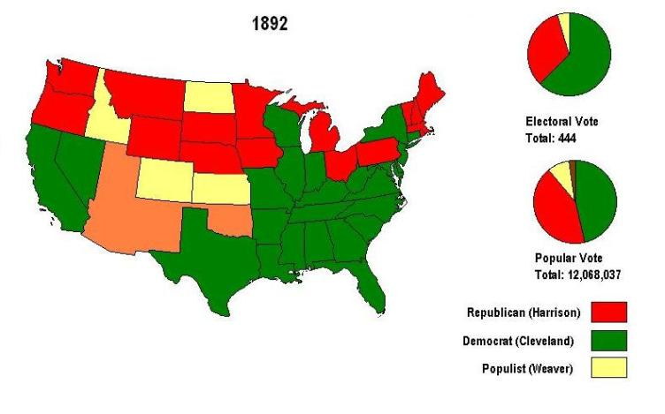

Slide 16
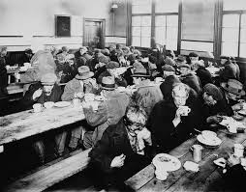
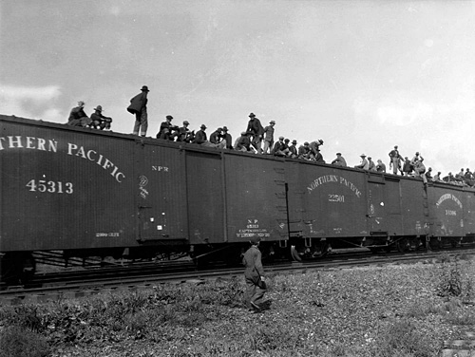
Panic of 1893
-overspeculation on stocks
-railroads failed due to overbuilding
-4 years; foreclosures; 20% unemployment

Slide 17
Issues with Gold
-Cleveland turned to JP Morgan to borrow $65 million to support the dollar and gold standard
-Washington a tool of Eastern bankers?

Slide 18
Wilson-Gorman Tariff 1894
2% tax on incomes over $2,000 (constitutional?)

Slide 19
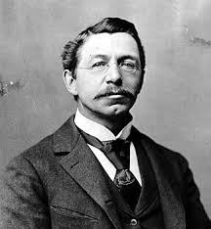
Coxey’s Army
Jacob Coxey - Populist from Ohio
led 200 protesters on march to Washington
demanded gov’t spend $500 million on public works
-many were terrified of a general rebellion

Slide 20
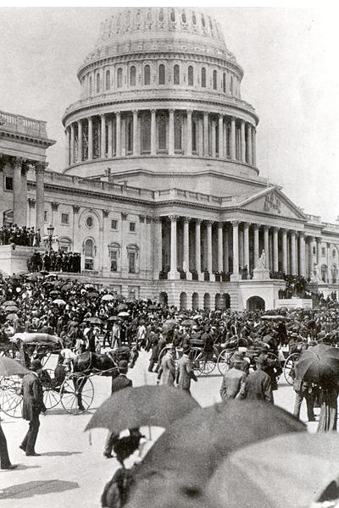
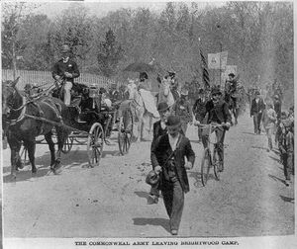

Slide 28
“If protection has slain its thousands, the gold standard has slain its tens of thousands.”

Slide 30
Defection of “Gold Bug” Democrats helped Republicans
Business leaders feared “silver lunacy”

Slide 31
McKinley had 10x the campaign funds that Bryan did –
-Standard Oil gave $250,000
-JP Morgan gave $250,000
-Railroads gave $174,000
-NY Life Insurance Co gave $50,000

Slide 32
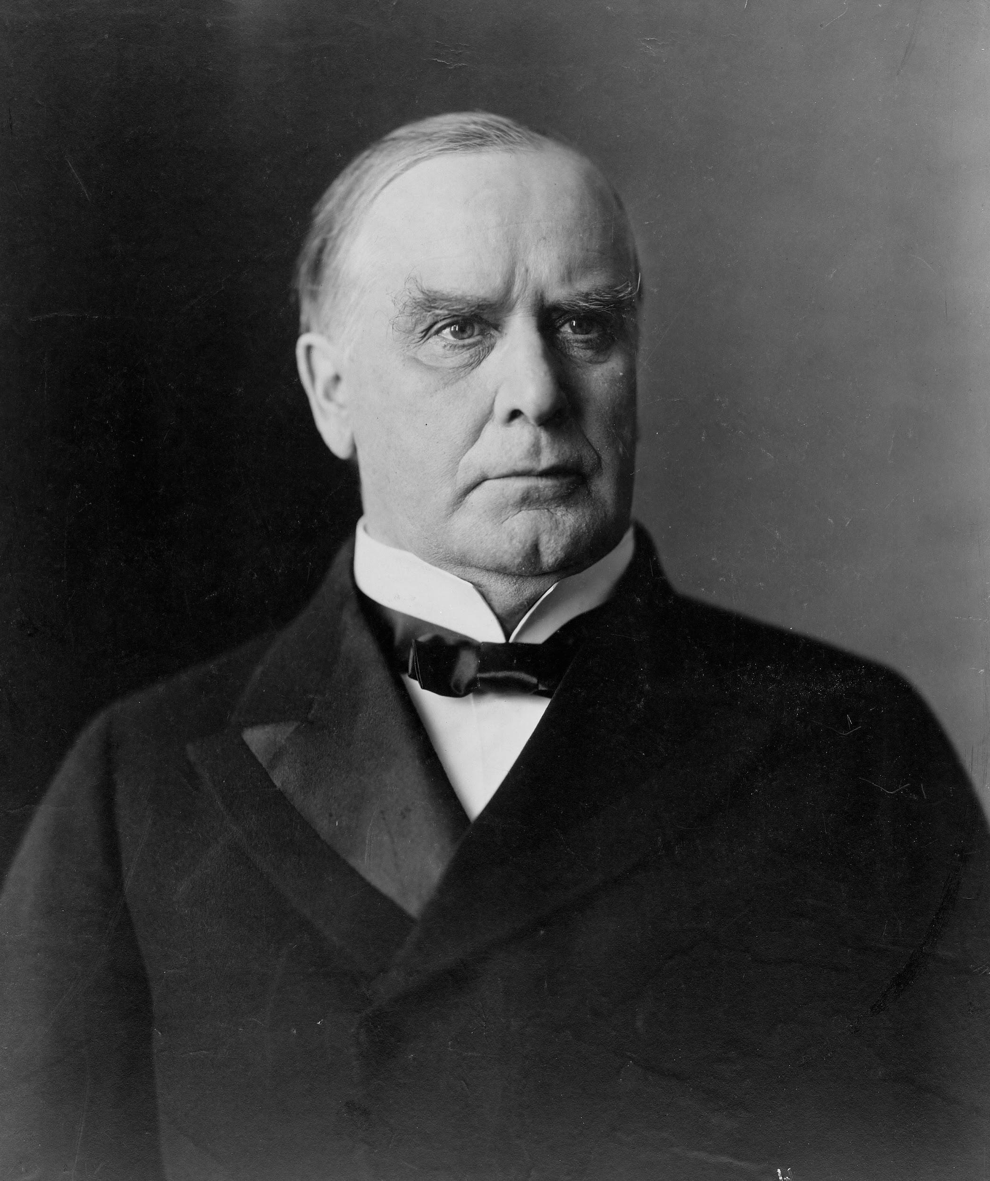
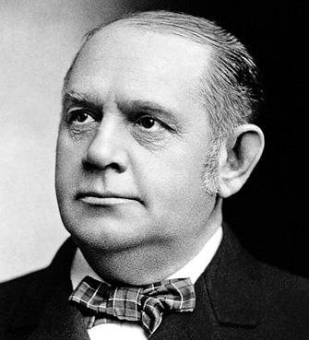
McKinley
“front porch campaign”
most of the work done by Mark Hanna (Republican Senator from Ohio)

Slide 33
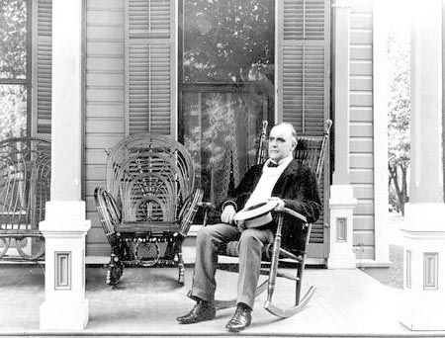
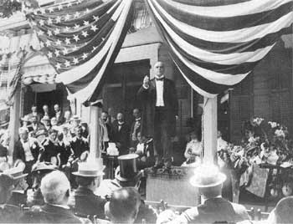

Slide 34
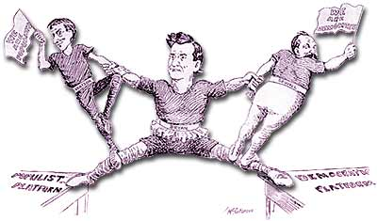

Slide 35
The “twin-tailed” ticket - Bryan as Populist w/ Tom Watson of Ga and Democrat w/ Arthur Sewall of Maine.
- Watson attacked Sewall.

Slide 36
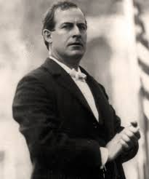
W.J. Bryan
-36 years old
-traveled 18,000 miles by train
-gave over 600 speeches
-hurt by:
-rise in wheat prices
-employers threatening to
shut down

Slide 37
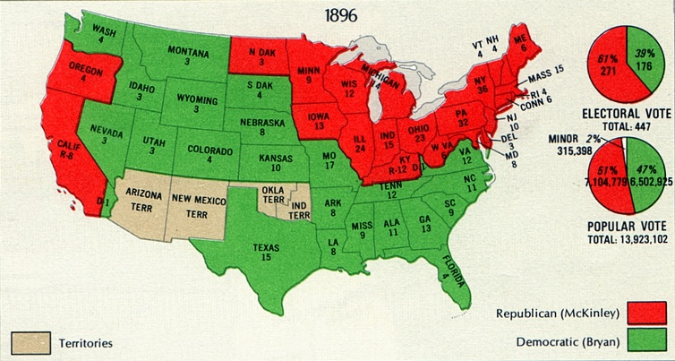

Slide 38
R. Hofstadter - Age of Reform (1955)
Saw good and bad in the Populists
positive - insisted on fed gov’t’s responsibility to promote common good and deal w/ problems of industrialization
negative - backward-looking and nostalgic ideology, hopelessly tried to restore a mythical agrarian golden age

