Slide 1
Mercantilism, the Empire, and Salutary Neglect

Slide 2
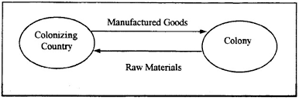
Mercantilism
Economic policy that looked upon trade, colonies, and accumulation of wealth as the basis for military and political strength
Colonies only exist to enrich parent country

Slide 3
Navigation Acts (1650-1673)
1. Trade to and from colonies can only be carried on English or colonial-built ships w/ English or colonial crews
2. (almost) all goods imported to colonies must go through ports in England
3. “enumerated” goods can be exported to England only (originally just tobacco)

Slide 4
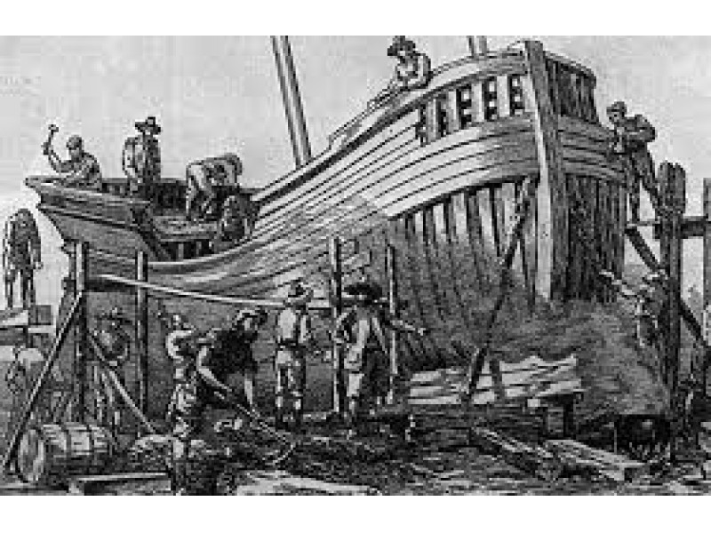
Impact of Acts?
Good for New England shipbuilding
Chesapeake tobacco had monopoly in England
Protection from French and Spanish
Hindered development of manufacturing in colonies

Slide 5
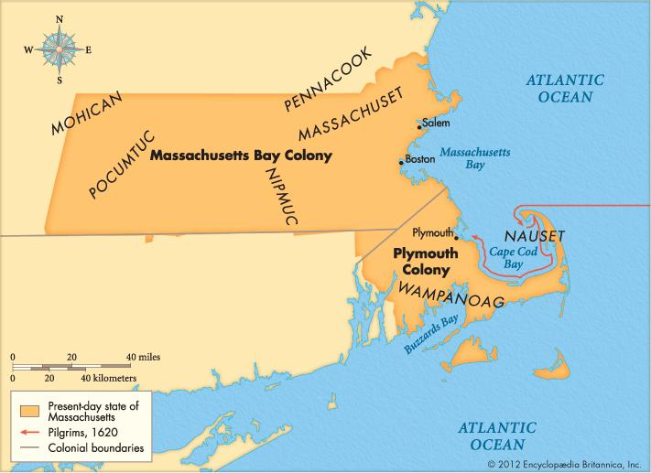
Enforcement of the Acts
Colonists engaged in smuggling with French, Dutch, and others
Enforcement lax, agents were corrupt
Crown made sporadic efforts
1684 – revoked charter of Mass. Bay colony

Slide 6
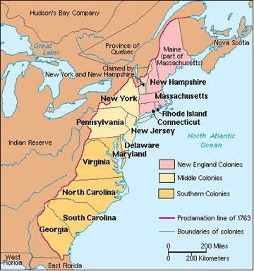
Tumult in the Colonies
1670 – Lord Baltimore places more property restrictions on voting
1675 – King Philip’s War
1676 – Bacon’s Rebellion
1680 – Westo Indian rebellion in Carolinas

Slide 7
Dominion of New England
James II – 1685
Determined to increase royal control over colonies
Larger administrative units
1686 – NY, NJ, NE colonies became Dominion of New England
Sir Edmund Andros sent as governor

Slide 8
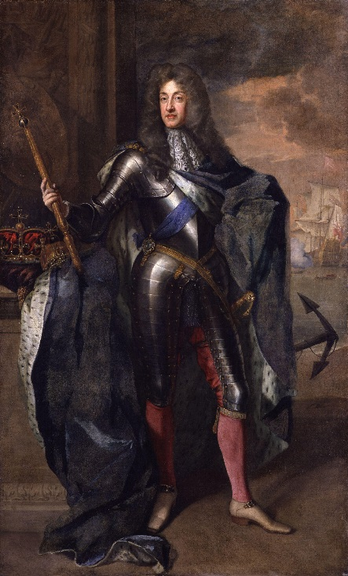
Glorious Revolution
1688 – James II deposed in favor of William and Mary
Dominion of New England ended and colonies operated separately again

Slide 9
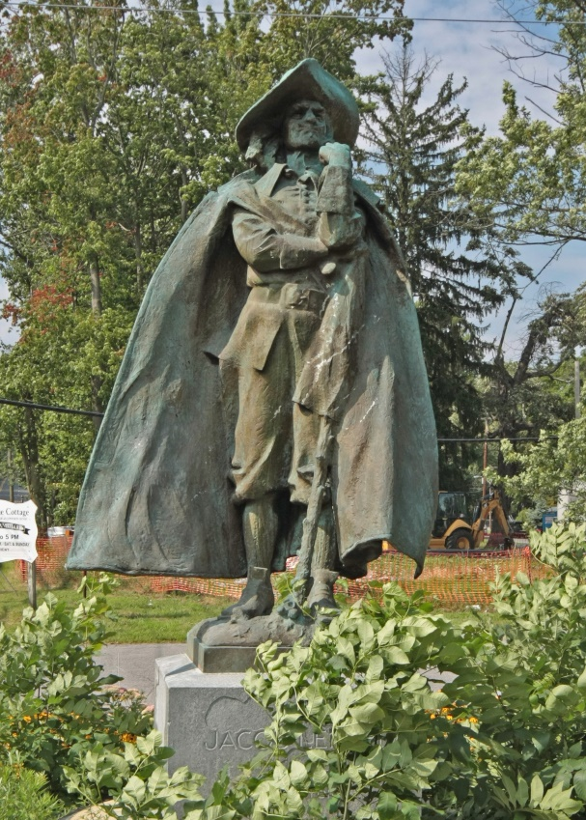
Other Dissidents
Maryland – insurgents drove out Lord Baltimore’s officials
-1715 – 5th Lord Baltimore joined Anglican Church
Jacob Leisler – NY dissident
Proclaimed himself head of NY gov’t for 2 years
Resisted new governor from W & M
Hung, drawn, quartered
“Leislerians” and “Anti-Leislerians” in NY politics

Slide 10
Changes in New England
1691 – new charter for Massachusetts, absorbed Plymouth
Property holders, and not “saints” vote in elections for Massachusetts General Court
Governor appointed by King (no longer elected)
English Toleration Act of 1690

Slide 11
Salutary Neglect
1607-1763 – England did not strictly enforce Parliamentary laws regarding colonies, let them act mostly as independent states

