Slide 1
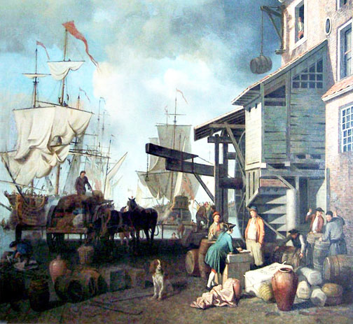
Mercantilism

Slide 2
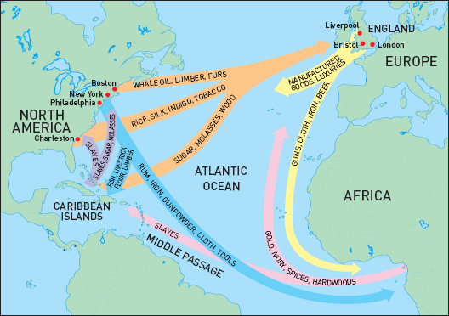
Mercantilism
An economic system in which colonies exist for the benefit of the colonial power
Europeans looked at their colonies as possessions that existed for their benefit

Slide 3
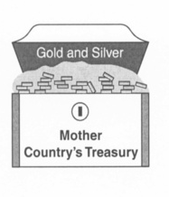
Principles of Mercantilism
Might of a country depends on gaining surpluses of gold and silver

Slide 4
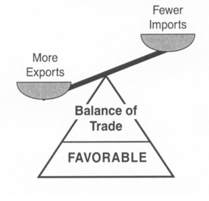
Principles of Mercantilism
A main goal is the creation of a favorable balance of trade
Exporting more goods than you import

Slide 5
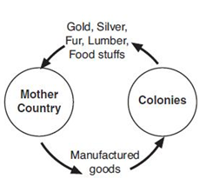
Principles of Mercantilism
The purpose of colonies:
Ship raw materials to the “mother country” (colonial power)
Buy finished goods from the colonial power

Slide 7
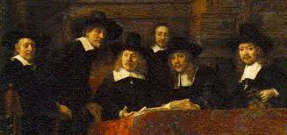
Growth of Capitalism in Europe
Increased trade with colonies encouraged the development of capitalism in Europe.
People invested money in companies in hopes of making a profit
Joint stock companies formed to finance overseas expedition
Led to the growth of the middle class in Europe.

Slide 8
Navigation Acts
1650 laws passed by Parliament only allowing the colonies to trade directly with England

Slide 9
The Desire for Africans
The Portuguese were the first Europeans to Explore Africa.
They were more interested in trading for gold than for slaves.
The colonization of the Americas changed the focus of trade.

Slide 10
The Desire for Africans
There were several advantages in using Africans:
They had been exposed to European diseases
They had experience in farming
They had little knowledge of the land and there were no familiar tribes

Slide 11
The Desire for Africans
This trade for slaves became the Atlantic Slave Trade
Between 1500 and 1600, about 300,000 slaves were taken to the Americas.
During the next 100 years, the number jumped to 1.5 million, and by 1870 the number was about 9.5 million.

Slide 12
Slavery Spreads
England then dominated the slave trade from the 1690 until 1807.
By 1830, there were nearly 2 million African slaves in North America.
African merchants, with the help of local rulers, captured fellow Africans to be enslaved.
They delivered them to the Europeans in exchange for gold, guns and other goods.

Slide 13
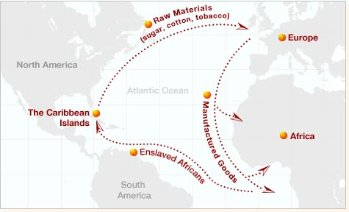

Slide 14
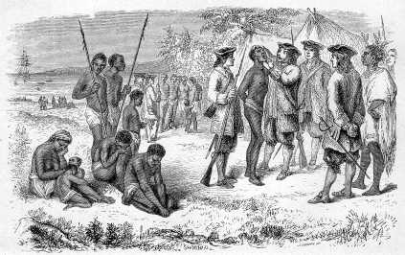

Slide 15
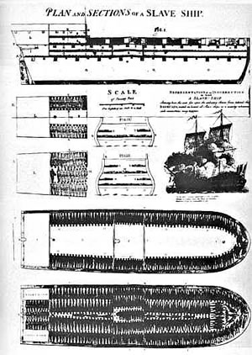

Slide 16
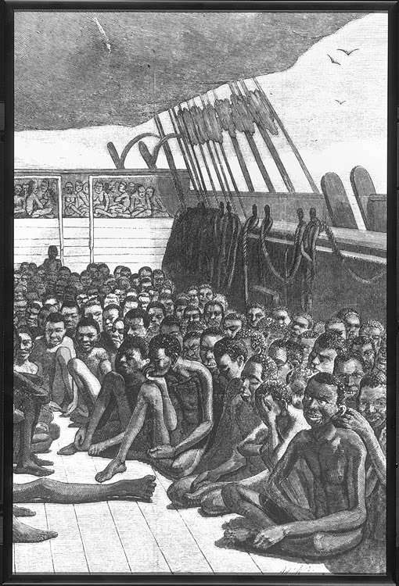

Slide 17
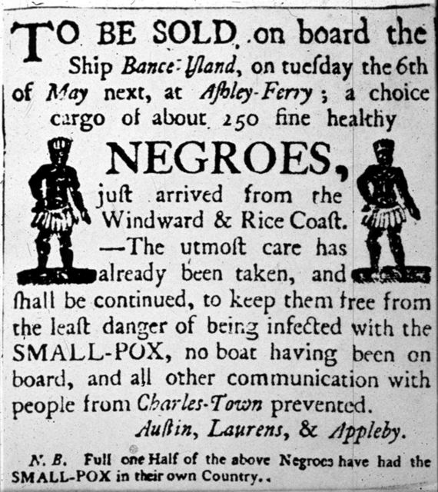

Slide 18
Consequences of the Atlantic Slave Trade
In Africa, numerous cultures lost generations of their strongest members, both men and women.
The slave trade introduced guns to the African continent
African slaves contributed greatly to the cultural and economic development of the Americas.
Africans brought their culture to the Americas

