Slide 1
American History II – Labor Unions

Slide 2
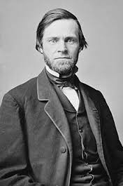
Gov’t Tackles the Trusts
Sherman Antitrust Act- 1890
¡No distinction b/t good & bad trust
¡No means of enforcement, lots of loopholes
¡Used against labor
¡SC of the period almost always favored business

Slide 3
South in the Age of Industry
Sharecropping
Cigarette-making machine
¡James Buchanan Duke- Trinity College- Durham


Slide 4
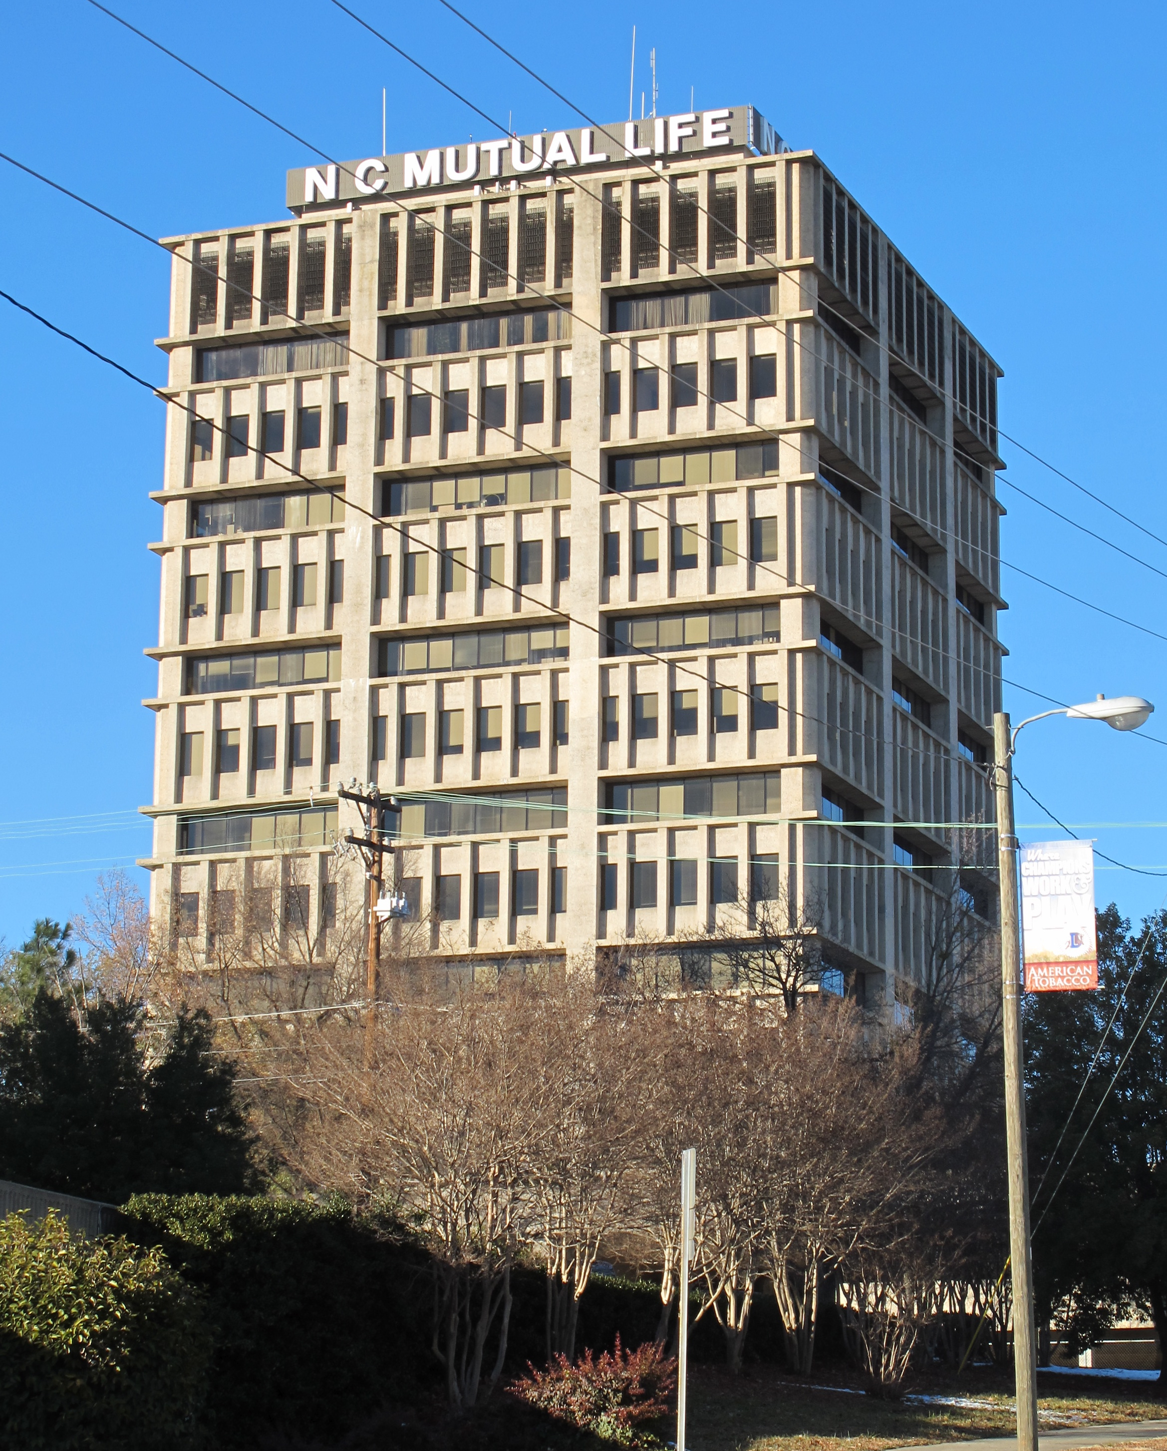

Slide 5
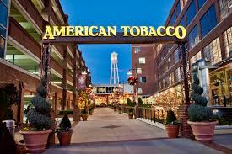
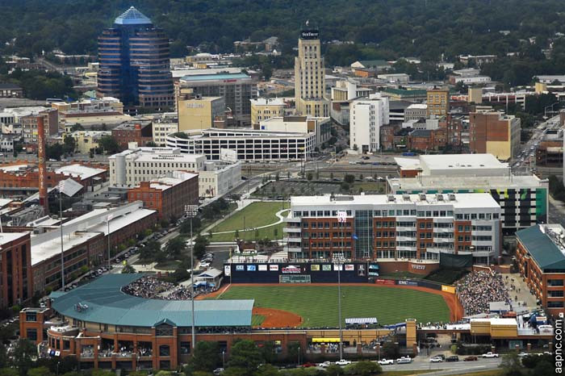

Slide 6
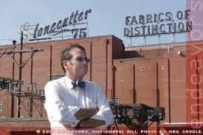
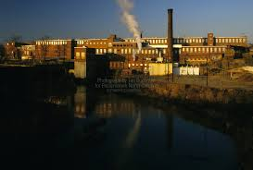
Idea of “New South”- Henry Grady
Atlanta Constitution - Confed.
funeral story
¡RRs cost too much
¡Textile mills in south
¢Cheap labor
¢Family work for wages
¢Bound to company town

Slide 7
US v EC Knight (1895)
Does the Sherman Act work?

Slide 8
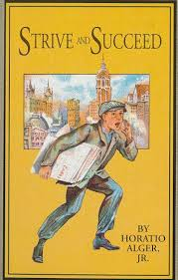
Impact of the New Industrial Revolution
Standard of living increase
Growth of cities, decline of agriculture (Jefferson)
Life by the whistle

Horatio Alger Myth - self made men were rare

Slide 9
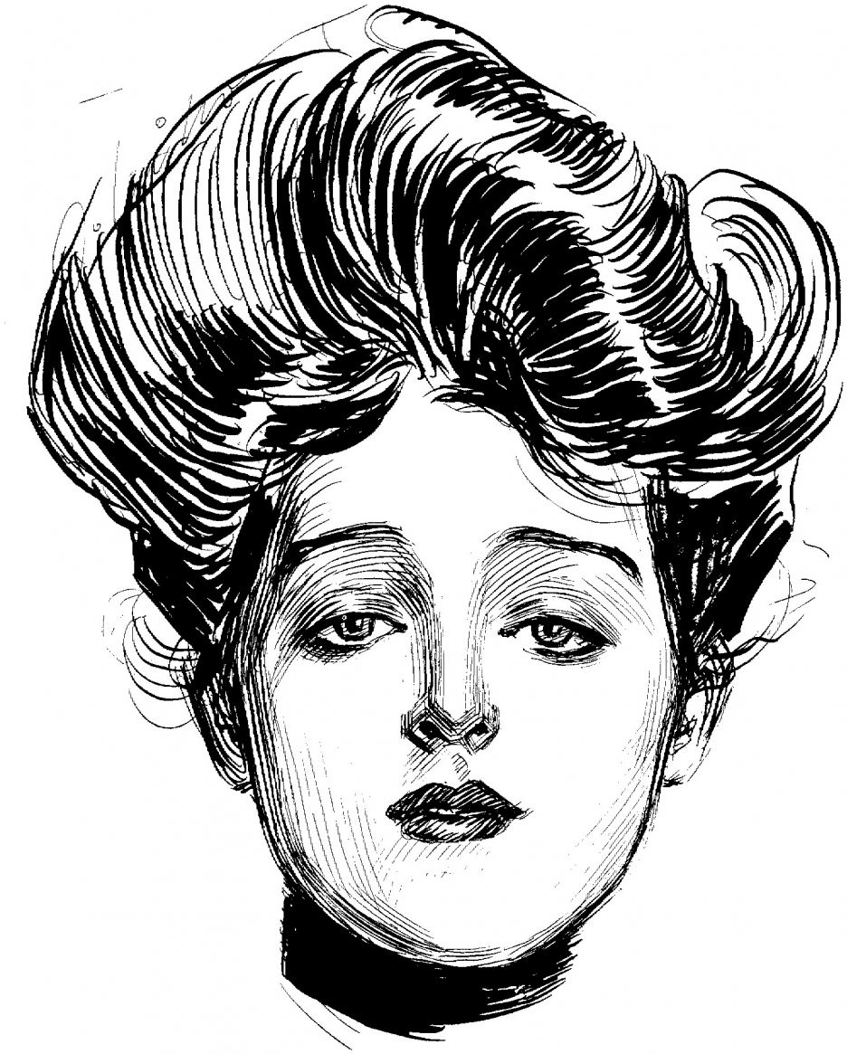
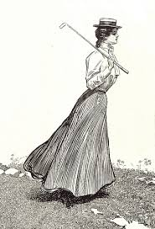
MOST married women worked to help support families
¡“Gibson Girls”
Class disparity- wealth, unemployment
American products around the world

Slide 10
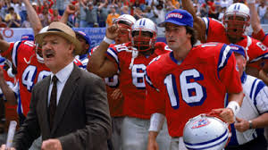
Strength in Unions
Value of labor
¡Corporations
¡Machines
¡Immigrants
Ways to fight labor
¡Scabs
¡Lockouts
¡Yellow dog contracts
¡Blacklists
¡Company towns
Middle-class mainly unconcerned with the poor

Slide 11
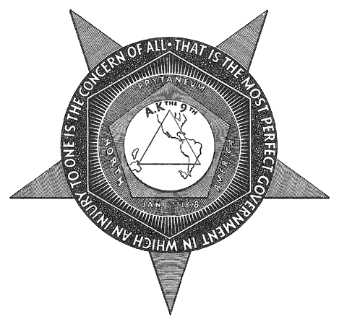
Ailing Labor Movement
After Civil War
National Labor Union- 1866
¡Depression of 1870s ended it
-broad social program
Knights of Labor- 1869 (secret)

Slide 12
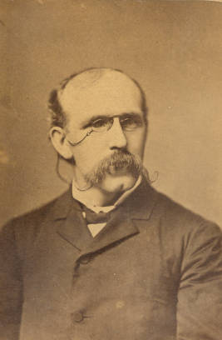
Knights involved in “communist” activities
¡Involved skilled & unskilled labor
Terence Powderly

Slide 13
Knights of Labor
Advocated
1) worker cooperatives
2) abolition of child labor
3) abolition of trusts and monopolies

Slide 14
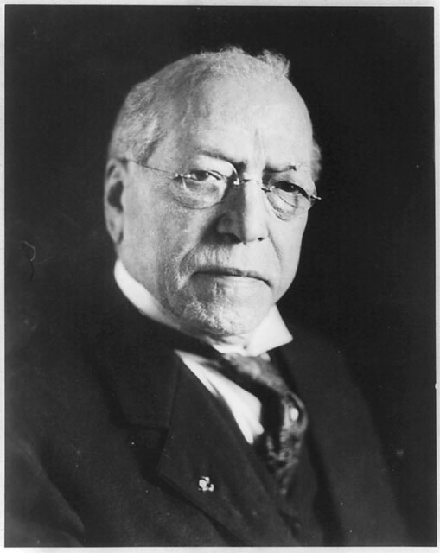
American Federation of Labor
1886- Samuel Gompers
¡Group of national unions of skilled craftsmen
¡Wanted more for labor- hours, wages, conditions
¡Believed in “closed shop trade agreements”
¡Used walkouts and boycotts

Slide 15
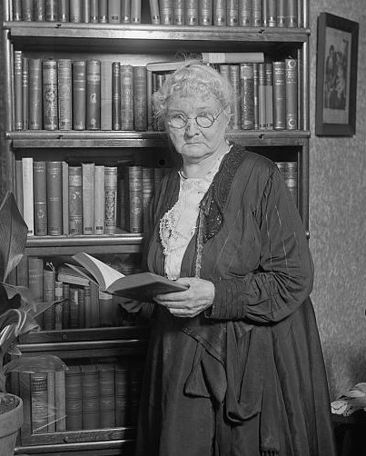
“Mother” Mary Harris Jones

Slide 16
Railroad Strike of 1877 (Great Strike)
oWorkers for Baltimore and Ohio Railroad (B & O) struck to protest 2nd wage cut in 2 months. (WVa)
oMany freight and some passenger trains stopped for over a week
oMore than half of freight on nation’s 75,000 miles of track stalled

Slide 17
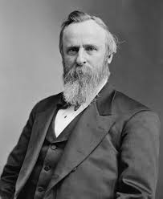
oNational Guard called in
oRutherford B. Hayes had to send in Federal troops to break strike as it spread to other cities.
oMany people sympathetic to the men on strike.
oWhen the RR strikes of 1877 were over, >100 people dead
n100,000 had gone on strike

Slide 18
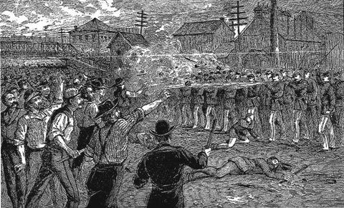

Slide 19
Haymarket Riot (1886)
oCrowd of 3,000 gathered in Chicago on May 4 to protest police brutality at the McCormick Harvester Works
oStorm clouds came and crowd dwindled
o180 policemen showed up and ordered the crowd to disperse
nSpeaker said meeting was almost over

Slide 20
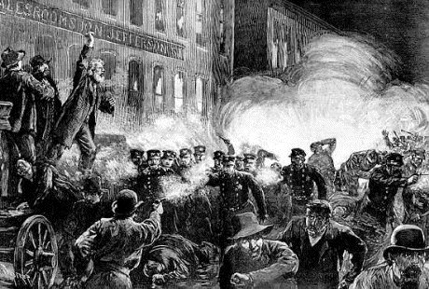

Slide 21
oBomb exploded in midst of policemen (66 wounded – 7 later died)
oPolice fired on crowd, killing several, wounding 200
oNo evidence of who threw bomb
oPolice arrested 8 anarchist leaders in Chicago

Slide 22
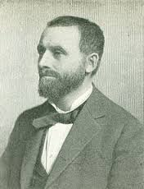
o8 anarchists were found guilty and sentenced to death
oPublic outcry
Also discredited labor movement in the U.S
-Gov. John Altgeld - pardons

Slide 23
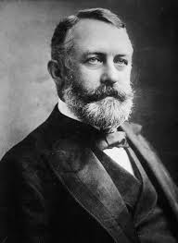
Homestead Strike - 1892
oWorkers at Carnegie Steel plant at Homestead, Pa. went on strike
oCarnegie away in Europe
nHenry Clay Frick managed plant
oReduced workers’ wages and fortified the plant
labor movement in steel industry set back
until New Deal

Slide 24
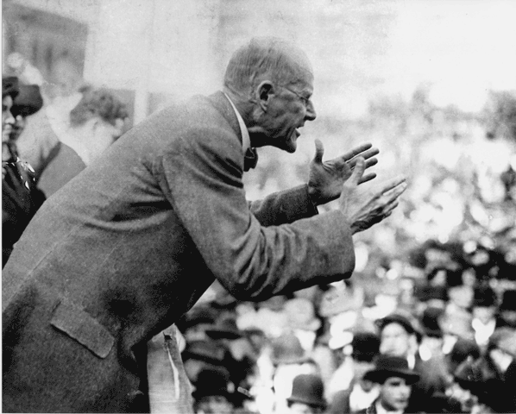
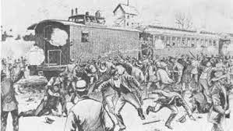
Pullman Strike - 1894
oStrike against the Pullman Company by workers, protesting the tight control Pullman had over his employees by setting rent and prices in stores, etc.
oAmerican Railway Union
oEugene Debs got involved.
jailed, In re Debs
oPolice, militia, and troops broke strike.

