Slide 1
Roosevelt and America Move to War
A.P. U.S. History

Slide 2
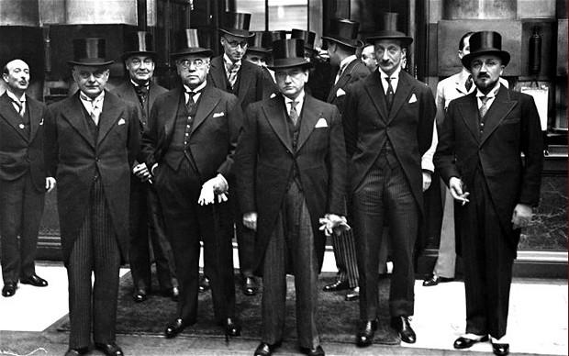
A. The London Conference
nAmerica continued isolationism- official policy was neutrality- depression
nFDR’s thinking
nSummer ’33- Conference planned to stabilize world currencies
nFDR- 1st US would go, then no- focus on domestic problems
nConference fell apart

Slide 3
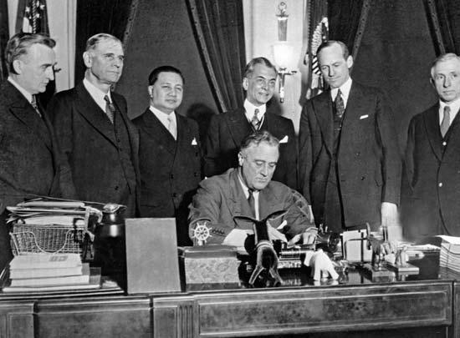
B. Freedom for (from?) the Filipinos Recognition for the Russians
nUS couldn’t afford overseas claims
nTydings-McDuffie Act- would grant independence after 12 years (by 1946)
nKeep naval bases

Slide 4
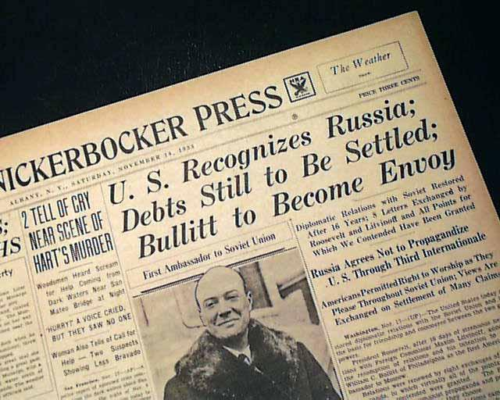
Recognition for the Russians
Japanese thoughts
nFormal recognition for USSR in 1933- trade & balance of power
nMany disagreed w/policy

Slide 5
C. Becoming a Good Neighbor
nDepression made America less willing to create empire in Latin America
nFewer American $ to protect there
nFDR wished to line up support against European & Asian threats to protect western hemisphere
nEndorsed nonintervention (no force)
-opposite of his distant cousin

Slide 6
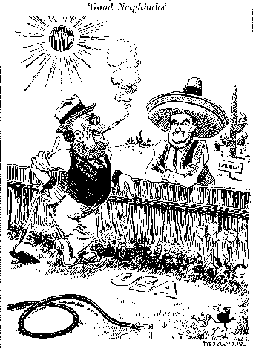
Good Neighbor Policy (continued)
Left Haiti in 1934
nReleased Cuba from Platt Amendment in 1934
nCame to peaceful treaty when Mexican govt. nationalized American oil companies in 1938
nFDR hero among Latin American nations

Slide 7
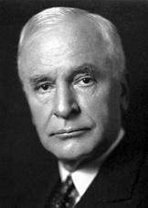
D. Secretary Cordell Hull’s Reciprocal Trade Agreement
nHull & FDR convinced Congress to pass Reciprocal Trade Agreements Act
nDesigned to lower Hawley-Smoot Tariff & increase international trade
nCould lower tariffs by 50% w/ individual nations if the other nation agreed to like measures
nDidn’t need Senate approval
n21 countries, large increase in trade
nLed way for American idea of international free trade

Slide 8
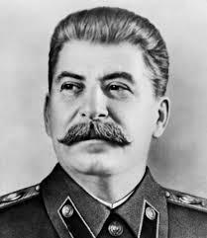
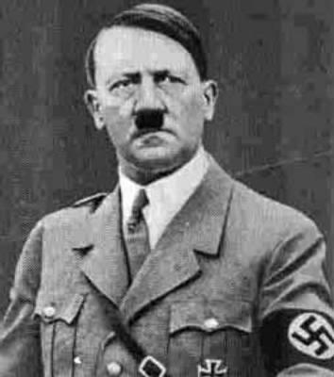
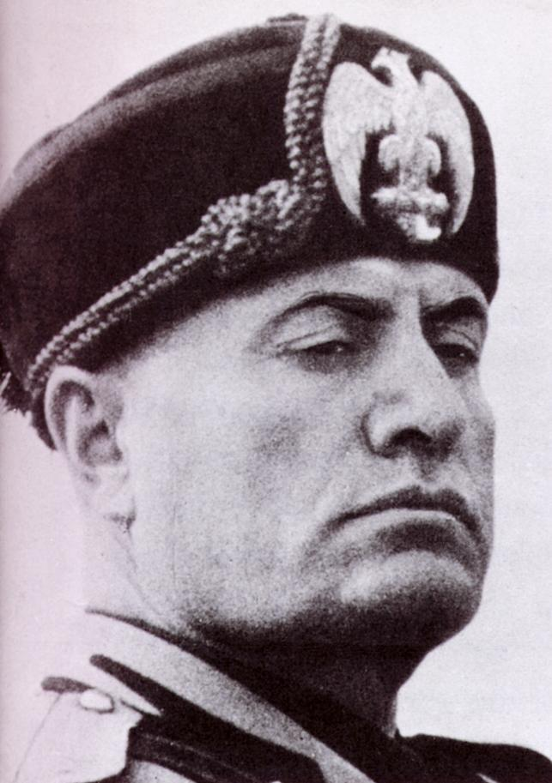
E. Storm-Cellar Isolationism
nRuin of WWI & depression spread totalitarianism in Europe- state is ALL
nUSSR (communism)- Joseph Stalin
nItaly (Fascism)- Benito Mussolini 1922
nGermany (Nazi)- Adolf Hitler 1933

Slide 9
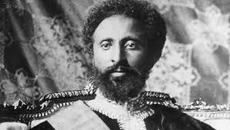
n1935- Italy attacked Ethiopia (oil)- League of Nation’s response- admonished Italy
n1936- Germany & Italy had allied, 1940- Japan joined in the Tripartite Pact
nAll felt mistreated by Treaty of Versailles, didn’t have enough land for population, wanted to build strong militaries, left League of Nations
nAmerica & their oceans
nRemembered WWI & its outcome

Slide 10
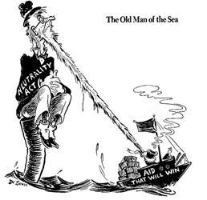
F. Congress Legislates Neutrality
n(Gerald) Nye Committee- idea that businesses & bankers caused WWI
nCitizens believed, Congress legislated
nMussolini’s attack on Ethiopia
nNeutrality Acts of ‘35, ‘36, & ‘37
nAmerican wartime restrictions
nCouldn’t sail on belligerent ships
nCouldn’t sell weapons to belligerents
nCouldn’t make loans to belligerents
nNo distinction b/t aggressors & defenders

Slide 11
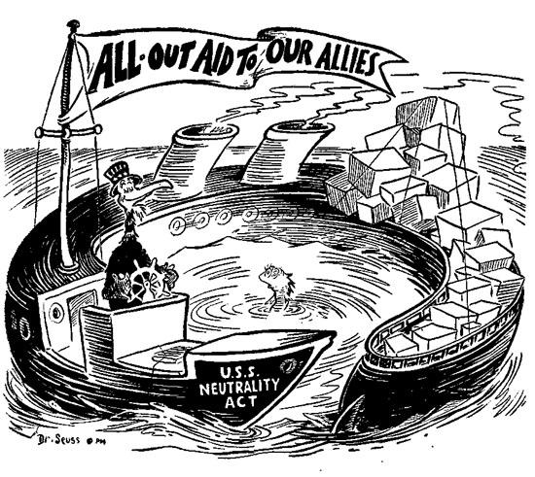

Slide 12
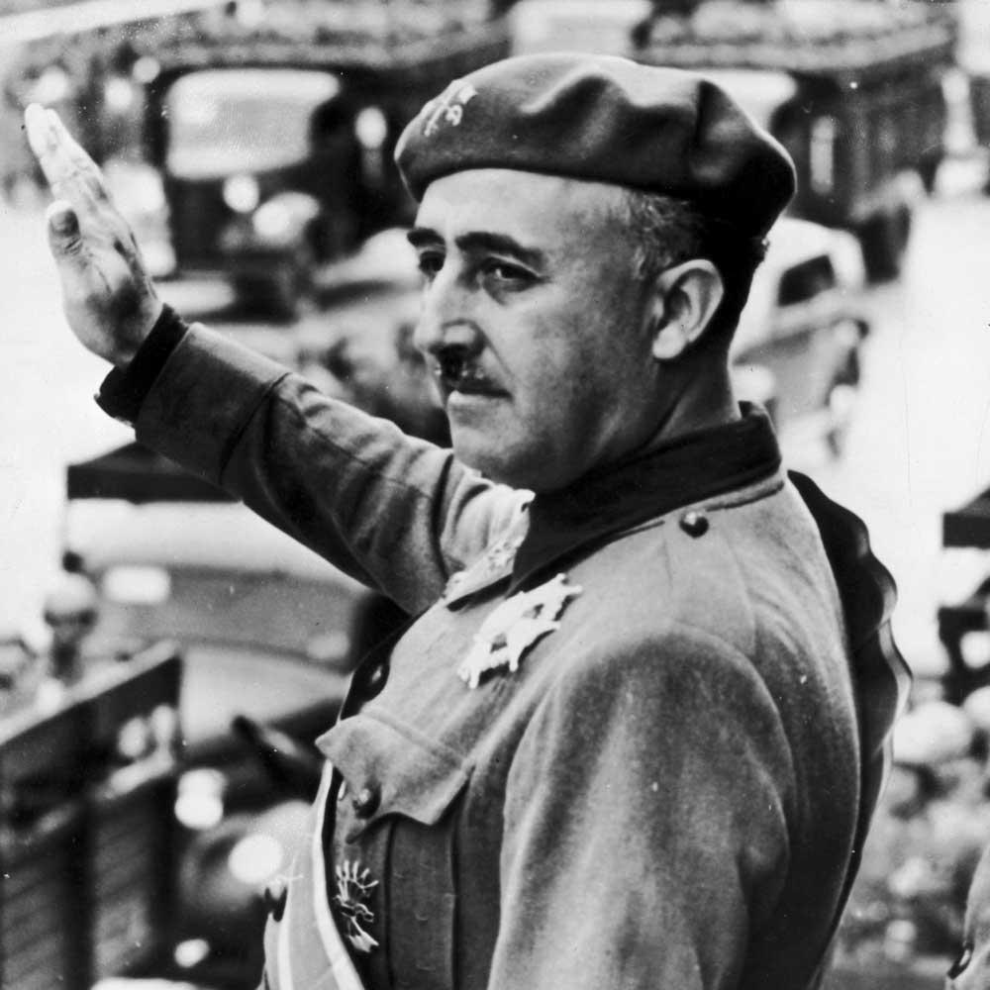
G. America Dooms Loyalist Spain
nSpanish Civil War- 1936-1939
nTraining ground of WWII
nRebels led by fascist Francisco Franco
nReceived aid from Mussolini & Hitler

Slide 13
nLoyalists (royal govt. in power)
nReceived aid from USSR
nMade US NOT send aid- doomed Spain to dictatorship
nTook Congress until 1938 to begin preparing for war

Slide 14
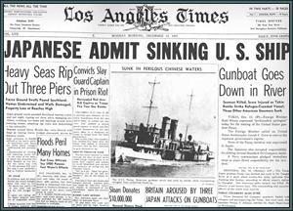
H. Appeasing Japan
n1937- Japan continued attack on China
nFDR’s “quarantine speech”- trade embargos on aggressor nations- attacked by isolationist critics
n‘37- Panay incident- Japanese sunk American gunboat w/ 2 killed- no war

Slide 15
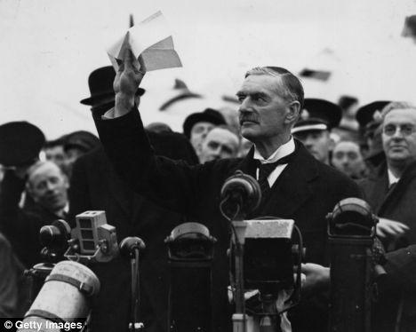
Appeasing Germany
Mid 1930s- Hitler built war machine
nMarch ‘38- took over Austria
nSept. ‘38- took over part of Czech- Sudetenland
nSept. ‘38- Munich Conference- appeasement
nGB PM Neville Chamberlain- “peace within our time”
nMarch ‘39- took over the rest of Czech

Slide 16
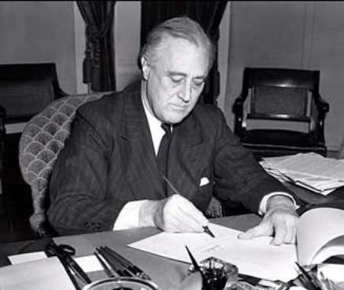
I. Hitler’s Belligerency & US Neutrality
nAug. 23,1939- USSR/German nonaggression pact (secretly decided to divide Poland)
nSept. 1, 1939- Hitler’s invasion of Poland- blitzkrieg
nAmericans still wanted neutrality
nNeutrality Act of 1939 (Cash & Carry)- pay immediately & transport in own ships
nStarted to lift recession of ‘37-’38

Slide 17
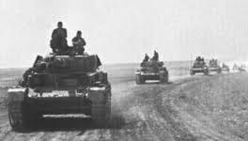
J. The Fall of France
nPhony war- followed Poland’s fall (sitzkrieg)
nUSSR took over Finland
nHitler launched attack on France April 1940- Denmark, Belgium, Netherlands, & Denmark
nFrance fell in June- Dunkirk
nPM Winston Churchill & England
nUS took serious note
nFDR asked Congress to prepare- $ for military
nDraft law
nMonroe Doctrine reborn (w/ help from Latin American nations)

Slide 18
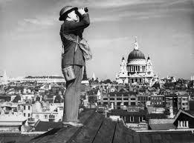
Battle of Britain
nGerman air attacks against Britain- summer 1940- Battle of Britain
nSentiment grew for GB- Committee to Defend America by Aiding the Allies
nHelping GB appealed to interventionists & isolationists
nAmerica First Committee- not help GB, focus on strengthening US

Slide 19
Destroyers for Bases
nBases for Battleships deal
n50 old ships to GB in exchange for 8 defensive base sites in Western Hem.
nDone w/out Congressional approval
nSome outraged, but most Americans okay w/ this- trying to stay out of war- violation of Neutrality Acts

Slide 20
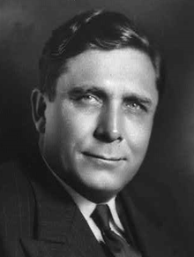
FDR Shatters the Two-Term Tradition in 1940
nReps. Nominated Wendell Wilkie (had been Democrat)
nFDR waited until late to declare intention to run again
nBoth ran on the platform to keep US out of war
nPopular vote a difference of 5 mil. But electoral college still a landslide for FDR

Slide 21
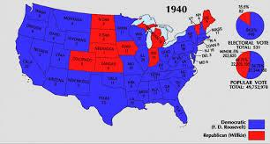

Slide 22
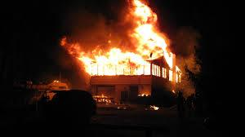
Congress Passes Lend-Lease
nFDR proposed Lend-Lease
nAllies could borrow or lease weapons, when fighting was over they could be returned (neighbor’s house on fire)
nCritics said we wouldn’t want used weapons back
nSend guns, not sons- billions, not bodies

Slide 23
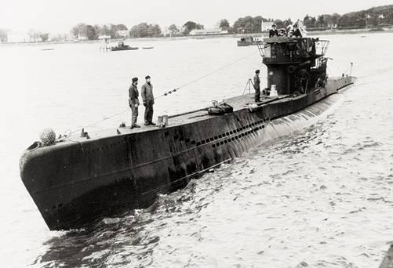
Lend-Lease
nApproved March 1941- abandonment of neutrality
nHelped prepare America’s factories for war
nRecognized by Germany As unofficial declaration of war
n1st American ship sunk by U-boat on May 21, 1941

Slide 24
End of Nazi-Soviet Pact
nHitler attacked Soviets June 1941- double cross
nAllies hoped the 2 would kill each other
nFDR decided to offer help to Stalin (lend-lease)- fear of Soviet collapse
Churchill - “If Hitler invaded hell…”

Slide 25
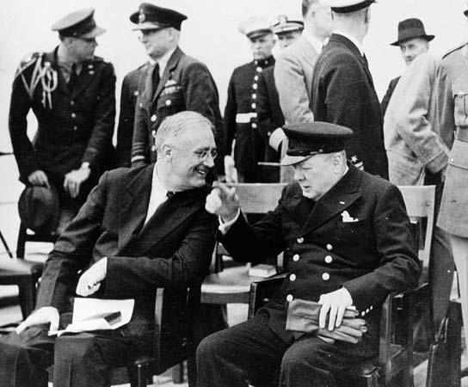
Atlantic Charter
Aug. 1941- agreements b/t FDR & Churchill that looked much like 14 Points- promise to protect GB, against Hitler Germany

Slide 26
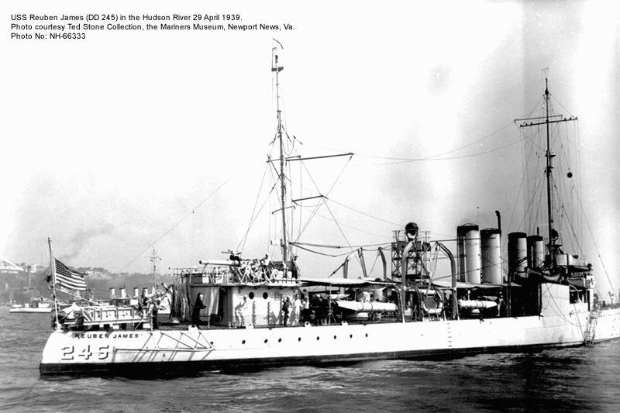
U.S. Destroyers & Hitler’s U-Boats Clash
nConvoys to protect shipping in July ‘41
nSept. 1941- USS Greer fired on
nFDR proclaimed shoot on sight
nOct.- USS Kearny & Reuben James attacked
nCash & Carry repealed completely- US merchants could arm themselves & carry weapons to Britain

Slide 27
US enters the War
nFDR by now looking for a way in
nCame in Pacific, not Atlantic
nJapan needed resources for its war machine- couldn’t rely on US
nUS imposed embargo on Japan

Slide 28
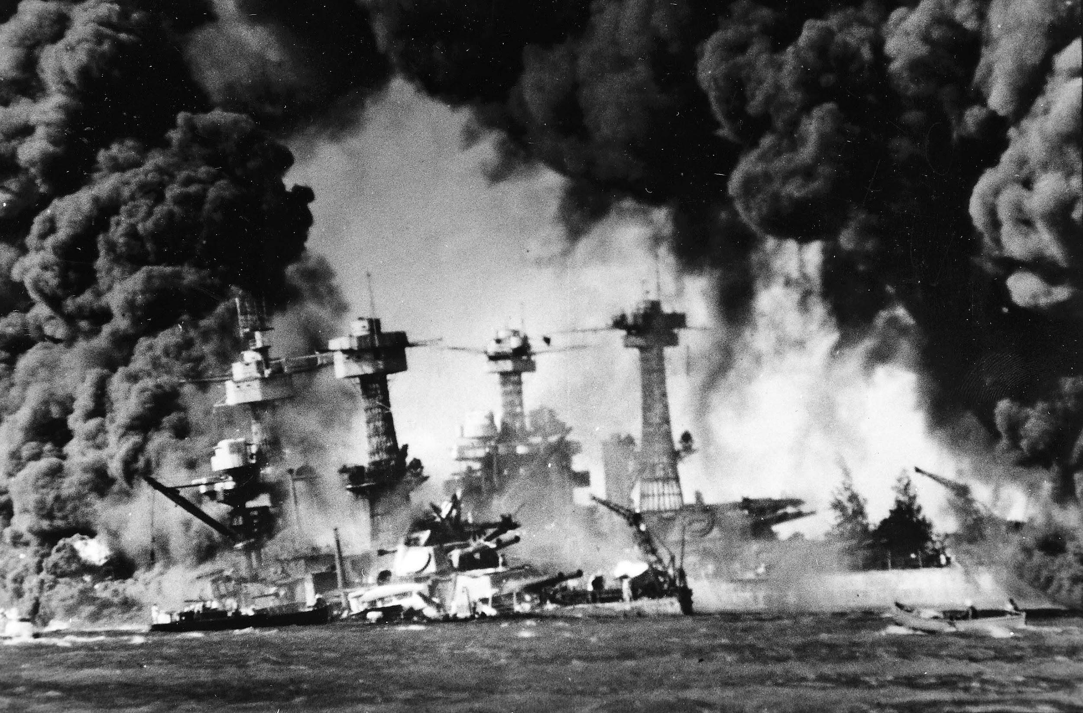
Japenese Response
nNeeded to cripple US Pacific fleet
nNo one to stop them in territory take over
nAttempted US/Japanese negotiations
nAttack on Pearl Harbor- Dec. 7, 1941
nBelieved it would come in Philippines
US losses in men & material

Slide 29
Bystander to Belligerent
nDamaged American fleet, but aroused US anger
nUS declared war on Japan- Dec. 8, 1941
nGermany declared war on US Dec. 11

Slide 30
Did we bring ourselves into the war?
-some claim that US isolationism emboldened dictators
-Could FDR and Hull have been more flexible?

Slide 31
Revisionists
-late 40s - Charles Beard - FDR intended embargo to force Japan into war
-50s and 60s - why was Pearl Harbor unprepared?

Slide 32
At Dawn We Slept (1981)
Gordon Prange - definitive study of Pearl Harbor
-could have been better prepared
-no evidence of “secret plot”
-well planned attack by Japanese

Slide 33
John Toland - Infamy: Pearl Harbor and Its Aftermath (1982)
-Claimed that FDR knew about Pearl Harbor attack but intentionally allowed it to happen
-no evidence

