Slide 1
Farmers and Railroads – AH2

Slide 2
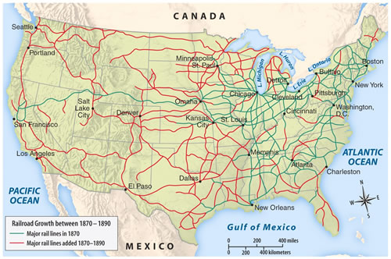

Slide 3
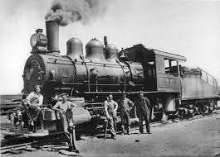
Railroads Open The West
•Federal Government gave large land grants to railroads (to assist in the settlement of the west).
•Railroads received 10 square miles of public land for every mile of track in a state and 20 square miles for every mile of track laid in a territory.

Slide 4
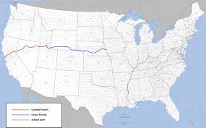
Union Pacific and Central Pacific create a transcontinental railroad
•Union Pacific moved east from Omaha and Central Pacific moved west from Sacramento.
•Many workers were immigrants (Irish and Chinese).

Slide 5
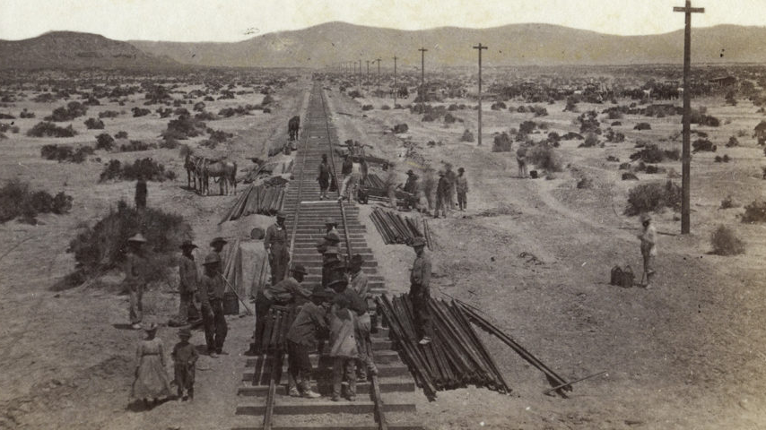

Slide 7
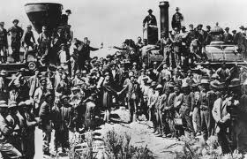
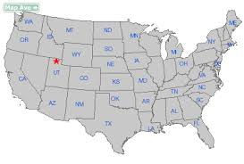
Promontory, Utah
•Central Pacific and Union Pacific met on May 10, 1869 at Promontory, Utah.

Slide 8
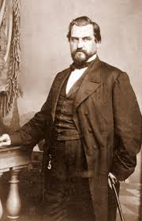
Spanning the Continent With Rails
Transcontinental RR started in 1862-
¡Union Pacific RR- land & loans
¡Central Pacific RR- mountains
¡Big Four (Stanford)
Lines together in Utah- 1869- Golden Spike
¡Tied Atlantic to Pacific

Slide 9
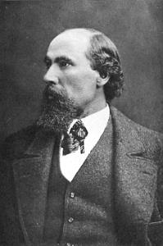
Binding the Continent w/ RR Ties
4 more transcont. RRs by 1893
RRs could be boom or bust
¡James J. Hill – Great Northern
-Empire Builder - no public money,
few land grants
¡Many RRs went bust

Slide 10
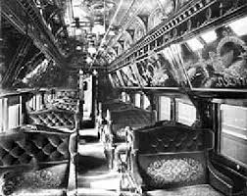
RR Consolidation and Mechanization
Commodore Cornelius Vanderbilt
¡NY
¡Bought up “trunk lines”- created “pools”
¢Trunk Lines – major route between large cities
¡Replaced iron w/steel tracks
Standardized gauge
Westinghouse air brakes
Pullman Palace Cars

Slide 11
Revolution By RRs
Biggest factor of industrialization & growth of cities
Immigration
¡RRs enticed immigrants w/ cheap land & free transport to it
Impact on the land
Time zones
Made millionaires

Slide 12
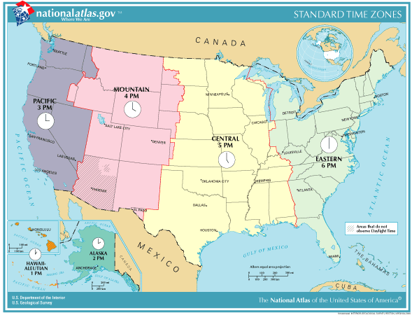

Slide 13
Wrongdoing in Railroading
Stockwatering- inflating the prices of stocks
Little care for public good (Vanderbilts)
Placed their people in high govt. offices
Kickbacks
Unfair freight charges

Slide 14
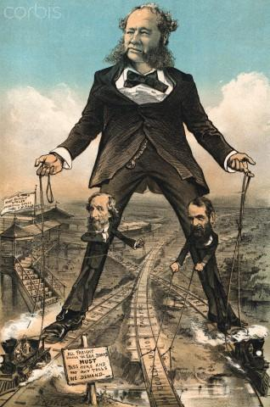
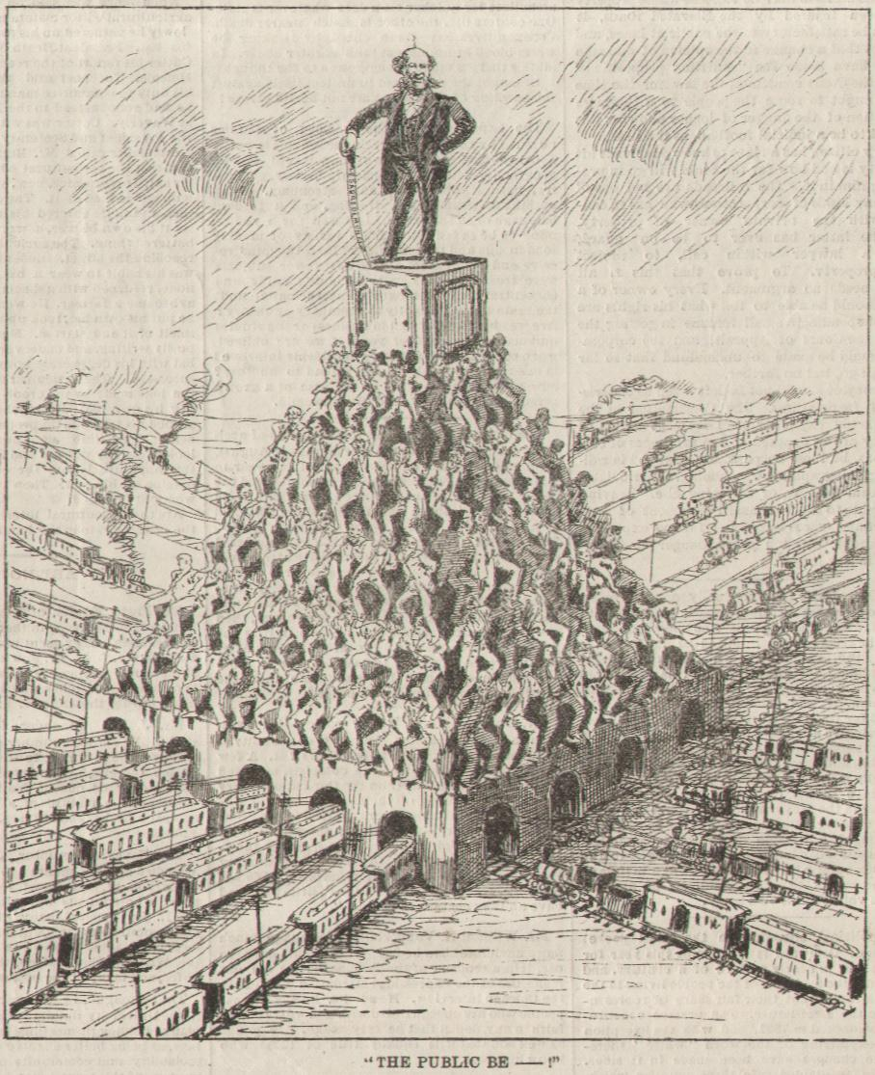

Slide 15
Gov’t Bridles the Iron Horse
Americans were torn on how to control RR giants
¡Mistreating people, but did govt. have right to control them?
¡Panic of 1873- Grange & Granger Laws
Munn v Illinois (1877) – states that Congress May Regulate RRs –
-states could regulated private business involved in serving a public interest.
¡¢

Slide 16
Wabash Case- 1886 - States cannot regulate interstate commerce (overturned a Granger Law)
(actual name was Wabash, St. Louis, and Pacific RR Company v. Illinois) – now reformers had to ask CONGRESS for help in fighting the railroads
¡Cong. & Cleveland passed Interstate Commerce Act in 1887: - set up the Interstate Commerce Commission

