Slide 1
Industry Comes of Age (1865-1900)

Slide 2
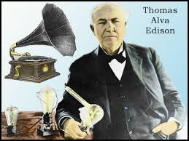
Miracles of Mechanization
Turn of century- US biggest in industry
¡Civil War
¡Natural resources
¡Immigration (labor)
¡Ingenuity
¢Cash register, stock ticker, typewriter, telephone
¢Thomas Edison- Menlo Park, NJ- *lightbulb*

Slide 3
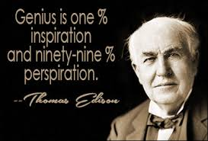

Slide 4
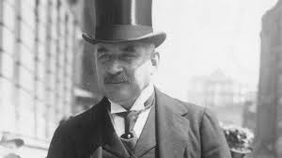
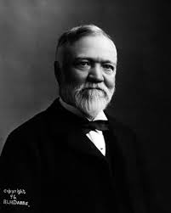
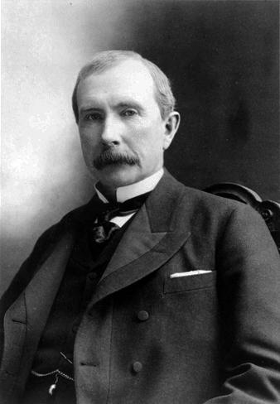
The Trust Titan Emerges
J.P. Morgan- banking
Andrew Carnegie- steel
¡Vertical integration
John D. Rockefeller- oil (Standard Oil)
¡Horizontal integration
¡Trust, interlocking directorates

Slide 5
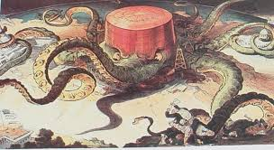
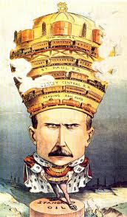
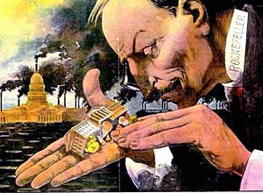

Slide 6
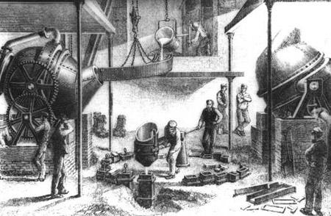
Supremacy of Steel
Transformed America- construction, capital goods, stronger
Bessemer Process, coal, iron ore, labor

Slide 7
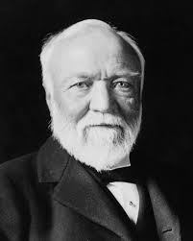
Carnegie and other Sultans of Steel
Scottish immigrant- quickly moved up the ladder
Partnership of steel producers- $40 mil.
J.P. Morgan bought him out in 1900- US Steel
¡1st billion dollar corp.
Carnegie’s philanthropy

Slide 8
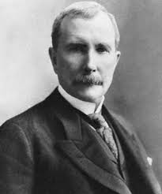
Rockefeller grows and American Beauty Rose
Oil in PA- 1859- Kerosene
Ker. Replaced by electric lights- 1885
Internal combustion engine- gasoline
John D. Rockefeller- Standard Oil Company- 1872
¡Trust
¡Believed he was going by natural economic law
¡Produced high quality low priced oil

Slide 9
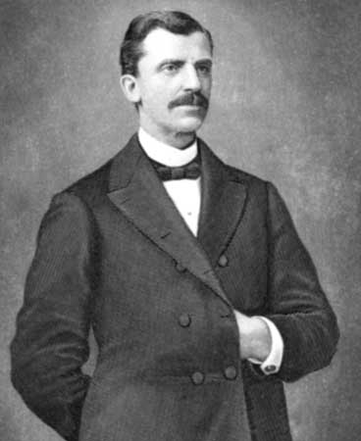
Gospel of Wealth
Robber barons vs. philanthropists
¡“godliness is in league with riches”
¡Rockefeller- God gave me my money
Rev. Russell Conwell - “Acres of Diamonds”
¡Carnegie- those entrusted with society’s riches have to prove themselves morally responsible


Slide 10
Russell Conwell
Acres of Diamonds - 1890
-Persian Farmer’s Story
Union Army Captain
Deserted post
Sermon repeated 6,000 times before he died in 1925
Founded Temple University
Takeaways?
-dig in your own garden!
-the rich and poor deserve their situation

Slide 11
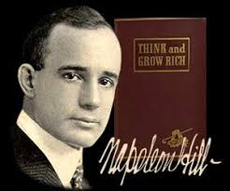

Slide 12
“Social Darwinists”- survival of the fittest
Contempt for poor- their own making
14th amend- courts ruled corporations as people- used against labor

