Slide 1
The Great Awakening
1730s-1740s

Slide 2
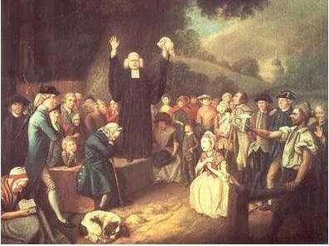
What was the Great Awakening?
Religious revival movement
Evangelicism – “new birth” considered the ultimate religious experience
Followers accepted that they were sinners and asked for salvation
George Whitefield preaching

Slide 3
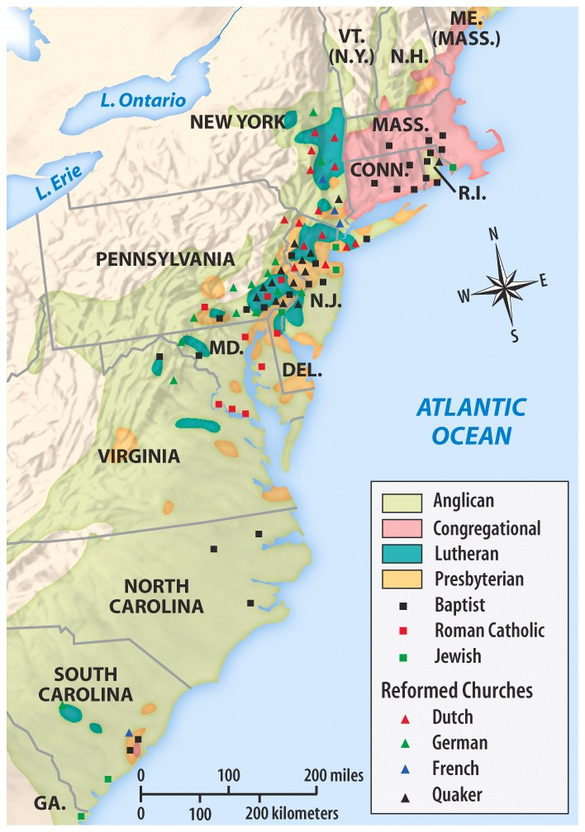
Before the Great Awakening
Before the 1730s, most colonies had two established religions.
Congregationalism was the largest religion in New England
Anglicanism was the largest religion in New York and the Southern colonies

Slide 4
-1730s and 1740s – local revivalism in Raritan Valley of NJ began to spread
-Theodore Frelinghuysen (Dutch Reformed Church)

Slide 5
-Tennent Family (William and son Gilbert (Presbyterian)
“Pietism” – emphasis on holy life without troubling too much about doctrinal disputes

Slide 6
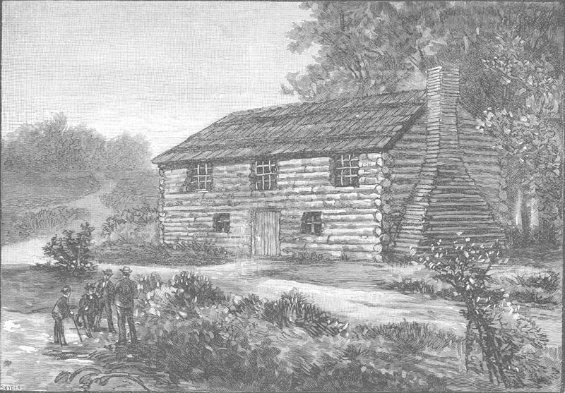
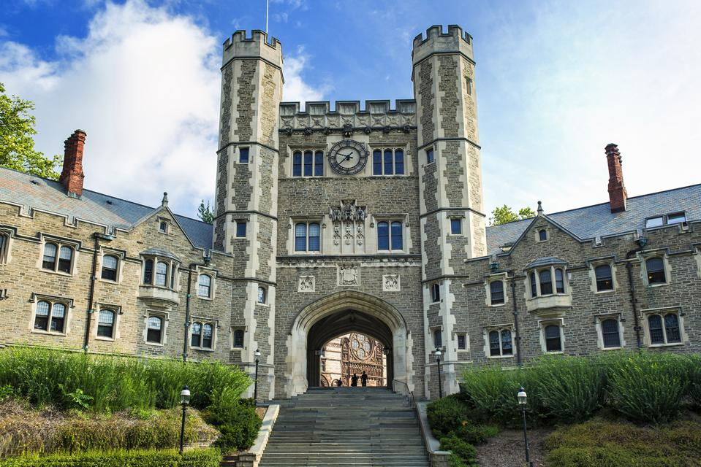
“Log College” – prototype for College of New Jersey (Princeton)

Slide 7
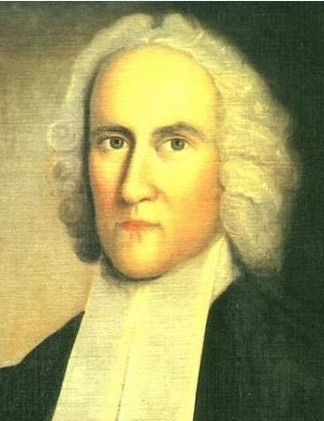
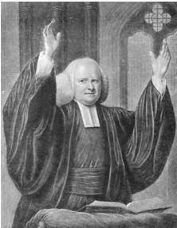
Leaders of the Great Awakening
Jonathan Edwards
George Whitefield

Slide 8
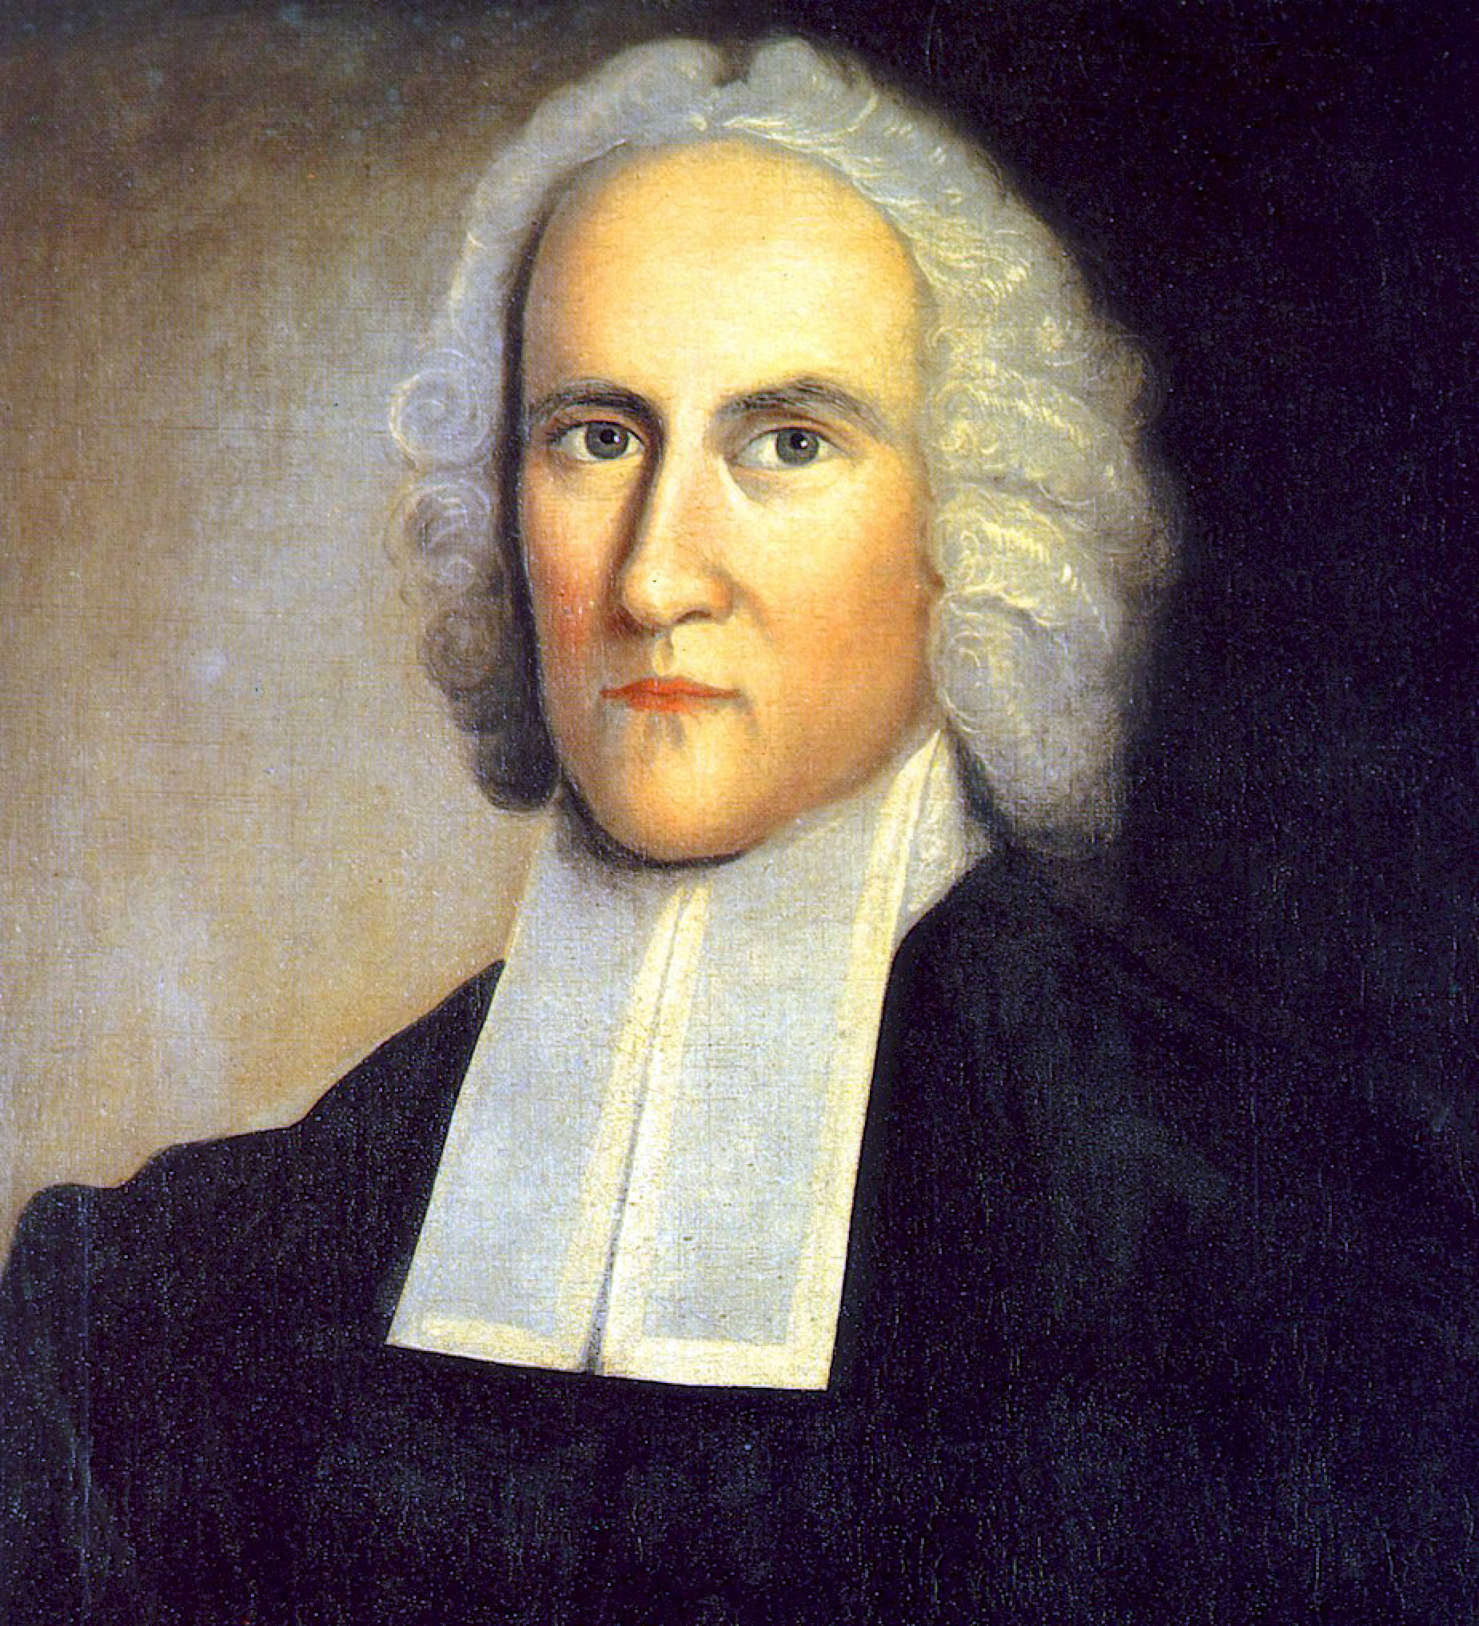
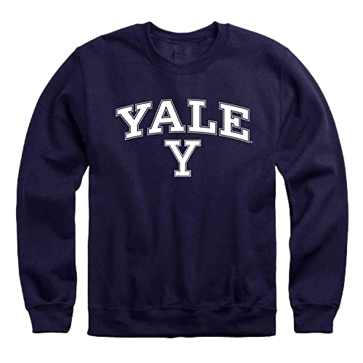
Johnathan Edwards – grandson of Solomon Stoddard (Northampton – 6 revivals over 60 years) – “Our people do not so much need to have their heads stored, as to have their hearts touched”
-Mid-1735 – Joseph Hawley’s suicide

Slide 9
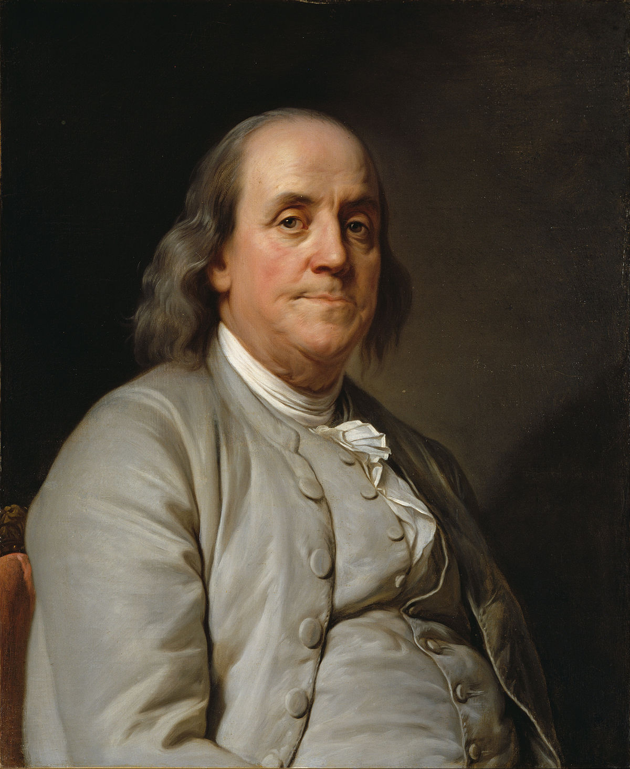
George Whitefield – England and Wales to colonies – great marketing - Ben Franklin and printing connection

Slide 10
Edwards – A Faithful Narrative of the Surprising Work of God
-published London 1737, Boston 1738

Slide 11
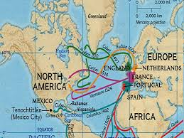
Trans-Atlantic Exchanges
Johnathan Edwards >>>>>> writings across the Atlantic and read by George Whitefield >>>>>>> Whitefield’s sermons printed and carried across the Atlantic and created an eager audience in the colonies

Slide 12
“my knees smote together…and it seemed to me I was a sinking down into hell…but then I resigned my distress and was perfectly easy quiet and calm…and it seemed as if I had a new soul & body both.” – Hannah Heaton

Slide 13
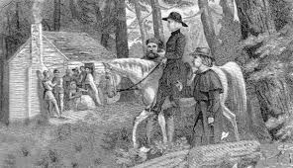
Itinerant preachers – stressed “heart religion”

Slide 14
Whitefield’s American Farewell
-20,000 in Boston
-”The generality of preachers talk of an unknown and unfelt Christ. The reason why many congregations have been dead is, because they had dead men preaching to them.”

Slide 15
Old Lights vs. New Lights
Churches that grew as a result of the Great Awakening: Presbyterianism, Methodism, Baptism (New Lights)
Challenged authority and hierarchy of established churches (Old Lights: Congregationalists and Anglicans)
Great Awakening said that anybody could be converted and born again. You didn’t need traditional church leadership to decide whether or not you belonged.

Slide 16
Old Light and New Light Schools

Slide 17
New Light Schools
King’s College (Columbia) – NY
College of Rhode Island (Brown) –
Queen’s College (Rutgers)

Slide 18
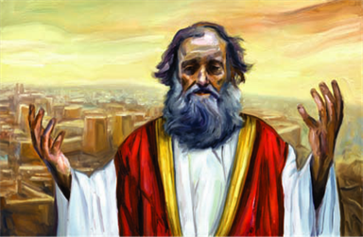
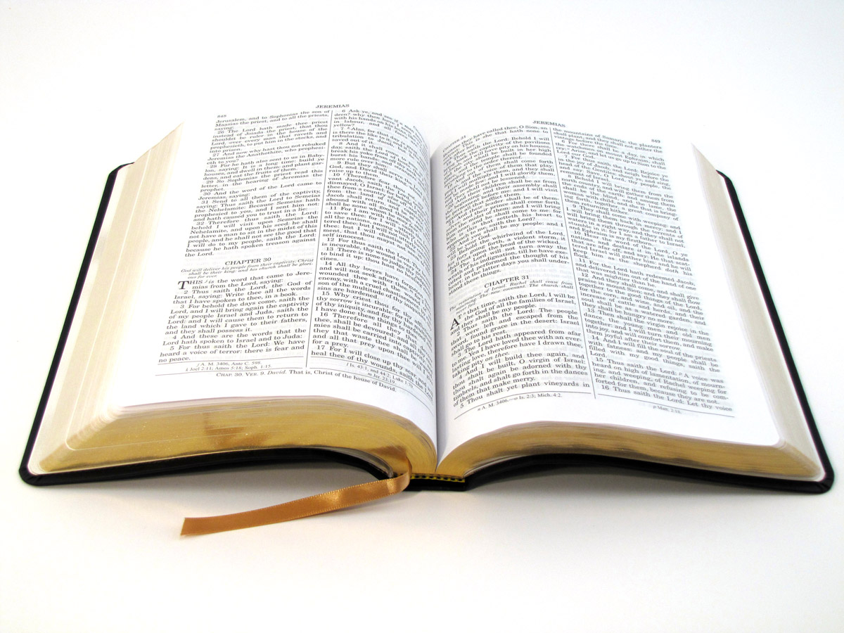
Jeremiads
New type of sermon
Focused on Biblical teachings of Jeremiah (prophet who warned of Doom)

Slide 19
Half-Way Covenant – 1662 - assembly of Boston ministers – baptized children of church members get “halfway” membership and secure baptism for own children
-no vote in church or communion

Slide 20
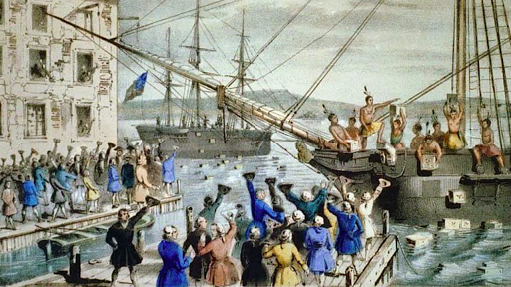
Peak
-Peaked in Virginia in 1760s
-Revivals too emotionally demanding to last
-Religious fervor replaced with Revolutionary fervor

Slide 21
Religion Spreads
Great Awakening extended religion to:
poor
blacks spurned by many sects
new settled areas
women
Bridging the gap between Southern whites and slaves?

