Slide 1
Civil Rights – Loose Ends

Slide 2
MLK – March on Washington (1963)
“I have a dream”
“We shall overcome”

Slide 3
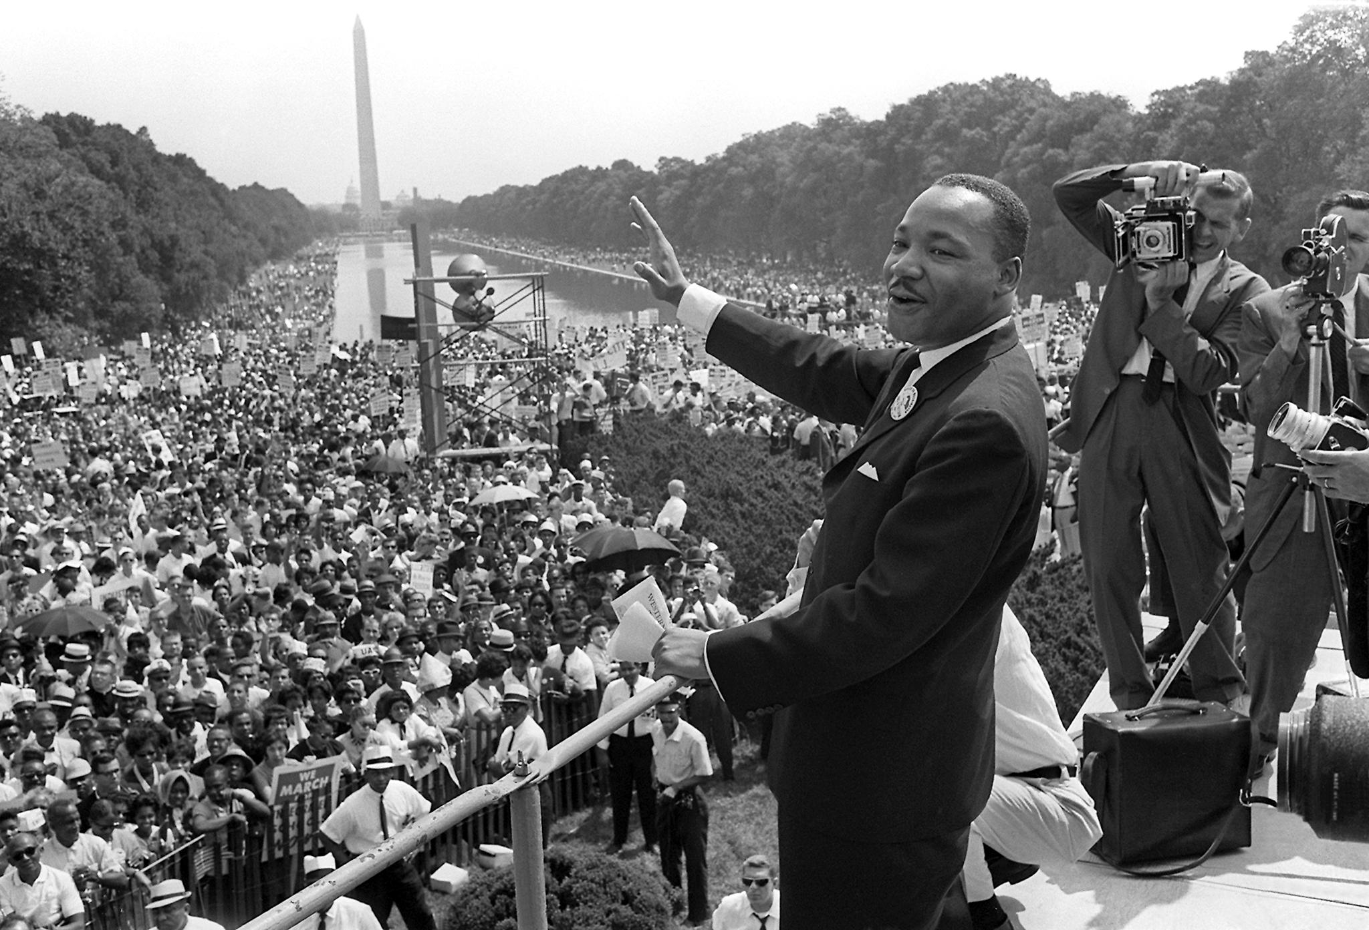

Slide 4
James Meredith – Ole Miss
Gov. George Wallace – attempted to prevent African-American student from attending U of Alabama
Medgar Evers – WWII Veteran – assassinated 1963

Slide 5
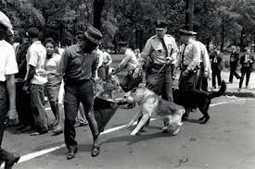
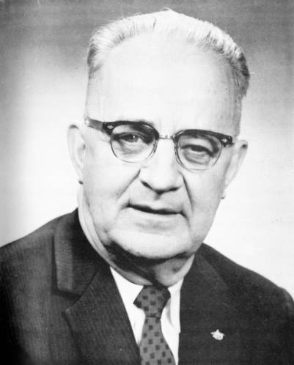
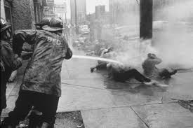
Eugene “Bull” Connor

Slide 6
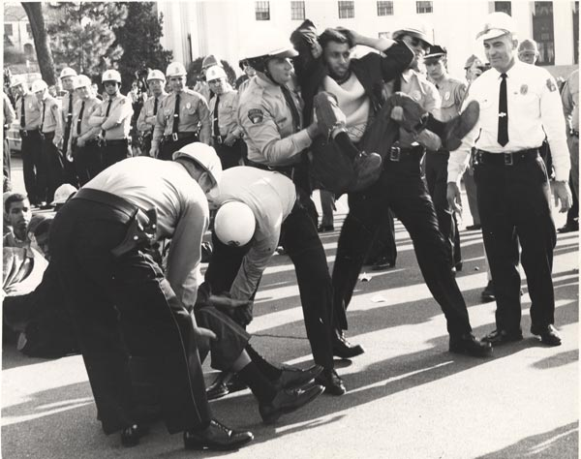

Slide 7
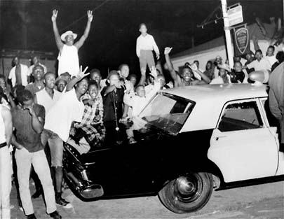

Slide 8
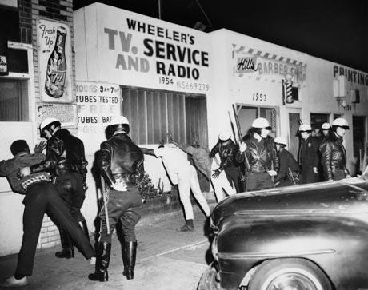

Slide 9
LBJ and Congress take Civil Rights Action
Civil Rights Acts of 1964 and 1965
Most important civil rights laws since Reconstruction
Dems and some Repubs passed CR Act of 1964
Outlawed segregation in all public facilities (including hotels and restaurants)
Est Equal Employment Opportunity Center
End discrimination in employment on the basis of race, religion, sex, or nat’l origin
Also in ‘64 – 24th Amendment ratified
Voting Rights Act of 1965

Slide 10
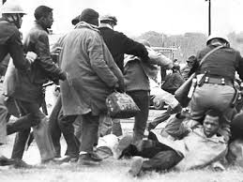
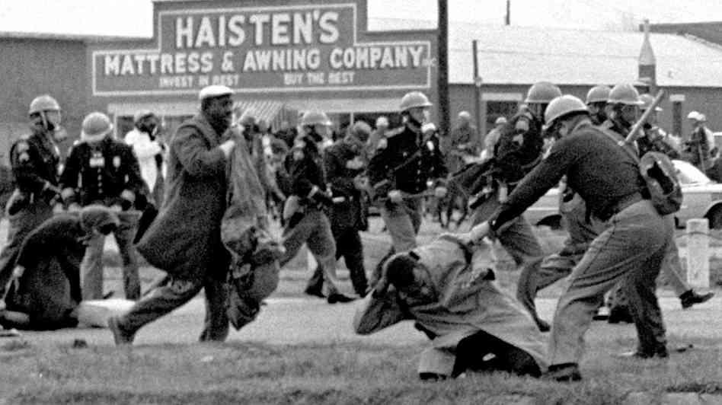
“Bloody Sunday”
Voting rights marchers attacked – beatings and tear gas
Selma, AL 1965
LBJ send federal troops to protect another March
Congress passed Voting Rights Act of 1965

Slide 11
Kerner Commission
1968
US was becoming “two societies, one black, one white – separate and unequal”

Slide 12
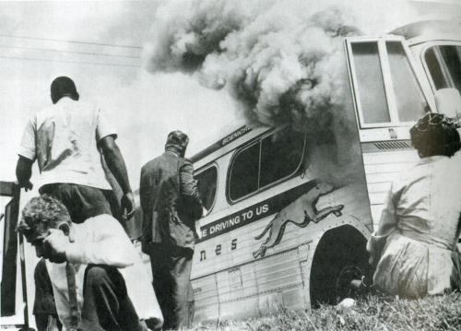

Slide 13
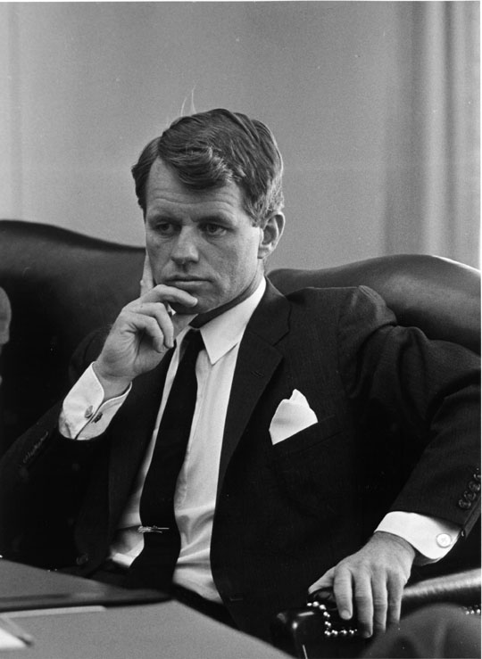

Slide 14
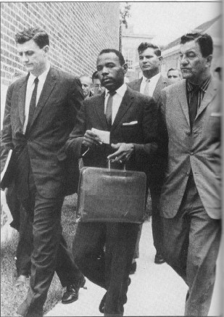

Slide 15
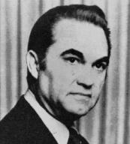

Slide 16
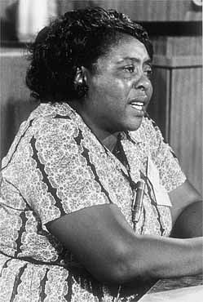

Slide 17
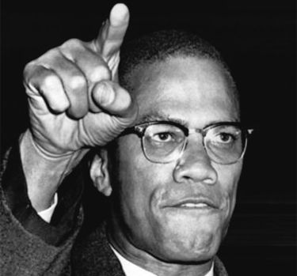

Slide 18
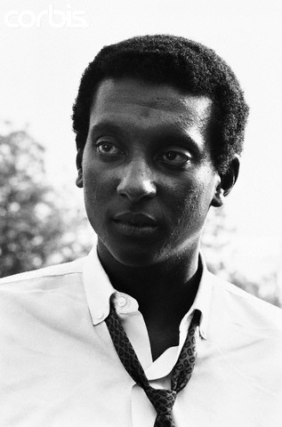

Slide 19
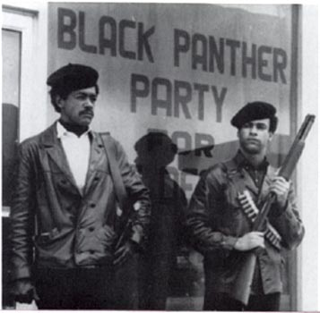

Slide 20
