Slide 1
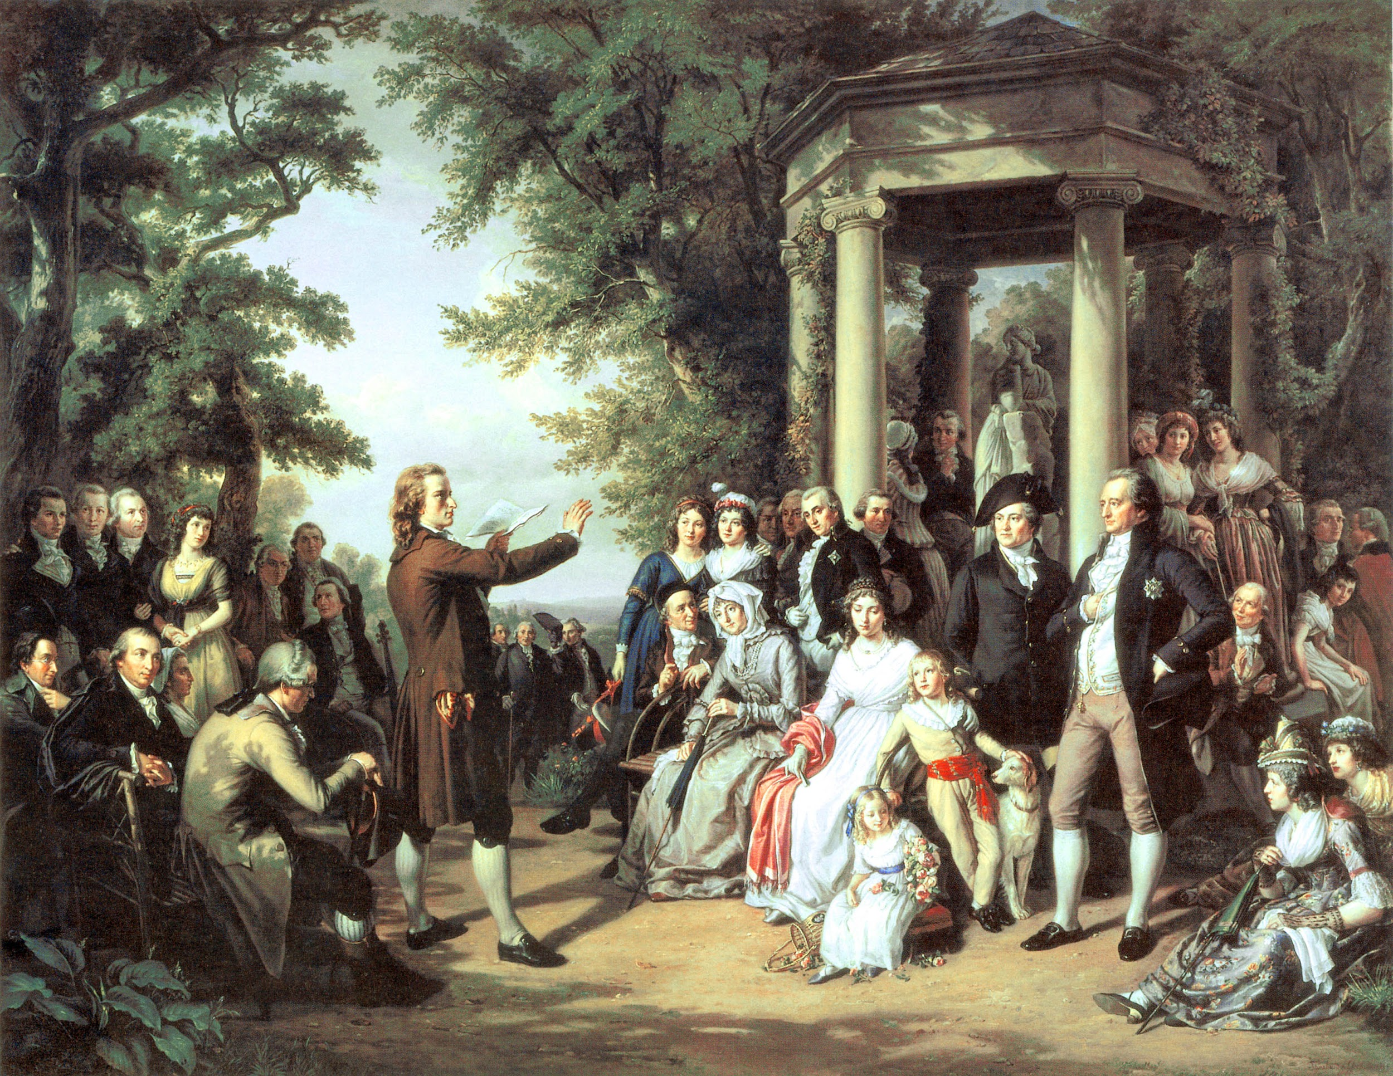
Enlightenment Thinkers

Slide 2
Objective
CE.C&G.1.2 “Explain how the Enlightenment and other contributing theories impacted the writing of the Declaration of Independence, the US Constitution and the Bill of Rights to help promote liberty, justice and equality”

Slide 3
The Enlightenment
Era in which people began to use reason to understand government and society
Paris was the center of the Enlightenment

Slide 4
Baron de Montesquieu
Wrote “The Spirit of the Laws”
Praised the separation of powers into three branches (judicial, legislative, and executive)

Slide 5
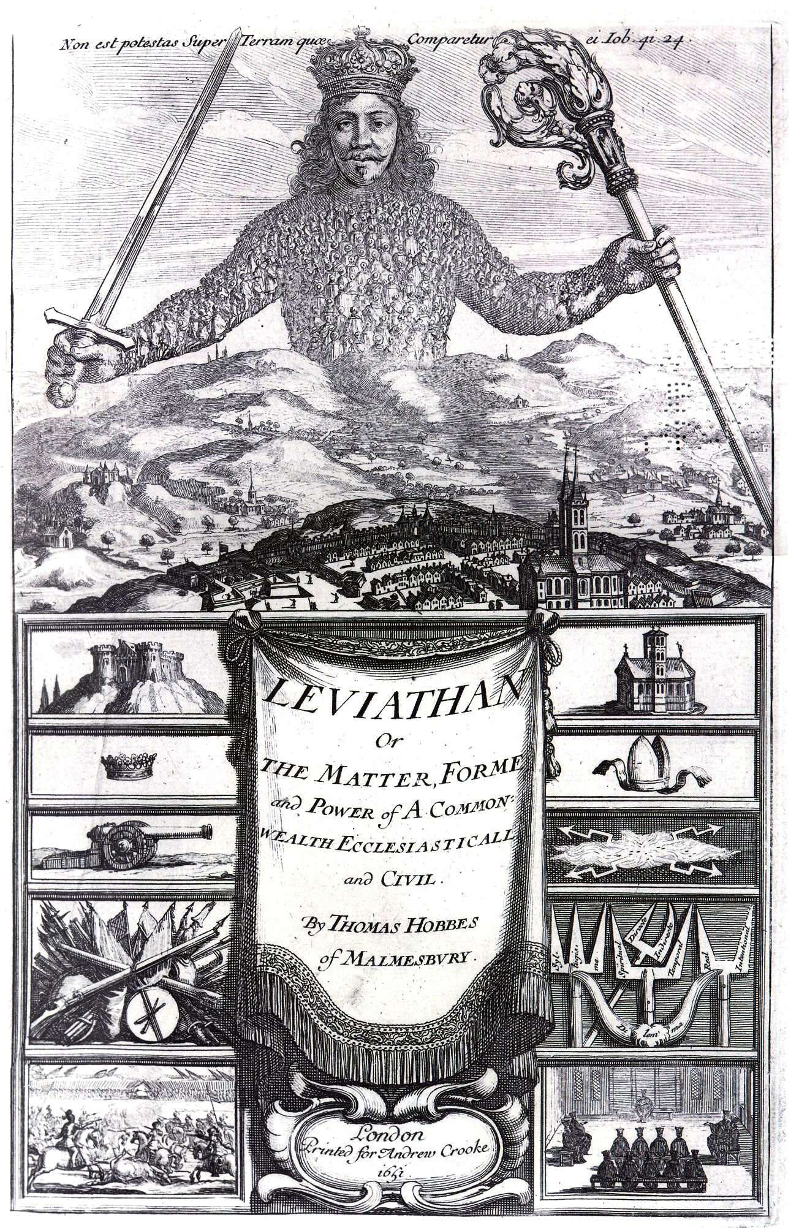
Thomas Hobbes
Wrote “Leviathan”
Social Contract Theory
Favored an absolute monarchy

Slide 6
Voltaire
Advocate of religious toleration and
the separation of church and state

Slide 7
Jean-Jacques Rousseau
Author of “The Social Contract”, and “A Discourse on Inequality”
Individuals are born good, but corrupted by society.

Slide 8
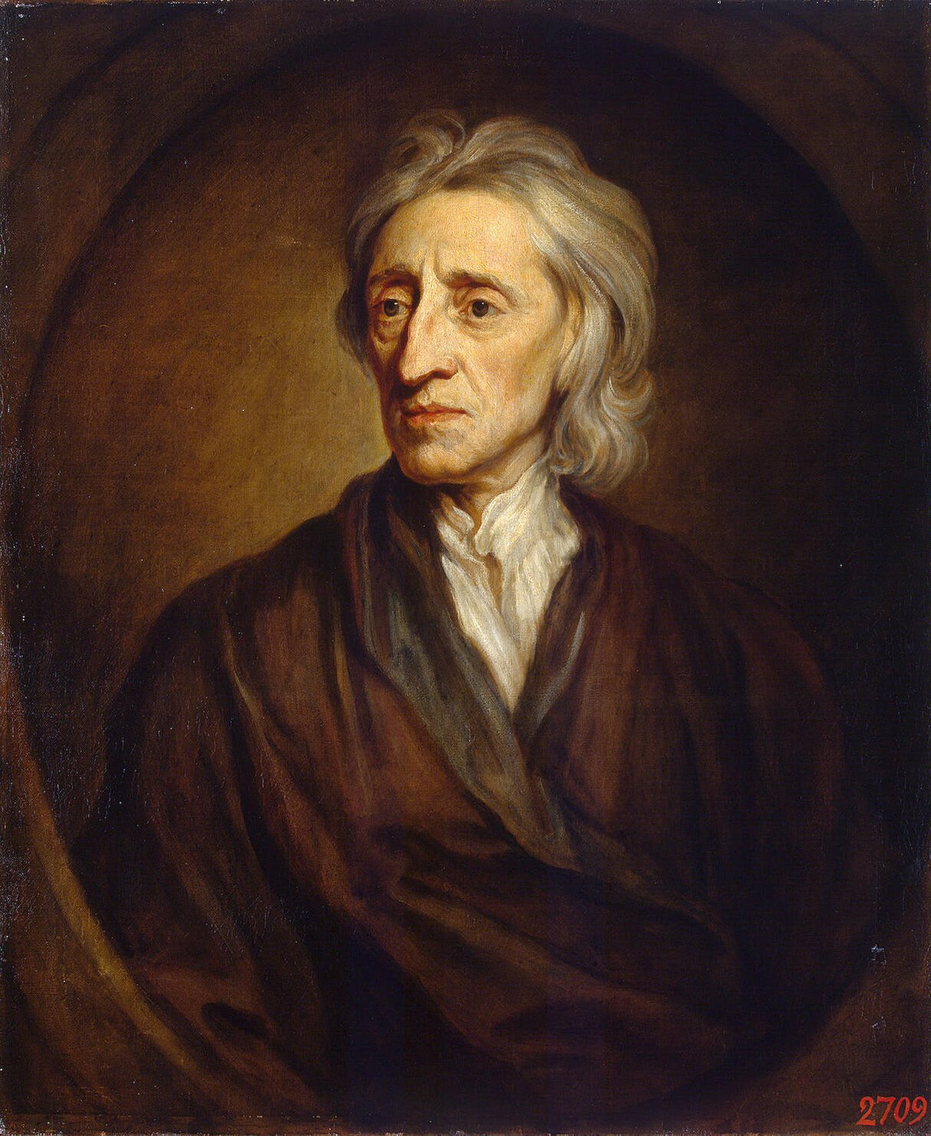
John Locke
Wrote “Two Treatises on Government”
Advocated idea that people were born with the natural right to life, liberty, and property

Slide 9
Adam Smith
Wrote “The Wealth of Nations”
Advocate of laissez-faire economics

Slide 10
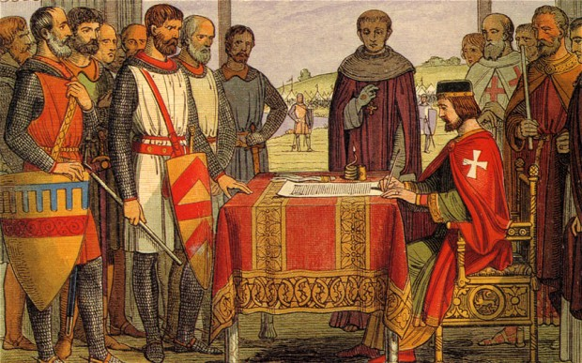
Magna Carta

Slide 11
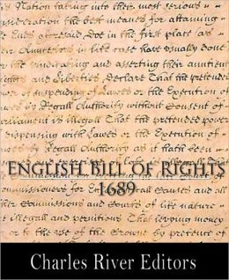
English Bill of Rights
Limited power of the monarchy
Gives rights to the English Parliament
Influenced by Locke

