Slide 1
AP US History
Unit 1 Part 3 Notes

Slide 2
Administration of New Spain
-early form of checks and balances?
-ViceRoyalties - New Spain and Peru
Viceroy (appointed by king)
Audencia (council appointed by king)
Archbishop (appointed by king, subcontract by pope)
Audit called visita - one ran to 49,555 pages
All three reported on each other
Lots of bureaucratic inertia and red tape - waited one year for instructions from crown

Slide 3
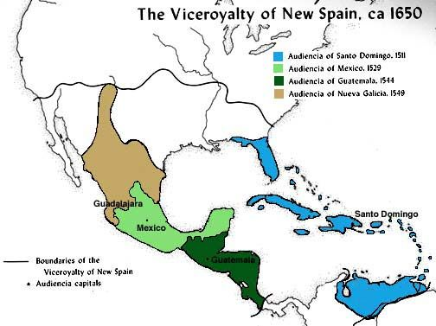

Slide 4
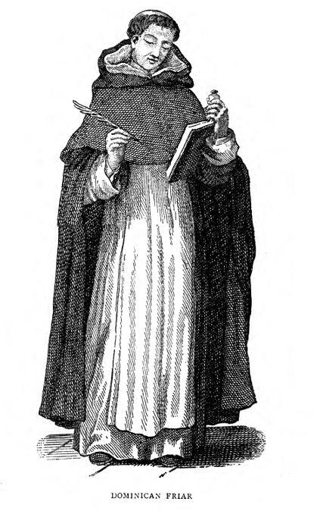
Protests against the encomienda system
-1511 sermon on Hispaniola - Dominican friar - “Are these Indians not men? Do they not have rational souls? Are you not obliged to love them as you love yourselves?”
-touched Bartolome de’ las Casas - renounced his encomienda and entered the Dominican order

Slide 8
The Black Legend
“Tell me, reader, whether these were civilized people landing among savages, or savages among civilized people.” - Guillame Thomas Raynal – 18th Century French Historian

Slide 9
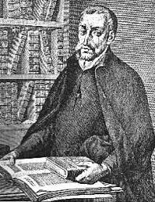

Slide 10
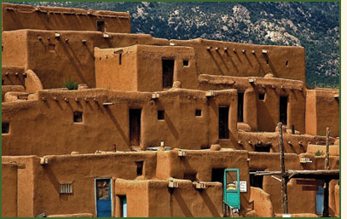
Pope’s Rebellion (Pueblo Revolt) - 1680
Context – prolonged drought, Spanish inability to protect Pueblo from Apache/Navajo raids
Most complete victory of Native Americans over Europeans in North American history

Slide 11
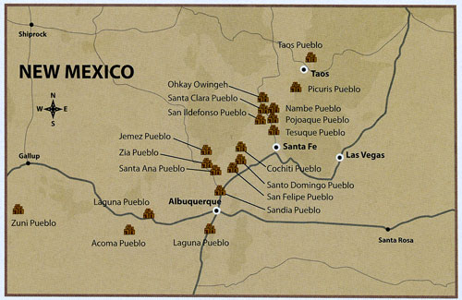
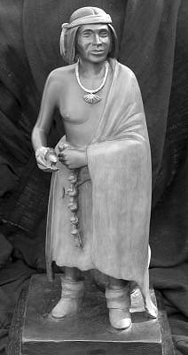
Pope’s Rebellion (continued)
Pope and others charged with “sorcery” (1675)
Coordinated uprising of 6 different Pueblo groups in 1980
~2,000 warriors killed 400 colonists
Spanish – “lingua franca” of the rebellion
Spanish reconquered area 1692 and forced to accept compromises

Slide 13
“Middle Ground” of Upper Great Lakes Region

Slide 14
Flushing Remonstrance - 1657

Slide 15
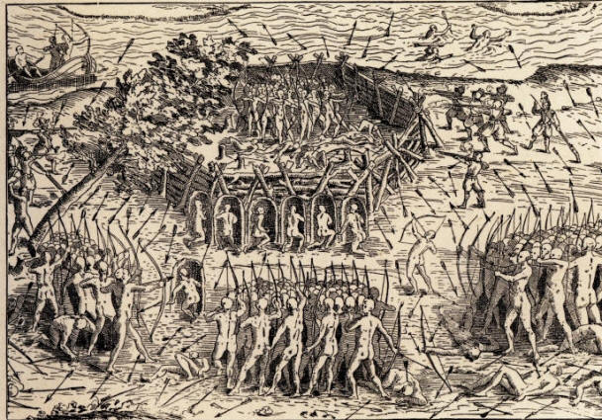
French and Dutch Trade led to Indian Wars
Hurons vs Iroquois
Torture
Vengeance wars
-replace relatives

