Slide 1
AP US History
Period 1 (Unit 1): 1491-1607

Slide 2
1491
Why this date?

Slide 3
1607
Why this date?

Slide 7
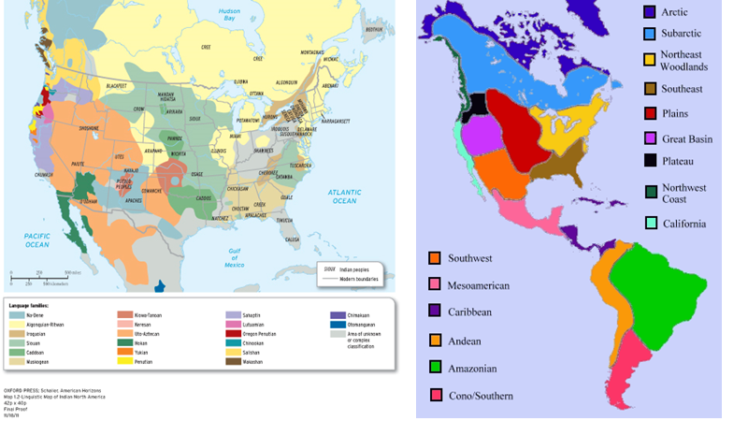

Slide 9
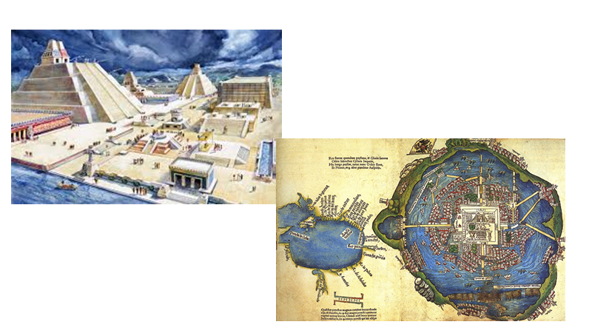
Tenochtitlan

Slide 10
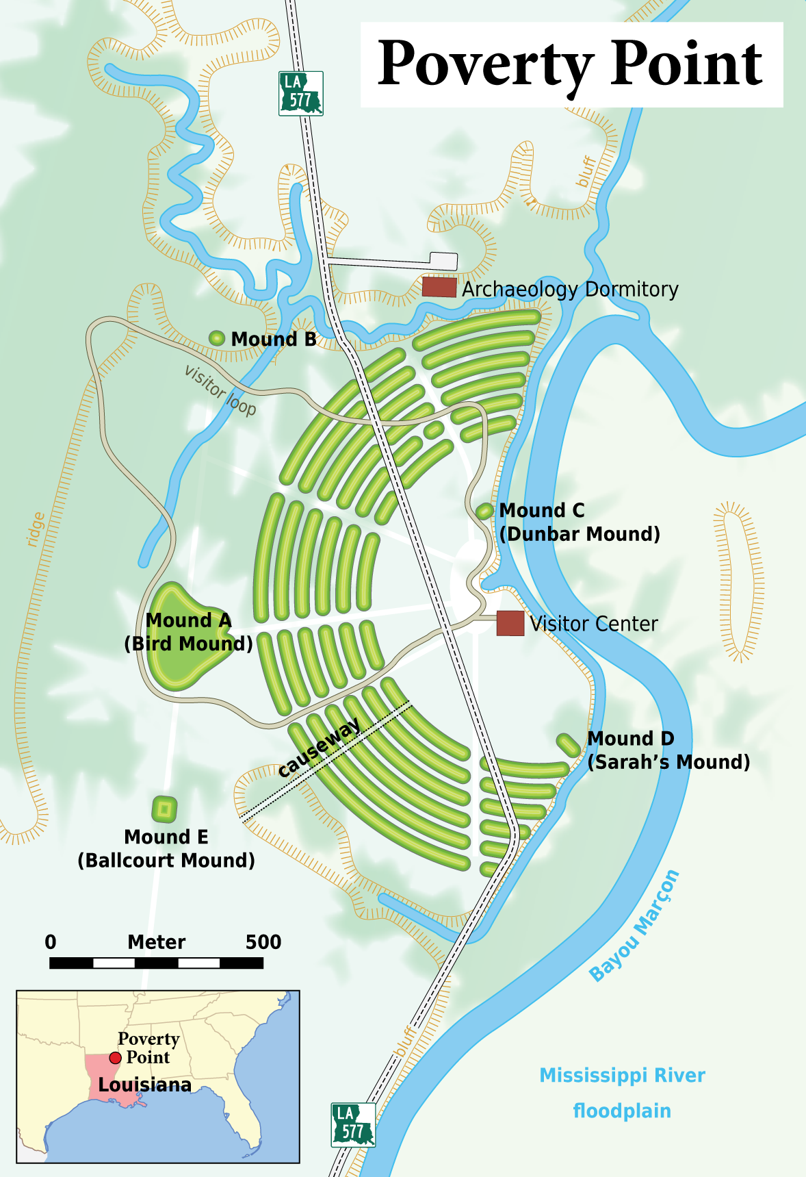
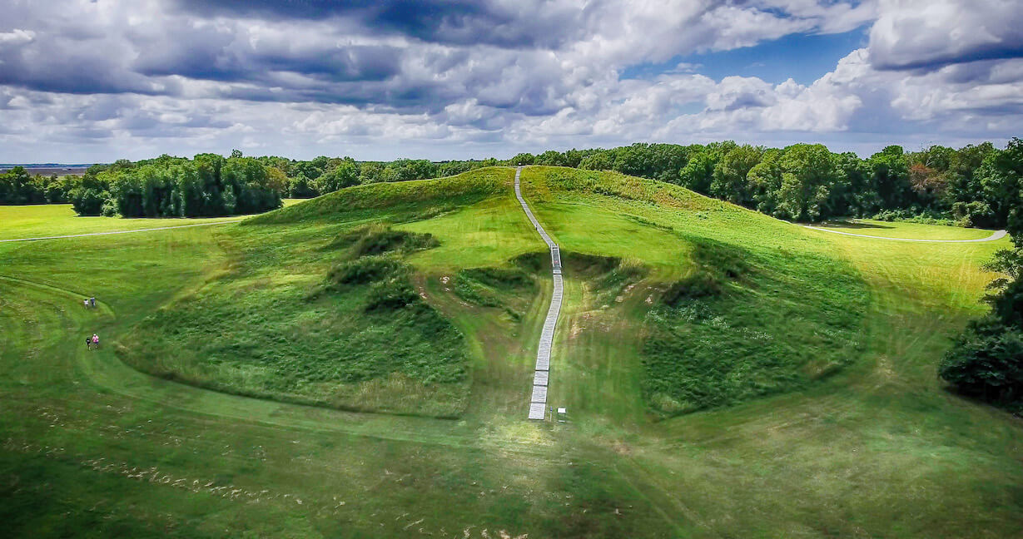
Poverty Point
Copper, Flint

Slide 11
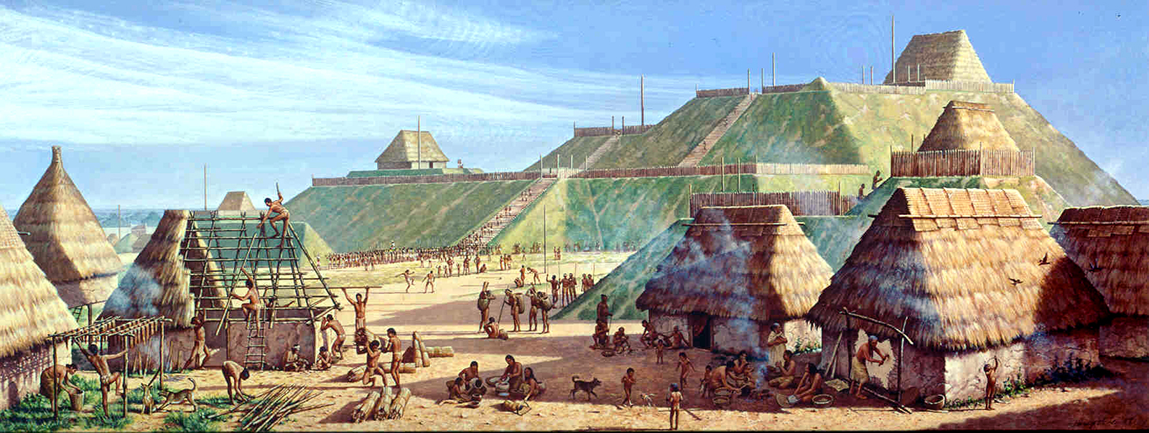
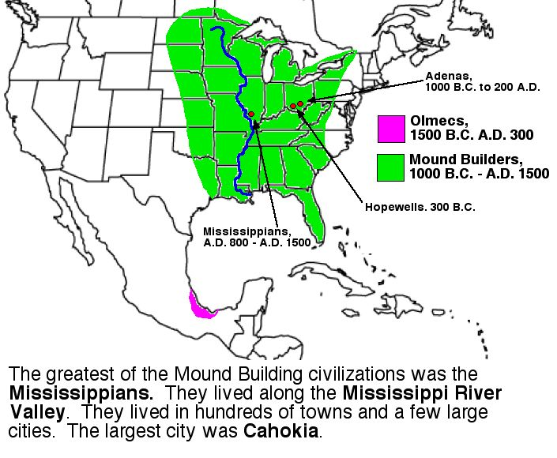
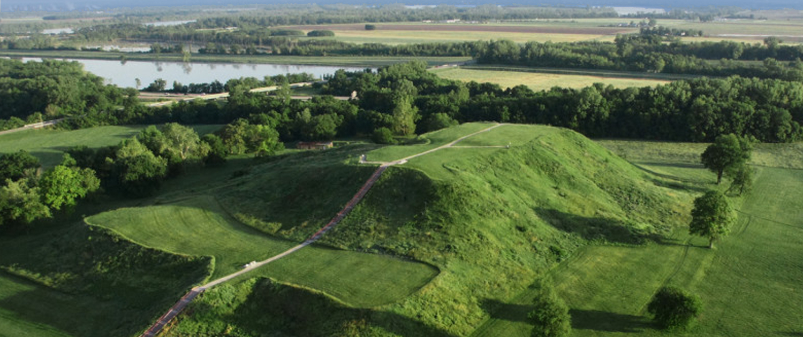
Cahokia

Slide 12
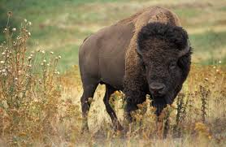
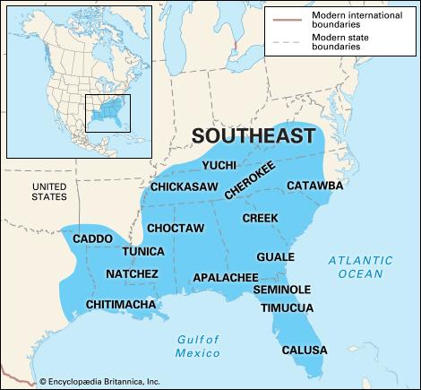
Change from European Exploration
Ethnogenesis - emergence of new ethnic groups and identities from consolidation of many peoples disrupted by invasion of European peoples, animals, and microbes

Slide 15
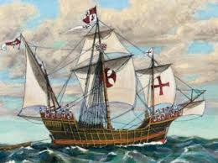
Caravel
-hybrid of the solidity of northern European ships and the maneuverability of southern European ships - Iberian and Genoese

Slide 17
Forerunners to (and contemporaries of) Columbus
Dias - 1487 rounded southern tip of Africa
Da Gama - 1492 - traversed Indian Ocean

Slide 18
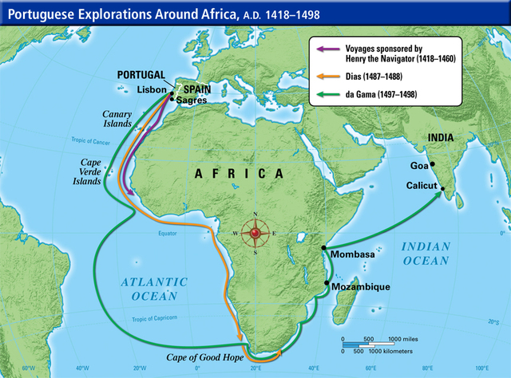

Slide 19
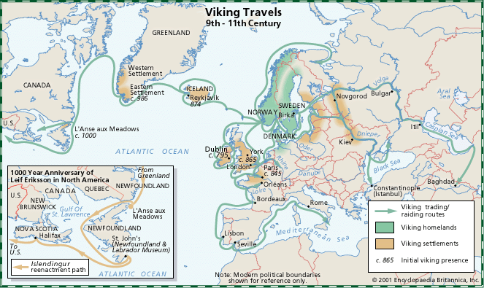
Pre-Columbian European Contact w/ Americas?

Slide 20
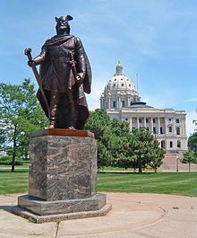

Slide 21
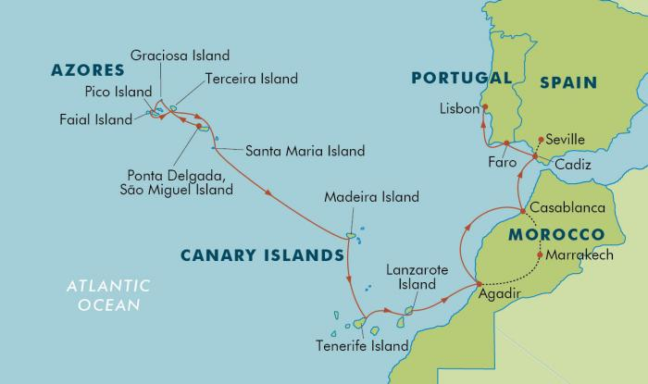
Training Grounds for European Invasion

Slide 22
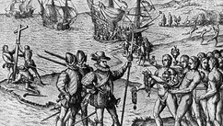
“First Contact” vs “First Encounters” vs “Discovery”

Slide 23
Alan Brinkley – 2003
Indians neither “murderous savages” nor “relatively docile allies of white people”
They are “important actors of their own”
Changes in recent scholarship

Slide 25
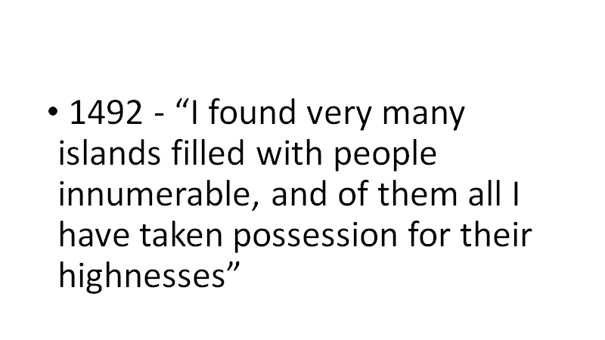

Slide 27
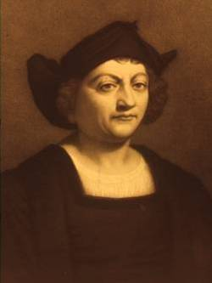
Columbus
-had sailed to North Atlantic, Azores, West Africa
-loved reading The Travels of Marco Polo
-renamed self “Christoferens” (“Christ-bearer”)

