Slide 1
American History II
Intro / AH 1 Recap

Slide 2
How did we get here?
-1491
-Native American/European Contact
-Colonization
-Jamestown
-Great Awakening
-French and Indian War
-Revolutionary War
-Articles of Confederation >>>Constitution
-War of 1812
-Market and Industrial Revolution

Slide 3
-Missouri Compromise
-Jacksonian Democracy
-Indian Removal
-Mexican War
-Compromise of 1850
-Uncle Tom’s Cabin
-Kansas-Nebraska Act
-John Brown’s Raid
-Secession and Civil War
-Emancipation Proclamation
-Reconstruction
-The West

Slide 4
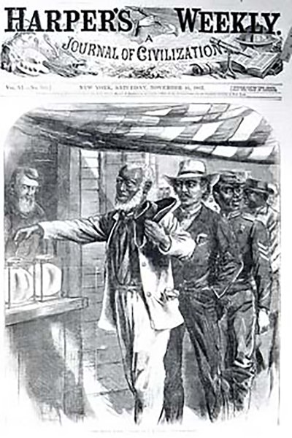
13th, 14th, and 15th Amendments

Slide 5
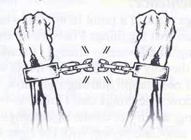
13th Amendment

Slide 6
14th Amendment

Slide 7
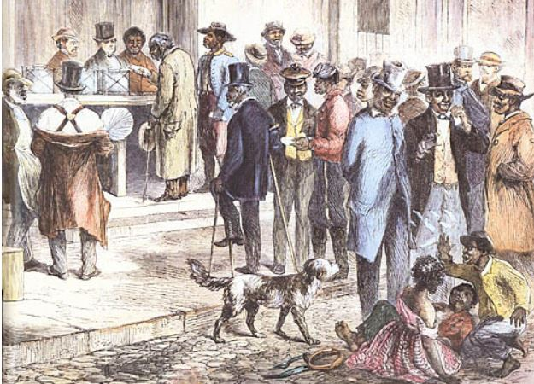
15th Amendment

Slide 8
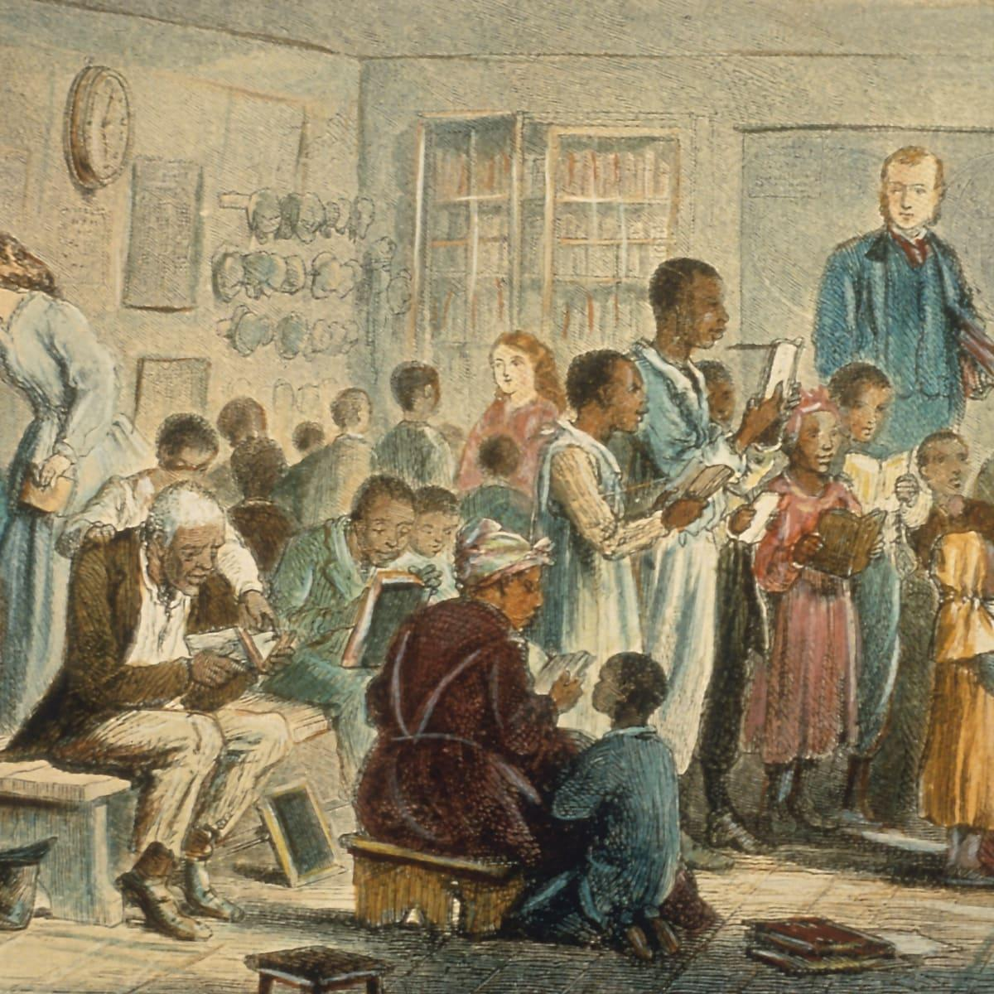
Freedman’s Bureau

Slide 9
Was Reconstruction a success?

Slide 10
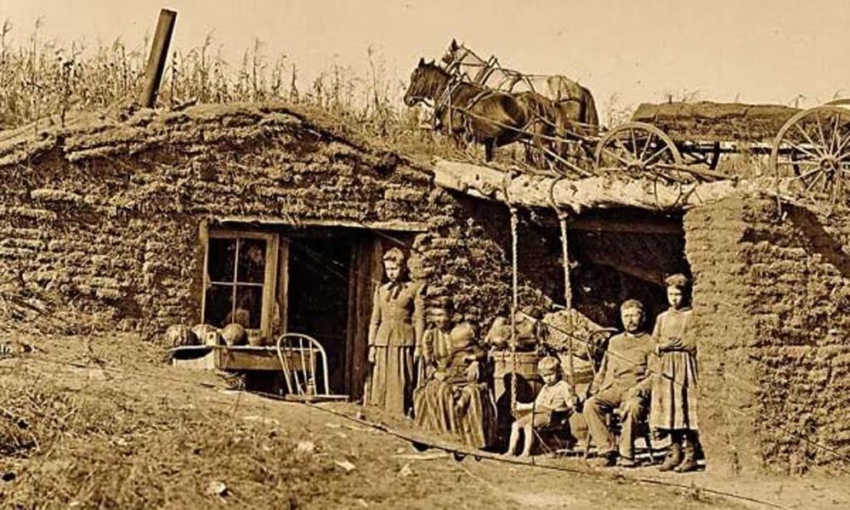
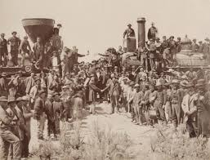
Homestead Act, Morrill Act, Pacific Railway Act

Slide 11
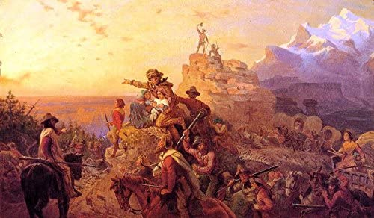
Who went West? Why did people move West?
-Diverse Groups
-Various pushes and pulls
-gold, land, search for equality, jobs, etc

Slide 12
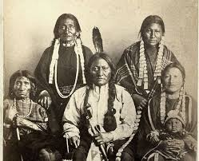
Consequences of Westward Expansion?
-Indian Wars
-Assimilation

Slide 13
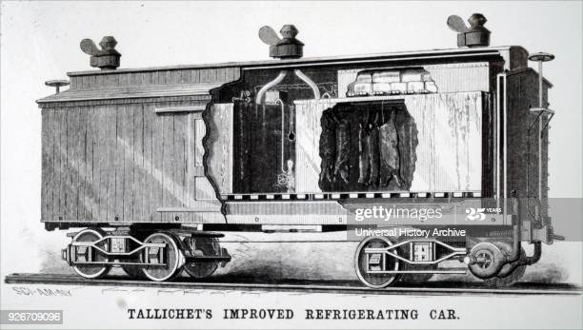
Other changes to the West

Slide 14
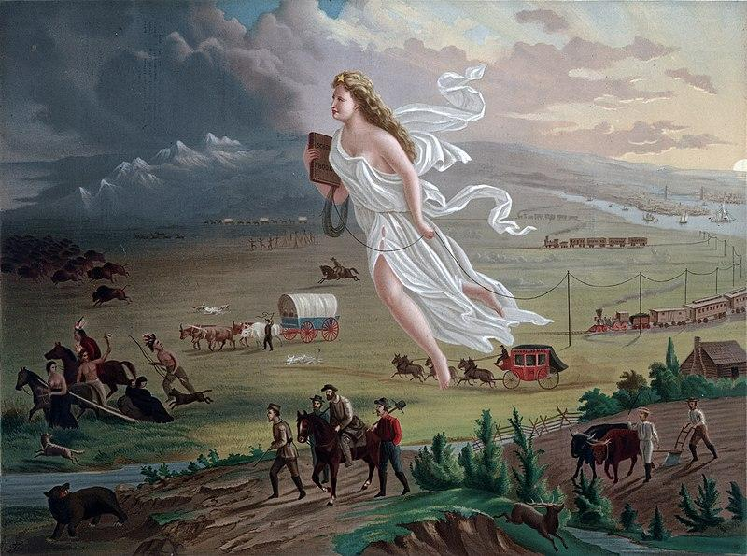
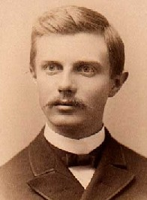
Frederick Jackson Turner - Frontier Thesis

