Slide 1
Imperialism Notes Addition

Slide 2
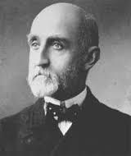
Imperialism
-expansion of territory into new lands- often overseas
 -New markets
 -Source of materials/resources
 -Missions/White Man’s Burden
-Militarism- navy- Alfred T. Mahan- Influence of Sea Power Upon History

Slide 3
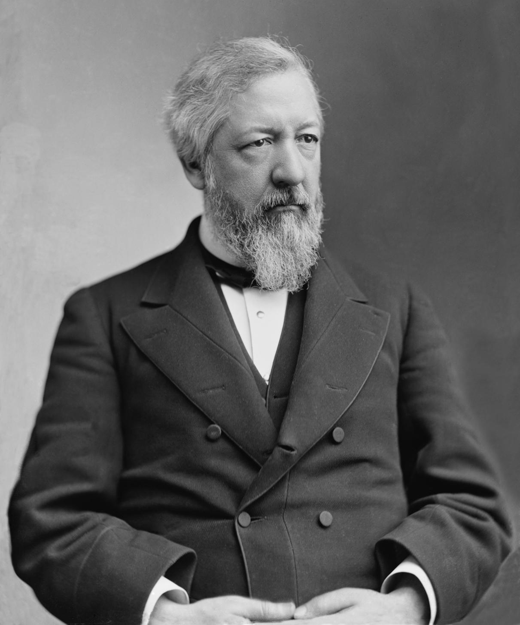
Extending the Monroe Doctrine
-Benjamin Harrison’s Sec of State James Blaine
-1889 Pan-American Conference met in DC
-greater Western Hemisphere cooperation

Slide 4
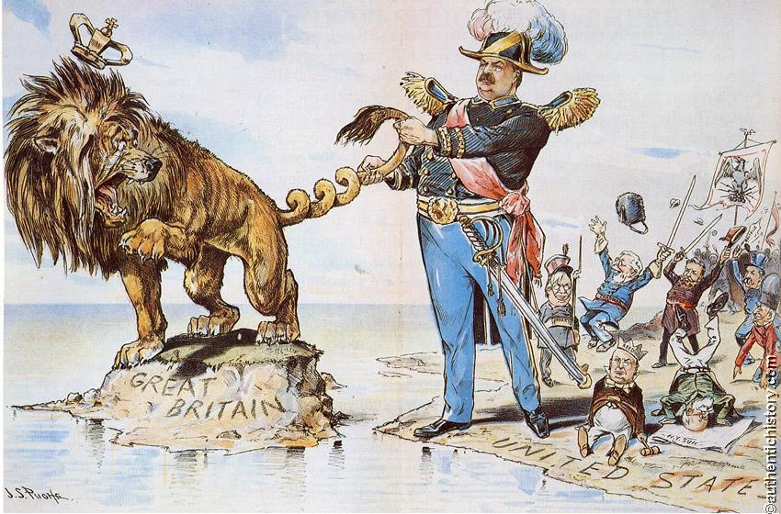
British/Venezuelan border crisis (1895-1896

Slide 5
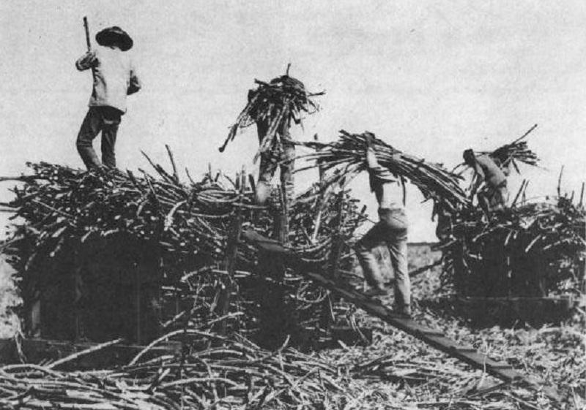
Spurning the Hawaiian Pear
-Early 19th century- way station
-1820- missionaries
-1840s- white sugar planters

Slide 6
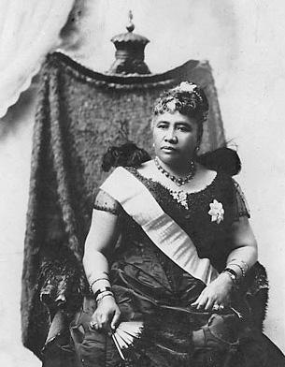
¢1880s- treaty giving naval base rights
Queen Liliukalani blocked annexation
¢1890- McKinley Tariff & sugar planters
¢1893- rebellion- annexation denied by
Cleveland

Slide 7
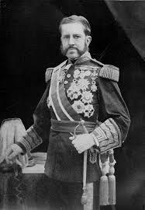
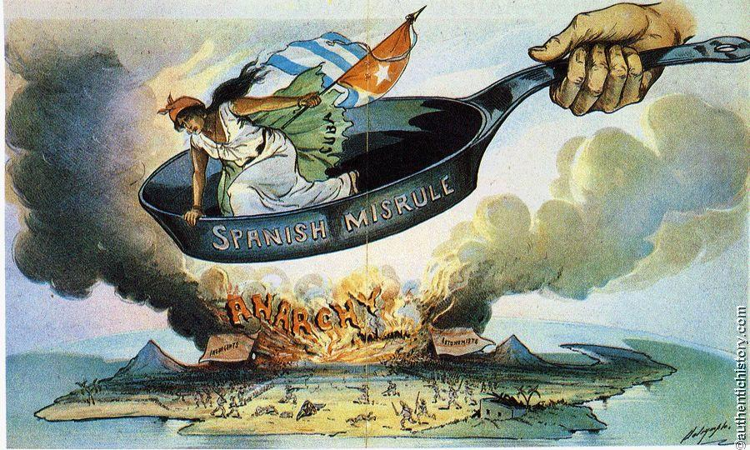
Cubans Rise in Revolt
¢1895- Cuban revolt
¢1896- Butcher Valeriano Weyler

Slide 8
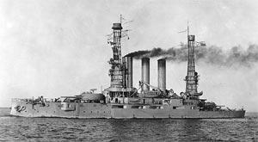
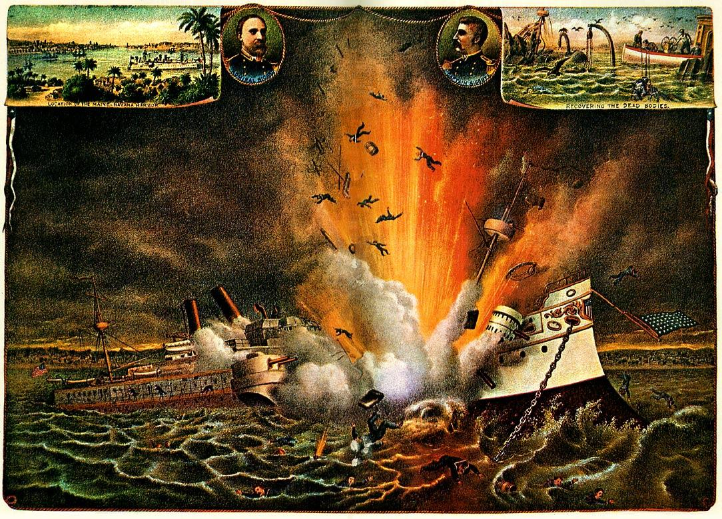
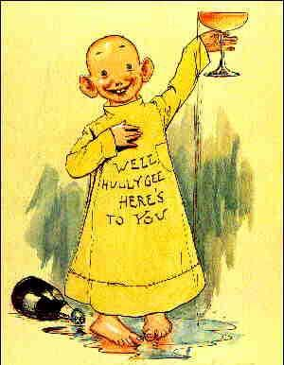
Causes of Spanish-American War
¢Hearst & Pulitzer- yellow journalism
¢De Lome Letter
¢Feb. 1898- USS Maine- war fever

Slide 9
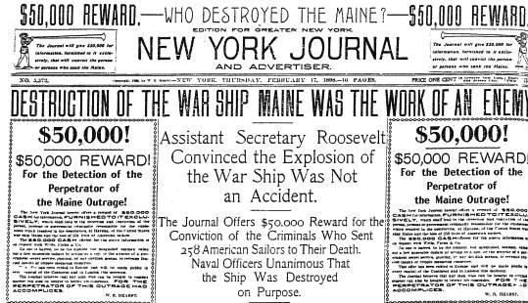

Slide 10
¢McKinley’s war message
Four Reasons for US intervention
“Put an end to the barbarities…” in Cuba
Protect lives and property of US Citizens in Cuba
End “the very serious injury to the commerce, trade, and business of our people”
End “the constant menace to our peace” arising from disorder in Cuba

Slide 11
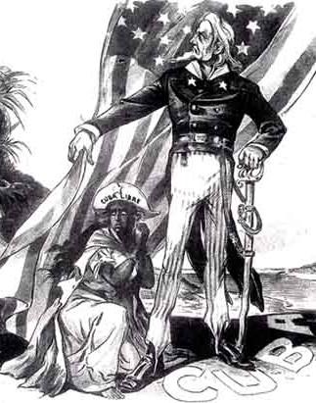
Teller Amendment
-Part of Congressional joint resolution authorizing war
-declared US had no intention of taking political control of Cuba and that once peace was restored Cubans would control own government

Slide 12
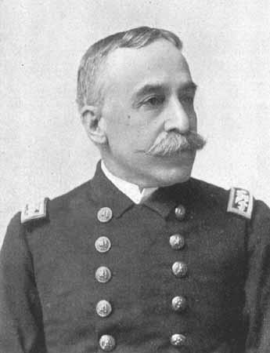
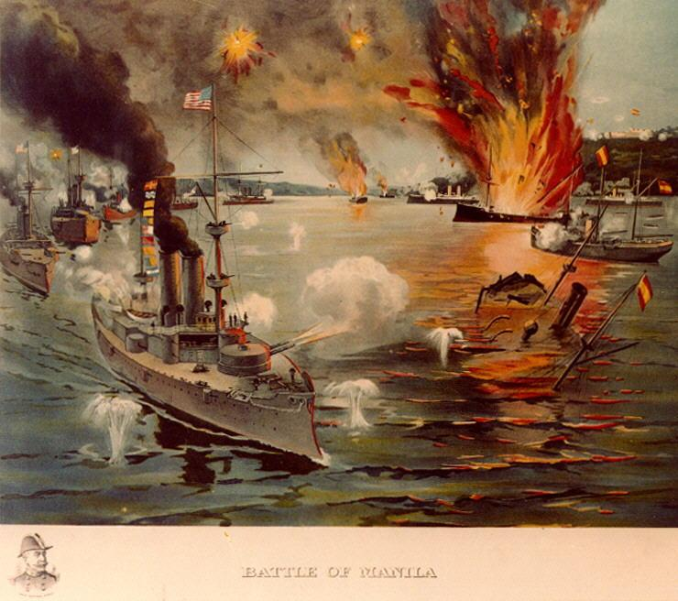
Dewey’s May Day Victory at Manila
¢Feb. 25, 1898- Asst. Sec. of Navy T. Roosevelt ordered attack to begin on Spanish Philippines
Free Cuba?
Commodore George Dewey
Spanish fleet quickly destroyed

Slide 13
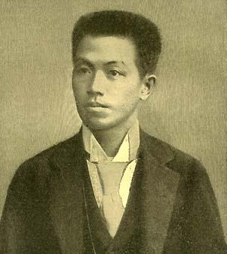
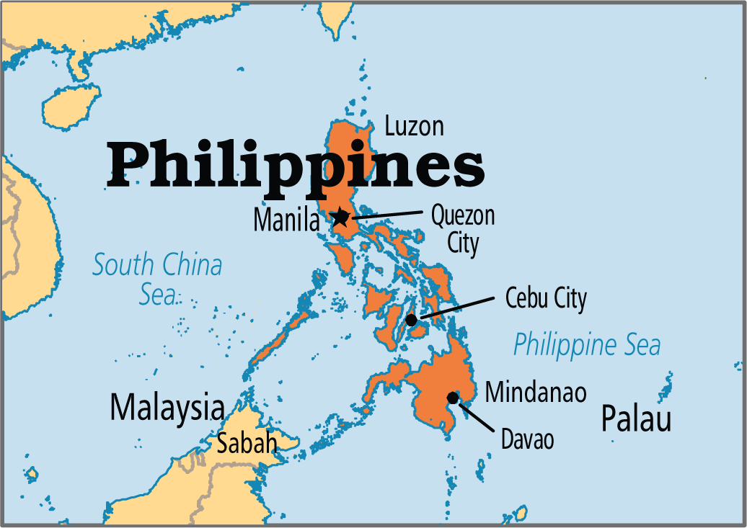
Philippines (continued)
American troops captured Manila Aug. 1898
¢Emilio Aguinaldo
Interest in Hawaii - annexation ordered July 1898

Slide 14
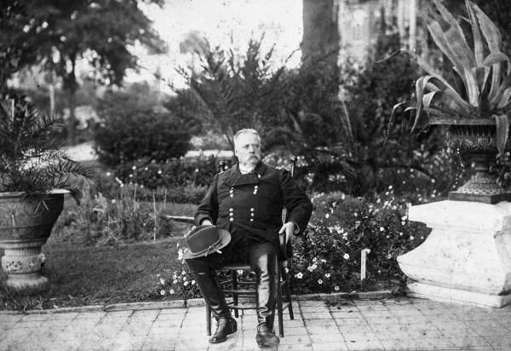
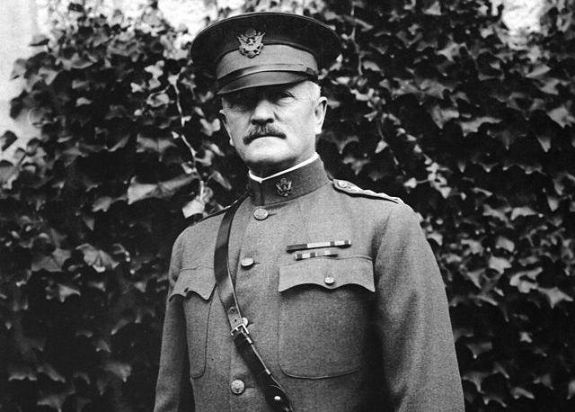
The Confused Invasion of Cuba
¢Army ill-prepared for fighting- Gen. Shafter
¢Rough Riders- volunteer regiment
Leonard Wood & TR
¢10th & 11th cavalries- Af. Am. Regiments & Col. John J. Pershing

Slide 15
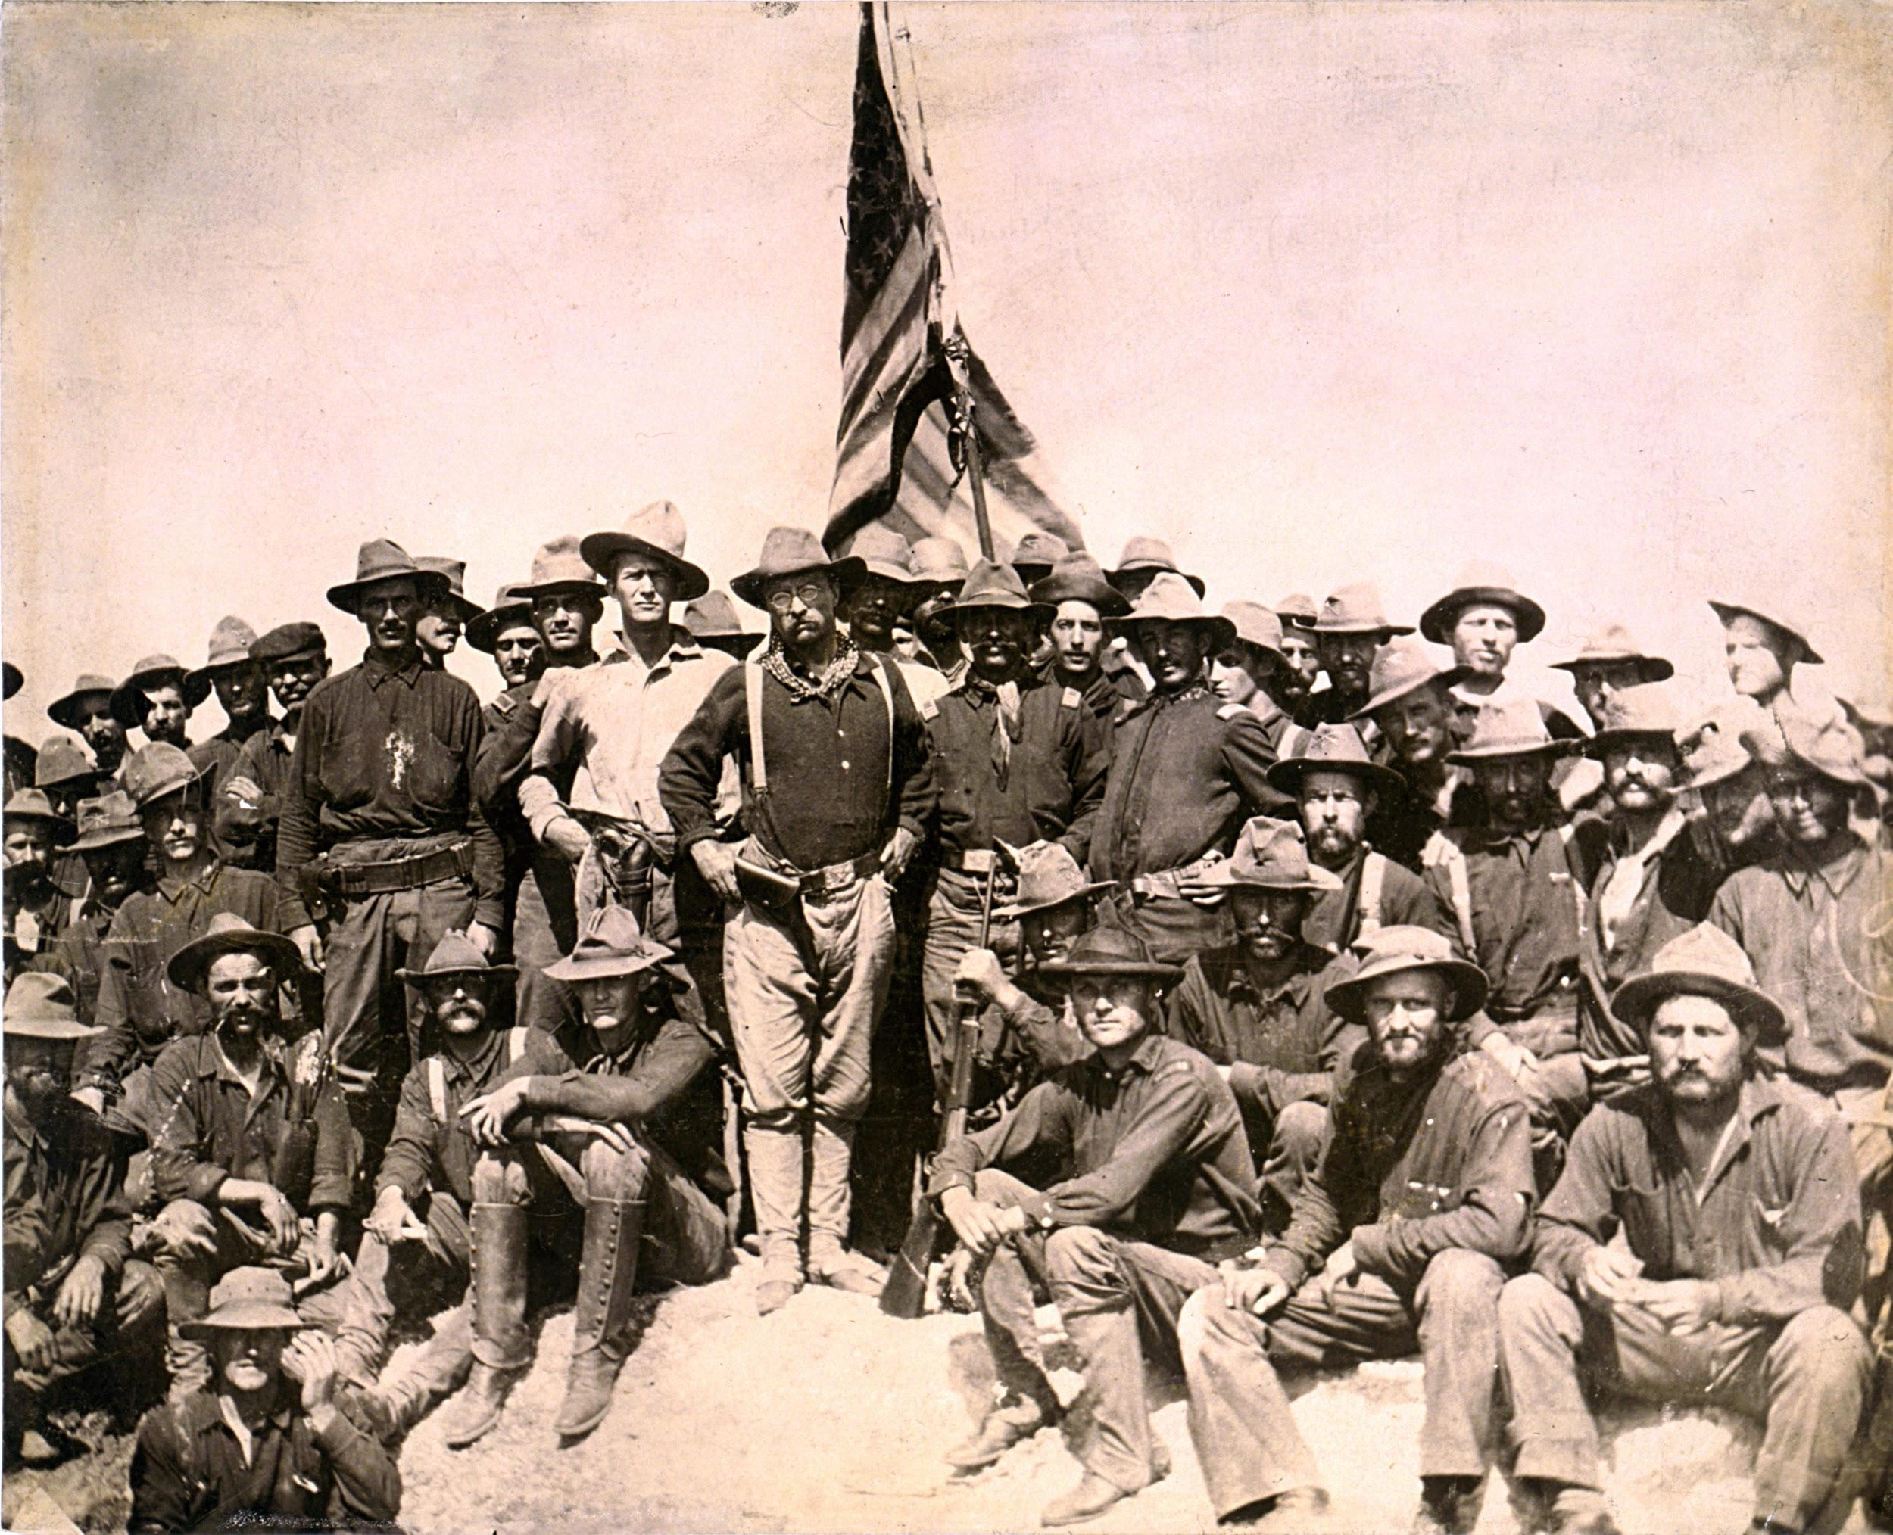

Slide 16
¢Charge up San Juan Hill
¢Spain & armistice Aug. 12, 1898
¢Casualties far worse from disease & unpreparedness
-5,000 American deaths from malaria, typhoid, and dystentery
-fewer than 500 American deaths in battle

Slide 17
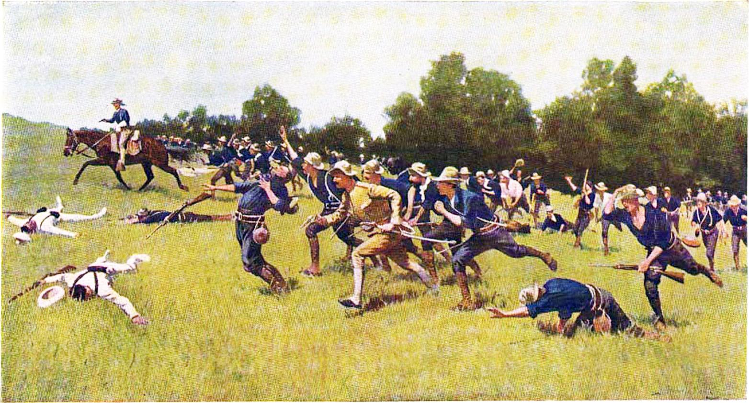
Charge of the Rough Riders Up San Juan Hill by Frederic Remington

Slide 18
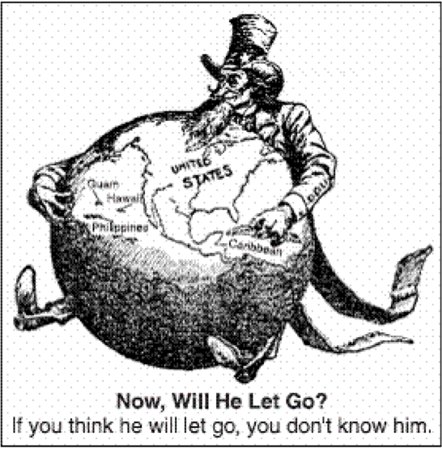
America’s Course (Curse) of Empire
Peace treaty- 1898
Cuba freed
US gained Puerto Rico & Guam
US gained Philippines for $20 mil.
-Became controversy over American imperialism
-Anti-Imperialist League

Slide 19
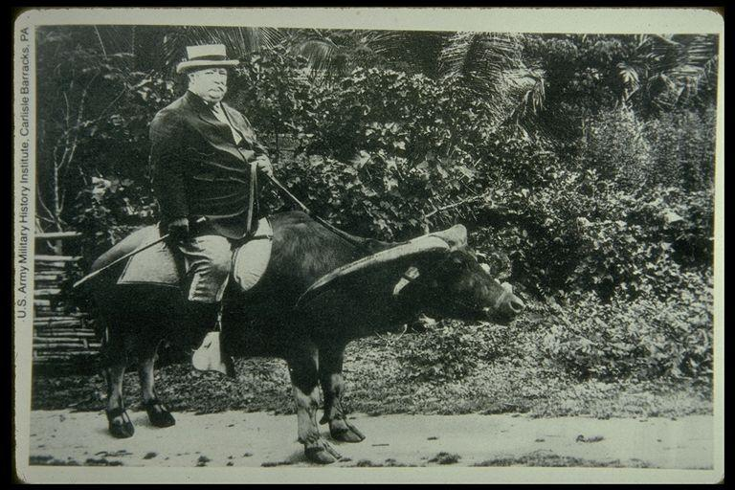
Filipino Insurrection - 1900
-Emilio Aguinaldo
-$400 mil. & millions of lives
-William Howard Taft - appointed Governor-General by Pres. McKinley

Slide 20
Puerto Rico
¢Puerto Rico- Foraker Act of 1900- popular govt. & eventual territorial status
Puerto Ricans gained citizenship in 1917
¢Insular (island) cases- people under the American flag not necessarily protected by Constitution

Slide 21
Cuba
¢US withdrew from Cuba 1902
Had written its Constitution In 1901 w/ Platt Amend.
¢No treaties w/out US consent
¢Not allowed to borrow w/out consent of US
¢Promised to give US land for naval stations

Slide 22
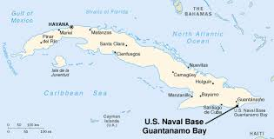

Slide 23
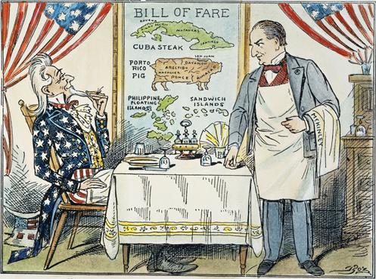

Slide 24
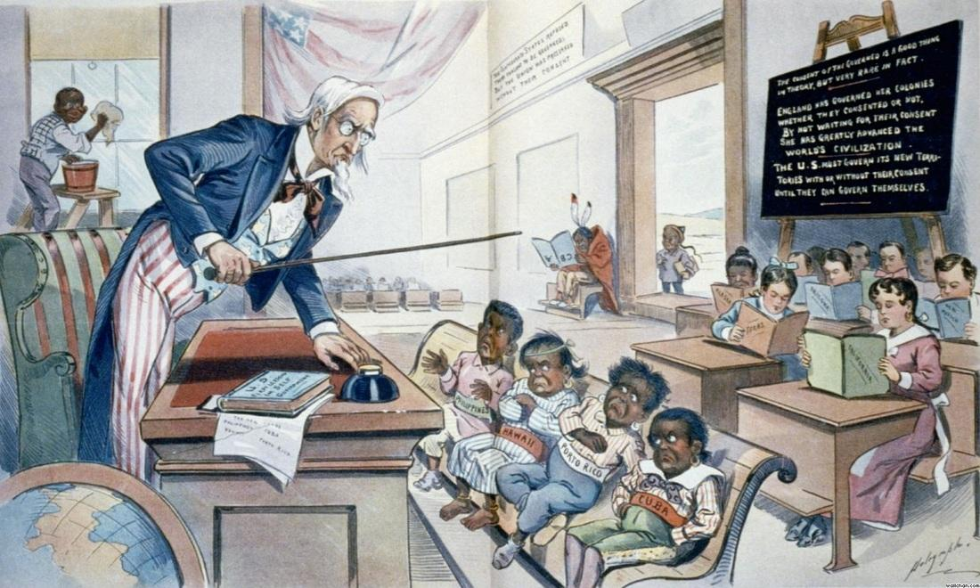

Slide 25
New Horizons in 2 Hemispheres
¢War made US an emerging power & promoted idea of imperialism
¢Helped heal the old Civil War wounds b/t North & South
¢Not fully ready for colonial responsibilities

Slide 26
“Little Brown Brothers” in the Philippines
¢US remained in Philippines Indefinitely- they thought they’d be freed
¢Filipino insurrection- 1899-1901
Emilio Aguinaldo
Cost nearly $400 mil
Nearly 5,000 Americans, 600,000 Filipions
¢W. H. Taft- Little Brown Brothers

Slide 27
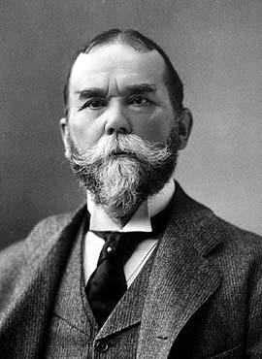
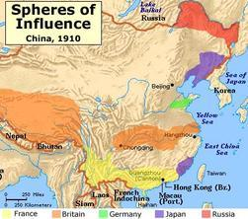
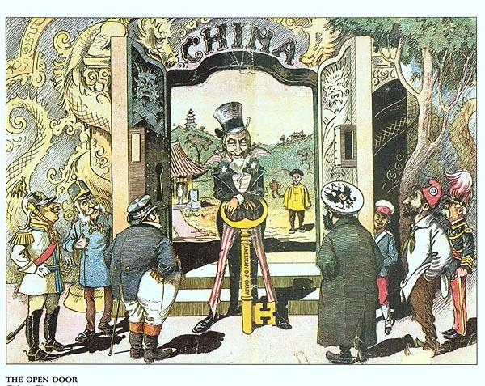
Open Door in China
¢China weakened by war w/ Japan- Europeans moved in
¢US concerned about free trade
¢Sec. of State John Hay & the Open Door note- 1899

Slide 28
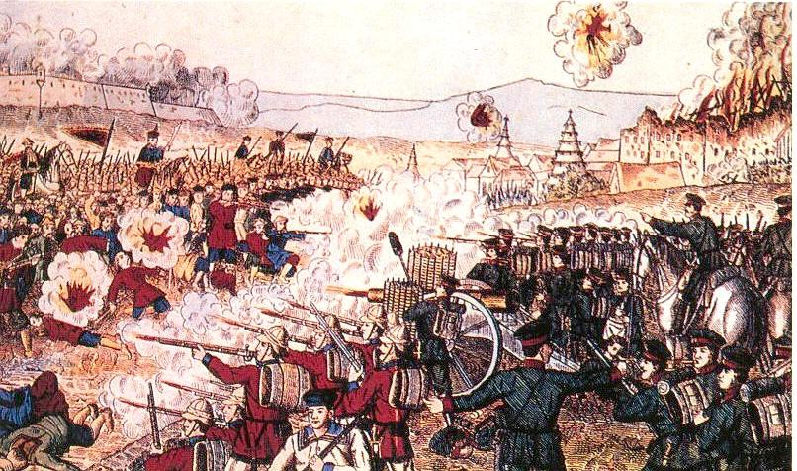
Chinese Resistance
¢Chinese Boxer Rebellion of 1900
Kill the Foreign Devils
Multinational group of soldiers
China forced to pay for damages
-overpaid - US made half-hearted gesture to repay
¢2nd Open Door Note- 1900- China not to be partitioned

Slide 29
Imperialism or Bryanism in 1900
¢McKinley renominated 1900- T. Roosevelt VP
-Why TR? - NY bosses wanted to shut him up
¢Bryan for Democrats Again
¢McKinley Won by large margin

Slide 30
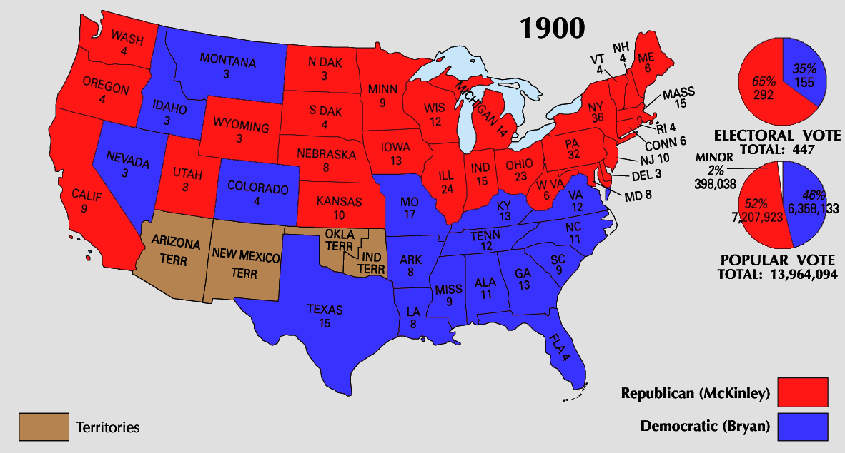

Slide 31
Building the Panama Canal
¢Possibility of canal- military & trade
¢British agreed to US construction
-Hay-Pauncefote Treaty - 1901

Slide 32
Canal Zone (continued)
1902- decided on Panama route- Colombia
US made $10 mil. Offer to buy Panama- rejected
Panamanians wanted away from Colombia
Rebelled 1903- US Navy blocked Colombia troops from stopping

Slide 33
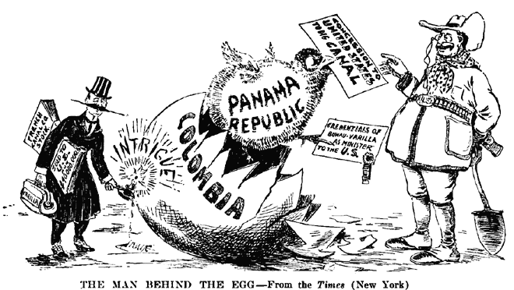

Slide 34
-T. Roosevelt recognized Panama as a nation
-Hay-Bunau-Varilla Treaty - 1903
-gave US rights over 51 mile long and 10 mile wide Canal Zone
-Made people believe US had planned the rebellion

Slide 35
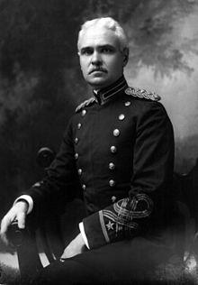
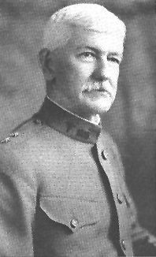
Canal Construction 1904-1914
-deaths of hundreds of laborers
-two Army colonels
-George Washington Goethals
-chief engineer
-Dr. William Gorgas
-helped eliminate yellow fever

Slide 36
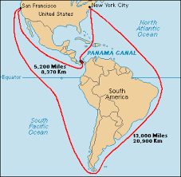
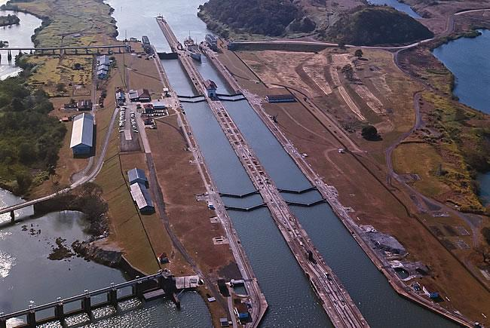

Slide 37
TR’s Perversion of the Monroe Doctrine
¢Latin American nations in debt to European powers
US afraid those nations would fall under European control
¢1905- Roosevelt Corollary to Monroe Doctrine

Slide 38
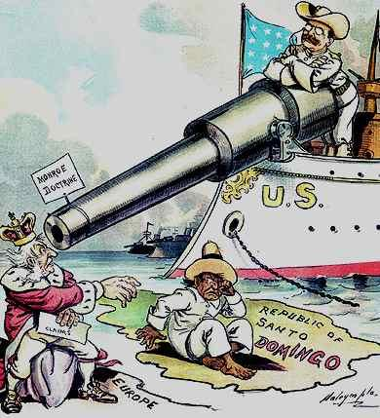
1905- Roosevelt Corollary to Monroe Doctrine
US would pay off existing debts
Latin Am. nations not allowed to take on new debt
”Bad neighbor policy”

Slide 39
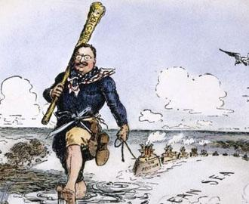

Slide 40
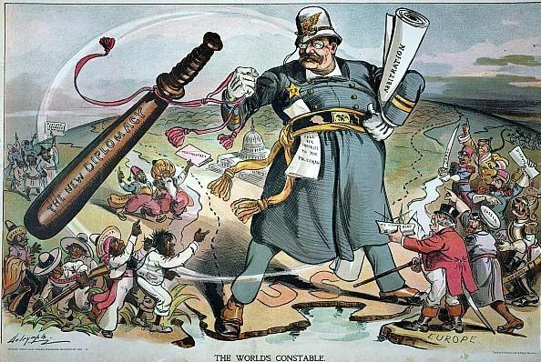

Slide 41
Roosevelt on the World Stage
¢Russo-Japanese War- 1904
¢TR asked to mediate
¢1905- treaty negotiated- neither side happy w/ agreement
US relations withered w/ both nations
¢1906- TR received Nobel Peace Prize

Slide 42
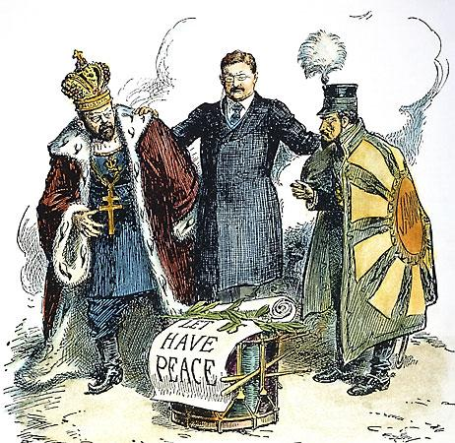

Slide 43
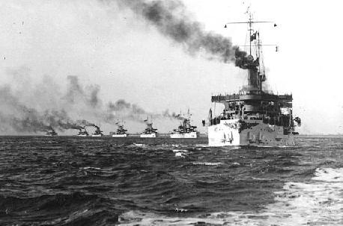

Slide 44
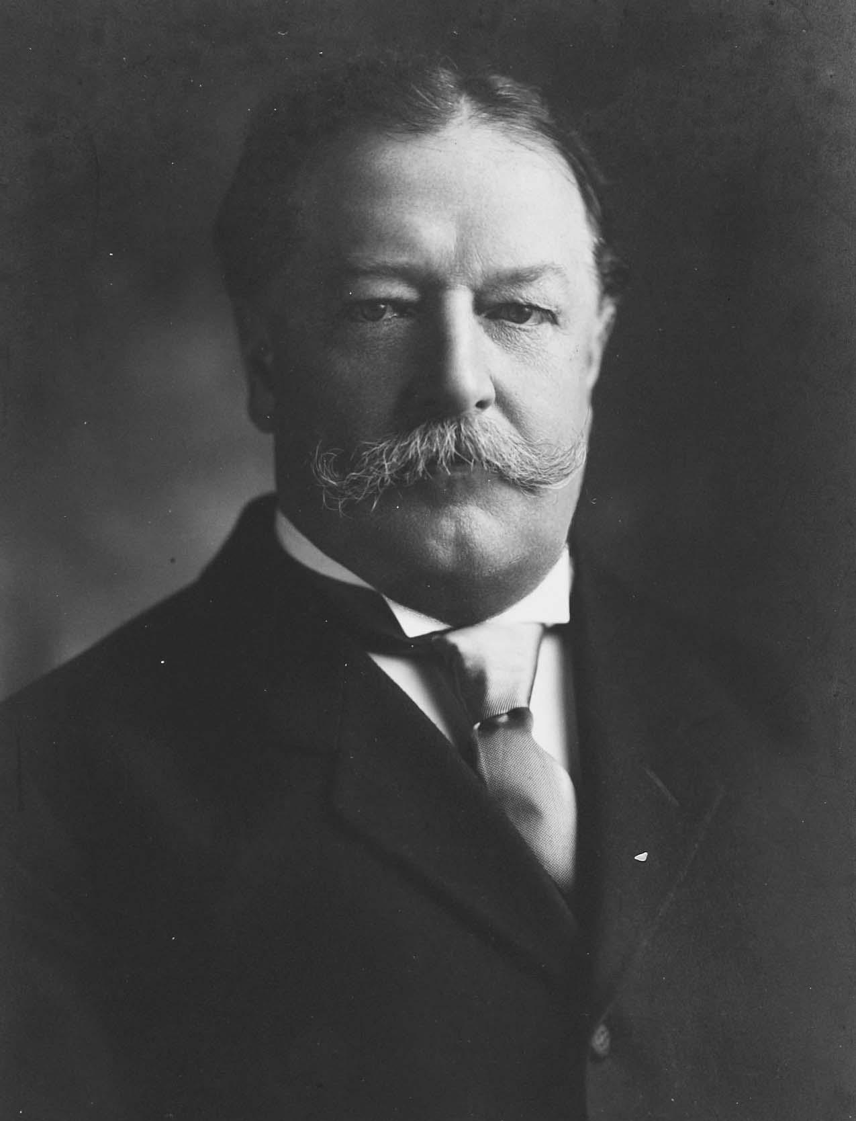
Taft’s “Dollar Diplomacy”
-mildly expansionist foreign policy depended more on investors’ dollars than battleships
-US investment in Chinese RR
-Nicaragua - US marines 1912-1933

Slide 45
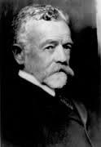
Lodge Corollary
-response to Japanese investors’ attempt to buy part of Mexico’s Baja Peninsula
-Senate passed a resolution in 1912 stating that non-European powers would be excluded from owning territory in Western Hemisphere
-Taft opposed, Japan/Latin American countries offended

Slide 46
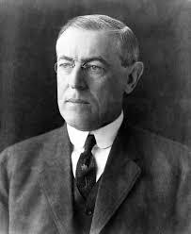
Wilson and Foreign Affairs
Woodrow Wilson and his Sec of State WJ Bryan disagreed with previous Republican policies

Slide 47
WIlson’s Moral (“Missionary”) Diplomacy
-Philippines - Jones Act of 1916 - Territorial status, bill of rights/male suffrage, eventual independence
-Puerto Rico - 1917 - US citizenship

Slide 48
Moral Diplomacy (continued)
-Panama Canal - 1914 - American exemption from tolls repealed - nationalists angered
Conciliation Treaties - Bryan - “cooling off” period

Slide 49
Moral? Diplomacy
Troops sent into Haiti and Dominican Republic

Slide 50
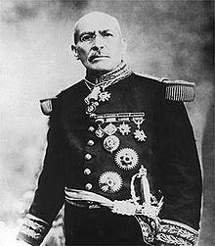
Wilson and Mexico
-Wilson refused to recognize Huerta
-arms embargo to aid revolutionaries, blockaded Vera Cruz
-U.S. Sailors - Tampico incident - mediation by “ABC” powers

Slide 51
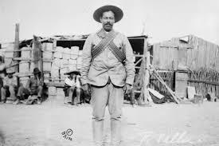
Pancho Villa
-challenged Carranza
-raided across border
-chased by Pershing, Carranza protests

