Slide 1
13 Colonies Settlement – AP US History

Slide 3
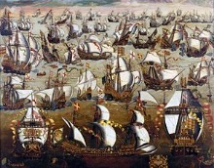
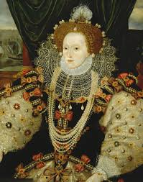

Slide 4
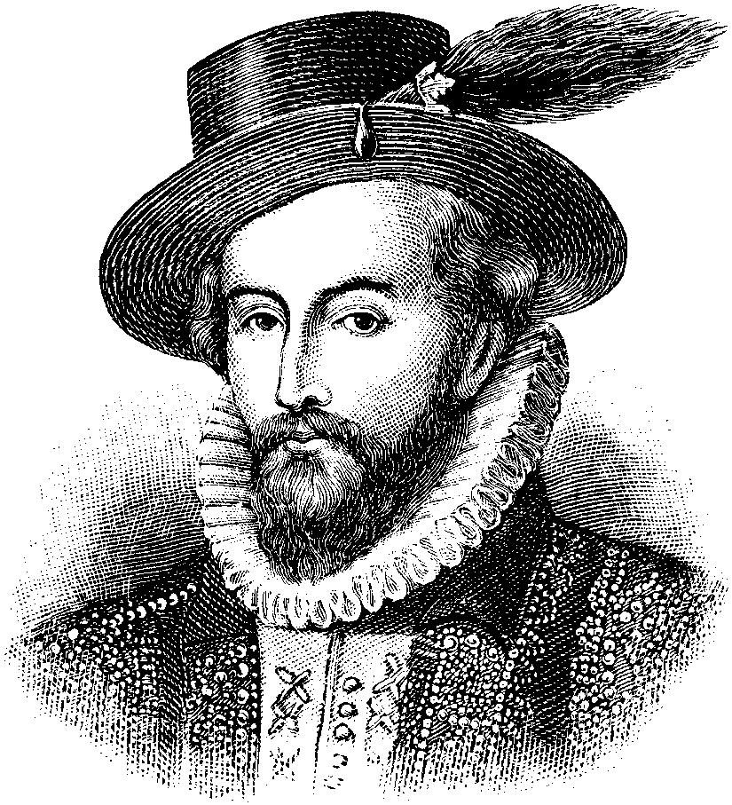
English Colonization of the Americas
Begins with Roanoke/Jamestown
Roanoke lost
Jamestown – 1607

Slide 5
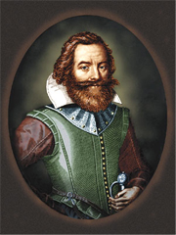
Jamestown
Virginia Company
Joint-Stock Co.
John Smith
Established order
1624 – Va Co Bankrupt
Transition to Royal Colony (1st)
Lord De La Warr
War with Powhatans

Slide 6
1619
“to settle and plant our men and diverse other inhabitants there, to the honour of the Almighty God, the enlarging of the Christian religion, and to the augmentation and revenue of the general plantation in that country, and the particular good and profit of ourselves.”

Slide 7
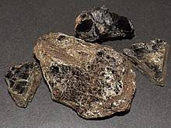
Jamestown Problems
To work or not to work?
Who arrived at Jamestown?
Powhatan
Is it gold?
1607-1622 – 10,000 >>>>> down to 20%

Slide 8
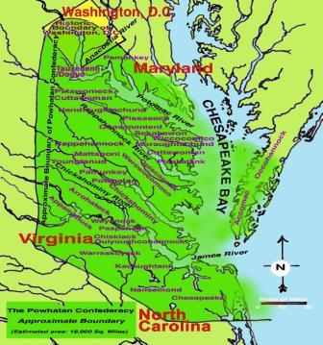
Powhatan

Slide 10
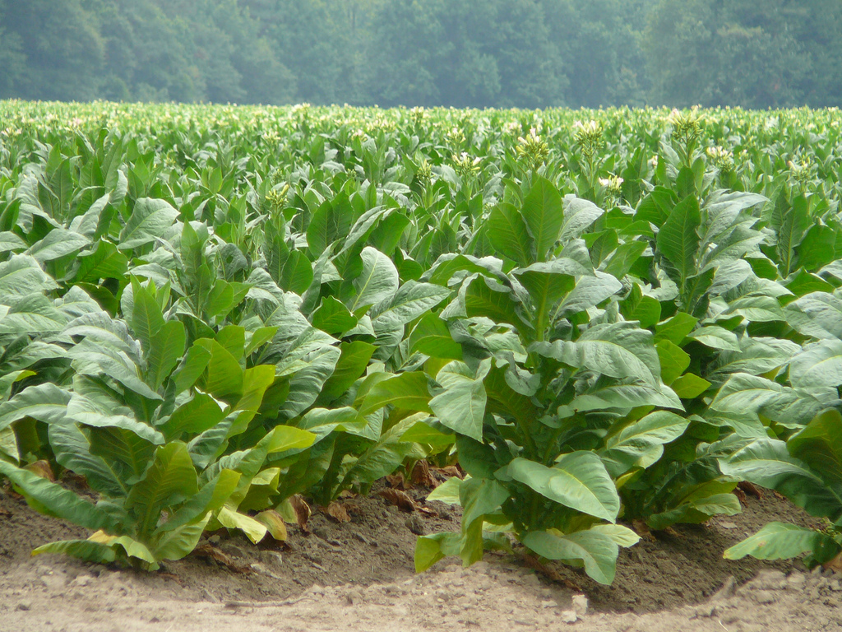
Tobacco
Finally makes VA profitable
John Rolfe

Slide 11
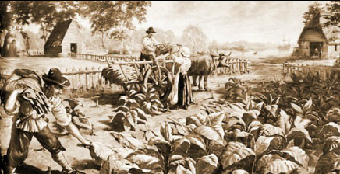
Chesapeake Colonies
Indentured Servants
Headright
50 acres of land
Slavery (1619)
400 African laborers in VA by 1650

Slide 12
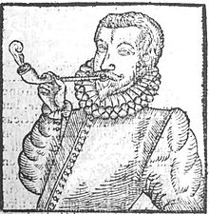
Tobacco
By 1660s low tobacco prices
Overproduction
Hurt MD and VA
House of Burgesses attempted to raise prices, London merchants retaliate

Slide 14
VA Conflict
Sir William Berkeley – royal gov of VA
Antagonized small farmers on frontier
Not enough protection against Native Americans
Nathaniel Bacon – gentleman farmer led rebellion against Berkeley – resented eastern elites
1676 – burned Jamestown, Bacon died, rebellion fizzled
Charles II on Berkeley - “that old fool…”

Slide 15
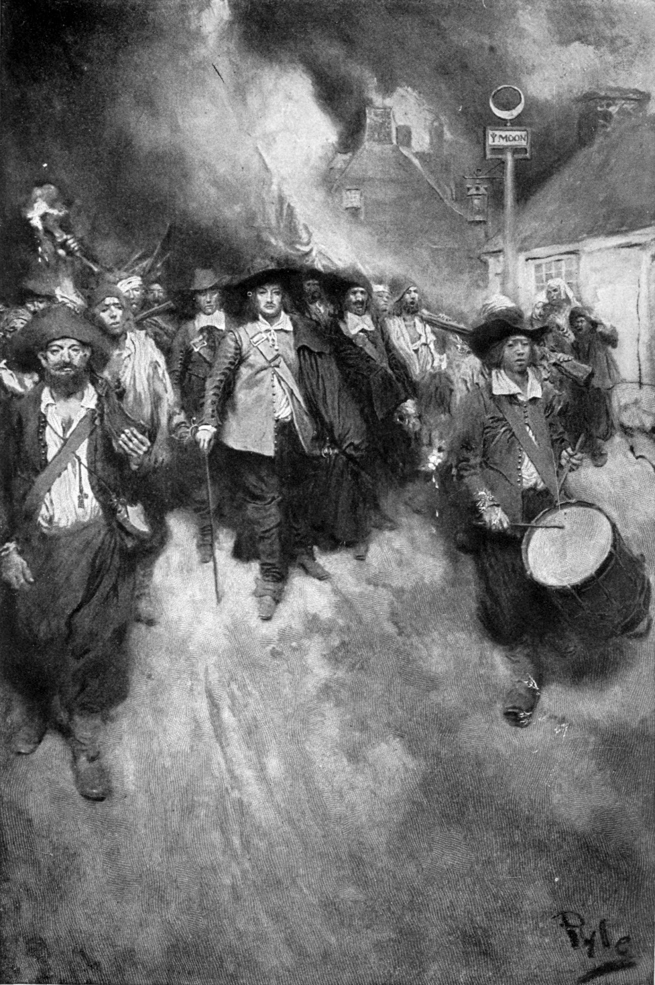
Effect of Bacon’s Rebellion
Highlighted class conflict
Need for different labor sources (than indentured servants)
African Slaves

Slide 16
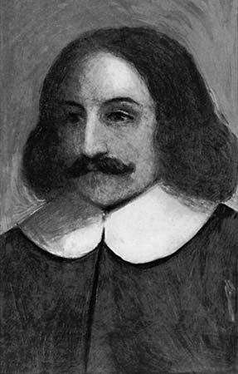
Plymouth
Separatists
Intended for VA, settled of Mass coast
Mayflower Compact
Direct Democracy
William Bradford
Miles Standish

Slide 17
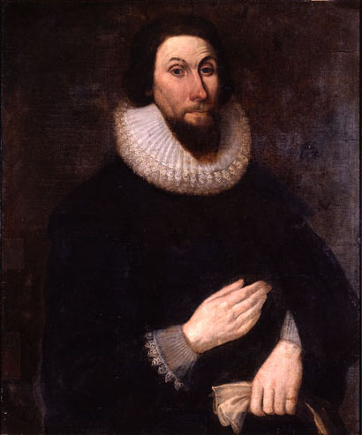
Massachusetts Bay Colony
Puritans gained a royal charter for Massachusetts Bay Company (1629)
1630 – John Winthrop sailed and founded Boston and other towns
1630s – English Civil War drove more migration

Slide 18
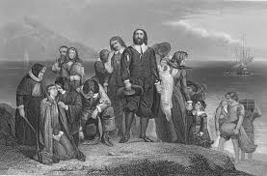
New England
1630 – Puritans – John Winthrop – City on a Hill

Slide 19
Maryland
1632 - Granted to George Calvert (Lord Baltimore) by Charles I
-Named for Henrietta Maria
Haven for Catholics
2nd Lord Baltimore (Cecil Calvert) put plan in place in 1634

Slide 20
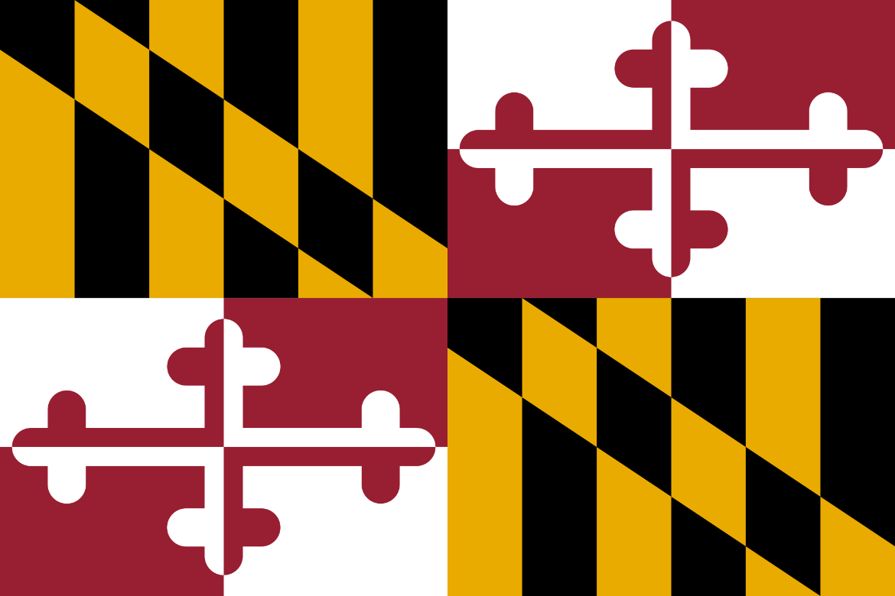
Act of Toleration - 1649
Passed by Maryland assembly
Granted religious freedom to all Christians
Death for denying Divinity of Christ
Late 1600s – mini civil war
Protestant revolt
Act of Toleration repealed

Slide 21
Rhode Island
Roger Williams to Boston 1631
Minister
Taught conscience is beyond civil or church authority
Separation of Church and State
Banished from MA
Fled south and founded Providence 1636

Slide 22
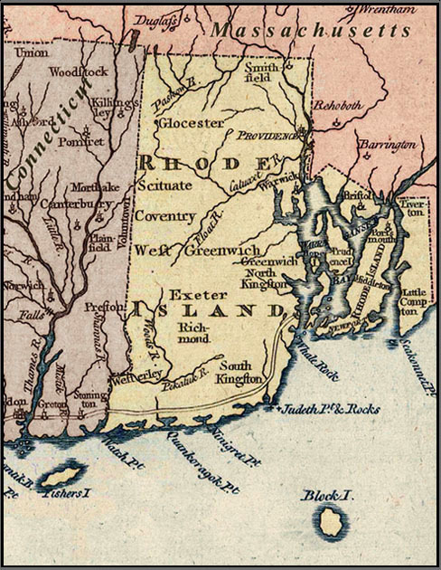
Rhode Island (continued)
Recognized rights of Indians and paid them for land use
Allowed Catholics, Quakers, Jews to worship freely
One of 1st Baptist churches in America
“The open Bible on the altar declares our belief in the presence of God through the proclaimed word and our commitment to the “soul liberty” of the individual conscience.”
Bulletin of the First Baptist Church, Providence, R.I. founded 1638

Slide 23
Anne Hutchinson
Antinomianism – faith alone (not deeds) necessary for salvation
founded Porstmouth in 1638
Moved to Long Island and killed in Indian uprising

Slide 24
Rhode Island “sewer”
1644 – R Williams charter from Parliament – join Providence and Portsmouth
Refuge for many

Slide 25
Connecticut
Attracted those unhappy with Massachusetts
Thomas Hooker
Led Boston Puritans to Hartford - 1636
First written Constitution in American History – 1639
Fundamental Order of Connecticut
Representative gov’t – legislature by pop vote, gov by legislature

Slide 26
Connecticut (continued)
1637 – John Davenport – Hartford
1665 – New Haven and Hartford joined to form Conn.
Royal charter gave a limited degree of self - govt

Slide 27
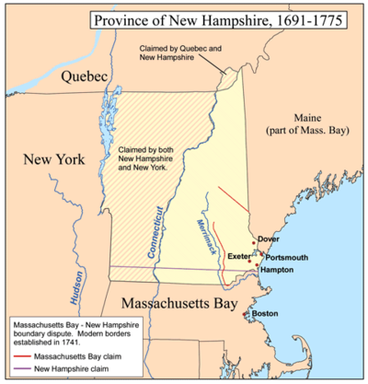
New Hampshire
Last of New England Colonies
Separated from Mass in 1679 by Charles II
Increase royal control over colonies

Slide 28
Restoration Colonies
Late 17th Century founding, Charles II restored to rule after Oliver Cromwell and Commonwealth

Slide 29
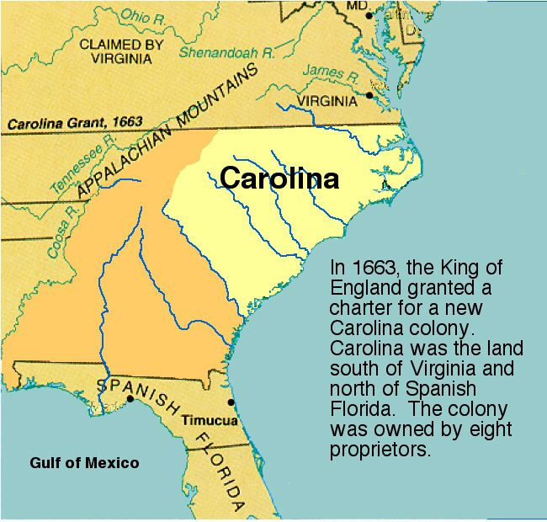
Carolinas
Reward to 8 nobles (“lords proprietors”) for helping Charles gain throne

Slide 30
Religion in Carolina
Lords Proprietors assured tolerance to everyone except for atheists
By 1702 SC Assembly barred non-Anglicans from political office and est Church of England as colony’s official tax-supported church

Slide 31
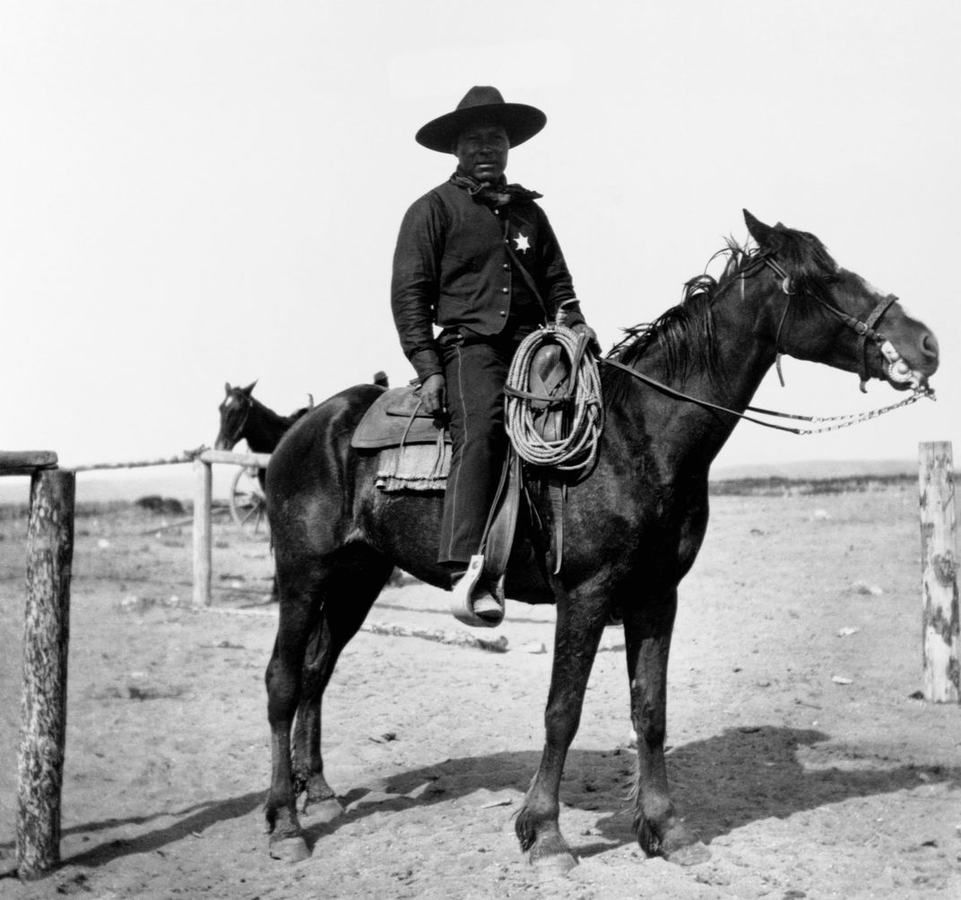
The original “cowboys”
Black herdsmen – experience herding in Africa
Cattle branding, annual roundups, cow pens, cattle drives from interior to Charles Town

Slide 32
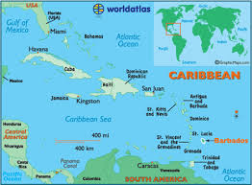
South Carolina
1670 – colonists from England and planters from Barbados
Rice growing
Large slave-labor population
Similar to West Indies
Aristocratic

Slide 33
North Carolina
“a vale of humility between two mountains of conceit”
Famers from VA and NE
Split from SC in 1712
Good harbors, poor transportation
Small, self-sufficient farms
Fewer plantations
18th century reputation for democratic views
Autonomy from British control

Slide 34
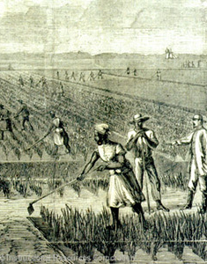
Other Carolinas info
Early leaders recruited Indians as slave catchers – offered guns and ammunition as incentives
Planters reengineered tidewater swamps for rice cultivation (diked out tide to reserve fresh water for rice)
By 1710 – SC became first colony with a black majority

Slide 35
NC and SC
1729 – two royal colonies formed from original grant
Descendants sold land back to crown

Slide 36
Rebellion
1724 – legislation required planter to bear firearms to church (discourage slave rebellion on Sundays)\
1739 – Stono Rebellion
20 slaves stole guns and gunpowder from a store, killed shopkeepers
Planned to go to Spanish Florida
Grew to at least 80, burned 7 plantations, killed 20 whites (showed discretion?)
White militia routed rebels on 2nd day
Heads placed on posts every mile between battlefield and Charles Town
Negro Act of 1740
Illegal for slaves to move abroad, raise food, earn money, assemble in groups, learn to write; permission to kill rebellious slaves
Act in effect until 1865

Slide 37
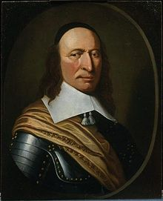
New York
Originally Dutch
Charles II wanted to consolidate power bt VA and NE
Get Dutch Out
Duke of York (1664) (brother, future James II)
Sent naval force to take Dutch colony from Peter Stuyvesant (governor)
Named New York
Ordered to treat Dutch well, freedom of worship, speak own language

Slide 38
New York (continued)
Ordered new taxes
Demanded no representative assembly
“taxation w/o representation”
Yielded in 1683

Slide 39
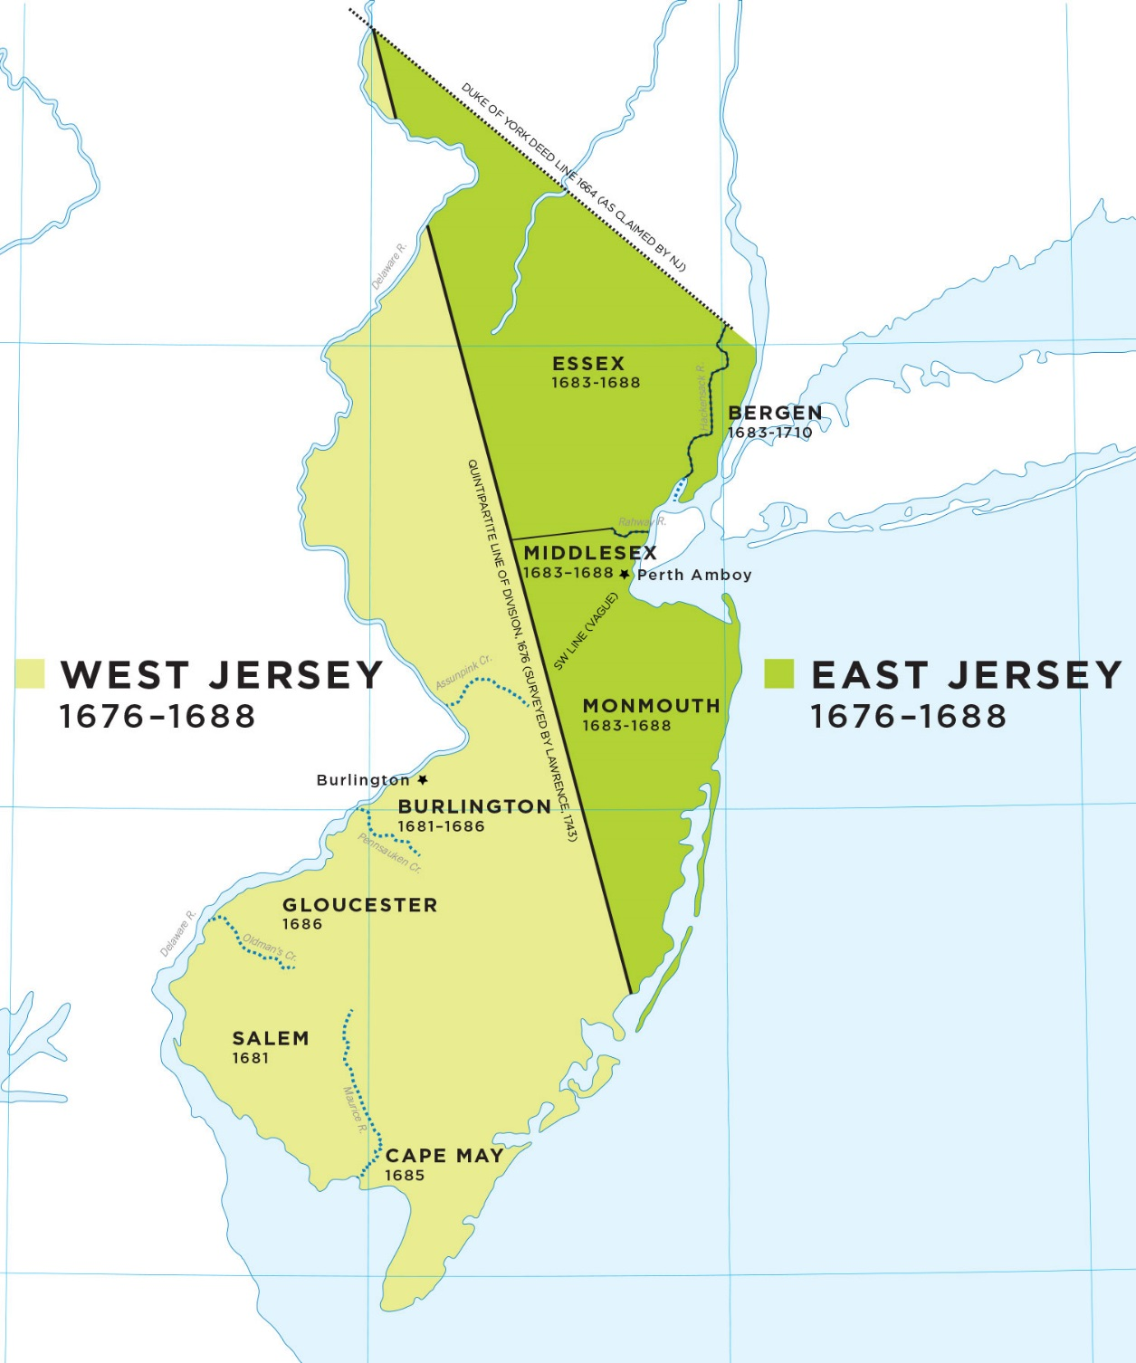
New Jersey
NY too large to administer
Split by James in 1664
Gave to 2 proprietors (East and West New Jersey)
Attract settlers w/ land grants, religious freedom, and an assembly
Sold interests to Quakers
Combined 1702 into 1 single royal colony

Slide 40
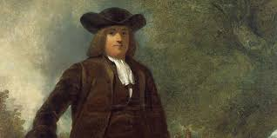
Pennsylvania
William Penn’s father was a victorious admiral
Opposed son’s Quaker beliefs
Royals owed debt to elder, gave William grant in 1681
Pennsylvania or “Penn’s Woods”

Slide 41
Pennsylvania (continued)
Quakers (Society of Friends) – religious authority found in each person’s soul (not Bible or outside source)
Persecuted and jailed in England

Slide 42
Pennsylvania (continued)
“Holy Experiment”
“Frame of Government” (1682-1683)
Guaranteed representative assembly elected by landowners
Written Constitution
Charter of Liberties (1702) – freedom of worship for all, unrestricted immigration

Slide 43
Pennsylvania (continued)
Supervised from town on Delaware River (Philadelphia)
Attempted to treat Indians fairly and not cheat them when purchasing land
Previously settled by Dutch and Swedish

Slide 44
Delaware
3 lower counties of PA
Given assembly by Penn in 1702
Separate colony but same governor until Revolution

Slide 45
Georgia
1732 – last of original 13 colonies
Only one to receive direct $$ support from British gov’t
2 Reasons
Buffer for SC plantations against Spanish Florida
Debtor haven

Slide 46
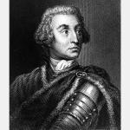
Georgia (continued)
Royal charter
Philanthropists led by James Oglethorpe
Savannah 1733
Oglethorpe first governor
Bans on rum and slavery

Slide 47
Georgia (continued)
1732 became a royal colony
Dropped restrictions on rum and slavery
Adopted plantation system
Smallest and poorest of original 13

